Slide 1
Credit Card Fraud Detection using Machine Learning
Manoj Kumar Eega

Slide 2
Outline
Introduction
Data Preparation
Model Building
Results
Original Vision vs Final Product
Lessons Learnt

Slide 3

Introduction
Introduction
Data Preparation
Model Building
Results
The total number of credit card transactions in the US was 50.8 billion in 2019, up from 37.3 billion in 2016
The number of credit cards from the four primary credit card networks is 679 million in 2018. There were a total of 1.06 billion credit cards in 2017
The United States leads as the most credit fraud prone country with 38.6% of reported card fraud cases in 2018
Credit card fraud increased by 18.4 percent in 2018 and has been increasing since 2014
Notes:
Ref : according to the 2013 Federal Reserve Payments Study (Ref https://www.creditcards.com/credit-card-news/market-share-statistics.php)
Four Networks “(VISA, Mastercard, American Express, and Discover (Ref https://www.creditcards.com/credit-card-news/market-share-statistics.php)
3 and 4 point Ref (https://shiftprocessing.com/credit-card-fraud-statistics/)

Slide 4
Purpose of Project
Introduction
Data Preparation
Model Building
Results
To Identify the fraudulent credit card transactions so that customers are not charged for items that they did not purchase
Even though the percent of a fraudulent transaction is very low in proportion to the total transactions, fraud transactions can hamper the consumer sentiment
This will be a damaging thing to the company, as the customer might not use the card later, and for the country, because a huge negative sentiment will put the consumption-based economies at risk

Slide 5

Data
Introduction
Data Preparation
Model Building
Results
The dataset has been collected and analyzed during a research collaboration of Worldline and the Machine Learning Group of ULB on big data mining and fraud detection
The data contains transactions made by European credit card users in September 2013
There are 284,807 transactions in the dataset
The dataset contains 30 numeric variables and 1 target variable (binary)

Slide 6
Data
Introduction
Data Preparation
Model Building
Results
Independent Variables
Features V1, V2, … V28 are the 28 principal components obtained by doing principal component analysis
The variable 'Time' contains the seconds elapsed between each transaction and the first transaction in the dataset
The variable 'Amount' is the transaction amount
Target Variable
The variable 'Class' is the binary response variable and it takes value ‘1’ in case of fraud and ‘0’ otherwise

Slide 7

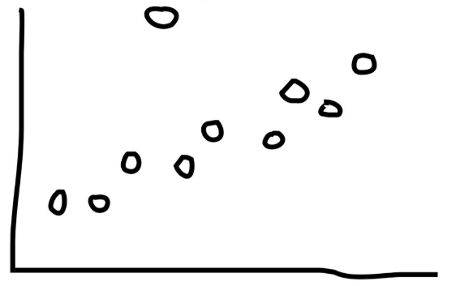
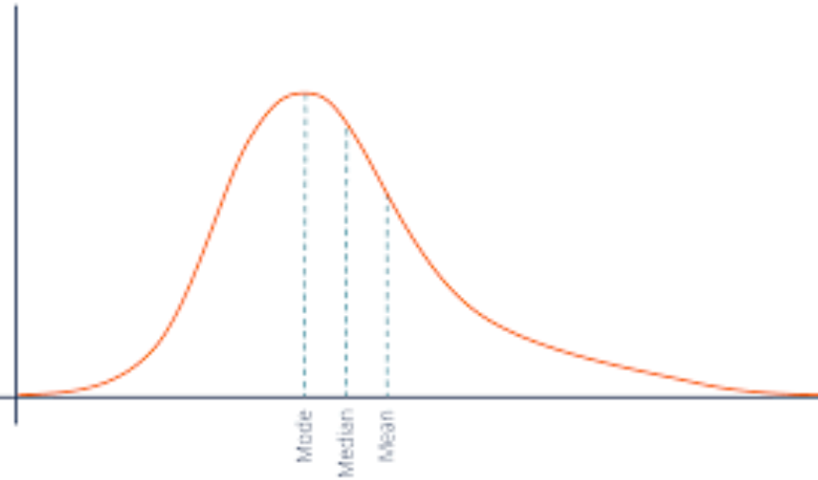
Limitations of Data
Introduction
Data Preparation
Model Building
Results
Class Imbalance
Outliers among independent variables
Highly Skewed variables

Slide 8
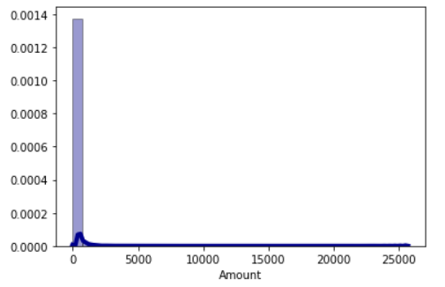
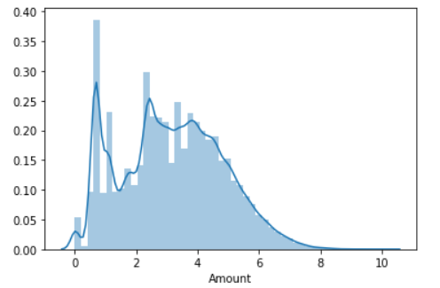
Data Transformation
Introduction
Data Preparation
Model Building
Results
Amount Variable is Highly Right Skewed
Standard scaling is applied after Log Transformation

Slide 9
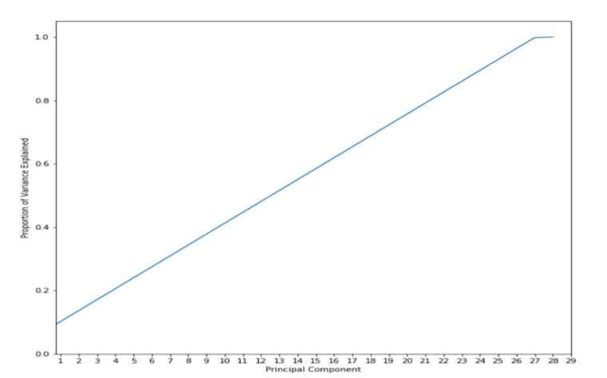
Data Reduction
Introduction
Data Preparation
Model Building
Results
PCA on 29 Variables except “Time”
The proportion of cumulative variance explained increases linearly
The last component doesn’t contribute much to the explained variance, and hence can be removed
But, selecting 28 among 29 variables doesn’t make much of a sense

Slide 10
Data Partition
Introduction
Data Preparation
Model Building
Results
Holdout sample
We have divided the data into 2 parts
The first one contains 75% of the data(Training Dataset)
The second one contains 25% of the data(Testing Dataset)
Cross-Validation
We split the entire data to 10 folds, use 9 folds to build the model, and the unused 1-fold to evaluate the test performance (repeat the process 9 times)
Due to class imbalance in dataset, its better to use all the information available in class with less observations. This can be achieved with Cross-validation technique

Slide 11
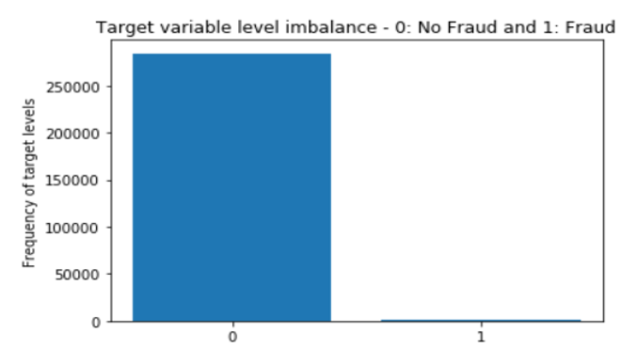
Data Imbalance
Introduction
Data Preparation
Model Building
Results
Number of fraud transactions are 492(0.18%)
Number of non-fraud transactions are 284,315(99.82%)
3 Methods:
Random Under Sampling
Random Over Sampling
SMOTE-TOMEK Over Sampling

Slide 12



Data Imbalance
Introduction
Data Preparation
Model Building
Results
Random Under Sampling
Random Over Sampling
Random Over Sampling

Slide 13
Model Building
Introduction
Data Preparation
Model Building
Results
Data for modelling
All independent variables except ‘Time’
Model types (6):
Logistic Regression
Decision Trees and its variants
Random Forest
Gradient Boosting
Support Vector Machine
K- Nearest Neighbors

Slide 14
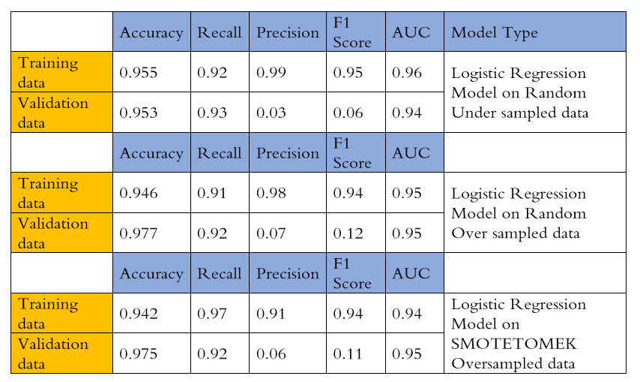
Logistic Regression – Holdout Sample
Introduction
Data Preparation
Model Building
Results

Slide 15
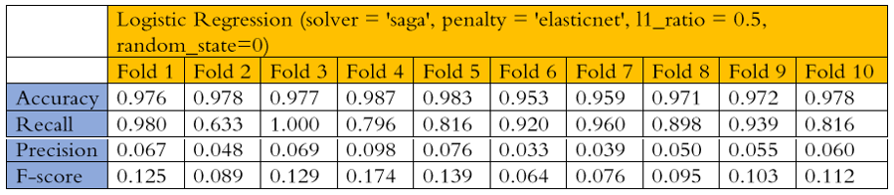
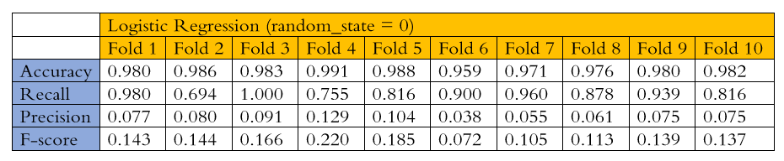
Logistic Regression – Cross Validation
Introduction
Data Preparation
Model Building
Results

Slide 16
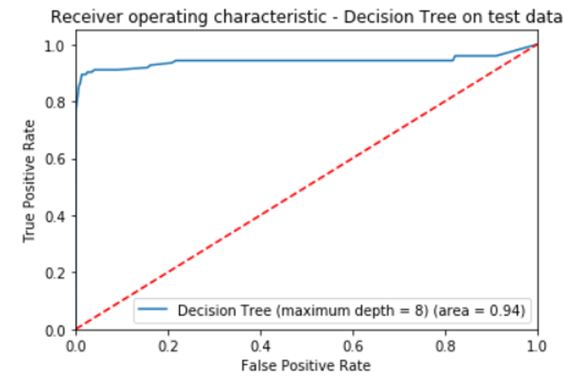
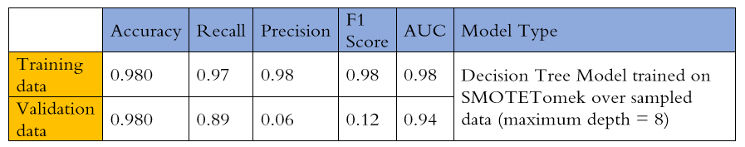
Decision Tree– Holdout Sample
Introduction
Data Preparation
Model Building
Results
Maximum depth of 8
SMOTE-TOMEK oversampled and standardized data for training
Standardized unsampled data for validation

Slide 17
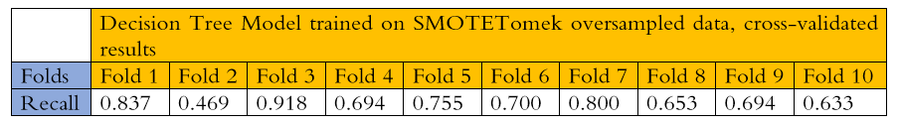
Decision Tree– Cross Validation
Introduction
Data Preparation
Model Building
Results
The average cross-validated recall is 71.5%. This is much lesser than the training recall
The decision tree model is overfitting on training data

Slide 18
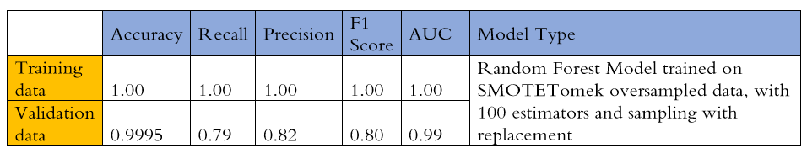
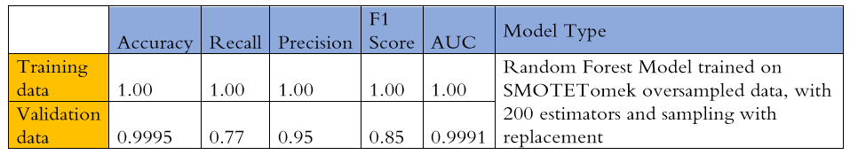
Random Forest
Introduction
Data Preparation
Model Building
Results

Slide 19
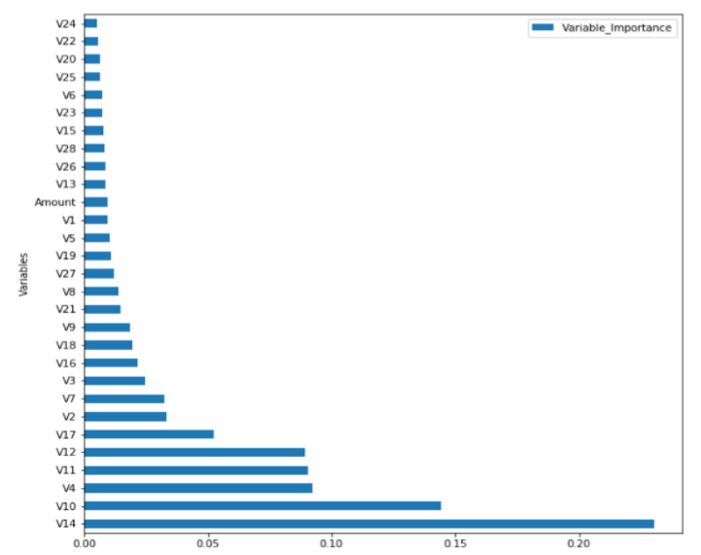
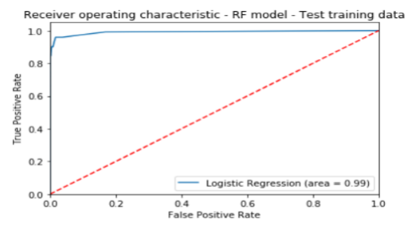
Random Forest
Introduction
Data Preparation
Model Building
Results
ROC Curve
Variable Importance

Slide 20
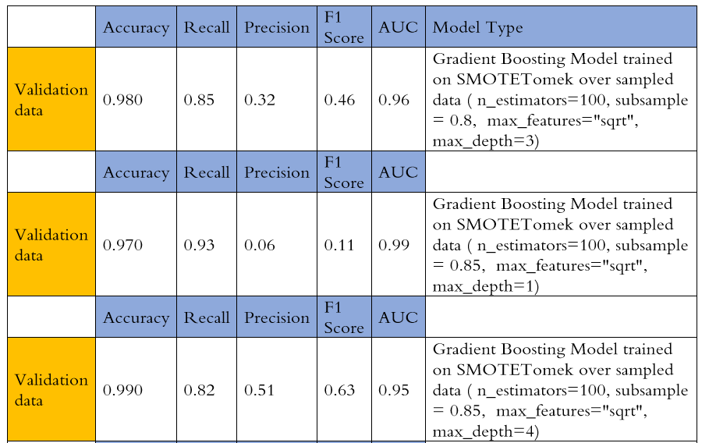
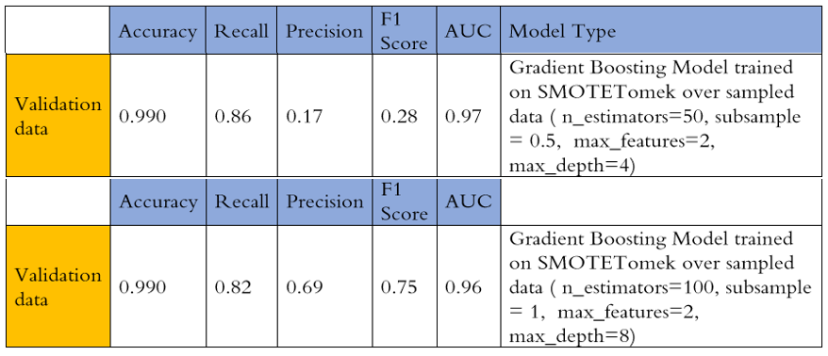
Gradient Boosting
Introduction
Data Preparation
Model Building
Results
5 models are built with different learning rate (0.05, 0.075, 0.1, 0.25, 0.5, 0.75, 1)

Slide 21
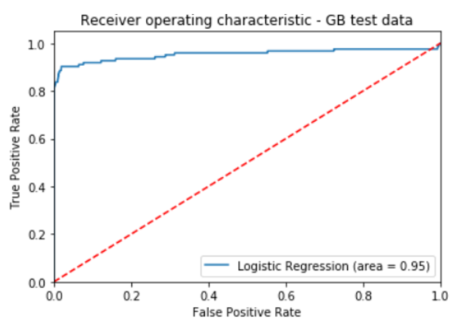
Gradient Boosting
Introduction
Data Preparation
Model Building
Results
Area under ROC curve is 0.95
Increasing the depth of the trees (growing bigger trees) is making the model more precise and less sensitive to true positives

Slide 22
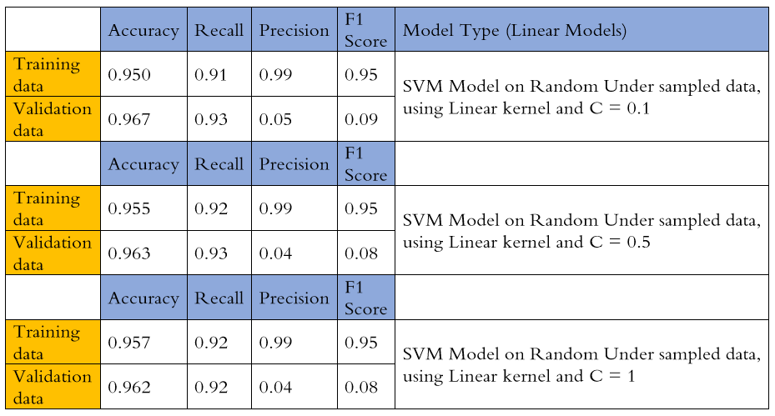
Support Vector Machines
Introduction
Data Preparation
Model Building
Results

Slide 23

Support Vector Machines
Introduction
Data Preparation
Model Building
Results

Slide 24
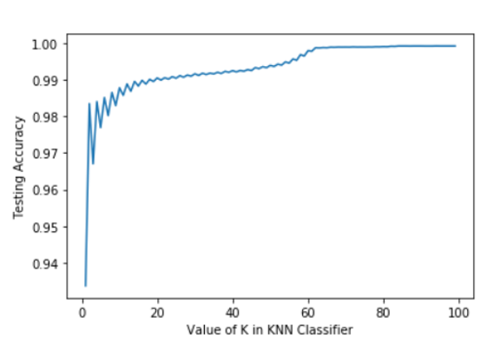
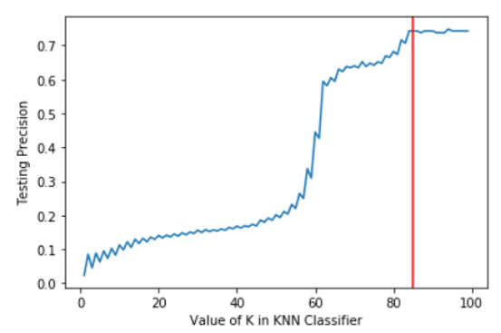
K – Nearest Neighbors
Introduction
Data Preparation
Model Building
Results
Plots for K ranging from 1 to 100
Accuracy
Precision

Slide 25
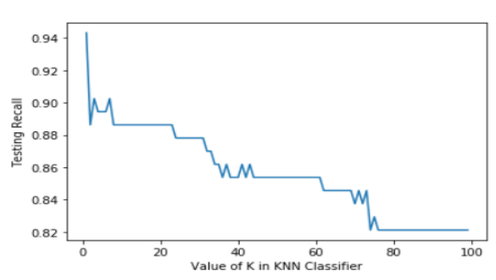
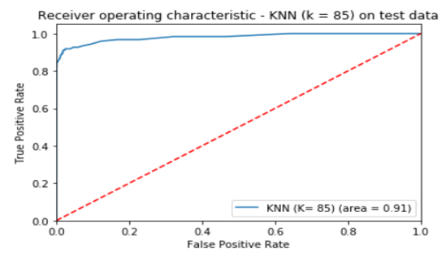
K – Nearest Neighbors
Introduction
Data Preparation
Model Building
Results
Recall
ROC Curve on Test Data for K = 85

Slide 26
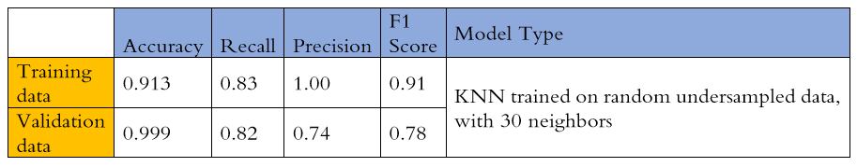
K – Nearest Neighbors
Introduction
Data Preparation
Model Building
Results
For k =85, the recall curve is flat, and precision is improving
If I choose a higher k, there is no reduction in the recall, but the computational load on the machine will increase. If I choose lower K, the precision will drop below 70%

Slide 27
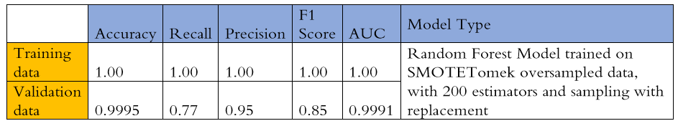
Results
Introduction
Data Preparation
Results
Model Building
Random Forest model is best model based on validation recall, AUC and precision
Random forest with 200 trees in parallel has a validation recall of 0.77 and a validation precision of 0.95. Even though the recall is not as high as other models the precision is much higher, thus giving the business much higher confidence in flagging fraud cases

Slide 28
Original Vision Vs Final Product
Introduction
Data Preparation
Results
Model Building
Original Vision was to classify the credit card fraud transactions with high recall using advanced ML methods
The vision was translated using Logistic Regression, Decision Tree, Support Vector Machines, Random forest and Gradient Boosting models
The original vision is achieved successfully by credit card fraud transactions with 99.91% accuracy, can find 77% of the fraud cases with a 95% precision in identifying the true positives

Slide 29
Lessons Learnt
Introduction
Data Preparation
Results
Model Building
Skewed data influence the predictions in ML models
Dealing with Imbalance in class variables
Finding the right metric in accessing the results for the model
Model evaluation methods such as Holdout sample, Cross validation
Principal Component Analysis can be performed to reduce complexity when there are large number of independent variables
AUC and precision are also better metrics than accuracy when it comes to deciding the discriminatory power of a model

Slide 30
THANK YOU

