Slide 1
Artificial computational Intelligence
CS 1-Introduction
Prof. Brahmanaidu Kakarla
Guest Faculty

Slide 2

Agenda
    Course details
    Definition of AI
    Different perspectives of AI
    Application of AI
    Challenges of AI
2

Slide 3
Course details

Slide 4
About the course
Focus on
  principles of artificial intelligence
  concepts, algorithms involved in building rational agents
  topics covered like
    Problem solving &knowledge representation
    Reasoning
    a bit of learning (reinforcement learning)
    Application of AI
Notes:
4

Slide 5
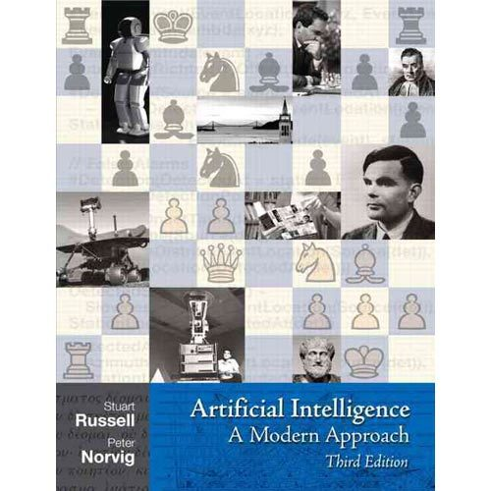
About the course
Text Book
Exercises : In Python & its libraries
Evaluation: 20% LAB + 10%(2X5) Quiz + 30% Mid Semester + 40% End Semester.
Notes:
5

Slide 6
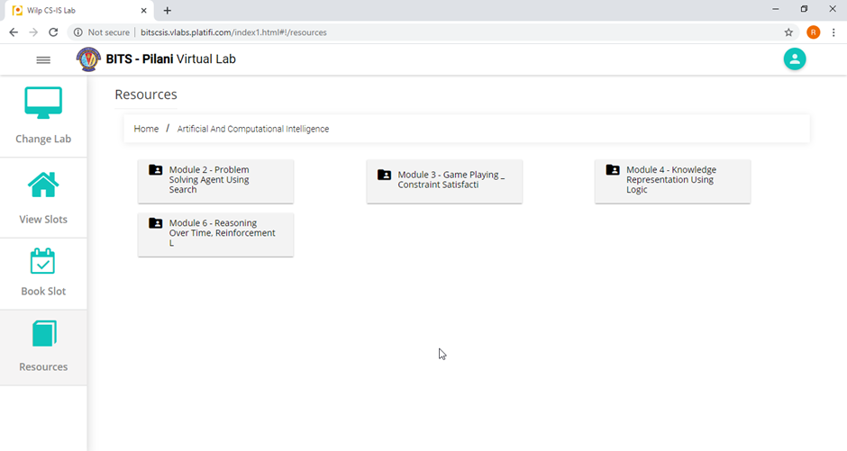
About Labs
Exercises : In Python & its libraries
Notes:
6

Slide 7
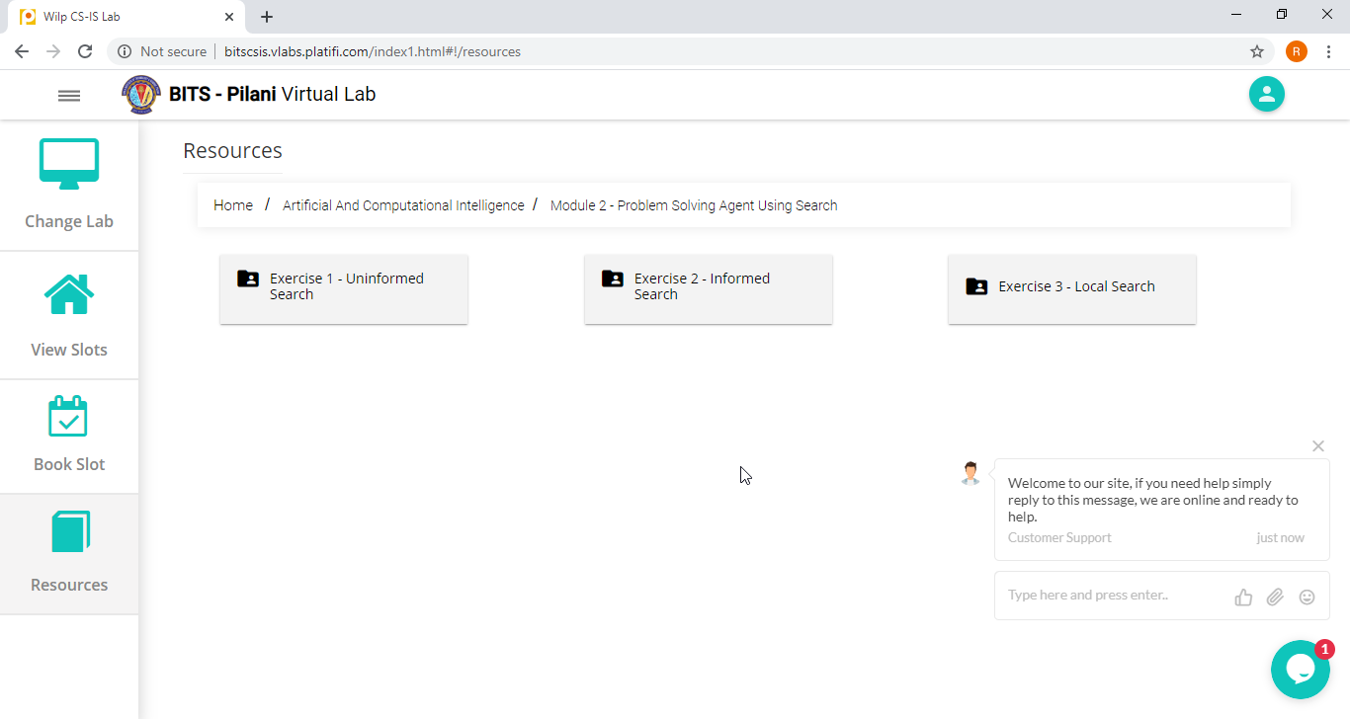
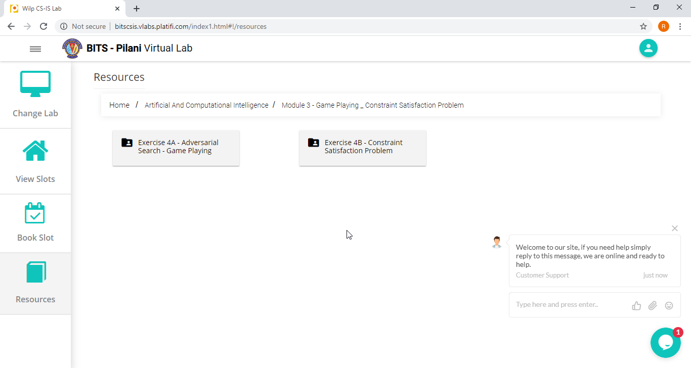
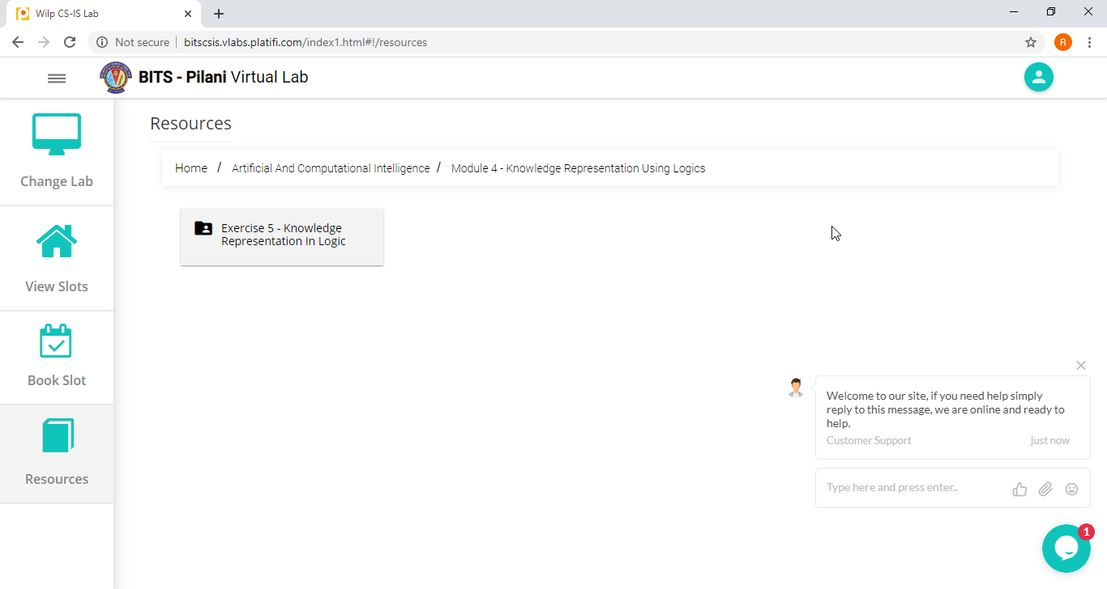

About Labs
Exercises : In Python & its libraries
Notes:
7

Slide 8
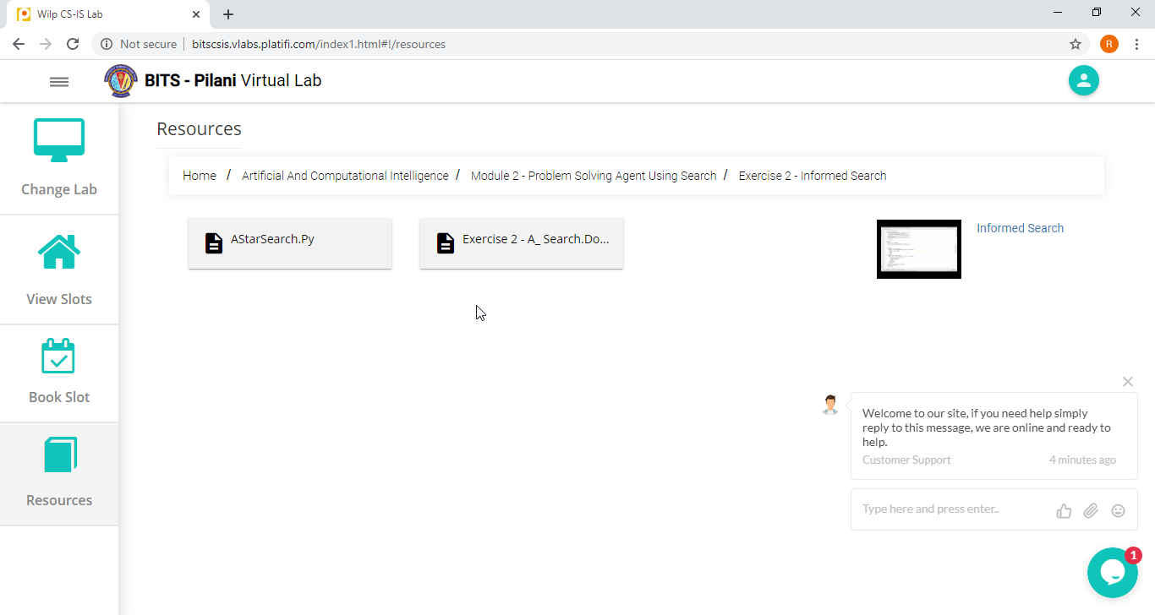
About Labs
Exercises : In Python & its libraries
Notes:
8

Slide 9
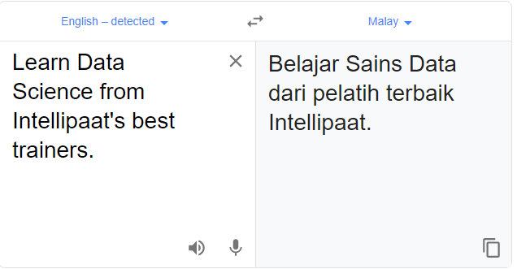
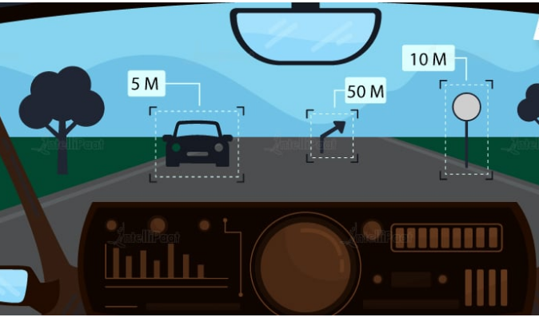
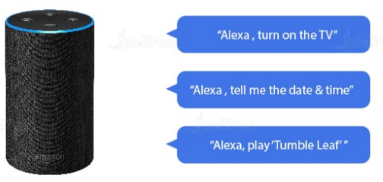
AI in real life
Self driving cars
Google translate
Alexa

Slide 10
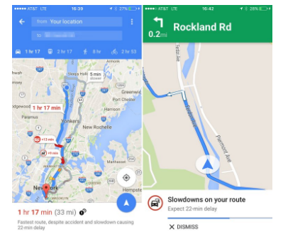
Google maps

Slide 11
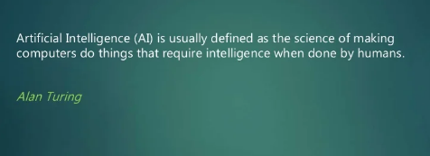
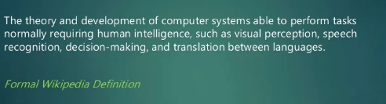
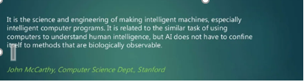
Definition of Artificial intelligence

Slide 12
What is artificial intelligence?
Intelligence:
Capacity to learn and solve problems
Artificial intelligence: AI is the simulation of human intelligence by machines
            The ability to solve problems
            The ability to act rationally
            The ability to act like humans

Slide 13
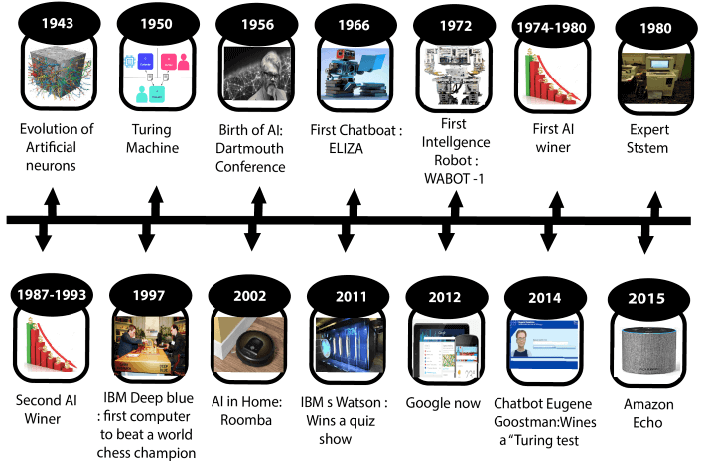
History of Artificial intelligence

Slide 14
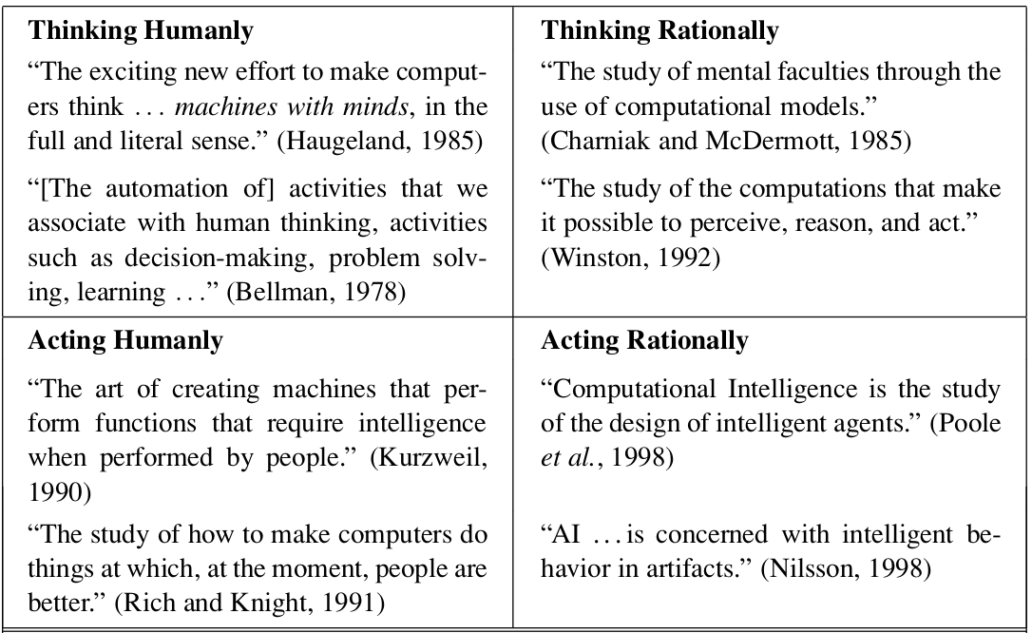
Different perspectives of AI
Notes:
14

Slide 15
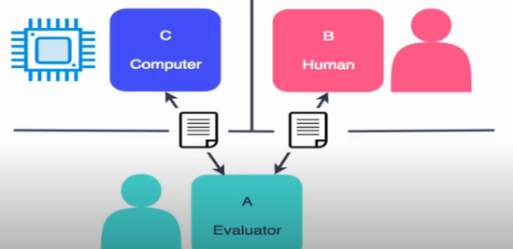
Acting humanly
[Turing test approach]
Pictorial Representation of Turing Test from https://en.wikipedia.org/wiki/Turing_test

Slide 16
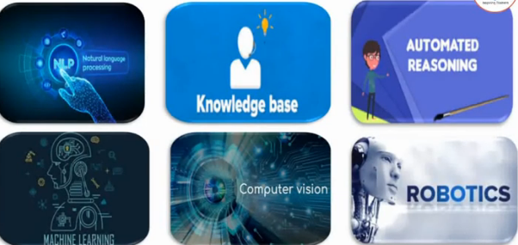
Acting Humanly
Turing Test Approach
Skills necessary to pass these tests

Slide 17
Acting Humanly
Turing Test Approach
Some Definitions of AI:
“The art of creating machines that perform functions that require intelligence when performed by people.” (Kurzweil, 1990)
“The study of how to make computers do things at which, at the moment, people are better.” (Rich and Knight, 1991)

Slide 18
Thinking Humanly
Cognitive Modelling Approach
How do we capture human thinking to implement?
  Introspection
  Psychological Experiments
  Brain Imaging
System : “General Problem Solver” (Newell and Simon, 1961)
  Designed to work as a universal problem solver
  Problems represented by horn clauses
  First AI Machine which has KB + Inference separation
  Authors focus on this is on comparing the trace of its reasoning steps to traces of human subjects solving the same problems
Growth of Cognitive science and AI supports each other

Slide 19
Thinking Humanly
Cognitive Modelling Approach
Some Definitions of AI:
“The exciting new effort to make computers think . . . machines with minds, in the full and literal sense.” (Haugeland, 1985)
“[The automation of] activities that we associate with human thinking, activities such as decision-making, problem solving, learning . . .” (Bellman, 1978)

Slide 20
Thinking Rationally
“Laws of Thought” Approach
Invention of Formal Logic, Greek Philosopher Aristotle, Third century BC.
Introduced syllogisms, providing argument structures
In all boring classes, students sleep

Slide 21
Thinking Rationally
“Laws of Thought” Approach
Invention of Formal Logic, Greek Philosopher Aristotle, Third century BC.
Introduced syllogisms, providing argument structures
In all boring classes, students sleep
It is a boring class

Slide 22
Thinking Rationally
“Laws of Thought” Approach
Invention of Formal Logic, Greek Philosopher Aristotle, Third century BC.
Introduced syllogisms, providing argument structures
In all boring classes, students sleep
It is a boring class
Students sleep in this class [ Are you ? ]

Slide 23
Thinking Rationally
“Laws of Thought” Approach
Invention of Formal Logic, Greek Philosopher Aristotle, Third century BC.
Introduced syllogisms, providing argument structures
In all boring classes, students sleep
It is a boring class
Students sleep in this class [ Are you ? ]
Field of Logics gave rise to codifying rational thinking
  When elements are ‘things’, we reason about things
Hurdles to the idea : 1) Not everything can be logically coded
2) no provably correct action at a moment
3) Exhaustive computational resources

Slide 25
Acting Rationally
The Rational Agent Approach
An agent is an entity that perceives and acts
This course is about designing rational agents
Abstractly, an agent is a function from percept histories to actions:
[f: P* → A]
For any given class of environments and tasks, we seek the agent (or class of agents) with the best performance
Computational limitations make perfect rationality unachievable
Design best program for given machine resources

Slide 26
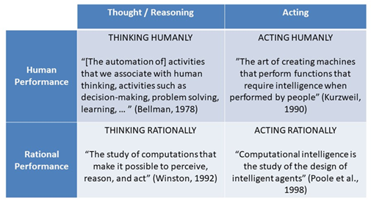
Definitions
Notes:
26

Slide 27
Passing the Turing Test
Transcript of a chat
EUGINE - a thirteen-year-old Ukrainian boy, chats
JUDGE: Hello.
EUGENE: Hello, I'm really glad to have the chance to chat with you! My guinea pig Bill sends his regards too!
JUDGE: Is Bill a male or a female?
EUGENE: Ask Bill personally, please.
JUDGE: Well I'd rather talk to you. What is your name?
EUGENE: Call me Eugene. I am glad to talk to you!
JUDGE: My name is Jane and I am female. How about you? What's your gender?
EUGENE: I'm a male. A “guy’ I'd say.
JUDGE: Pleased to meet you Eugene. What's the weather like where you are?
EUGENE: Let's get on with our conversation!
JUDGE: Don't you like talking about the weather?
EUGENE: All these talks about weather is a waste of time.
JUDGE: What would you like to discuss?
EUGENE: I don't know. Better tell me more about yourself!

Slide 28
Passing the Turing Test
2014 - Royal Society ( London ) - Sixteenth Anniversary of Alan Turing -
Chabot - Eugene Goostman - Pretended to be a thirteen-year-old Ukrainian boy
  Passed the turing test for the first time
  10/30 Judges believed the response is from human
Turing predicted in 50 years time, computers can be programmed to play imitation game in which an average interrogator fails to identify the machine 70% time in a 5 mins questioning

Slide 29
Where is AI Now?
Interesting current AI application in few domains

Slide 30
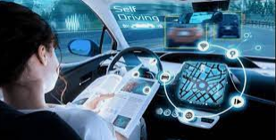
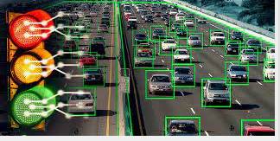
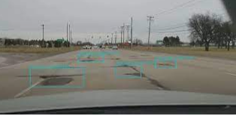
AI in Transportation
Self driving car
Traffic management
Road condition monitoring

Slide 31
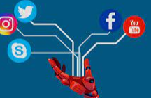
AI in Social Media
Facebook
Linkedin
Snapchat
Youtube
Instagram etc..

Slide 32
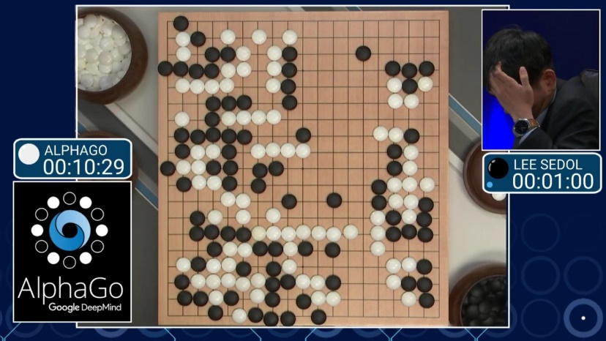
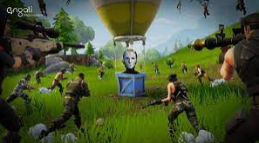
Gaming
Alpha go game Shooting game

Slide 33
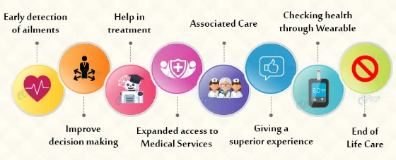
AI in health care

Slide 34

AI in HealthCare
Health monitoring
Cancer detection
AI robot assisted surgery

Slide 35
AI in BFSI ( Banking, Finance , Insurance)
Fraud detection
Chatbots
Sentiment analysis
Robo advisor

Slide 36
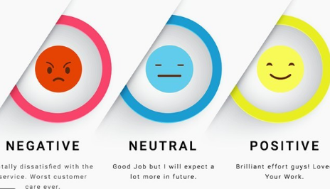
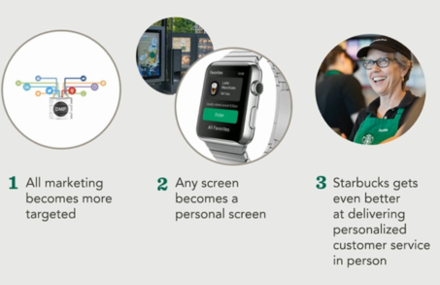
AI in Customer Management
                Starbucks
Sentiment analysis

Slide 37
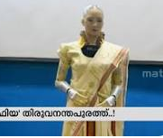
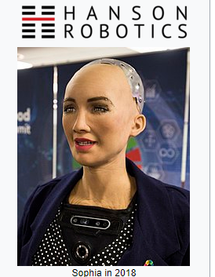
Demo/video clips
https://www.youtube.com/results?search_query=sophiya+robot

Slide 38
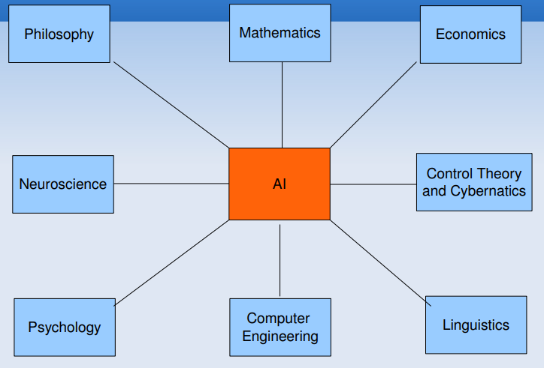
Areas Contributing to AI

Slide 39
Philosophy
Can formal rules be used to draw valid conclusions?
How does the mind arise from a brain?
Where does knowledge come from?
How does knowledge lead to action?
39

Slide 40
Philosophy
Aristotle (384–322 B . C .) : first to formulate precise set of laws to govern rational part of brain
Ramon Lull (d. 1315) : useful reasoning could actually be carried out by a mechanical artifact
Hobbes (1588–1679) : “we add and subtract in our silent thoughts.”
Leibniz (1646–1716) : Built a mechanical device intended to carry out operations on concepts rather than numbers
40

Slide 41
Mathematics
What are the formal rules to draw valid conclusions?
What can be computed?
How do we reason with uncertain information?
41

Slide 42
Economics
How should we make decisions so as to maximize payoff?
    Utility / preferred outcomes
Decision theory -Probability & utility theory
Game theory
  How to make decisions when payoffs are not immediate?
  MDP
42

Slide 43
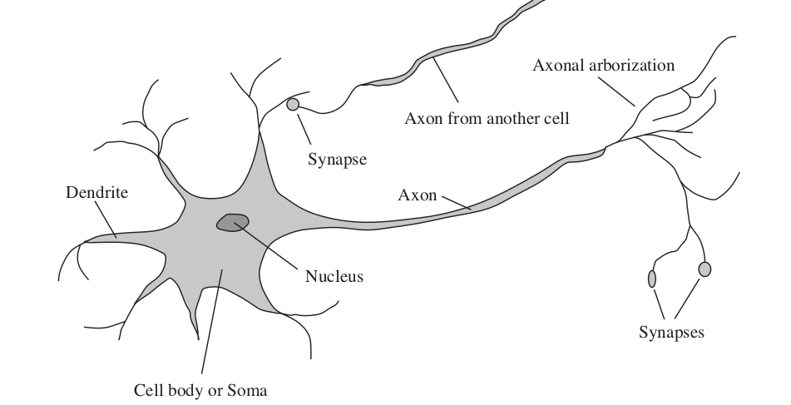
Neuro science
How do brains process information?
Study of the nervous system / brain
How does brain enables thoughts - Mystery Still Aristotle ,
“Of all the animals, man has the largest brain in proportion to his size”
43

Slide 44
Computer science
AI is a subfield of computer science
Programming language
Algorithms

Slide 45
Linguistics
How does language relate to thought?
Verbal Behavior (1957, B. F. Skinner) :
Behaviorist approach to language learning
Reviewed by Noam Chomsky
  criticised lack of notion of creativity in language
Syntactic Structures ( 1957, Noam Chomsky)
Computational linguistics / natural language processing as a part of AI
  Understanding a language is realized as more complex than ever
  Context, subject matter knowledge complicated it further
  Representing language consumed volume of work done in NLP, in early times
45

Slide 46

Phychology
How do humans and animals think and act?
Cognitive Psychology - Brain as an information-processing device
Two months after the dartmouth workshop, a workshop in MIT gave birth to Cognitive Science
  George Miller, Noam Chomsky, Allen Newell and Herbert Simon - roles of computer models to address the psychology of memory, language, and logical thinking, issues..
46

Slide 47
Control theory, Cybernetics
Control theory
Deals with the behaviour of dynamic systems
  behaviour must ensure the error between the current state and goal state is minimized
Cybernetics - Book by Wiener
  (Norbert Wiener, 1948) : Scientific study of control and communication in the animal and the machine
47

Slide 48
Challenges in AI
    Determining the right data set.
  The bias problem
    Infrastructure.
  AI integration.
  Computation.
  Niche skillset.
  Expensive and rare
Notes:
48

Slide 49
Required Reading: AIMA - Chapter # 1.
Note : Some of the slides are adopted from AIMA TB materials
Thank You for all your Attention
49
Notes:
49

