Slide 1
ArtificialIntelligence-[DSE ZC444]
CS 2-Agents &Environment
Prof. Brahmanaidu Kakarla

Slide 2
Course Plan
M1 | Introduction to AI
M2 | Problem Solving Agent using Search
M3 | Game Playing, Constraint Satisfaction Problem
M4 | Knowledge Representation using Logics
M5 | Probabilistic Representation and Reasoning
M6 | Reasoning over time, Reinforcement Learning

Slide 3
Module 1 : Introduction to AI
Overview of AI & Applications
Intelligent Agents
Task Environment

Slide 4
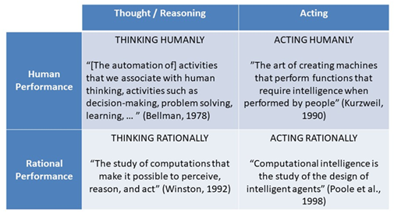
Design Principles & Techniques
Notes:
4

Slide 5
AI Agents and Environment
An AI system is composed of
an agent
an environment

Slide 6
What is agent?
Agent is anything that can perceive its environment through sensors and acts upon the environment through effectors.
Example of agents
            Robotic
            Human
            Software

Slide 7
Important Terminologies
1.Percept-It is a perceptual inputs at a given instance
2.Agent program is an implementation of an agent function.
3.Agent function is a map from the percept sequence(history of all that an agent has perceived to date) to an action.
4.Performance measure-It is criteria how successful an agent is
5.Action-Agent performs after any given sequence of percepts
6.Effectors- can be legs, wheels, arms, fingers, wings, fins, and display screen

Slide 8
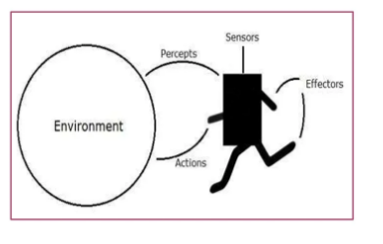
AI system architecture

Slide 9
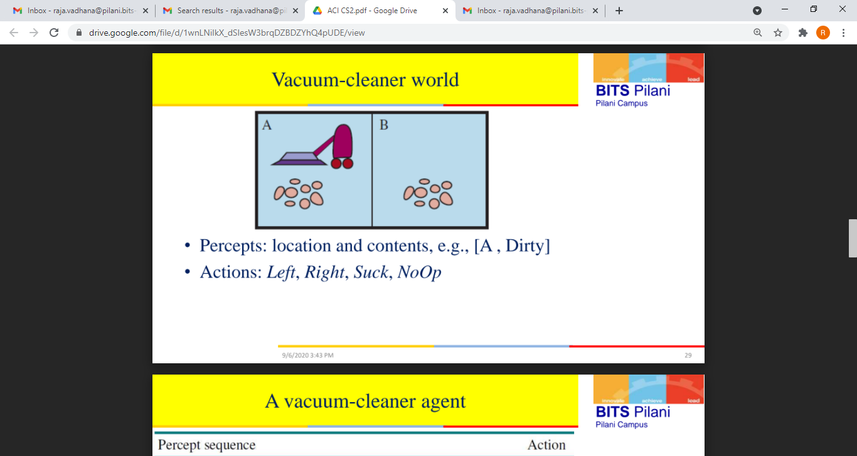
Real time example
Performance measure: An objective criterion for success of an agent's behaviour
E.g., performance measure of a vacuum-cleaner agent
» amount of dirt cleaned up
» amount of time taken
» amount of electricity consumed
» amount of noise generated, etc.

Slide 10
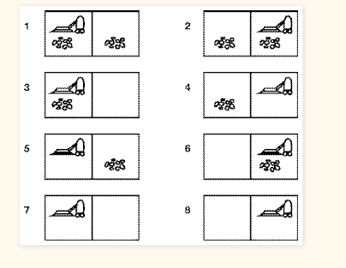
Contd..

Slide 11
PEAS Environment
Design on what an application wants the agent to do in the environment
Agent | Performance | Environment | Sensors | Actuators
Medical diagnosis system | Healthy patient, reduced costs | Patient, hospital, staff | Keyboard entry of symptoms, findings, patient’s answers | Display of questions, tests, diagnosis, treatments, referrals
Satellite Image analysis system | Correct image categorization | Downlink from orbiting satellite | Color pixel analysis | Display of scene categorization
Interactive English tutor | Student’s score on test | Set of students, testing agency | Keyboard entry | Display of exercises, suggestions, corrections

Slide 12
PEAS Environment
Agent | Performance | Environment | Sensors | Actuators
Automated taxi driver | Safe, fast, legal, comfortable trip, maximize profits | Roads, other traffic, pedestrians, customers | Cameras, sonar, speedometer, GPS, odometer, engine sensors, keyboard | Steering wheel, accelerator, brake, signal, horn

Slide 13
Types of agents
Simple Reflex Agents
Model-Based Reflex Agents
Goal-Based Agents
Utility-Based Agents
Learning Agent

Slide 14
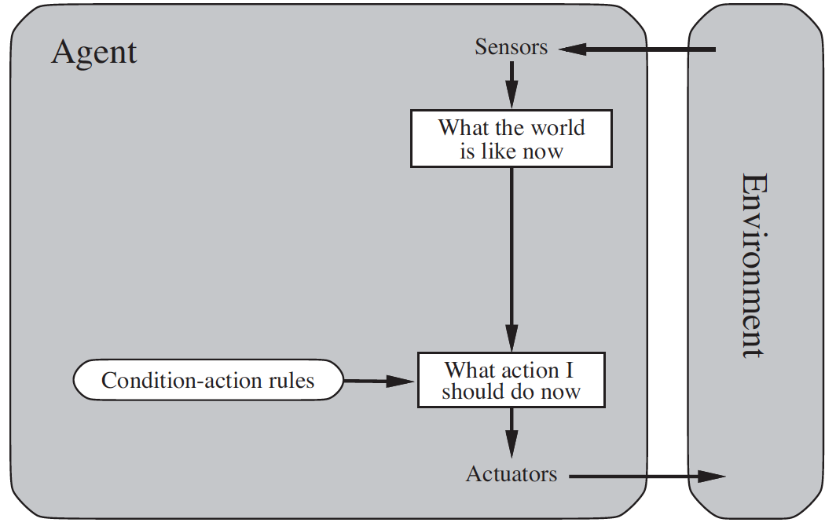
Simple reflex agent
Simple
No calculation or solve complicated problems
Fully observable environment
Works on condition-action rule

Slide 15
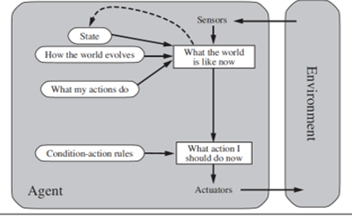
Model Based reflex agents
Partially observable environment
Store perceive history

Slide 16
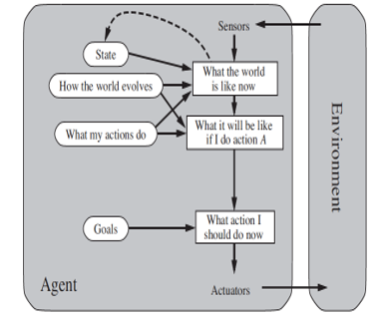
Goal based agent
Expansion of model based reflex agent
Mainly focused on its Goal
Searching and planning
Agent is more flexible

Slide 17
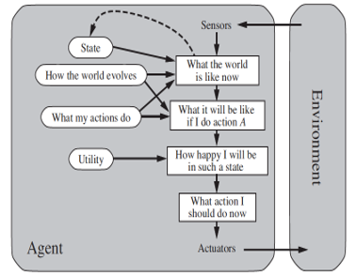
Utility based agent
Main focus is on utility
Utility function
Deals with happy and unhappy state

Slide 18
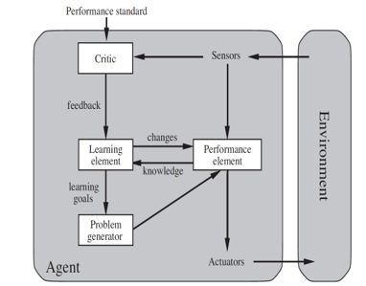
Learning agent
Learning element: It is responsible for making improvements by learning from the environment
Critic: The learning element takes feedback from critics which describes how well the agent is doing with respect to a fixed performance standard.

Slide 19
Learning agent
Performance element: It is responsible for selecting external action
Problem Generator: This component is responsible for suggesting actions that will lead to new and informative experiences.

Slide 20
Environment

Slide 21
Task Environment
A rational agent is built to solve a specific task. Each such task would then have a different environment which we refer to as Task Environment
Based on the applicability of each technique for agent implementation its task environment design is determined by multiple dimension

Slide 22

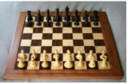
Sensor based Task environment
Observability : Fully observable Vs Partial observable
Poker
Chess

Slide 23
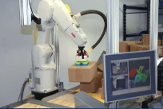
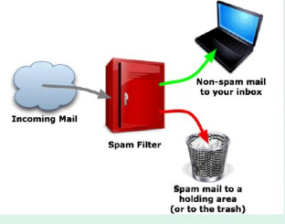
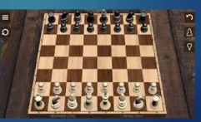
Action Based Task Environment
Dependency : Episodic Vs Sequential
chech chess game
                Mail sorting system
Pick and place robot system

Slide 24
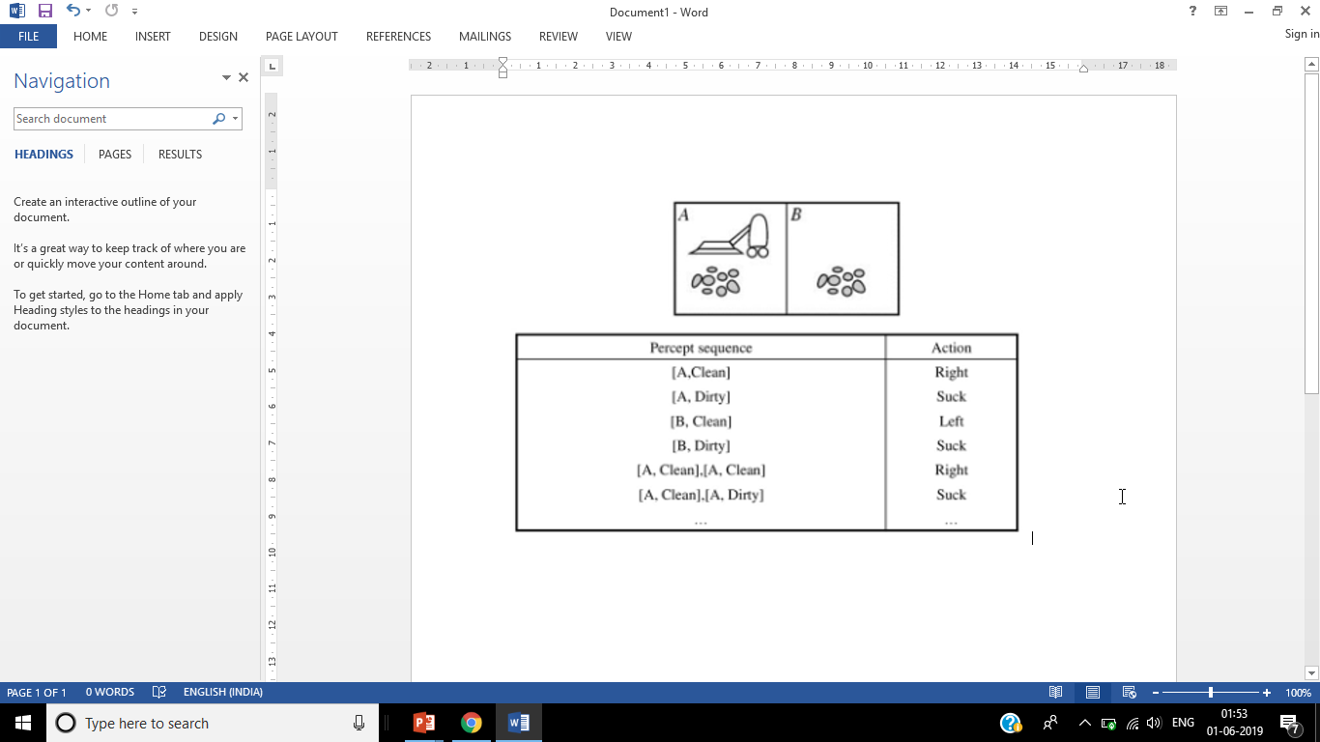
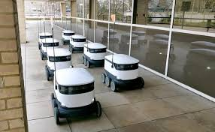
State Based Task Environment
No.of.State : Discrete Vs Continuous

Slide 25
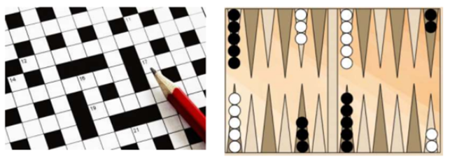
Action & State Based:
State Determinism : Deterministic Vs Stochastic | Strategic
(If the environment is deterministic except for the actions of other agents, then the environment is strategic)

Slide 26
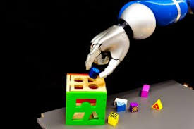
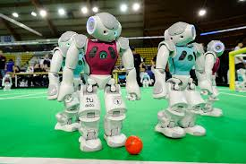
Agent Based:
> Cardinality : Single Vs MultiAgent

Slide 27
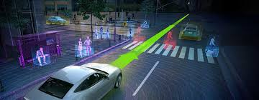
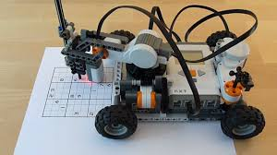
Action & State Based:
Change in Time : Static Vs Dynamic
(The environment is semi dynamic if the environment itself does not change with the passage of time but the agent's performance score does)

Slide 28
Task Environment
Sensor Based:
Observability : Full Vs Partial
Action Based:
Dependency : Episodic Vs Sequential
State Based:
No.of.State : Discrete Vs Continuous
Agent Based:
> Cardinality : Single Vs MultiAgent
Action & State Based:
State Determinism : Deterministic Vs Stochastic | Strategic
Change in Time : Static Vs Dynamic

Slide 29
Task Environment
Task Environment | Fully vs Partially Observable | Single vs Multi-Agent | Deterministic vs Stochastic | Episodic vs Sequential | Static vs Dynamic | Discrete vs Continuous
Medical diagnosis system | Partially | Single | Stochastic | Sequential | Dynamic | Continuous
Satellite Image Analysis System | Fully | Single | Deterministic | Episodic | Static | Continuous
Interactive English tutor | Partially | Multi | Stochastic | Sequential | Dynamic | Discrete

Slide 30
Task Environment
Task Environment | Fully vs Partially Observable | Single vs Multi-Agent | Deterministic vs Stochastic | Episodic vs Sequential | Static vs Dynamic | Discrete vs Continuous
Taxi Driving | P | M | S | S | D | C

Slide 31
Question...
Exercises
Develop PEAS description for the following task environment:
  Robot soccer player
  Shopping for used AI books on the Internet
Analyze the properties of the above environments

Slide 32
Required Reading: AIMA - Chapter # 1.2, 1.4, 2
32
Notes:
32

Slide 33
Module 2 :
Problem Solving Agent using Search
Uninformed Search
Informed Search
Heuristic Functions
D. Local Search Algorithms & Optimization Problems

Slide 34
Problem Solving Agents
An agent that tries to come up with a sequence of actions that will bring the environment into a desired state.
Phases of Solution Search by PSA
Goal Formulation
Problem Formulation
Search Phase
Execution Phase
“a problem-solving refers to a state where we wish to reach to a definite goal from a present state or condition

Slide 35
Problem Solving Agents-Goal formulation
First and simplest step in problem-solving.
Organizes the steps/sequence required to formulate one goal out of multiple goals as well as actions to achieve that goal.
Current situation and the agent’s performance measure is the first step in problem solving.

Slide 36
Problem solving Agents-Problem formulation
Initial State: Start point of problem
Final State: The finish point of problem. Aka Goal or solution state
States: Total states in problem
Transition Model: How one can shift from one state to another
Actions: Actions set, used to move from one state to another
Path Cost: What is total effort (cost) from initial state to final state

Slide 37
Problem Solving Agents –Search Phase
It identifies all the best possible sequence of actions to reach the goal state from the current state.
It takes a problem as an input and returns solution as its output.

Slide 38
Problem solving agents –execution phase
It executes the best optimal solution from the searching algorithms to reach the goal state from the current state.

Slide 39
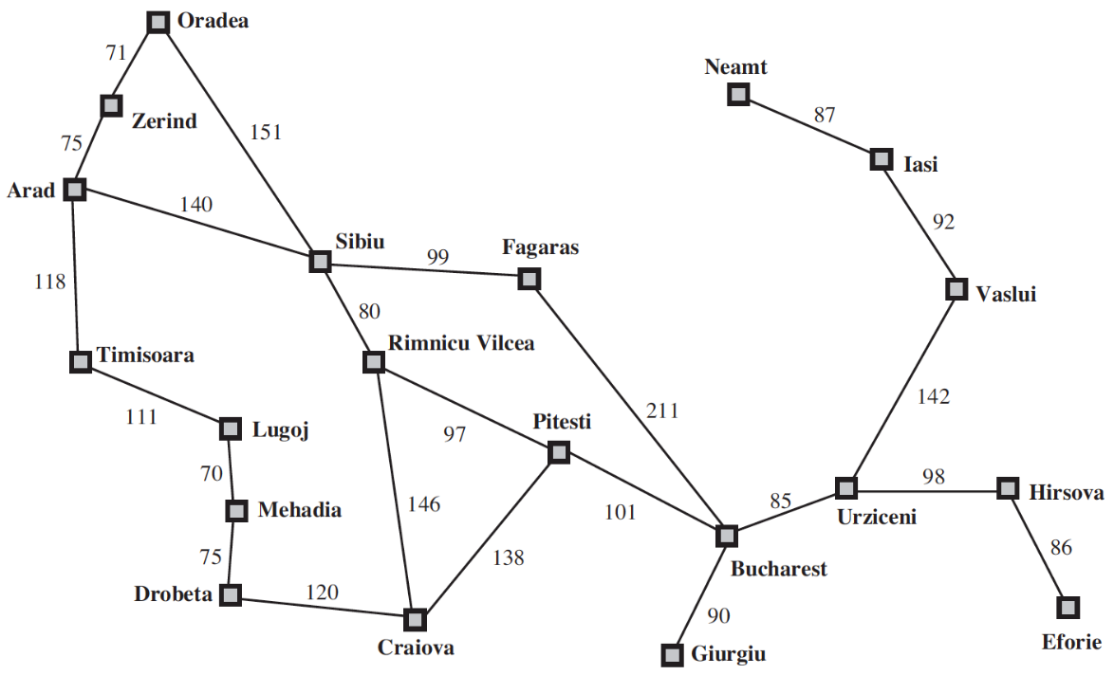
Problem Solving Agents – example
  Initial State –E.g., In(Arad)
  Possible Actions – ACTIONS(s) ➔ {Go(Sibiu), Go(Timisoara), Go(Zerind)}
  Transition Model – RESULT( In(Arad), Go(Sibiu) ) = In(Sibiu)
  Goal Test – IsGoal( In(Bucharest) ) = Yes
  Path Cost – cost( In(Arad), go(Sibiu)) = 140 kms

Slide 40
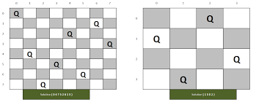
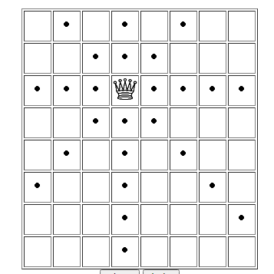
N - Queen

Slide 41

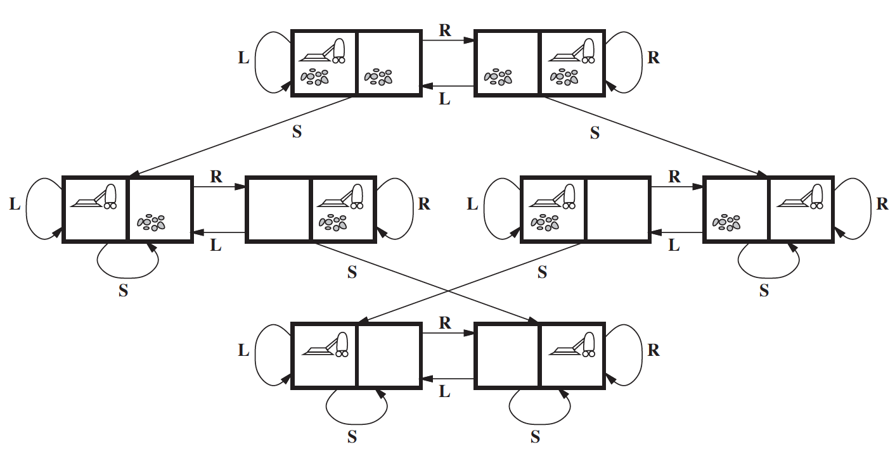
Vacuum World Problem

Slide 42
Example Problem Formulation
 | Vacuum World | 8 – Queen Problem | Travelling Problem
Initial State | Any | No Queen on board | Based on the problem
Possible Actions | [Move Left, Move Right, Suck] | Add a Queen to any empty square | Take a flight | Train | Shop
Transition Model | [A, ML] = [B , Dirty] [A, ML] = [B, Clean] | [A1, B2] = [FAIL] [A1, B3] = [SAFE] | [A, Go(A->S)] = [S]
Goal Test | Is all room clean? [A, Clean] [B, Clean] | All Queen Safe | Is current = B (destination)
Path Cost | No of steps in path | No of Moves done, backtracking | Cost + Time + Quality

Slide 43
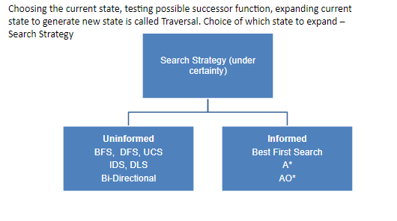
Searching for solutions

Slide 44
In(Arad)
Go(Sibiu)
Go(Timisoara)
Go(Zerind)
In(Sibiu)
In(Timisoara)
In(Zerind)
Go(Arad)
Go(Fagaras)
Go(Oradea)
Go(Rimnicu Vilcea)
In(Arad)
In(Fagaras)
In(Oradea)
In(Rimnicu Vilcea)
Leaf Nodes
(no children yet)

Slide 45
Terminologies
Nodes
States
Frontier | Fringes
Search Strategy : LIFO | FIFO | Priority Queue
Performance Metrics
Completeness
Optimality
Time Complexity
Space Complexity
Algorithm Terminology
- d Depth of a node - m – maximum
- b Branching factor - C* - Optimal Cost
- n – nodes - E – least Cost
- l – level of a node - N –total node generated

Slide 46
Uninformed Search
BFS & its Variants

Slide 47
Uninformed Search
Uninformed Search
BFS & its Variants

Slide 48
Thank you
Questions Please..???

