Slide 1
Artificial Intelligence-[SESIZC444]
CS 3- Problem Solving: Knowledge representation and Inference
By
Prof. Brahmanaidu Kakarla

Slide 2
Module 2 :
Problem Solving Agent using Search
Uninformed Search
Informed Search
Heuristic Functions
D. Local Search Algorithms & Optimization Problems

Slide 3
Some example problems
Toy problems and micro-worlds
  8-Puzzle
  Missionaries and Cannibals
  Cryptarithmetic
  Remove 5 Sticks
  Water Jug Problem
Real-world problems

Slide 4
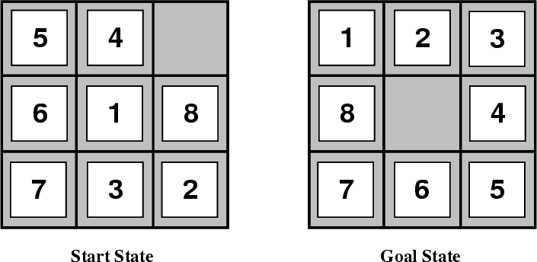
8-Puzzle
Given an initial configuration of 8 numbered tiles on a 3 x 3 board, move the tiles in such a way so as to produce a desired goal configuration of the tiles.

Slide 5
8-Puzzle
3 x 3 array configuration of the tiles on the board.
  Move Blank Square Left, Right, Up or Down.
  This is a more efficient encoding of the operators than one in which each of four possible moves for each of the 8 distinct tiles is used.
A particular configuration of the board.
A particular configuration of the board.
State Representation: 3 x 3 array configuration of the tiles on the board.
Operators: Move Blank Square Left, Right, Up or Down.
  This is a more efficient encoding of the operators than one in which each of four possible moves for each of the 8 distinct tiles is used.
Initial State: A particular configuration of the board.
Goal: A particular configuration of the board.

Slide 6
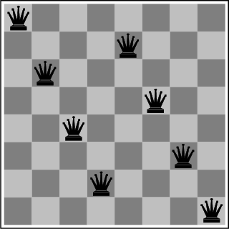
The 8-Queens Problem
State Representation: ?
Initial State: ?
Operators: ?
Goal: Place eight queens on a chessboard such that no queen attacks any other!

Slide 7
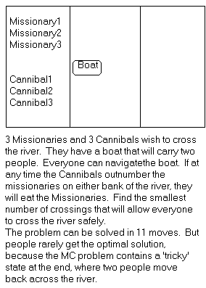
Missionaries and Cannibals
Three missionaries and three cannibals wish to cross the river. They have a small boat that will carry up to two people. Everyone can navigate the boat. If at any time the Cannibals outnumber the Missionaries on either bank of the river, they will eat the Missionaries. Find the smallest number of crossings that will allow everyone to cross the river safely.

Slide 8
Missionaries and Cannibals
Goal: Move all the missionaries and cannibals across the river.
Constraint: Missionaries can never be outnumbered by cannibals on either side of river, or else the missionaries are killed.
State: configuration of missionaries and cannibals and boat on each side of river.
Initial State: 3 missionaries, 3 cannibals and the boat are on the near bank.
Operators: Move boat containing some set of occupants across the river (in either direction) to the other side.

Slide 9
Missionaries and Cannibals Solution
Near side Far side
0 Initial setup: MMMCCC B -
1 Two cannibals cross over: MMMC B CC
2 One comes back: MMMCC B C
3 Two cannibals go over again: MMM B CCC
4 One comes back: MMMC B CC
5 Two missionaries cross: MC B MMCC
6 A missionary & cannibal return: MMCC B MC
7 Two missionaries cross again: CC B MMMC
8 A cannibal returns: CCC B MMM
9 Two cannibals cross: C B MMMCC
10 One returns: CC B MMMC
11 And brings over the third: - B MMMCCC

Slide 10
Cryptarithmetic
Find an assignment of digits (0, ..., 9) to letters so that a given arithmetic expression is true. examples: SEND + MORE = MONEY and
    FORTY Solution: 29786
    + TEN 850
    + TEN 850
    ----- -----
    SIXTY 31486
    F=2, O=9, R=7, etc.

Slide 11
Cryptarithmetic
State: mapping from letters to digits
Initial State: empty mapping
Operators: assign a digit to a letter
Goal Test: whether the expression is true given the complete mapping
State: mapping from letters to digits
Initial State: empty mapping
Operators: assign a digit to a letter
Goal Test: whether the expression is true given the complete mapping
Note: In this problem, the solution is NOT a sequence of actions that transforms the initial state into the goal state; rather, the solution is a goal node that includes an assignment of a digit to each letter in the given problem.
Find an assignment of digits to letters so that a given arithmetic expression is true. examples: SEND + MORE = MONEY and
    FORTY Solution: 29786
    + TEN 850
    + TEN 850
    ----- -----
    SIXTY 31486
    F=2, O=9, R=7, etc.

Slide 12
Remove 5 Sticks
Given the following configuration of sticks, remove exactly 5 sticks in such a way that the remaining configuration forms exactly 3 squares.
State: ?
Initial State: ?
Operators: ?
Goal Test: ?

Slide 13
Water Jug Problem
Given a full 5-gallon jug and a full 2-gallon jug, fill the 2-gallon jug with exactly one gallon of water.
State: ?
Initial State: ?
Operators: ?
Goal State: ?
5
2

Slide 14
Water Jug Problem
State = (x,y), where x is the number of gallons of water in the 5-gallon jug and y is # of gallons in the 2-gallon jug
Initial State = (5,2)
Goal State = (*,1), where * means any amount
Operator table
5
2
Name | Cond. | Transition | Effect
Empty5 | – | (x,y)→(0,y) | Empty 5-gal. jug
Empty2 | – | (x,y)→(x,0) | Empty 2-gal. jug
2to5 | x ≤ 3 | (x,2)→(x+2,0) | Pour 2-gal. into 5-gal.
5to2 | x ≥ 2 | (x,0)→(x-2,2) | Pour 5-gal. into 2-gal.
5to2part | y < 2 | (1,y)→(0,y+1) | Pour partial 5-gal. into 2-gal.

Slide 15
Water jug state space
5, 2
5, 1
5, 0
Empty5
4, 2
4, 1
4, 0
Empty2
3, 2
3, 1
3, 0
2to5
2, 2
2, 1
2, 0
5to2
1, 2
1, 1
1, 0
5to2part
0, 2
0, 1
0, 0

Slide 16
Water jug solution
5, 2
5, 1
5, 0
4, 2
4, 1
4, 0
3, 2
3, 1
3, 0
2, 2
2, 1
2, 0
1, 2
1, 1
1, 0
0, 2
0, 1
0, 0

Slide 17
Some more real-world problems
Route finding
Touring (traveling salesman)
Logistics
VLSI layout
Robot navigation
Learning

Slide 18
Knowledge representation issues
What’s in a state ?
  Is the color of the boat relevant to solving the Missionaries and Cannibals problem? Is sunspot activity relevant to predicting the stock market? What to represent is a very hard problem that is usually left to the system designer to specify.
What level of abstraction or detail to describe the world.
  Too fine-grained and we’ll “miss the forest for the trees.” Too coarse-grained and we’ll miss critical details for solving the problem.
The number of states depends on the representation and level of abstraction chosen.
  In the Remove-5-Sticks problem, if we represent the individual sticks, then there are 17-choose-5 possible ways of removing 5 sticks.
  On the other hand, if we represent the “squares” defined by 4 sticks, then there are 6 squares initially and we must remove 3 squares, so only 6-choose-3 ways of removing 3 squares.

Slide 19
Formalizing search in a state space
A state space is a graph (V, E) where V is a set of nodes and E is a set of arcs, and each arc is directed from a node to another node
Each node is a data structure that contains a state description plus other information such as the parent of the node, the name of the operator that generated the node from that parent, and other bookkeeping data
Each arc corresponds to an instance of one of the operators. When the operator is applied to the state associated with the arc’s source node, then the resulting state is the state associated with the arc’s destination node

Slide 20
Formalizing search II
Each arc has a fixed, positive cost associated with it corresponding to the cost of the operator.
Each node has a set of successor nodes corresponding to all of the legal operators that can be applied at the source node’s state.
  The process of expanding a node means to generate all of the successor nodes and add them and their associated arcs to the state-space graph
One or more nodes are designated as start nodes.
A goal test predicate is applied to a state to determine if its associated node is a goal node.

Slide 21
Formalizing search III
A solution is a sequence of operators that is associated with a path in a state space from a start node to a goal node.
The cost of a solution is the sum of the arc costs on the solution path.
  If all arcs have the same (unit) cost, then the solution cost is just the length of the solution (number of steps / state transitions)

Slide 22
Formalizing search IV
State-space search is the process of searching through a state space for a solution by making explicit a sufficient portion of an implicit state-space graph to find a goal node.
  For large state spaces, it isn’t practical to represent the whole space.
  Initially V={S}, where S is the start node; when S is expanded, its successors are generated and those nodes are added to V and the associated arcs are added to E. This process continues until a goal node is found.
Each node implicitly or explicitly represents a partial solution path (and cost of the partial solution path) from the start node to the given node.
  In general, from this node there are many possible paths (and therefore solutions) that have this partial path as a prefix.

Slide 23
State-space search algorithm
function general-search (problem, QUEUEING-FUNCTION)
;; problem describes the start state, operators, goal test, and operator costs
;; queueing-function is a comparator function that ranks two states
;; general-search returns either a goal node or failure
nodes = MAKE-QUEUE(MAKE-NODE(problem.INITIAL-STATE))
loop
if EMPTY(nodes) then return "failure"
node = REMOVE-FRONT(nodes)
if problem.GOAL-TEST(node.STATE) succeeds
then return node
nodes = QUEUEING-FUNCTION(nodes, EXPAND(node,
problem.OPERATORS))
end
;; Note: The goal test is NOT done when nodes are generated
;; Note: This algorithm does not detect loops

Slide 24
Key procedures to be defined
EXPAND
  Generate all successor nodes of a given node
GOAL-TEST
  Test if state satisfies all goal conditions
QUEUEING-FUNCTION
  Used to maintain a ranked list of nodes that are candidates for expansion

Slide 25
Bookkeeping
Typical node data structure includes:
  State at this node
  Parent node
  Operator applied to get to this node
  Depth of this node (number of operator applications since initial state)
  Cost of the path (sum of each operator application so far)

Slide 26
Some issues
Search process constructs a search tree, where
  root is the initial state and
  leaf nodes are nodes
    not yet expanded (i.e., they are in the list “nodes”) or
    having no successors (i.e., they’re “deadends” because no operators were applicable and yet they are not goals)
Search tree may be infinite because of loops even if state space is small
Return a path or a node depending on problem.
  E.g., in cryptarithmetic return a node; in 8-puzzle return a path
Changing definition of the QUEUEING-FUNCTION leads to different search strategies

Slide 27
Evaluating Search Strategies
Completeness
  Guarantees finding a solution whenever one exists
Time complexity
  How long (worst or average case) does it take to find a solution? Usually measured in terms of the number of nodes expanded
Space complexity
  How much space is used by the algorithm? Usually measured in terms of the maximum size of the “nodes” list during the search
Optimality/Admissibility
  If a solution is found, is it guaranteed to be an optimal one? That is, is it the one with minimum cost?

Slide 28
Uninformed vs. informed search
Uninformed search strategies
  Also known as “blind search,” uninformed search strategies use no information about the likely “direction” of the goal node(s)
  Uninformed search methods: Breadth-first, depth-first, depth-limited, uniform-cost, depth-first iterative deepening, bidirectional
Informed search strategies
  Also known as “heuristic search,” informed search strategies use information about the domain to (try to) (usually) head in the general direction of the goal node(s)
  Informed search methods: Hill climbing, best-first, greedy search, beam search, A, A*

Slide 29
Example for illustrating uninformed search strategies
S
3
8
1
A
B
C
3
15
7
20
5
D
E
G

Slide 30
Uninformed Search Methods

Slide 31
Breadth-First
Enqueue nodes on nodes in FIFO (first-in, first-out) order.
Complete
Optimal (i.e., admissible) if all operators have the same cost. Otherwise, not optimal but finds solution with shortest path length.
Exponential time and space complexity, O(b^{d}), where d is the depth of the solution and b is the branching factor (i.e., number of children) at each node
Will take a long time to find solutions with a large number of steps because must look at all shorter length possibilities first
  A complete search tree of depth d where each non-leaf node has b children, has a total of 1 + b + b² + ... + b^{d} = (b^{(d+1)} - 1)/(b-1) nodes
  For a complete search tree of depth 12, where every node at depths 0, ..., 11 has 10 children and every node at depth 12 has 0 children, there are 1 + 10 + 100 + 1000 + ... + 10¹² = (10¹³ - 1)/9 = O(10¹²) nodes in the complete search tree. If BFS expands 1000 nodes/sec and each node uses 100 bytes of storage, then BFS will take 35 years to run in the worst case, and it will use 111 terabytes of memory!

Slide 32
Depth-First (DFS)
Enqueue nodes on nodes in LIFO (last-in, first-out) order. That is, nodes used as a stack data structure to order nodes.
May not terminate without a “depth bound,” i.e., cutting off search below a fixed depth D ( “depth-limited search”)
Not complete (with or without cycle detection, and with or without a cutoff depth)
Exponential time, O(b^{d}), but only linear space, O(bd)
Can find long solutions quickly if lucky (and short solutions slowly if unlucky!)
When search hits a dead-end, can only back up one level at a time even if the “problem” occurs because of a bad operator choice near the top of the tree. Hence, only does “chronological backtracking”

Slide 33
Uniform-Cost (UCS)
Enqueue nodes by path cost. That is, let g(n) = cost of the path from the start node to the current node n. Sort nodes by increasing value of g.
Called “Dijkstra’s Algorithm” in the algorithms literature and similar to “Branch and Bound Algorithm” in operations research literature
Complete (*)
Optimal/Admissible (*)
Admissibility depends on the goal test being applied when a node is removed from the nodes list, not when its parent node is expanded and the node is first generated
Exponential time and space complexity, O(b^{d})

Slide 34
Depth-First Iterative Deepening (DFID)
First do DFS to depth 0 (i.e., treat start node as having no successors), then, if no solution found, do DFS to depth 1, etc.
    until solution found do
    DFS with depth cutoff c
    c = c+1
Complete
Optimal/Admissible if all operators have the same cost. Otherwise, not optimal but guarantees finding solution of shortest length (like BFS).
Time complexity seems worse than BFS or DFS because nodes near the top of the search tree are generated multiple times, but because almost all of the nodes are near the bottom of a tree, the worst case time complexity is still exponential, O(b^{d}).

Slide 35
Depth-First Iterative Deepening
If branching factor is b and solution is at depth d, then nodes at depth d are generated once, nodes at depth d-1 are generated twice, etc.
  IDS : (d) b + (d-1) b² + … + (2) b^{(d-1)} + b^{d} = O(b^{d}).
  If b=4, then worst case is 1.78 * 4^{d}, i.e., 78% more nodes searched than exist at depth d (in the worst case).
However, let’s compare this to the time spent on BFS:
  BFS : b + b² + … + b^{d} + (b^{(d+1)} – b) = O(b^{d}).
  Same time complexity of O(b^{d}), but BFS expands some nodes at depth d+1, which can make a HUGE difference:
    With b = 10, d = 5,
    BFS: 10 + 100 + 1,000 + 10,000 + 100,000 + 999,990 = 1,111,100
    IDS: 50 + 400 + 3,000 + 20,000 + 100,000 = 123,450
IDS can actually be quicker in-practice than BFS, even though it regenerates early states.

Slide 36
Depth-First Iterative Deepening
Exponential time complexity, O(b^{d}), like BFS
Linear space complexity, O(bd), like DFS
Has advantage of BFS (i.e., completeness) and also advantages of DFS (i.e., limited space and finds longer paths more quickly)
Generally preferred for large state spaces where solution depth is unknown

Slide 37
Uninformed Search Results

Slide 38
Breadth-First Search
Expanded node Nodes list
{ S⁰ }
S⁰ { A³ B¹ C⁸ }
A³ { B¹ C⁸ D⁶ E¹⁰ G¹⁸ }
B¹ { C⁸ D⁶ E¹⁰ G¹⁸ G²¹ }
C⁸ { D⁶ E¹⁰ G¹⁸ G²¹ G¹³ }
D⁶ { E¹⁰ G¹⁸ G²¹ G¹³ }
E¹⁰ { G¹⁸ G²¹ G¹³ }
G¹⁸ { G²¹ G¹³ }
Solution path found is S A G , cost 18
Number of nodes expanded
(including goal node) = 7
S
3
1
8
A
B
C
3
15
7
20
5
D
E
G

Slide 39
Depth-First Search
Expanded node Nodes list
{ S⁰ }
S⁰ { A³ B¹ C⁸ }
A³ { D⁶ E¹⁰ G¹⁸ B¹ C⁸ }
D⁶ { E¹⁰ G¹⁸ B¹ C⁸ }
E¹⁰ { G¹⁸ B¹ C⁸ }
G¹⁸ { B¹ C⁸ }
Solution path found is S A G, cost 18
Number of nodes expanded
(including goal node) = 5
S
3
1
8
A
B
C
3
15
7
20
5
D
E
G

Slide 40
Uniform-Cost Search
Expanded node Nodes list
{ S⁰ }
S⁰ { B¹ A³ C⁸ }
B¹ { A³ C⁸ G²¹ }
A³ { D⁶ C⁸ E¹⁰ G¹⁸ G²¹ }
D⁶ { C⁸ E¹⁰ G¹⁸ G¹ }
C⁸ { E¹⁰ G¹³ G¹⁸ G²¹ }
E¹⁰ { G¹³ G¹⁸ G²¹ }
G¹³ { G¹⁸ G²¹ }
Solution path found is S B G, cost 13
Number of nodes expanded
(including goal node) = 7
S
3
1
8
A
B
C
3
15
7
20
5
D
E
G

Slide 41
How they perform
Breadth-First Search:
  Expanded nodes: S A B C D E G
  Solution found: S A G (cost 18)
Depth-First Search:
  Expanded nodes: S A D E G
  Solution found: S A G (cost 18)
Uniform-Cost Search:
  Expanded nodes: S A D B C E G
  Solution found: S B G (cost 13)
  This is the only uninformed search that worries about costs.
Iterative-Deepening Search:
  nodes expanded: S S A B C S A D E G
  Solution found: S A G (cost 18)

Slide 42
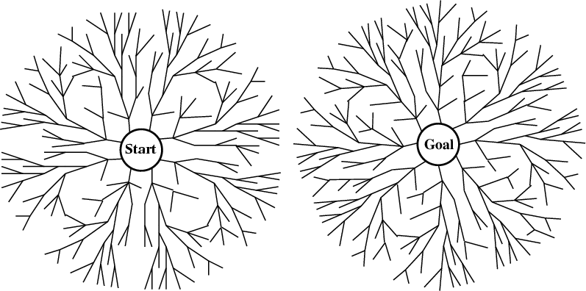
Bi-directional search
Alternate searching from the start state toward the goal and from the goal state toward the start.
Stop when the frontiers intersect.
Works well only when there are unique start and goal states.
Requires the ability to generate “predecessor” states.
Can (sometimes) lead to finding a solution more quickly.
Time complexity: O(b^{d/2}). Space complexity: O(b^{d/2}).

Slide 43
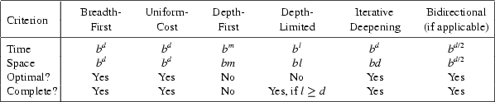
Comparing Search Strategies
b – branching factor d – depth of optimal solution
m – maximum depth l – depth limit

Slide 44
Avoiding Repeated States
In increasing order of effectiveness in reducing size of state space and with increasing computational costs:
  1. Do not return to the state you just came from.
  2. Do not create paths with cycles in them.
  3. Do not generate any state that was ever created before.
Net effect depends on frequency of “loops” in state space.

Slide 45
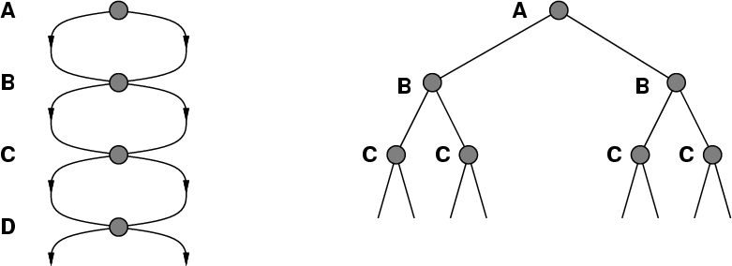
A State Space that Generates an
Exponentially Growing Search Space

Slide 46
Graph Search
function graph-search (problem, QUEUEING-FUNCTION)
;; problem describes the start state, operators, goal test, and operator costs
;; queueing-function is a comparator function that ranks two states
;; graph-search returns either a goal node or failure
nodes = MAKE-QUEUE(MAKE-NODE(problem.INITIAL-STATE))
closed = {}
loop
if EMPTY(nodes) then return "failure"
node = REMOVE-FRONT(nodes)
if problem.GOAL-TEST(node.STATE) succeeds
then return node.SOLUTION
if node.STATE is not in closed
then ADD(node, closed)
nodes = QUEUEING-FUNCTION(nodes,
EXPAND(node, problem.OPERATORS))
end
;; Note: The goal test is NOT done when nodes are generated
;; Note: closed should be implemented as a hash table for efficiency

Slide 47
Graph Search Strategies
Breadth-first search and uniform-cost search are optimal graph search strategies.
Iterative deepening search and depth-first search can follow a non-optimal path to the goal.
Iterative deepening search can be used with modification:
  It must check whether a new path to a node is better than the original one
  If so, IDS must revise the depths and path costs of the node’s descendants.

Slide 48
Informed Search Methods

Slide 49
Informed Search
Blind search methods take O(b^{m}) in the worst case
May make blind search algorithms prohibitively slow where d is large
How can we reduce the running time?
  Use problem-specific knowledge to pick which states are better candidates

Slide 50
Informed Search
Also called heuristic search
In a heuristic search each state is assigned a “heuristic value” (h-value) that the search uses in selecting the “best” next step
A heuristic is an operationally-effective nugget of information on how to direct search in a problem space
Heuristics are only approximately correct

Slide 51
Informed Search: Prominent methods
Best-First Search
A*
Backtracking
Hill Climbing
AO*

Slide 52
Cost and Cost Estimation
  f(n)=g(n)+h(n)
g(n) the cost (so far) to reach the node n
h(n) estimated cost to get from the node to the goal
f(n) estimated total cost of path through n to goal

Slide 53
Informed Search: Best-First Search
Special case of breadth-first search
Uses h(n) = heuristic function as its evaluation function
Ignores cost so far to get to that node (g(n))
Expand the node that appears closest to goal
Best First Search is complete
Best First Search is not optimal
  A solution can be found in a longer path (higher h(n) with a lower g(n) value)
Special cases:
  uniform cost search: f(n) = g(n) = path to n
  A* search
58

Slide 54
Best-First Search: Algorithm
List open, closed, successors={};
Node root_node, current_node;
insert-last(root_node,open)
while not-empty(open);
current_node=remove-first (open);
insert-last(current_node,closed);
if (goal(current_node)) return current_node;
else
successors=estimationOrderedSuccessorsOf(current_node);
for(x in successors)
if(not-in(x,closed)) insert-last(x,open);
endIf
endWhile
returns the list of direct descendants of the current node in shortest cost order
N.B.= this version is not saving the path for simplicity
59
Notes:
1 initialize the list (open for not closed nodes, closed for closed nodes)
2 insert in the open list the root node
3 while the open list is not empty
a. remove from the front of the list the first node
b. insert the current node in the back of the closed list
c. if the node is the goal state, return it
d. otherwise
i. Create the list of successors in shortest estimation order for the current node (local cost estimation! Not total!)
ii. Add all the successors not already visited in back of the open list
remove-front corresponds to pop
insert-back, instead of putting the element at the beginning of the list (push), put it at the end
not-empty checks if the list is empty
estimationOrderedSuccessorsOf returns the list of direct descendants of the current node in shortest cost order
not-in checks if a node is not in a list
59

Slide 55
Best-First Search: Example
S
1
h=1
h=1
A
2
B
h=2
h=2
h=2
h=2
3
h=2
h=2
h=2
S
B
F
F
A
C
D
open = {S}, closed={}
0. Visit S: open = {A,B}, closed={S}
Visit A: open={B,F,B,S}, closed={S,A}
Visit B: open={F,B,S,F,A,C,D}, closed={S,A,B}
Visit F: Goal Found!
S
A
F
D
In this case we estimate the cost as the distance from the root node (in term of nodes)
60
Notes:
60

Slide 56
Best-First Search: Example
S
h=1, w=2
h=1, w=1
A
B
h=2, w=7
h=2, w=4
h=2
h=2
h=2
h=2
h=2
S
B
F
F
A
C
D
S
A
F
D
Result is: S->A->F!
If we consider real costs, optimal solution is:
S->B->F
61
Notes:
61

Slide 57
A* Algorithm
Derived from Best-First Search
Uses both g(n) and h(n)
A* is optimal
A* is complete

Slide 58
A* : Algorithm
returns the list of direct descendants of the current node in shortest total estimation order
List open, closed, successors={};
Node root_node, current_node, goal;
insert-back(root_node,open)
while not-empty(open);
current_node=remove-front(open);
insert-back(current_node,closed);
if (current_node==goal) return current_node;
else
successors=totalEstOrderedSuccessorsOf(current_node);
for(x in successors)
if(not-in(x,closed)) insert-back(x,open);
endIf
endWhile
N.B.= this version is not saving the path for simplicity
63
Notes:
1 initialize the list (open for not closed nodes, closed for closed nodes)
2 insert in the open list the root node
3 while the open list is not empty
a. remove from the front of the list the first node
b. insert the current node in the back of the closed list
c. if the node is the goal state, return it
d. otherwise
i. Create the list of successors in shortest estimation order for the current node (Total cost estimation! Not local!)
ii. Add all the successors not already visited in back of the open list
remove-front corresponds to pop
insert-back, instead of putting the element at the beginning of the list (push), put it at the end
not-empty checks if the list is empty
totalEstimationOrderedSuccessorsOf returns the list of direct descendants of the current node in shortest total estimation order
not-in checks if a node is not in a list
63

Slide 59
A* : Example
S
1
h=1, w=2, g=2
h=1, w=1, g=1
A
2
B
h=2,
w=2,
g=4
h=2, w=7, g=9
h=2, w=4, g=5
h=2,
w=1
g=3
3
h=2
w=3
g=4
h=2, w=4, g=5
S
B
F
F
A
C
h=2,
w=1
g=2
D
5
4
open = {S}, closed={}
0. Visit S: open = {B,A}, closed={S}
Visit B: open={A,C,A,F,D}, closed={S,B}
Visit A: open={C,A,F,D,B,S,F}, closed={S,B,A}
Visit C: open={A,F,D,B,S,F}, closed={S,B,A,C}
Visit A: open={F,D,B,S,F}, closed={S,B,A,C,A}
Visit F: Goal Found!
S
A
F
D
In this case we estimate the cost as the distance from the root node (in term of nodes)
64
Notes:
64

Slide 60
A* : Example
S
h=1, w=2, g=2
h=1, w=1, g=1
A
B
h=2,
w=2,
g=4
h=2, w=7, g=9
h=2, w=4, g=5
h=2,
w=1
g=3
h=2
w=3
g=4
h=2, w=4, g=5
S
B
F
F
A
C
h=2,
w=1
g=2
D
S
A
F
D
Result is: S->B->F!
65
Notes:
65

Slide 61
Hill Climbing
Special case of depth-first search
Uses h(n) = heuristic function as its evaluation function
Ignores cost so far to get to that node (g(n))
Expand the node that appears closest to goal
Hill Climbing is not complete
  Unless we introduce backtracking
Hill Climbing is not optimal
  Solution found is a local optimum

Slide 62
Hill Climbing: Algorithm
List successors={}; Node root_node, current_node, nextNode;
current_node=root_node
while (current_node!=null)
if (goal(current_node)) return current_node;
else
successors=successorsOf(current_node);
nextEval = -∞; nextNode=null;
for(x in successors)
if(eval(x)> nextEval)
nexEval=eval(x);
nextNode=x;
current_node=nextNode,
endIf
endWhile
N.B.= this version is not using backtracking
67
Notes:
1 set current node as root node
2 while a solution is not found or reach dead end
a. if the node is the goal state, return it
b. otherwise
i. Create the list of successors for the current node
ii. Find the nearest successor and use it as next node
67

Slide 63
Hill Climbing: Example
S
1
h=1
h=1
A
B
h=2
h=2
h=3
2
h=2
h=2
h=2
h=2
S
B
F
F
A
C
D
h=1
0. current_node=S, successors (A=1,B=1)
current_node=A, successors (B=2,F=2,S=2)
current_node=B, successors (F=1,….)
current_node=F: Goal Found!
3
S
A
F
D
In this case we estimate the cost as the distance from the root node (in term of nodes)
68
Notes:
68

Slide 64
Hill Climbing: Example
S
h=1
h=1
A
B
h=2
h=2
h=3
h=2
h=2
h=2
h=2
S
B
F
F
A
C
D
h=1
S
A
F
D
Result is: S->A->B->F!
Not optimal, more if at step 1 h(S)=2 we would have completed without funding a solution
69
Notes:
69

Slide 65
AO* Search: (And-Or) Graph
The Depth first search and Breadth first search given earlier for OR trees or graphs can be easily adopted by AND-OR graph.
The main difference lies in the way termination conditions are determined, since all goals following an AND nodes must be realized; where as a single goal node following an OR node will do. So for this purpose we are using AO* algorithm.
Like A* algorithm here we will use two arrays and one heuristic function.
OPEN:
It contains the nodes that has been traversed but yet not been marked solvable or unsolvable.
CLOSE:
It contains the nodes that have already been processed.
FUNCTION :The distance from current node to goal node.

Slide 66
AO* Search Algorithm
Step 1: Place the starting node into OPEN.
Step 2: Compute the most promising solution tree say T0.
Step 3: Select a node n that is both on OPEN and a member of T0. Remove it from OPEN and place it in CLOSE
Step 4: If n is the terminal goal node then leveled n as solved and leveled all the ancestors of n as solved. If the starting node is marked as solved then success and exit.
Step 5: If n is not a solvable node, then mark n as unsolvable. If starting node is marked as unsolvable, then return failure and exit.
Step 6: Expand n. Find all its successors and find their h (n) value, push them into OPEN.
Step 7: Return to Step 2.
Step 8: Exit.

Slide 67
Informed Search Algorithm Comparison
Algorithm | Time | Space | Optimal | Complete | Derivative
Best First Search | O(bm) | O(bm) | No | Yes | BFS
Hill Climbing | O(∞) | O(b) | No | No
A* | O(2^{N}) | O(b^{d}) | Yes | Yes | Best First Search
b, branching factor
d, tree depth of the solution
m, maximum tree depth
72

Slide 68
Thank you

Slide 69
Any Questions?

