Slide 1
Artificial Intelligence
Knowledge Representation: Logic
By
Prof. Brahmanaidu Kakarla

Slide 2
SSWT ZC444 – Artificial Intelligence
Lecture No. : 5

Slide 3


Slide 4
It is important to know that just login to the session does not guarantee the attendance.
Once you join the session, continue till the end to consider you as present in the class.
IMPORTANTLY, you need to make the class more interactive by responding to Professors queries in the session.
Whenever Professor calls your number / name ,you need to respond, otherwise it will be considered as ABSENT

Slide 5
Agenda
Reducing first-order inference to propositional inference
Unification
Generalized Modus Ponens
Forward chaining
Backward chaining
Resolution

Slide 6
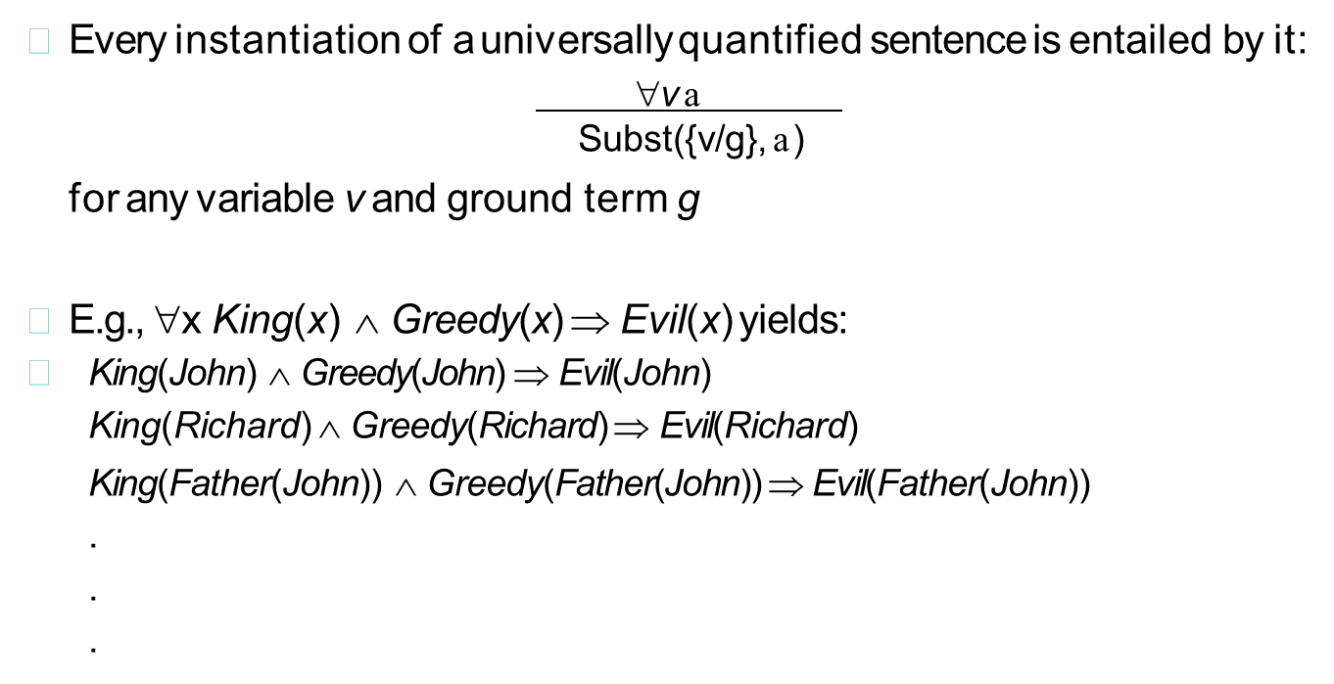
Reducing first-order inference to propositional inference
Universal instantiation (UI)

Slide 7
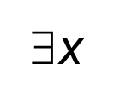
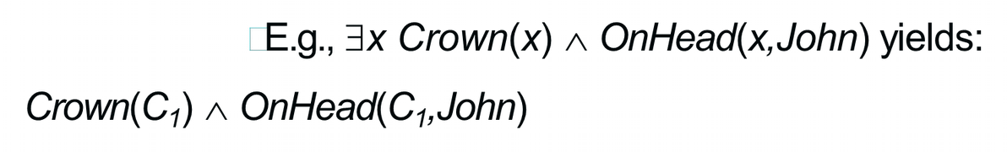
Reducing first-order inference to propositional inference
Existential instantiation (EI)
For any sentence a, variable v, and constant symbol k that does not appear elsewhere in the knowledge base:
Subst({v/k}, a)
provided C1 is a new constant symbol, called a Skolem Constant

Slide 8



Reduction to propositional inference
Suppose the KB covers just the following:
King(John) Greedy(John) Brother(Richard, John)
Instantiating the universal sentence in all possible ways, we have:
King(John) Greedy(John) Brother(Richard,John)
The new KB is propositionalized: proposition symbols are: King(John), Greedy(John), Evil(John), King(Richard), etc.

Slide 9
Reduction to propositional inference
Every FOL KB can be propositionalized so as to preserve entailment. (A ground sentence is entailed by new KB iff entailed by original KB).
Idea: propositionalize KB and query, apply resolution, return result Problem: with function symbols, there are infinitely many ground terms, Example: Father(Father(Father(John)))

Slide 10
Reduction to propositional inference
Theorem: Herbrand (1930). If a sentence 'a' is entailed by an FOL KB, it is entailed by a finite subset of the propositionalized KB
Idea: For n = 0 to ∞ do
create a propositional KB by instantiating with depth-$n$ terms see if 'a' is entailed by this KB
Problem: works if 'a' is entailed, loops if 'a' is not entailed
Theorem: Turing (1936), Church (1936) Entailment for FOL is semi-decidable (algorithms exist that say yes to every entailed sentence, but no algorithm exists that also says no to every nonentailed sentence.)

Slide 11
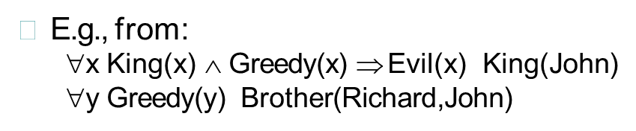
Reduction to propositional inference
Propositionalization seems to generate lots of irrelevant sentences.
It seems obvious that Evil(John), but propositionalizing produces lots of facts such as Greedy(Richard) that are irrelevant.
With p k-ary predicates and n constants, there are p.nk instantiations.

Slide 12
Unification
We can get the inference immediately if we can find a substitution θ such that King(x) and Greedy(x) match King(John) and Greedy(y)
  θ = {x/John,y/John} works
Unify(a,þ) = θ if a θ = þ θ
P | Q | θ
Knows(John,x) | Knows(John,Jane)
Knows(John,x) | Knows(y,OJ)
Knows(John,x) | Knows(y,Mother(y))
Knows(John,x) | Knows(x,OJ)

Slide 13
Unification
We can get the inference immediately if we can find a substitution θ such that King(x) and Greedy(x) match King(John) and Greedy(y)
  θ = {x/John,y/John} works
Unify(a,þ) = θ if aθ = þθ
P | Q | θ
Knows(John,x) | Knows(John,Jane) | {x/Jane}}
Knows(John,x) | Knows(y,OJ)
Knows(John,x) | Knows(y,Mother(y))
Knows(John,x) | Knows(x,OJ)
➢
Standardizing apart eliminates overlap of variables, e.g., Knows(z,OJ)

Slide 14
Unification
We can get the inference immediately if we can find a substitution θ such that King(x) and Greedy(x) match King(John) and Greedy(y)
  θ = {x/John,y/John} works
Unify(a,þ) = θ if aθ = þθ
P | Q | θ
Knows(John,x) | Knows(John,Jane) | {x/Jane}}
Knows(John,x) | Knows(y,OJ) | {x/OJ,y/John}}
Knows(John,x) | Knows(y,Mother(y))
Knows(John,x) | Knows(x,OJ)
➢
Standardizing apart eliminates overlap of variables, e.g., Knows(z,OJ)

Slide 15
Unification
We can get the inference immediately if we can find a substitution θ such that King(x) and Greedy(x) match King(John) and Greedy(y)
  θ = {x/John,y/John} works
Unify(a,þ) = θ if aθ = þθ
P | Q | θ
Knows(John,x) Knows(John,x) Knows(John,x) Knows(John,x) | Knows(John,Jane) Knows(y,OJ) Knows(y,Mother(y)) Knows(x,OJ) | {x/Jane}} {x/OJ,y/John}} {y/John,x/Mother(John)}}
➢
Standardizing apart eliminates overlap of variables, e.g., Knows(z17,OJ)

Slide 16
Unification
We can get the inference immediately if we can find a substitution θ such that King(x) and Greedy(x) match King(John) and Greedy(y)
  θ = {x/John,y/John} works
Unify(a,þ) = θ if aθ = þθ
P | Q | θ
Knows(John,x) Knows(John,x) Knows(John,x) Knows(John,x) | Knows(John,Jane) Knows(y,OJ) Knows(y,Mother(y)) Knows(x,OJ) | {x/Jane}} {x/OJ,y/John}} {y/John,x/Mother(John)}} {fail}

Slide 17
Unification
To unify Knows(John,x) and Knows(y,z),
θ = {y/John, x/z } or θ = {y/John, x/John, z/John}
The first unifier is more general than the second.
There is a single most general unifier (MGU) that is unique up to renaming of variables.
MGU = { y/John, x/z }

Slide 18
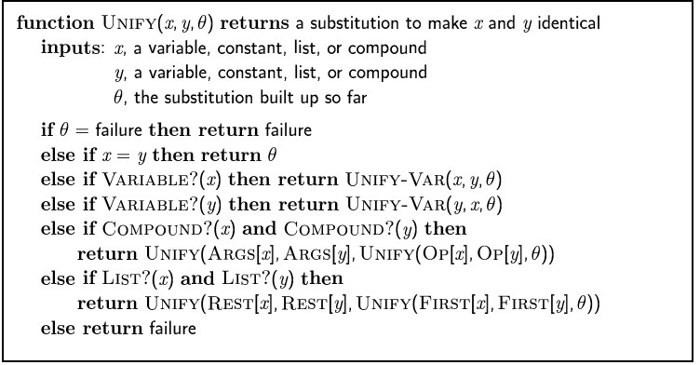
The Unification Algorithm

Slide 19
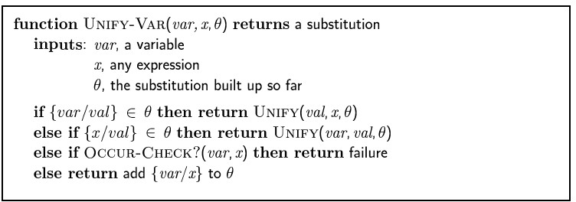
The Unification Algorithm

Slide 20
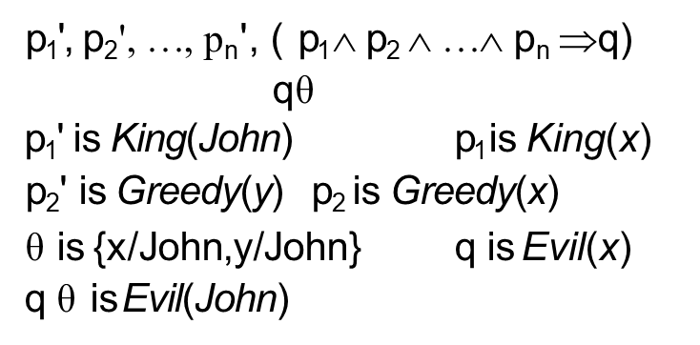

Generalized Modus Ponens (GMP)
GMP used with KB of definite clauses (exactly one positive literal) All variables assumed universally quantified

Slide 21
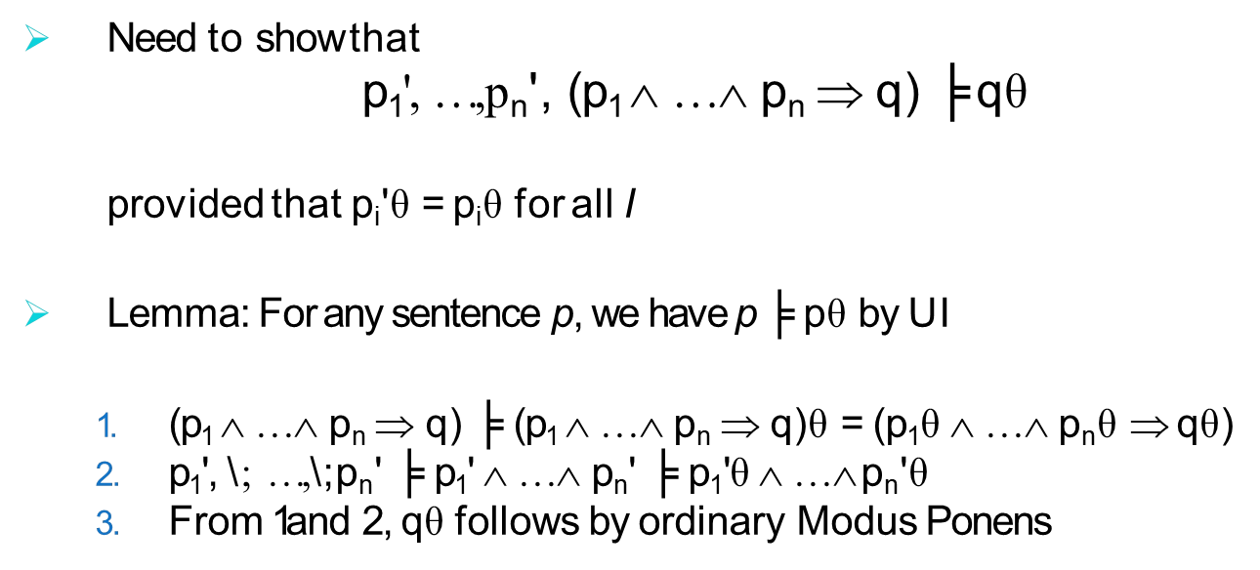
Generalized Modus Ponens (GMP)

Slide 22
Example Knowledge Base
The law says that it is a crime for an American to sell weapons to hostile nations. The country Nono, an enemy of America, has some missiles, and all of its missiles were sold to it by Colonel West, who is American.
Prove that Col. West is a criminal

Slide 23
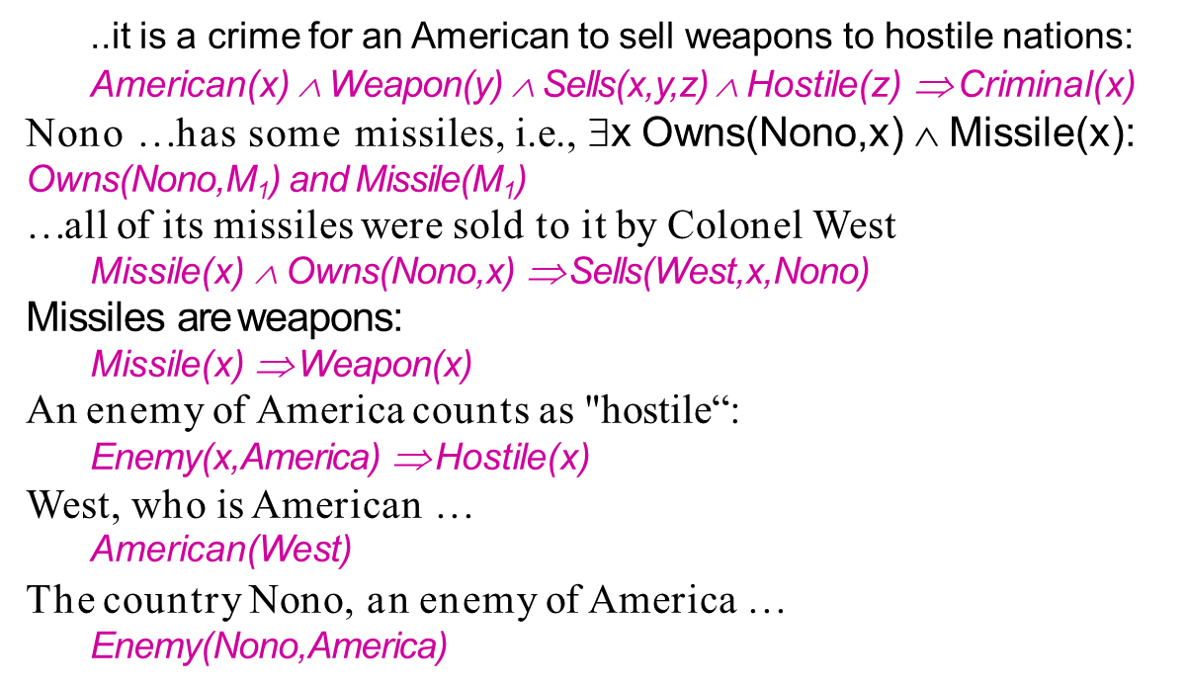
Example Knowledge Base

Slide 24
Forward Chaining Algorithm
Algorithm:
  Start from the facts
  Trigger all rules whose premises are satisfied
  Add the conclusion to known facts
  Repeat the steps till no new facts are added or the query is answered

Slide 25
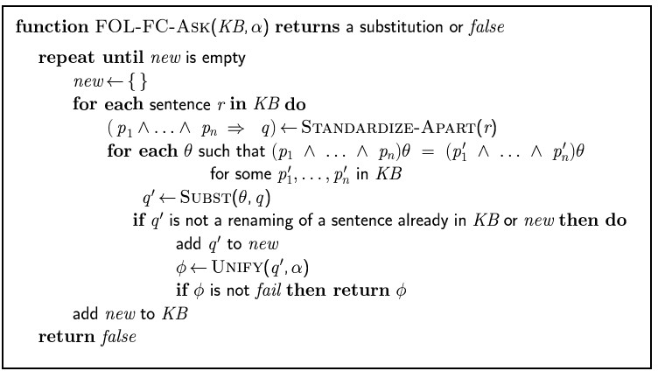
Forward Chaining Algorithm

Slide 26
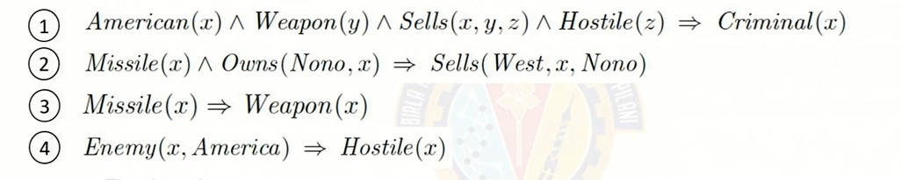
Forward Chaining Proof
Missile(M1) Owns(Nono, M1) American (West) Enemy (Nono, America)

Slide 27
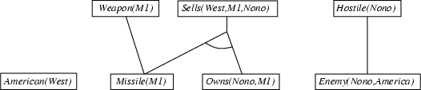
Forward Chaining Proof
Missile(M1) Owns(Nono, M1) American (West) Enemy (Nono, America)

Slide 28

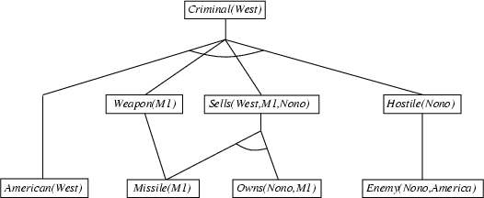
Forward Chaining Proof
Missile(M1) Owns(Nono, M1) American (West) Enemy (Nono, America)

Slide 29
Properties of Forward Chaining
Sound and complete for first-order definite clauses
Datalog = first-order definite clauses + no functions FC terminates for Datalog in finite number of iterations
May not terminate in general if 'a' is not entailed
This is unavoidable: entailment with definite clauses is semi-decidable

Slide 30
Efficiency of Forward Chaining
Incremental forward chaining: no need to match a rule on iteration k if a premise wasn't added on iteration k-1
Match each rule whose premise contains a newly added positive literal
Matching itself can be expensive:
Database indexing allows O(1) retrieval of known facts e.g., query Missile(x) retrieves Missile(M1)
Forward chaining is widely used in deductive databases

Slide 31
Backward Chaining Algorithm
Algorithm:
Form Definite Clause
Start from the Goals
Search through rules to find the fact that support the proof
If it stops in the fact which is to be proved → Empty Set- LHS
Divide & Conquer Strategy Substitution by Unification

Slide 32
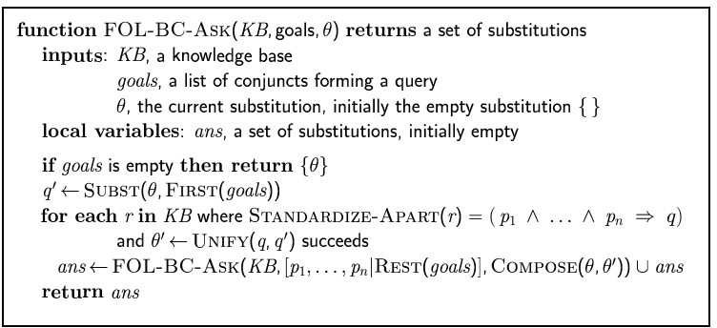
Backward Chaining Algorithm
SUBST(COMPOSE(θ1, θ2), p) = SUBST(θ2, SUBST(θ1, p))

Slide 33
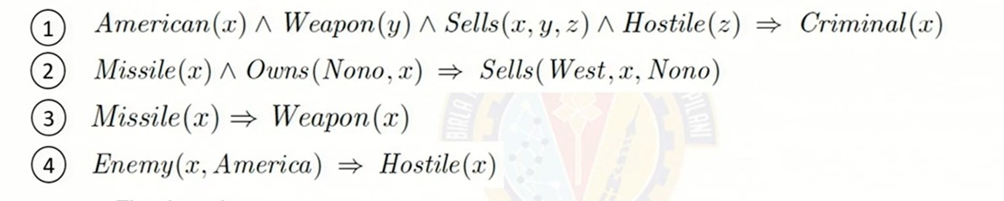
Backward Chaining Algorithm
Missile(M1) Owns(Nono, M1) American (West) Enemy (Nono, America)

Slide 34
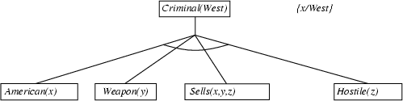
Backward Chaining Algorithm
Missile(M1)
Owns(Nono, M1) American (West)
Enemy (Nono, America)

Slide 35
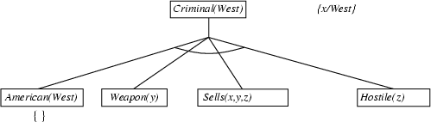
Backward Chaining Algorithm

Slide 36
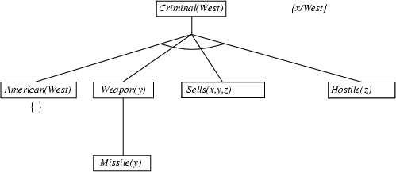
Backward Chaining Algorithm

Slide 37
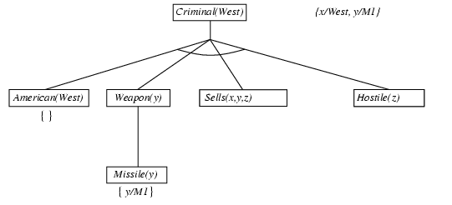
Backward Chaining Algorithm

Slide 38
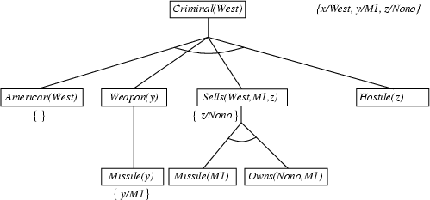
Backward Chaining Algorithm

Slide 39
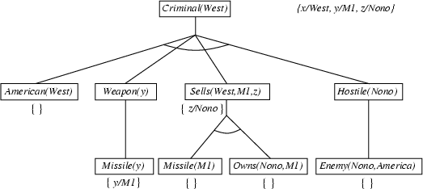
Backward Chaining Algorithm

Slide 40
Properties of Backward Chaining
Depth-first recursive proof search: space is linear in size of proof
Incomplete due to infinite loops
  fix by checking current goal against every goal on stack
Inefficient due to repeated sub goals (both success and failure)
  fix using caching of previous results (extra space)
Widely used for logic programming

Slide 41
Exercise:
All courses offered are interesting
Students like easy to score courses
Data Mining is a Compute Science course
Some of the easy courses are interesting
All Math are interesting course
Statistics is a math course
All computer science course are easy
Apply chaining for below :
Q1: Do students like statistics?
Q2: What course does students like?
O(Z) →I(Z)
E(A) → L(s, A)
C(dm, cs)
E(B) → I(B)
C(E,math) → I(E)
C(stat, math)
C(D,cs) → E(D)
BITS Pilani, Pilani Campus

Slide 42
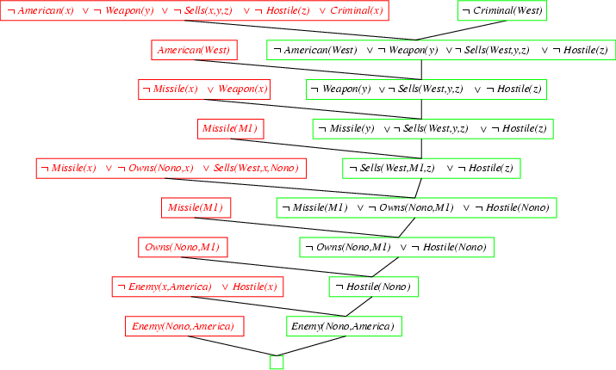
Resolution proof: definite clauses

Slide 43
Thank you
Any Questions?

Slide 44


