Slide 1
Random Walker Implemented on Twitter Dataset (Reduced)
Ganne Manoj Kumar
Sri Sai Charan Yarramsetty

Slide 2
Problem:
Have to implemented random walker algorithm In twitter dataset.
Process the Huge twitter data into Vector form and create a Grid to apply Random walker algorithm.
Have to add user selectable walker_path_length to increase the efficiency of algorithm and walker_break_point to stop graph walker.
Find the total number of visited Nodes and Edges.

Slide 3
Implementation:
We have to Implemented the Random_walker algorithm on Twitter data and its too huge to compile and process so we reduced and procced it with 6000*6000 matrix size.
std::vector<std::vector<int> > grid(6000, std::vector<int>(6000));
Graph walker will use Radom choices between 0-3 to decide the next move.
0 – Down
1 – Right
2 – Up
3 – Left

Slide 4
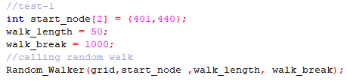
Implementation:
We have Implemented the Random_walker algorithm function in such a way that it will take below as inputs to find the number of visited nodes and edges.
Start Node
Walk Length
Break Point Length

Slide 5
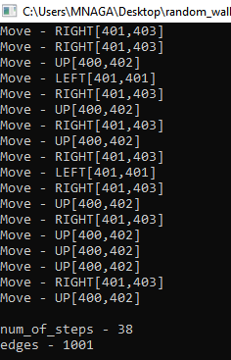
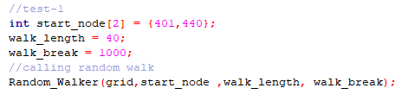
Results:
Input Test data -1

Slide 6
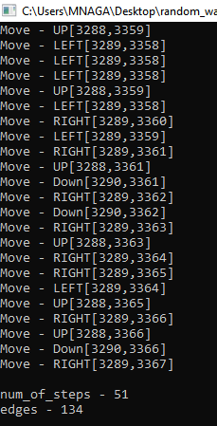
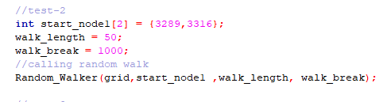
Results:
Input Test data -2

Slide 7
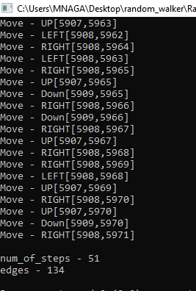
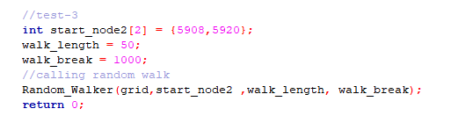
Results:
Input Test data -3

Slide 8
Conclusion:
Here we successfully implemented and tested the Graph walker on Twitter dataset(reduced).
And used rand() to decide the Up,Down,Right and Left moves. Have also executed testcases with different inputs to test the Algorithm performance.

Slide 9
Thank you

