Slide 1

IBM University Engagement Project Submission
“Exploring the Power of Agentic AI with IBM Granite and LangFlow”

Slide 2

Project Tile – Fitness Buddy
Domain of Project – Healthcare / Fitness & Wellness
Student Name | Recent Passport Photo | Email ID | Mobile number [WhatsApp]
manojgowdaa17@gmail.com
Manoj M D
9945584076

Slide 3
Problem Statement - Fitness Buddy
The Challenge
In today's fast-paced world, many individuals struggle to maintain a healthy lifestyle due to lack of personalized guidance, time constraints, and inconsistent motivation. Traditional fitness solutions often require expensive subscriptions, in-person consultations, or rigid schedules that don't adapt to personal preferences or daily routines.
There is a growing need for an accessible, friendly, and intelligent virtual assistant that can provide on-demand fitness advice, healthy lifestyle suggestions, and basic nutrition guidance — all tailored to individual needs and available at any time.
The Objective
Fitness Buddy aims to solve this problem by offering a conversational, AI-powered health and fitness coach that can:
  Recommend home workouts and routines based on user input
  Provide motivational tips and daily fitness inspiration
  Suggest simple, nutritious meal ideas
  Encourage habit-building and consistency
Technology Requirements
  Use of IBM Cloud Lite services is mandatory
  Use of IBM Granite (via IBM watsonx.ai) is mandatory

Slide 4
Proposed Solution
The proposed solution is a full-stack conversational AI application built using Node.js (Express), IBM Granite (ibm/granite-4-h-small) via IBM watsonx.ai, and a responsive single-page frontend. The system addresses challenges in personalized fitness guidance, workout tracking, nutrition planning, and motivation through an intelligent, modular architecture.
At its core, the solution uses IBM Granite's Chat Completions API (/ml/v1/text/chat) to deliver real-time, context-aware fitness coaching. An intent detection module classifies every user message into one of five categories — workout, nutrition, motivation, habit, or general — and dynamically adjusts the system prompt, enabling the model to act like a specialized coaching agent for each domain.
The system consists of five key components:
1. AI Chat Engine — Powered by IBM Granite (ibm/granite-4-h-small), it maintains a 6-turn conversation history per session and delivers personalized responses for workout routines, meal ideas, habit strategies, and daily motivation.
2. Workout Plans Module — 5 expert-curated plans (Beginner Full Body, Fat Loss HIIT, Home Muscle Builder, Yoga & Flexibility, 30-Day Cardio) with 14 sessions and 54 exercises, each including sets, reps, rest periods, and coaching tips.
3. Exercise Logging & Progress Tracker — Users log sets/reps per exercise, mark sessions complete, and view a real-time progress dashboard with stats (active plans, sessions done, total logs, and per-plan progress bars).
4. Authentication System — Optional login/signup with in-memory token sessions. The app is fully accessible without an account — guest progress is tracked automatically by session.
5. Responsive Frontend — A single-page application with sidebar navigation, category tab strip (7 categories), AI chat window with markdown rendering, login/signup modals, and full mobile support.
The solution is deployed live on Render.com over HTTPS, accessible from any phone, tablet, or desktop at all times. IBM Cloud IAM tokens are cached and auto-refreshed, ensuring seamless, uninterrupted access to IBM watsonx.ai.
Overall, this solution delivers an end-to-end intelligent fitness assistant that promotes healthier lifestyles through personalized AI coaching, structured workout programmes, real-time progress tracking, and motivational guidance — all at zero cost using IBM Cloud Lite.

Slide 5
Technology Used
  1. IBM Granite Model — ibm/granite-4-h-small Used via IBM watsonx.ai for natural language understanding, reasoning, and personalization. Powers all AI responses — workout plans, meal ideas, motivation, and habit advice.
  2. IBM watsonx.ai (IBM Cloud Lite) For model deployment and AI inference. Provides secure, scalable cloud infrastructure. IAM token-based authentication with auto-refresh every ~55 minutes.
  3. IBM Cloud IAM For API key-based authentication. Generates Bearer tokens to securely access IBM watsonx.ai endpoints (iam.cloud.ibm.com/identity/token).
  4. Node.js + Express.js Backend REST API server. Handles AI chat, user auth, workout plans, exercise logging, and progress tracking with rate limiting and CORS support.
  5. Render.com Free cloud hosting platform. Deployed directly from GitHub via render.yaml. Server binds to 0.0.0.0 for public HTTPS access from any device worldwide.
  6. Vanilla HTML / CSS / JavaScript Zero-dependency single-page frontend. Responsive UI with sidebar, chat window, login/signup modals, workout plans, and progress dashboard. Works on mobile and desktop.

Slide 6
Component Used
1. Chat Input The frontend textarea where users type their fitness queries — workout requests, meal questions, or motivational prompts. Supports multi-line input, auto-resize, Enter-to-send, and a character counter (max 1000 chars).
2. IBM watsonx.ai Agent (IBM Granite) The core AI processing component. Receives a structured messages array (system prompt + conversation history + user message) and returns a fitness-coached response using ibm/granite-4-h-small via the /ml/v1/text/chat API.
3. IBM Granite Model — ibm/granite-4-h-small Instruct-tuned Granite model on IBM Cloud Lite. Handles natural language understanding, workout generation, meal planning, motivational responses, and habit coaching in real time.
4. Intent Detection Module (fitnessPrompts.js) Classifies every user message into one of five categories — workout / nutrition / motivation / habit / general — and injects a targeted instruction into the system prompt, making each response more precise and domain-specific.
5. Chat Output The chat window that displays AI responses rendered with markdown support (bold, italic, bullet lists, headings). Each message shows a timestamp and avatar. Includes a typing indicator ("Thinking…") while the model generates a response.
6. Progress Tracking Component (routes/plans.js) Handles starting workout plans, logging exercise sets/reps, completing sessions, and fetching aggregated progress stats. Acts as the data layer between the UI and the in-memory progress store.

Slide 7
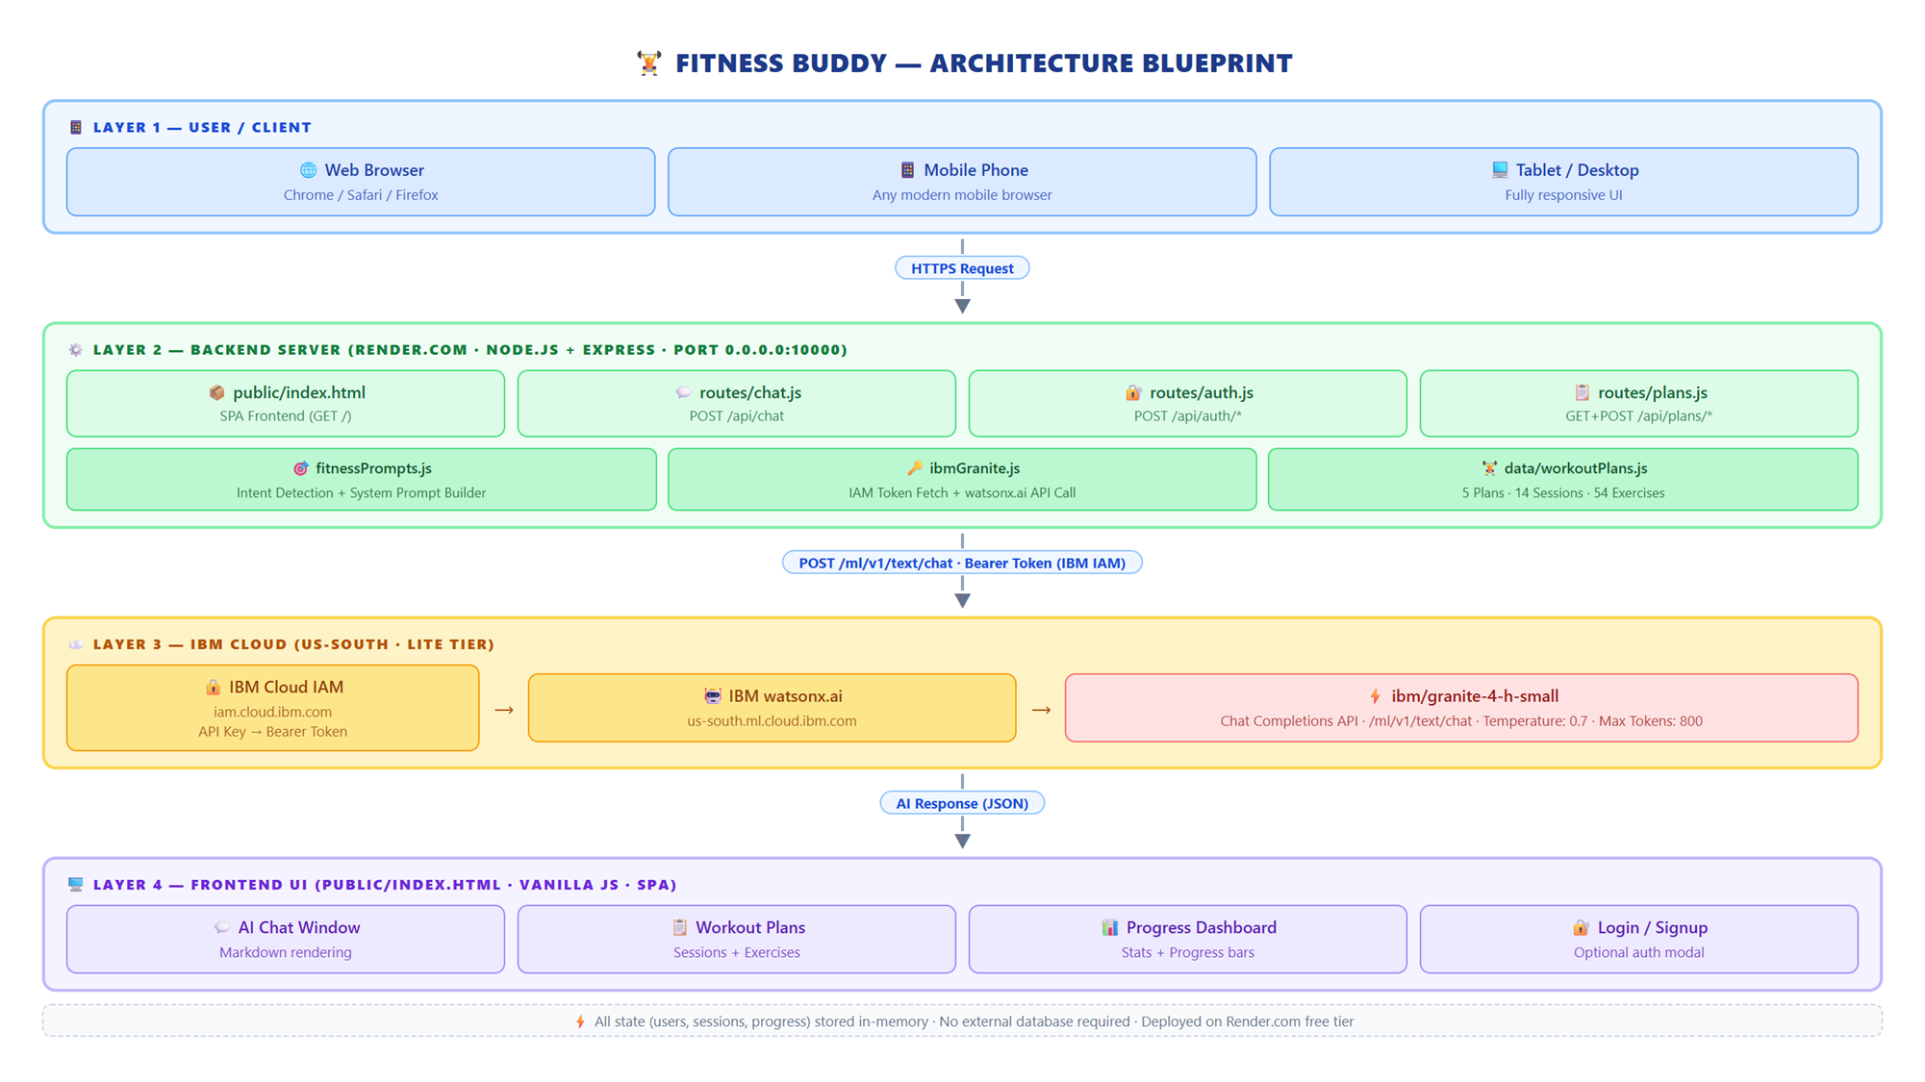
Architecture blueprint

Slide 8
Role of Agentic AI in the solution
Fitness Buddy uses IBM Granite (ibm/granite-4-h-small) via IBM watsonx.ai as an agentic AI model that acts as an intelligent, context-aware fitness coach — not just a generic question-answer chatbot.
1. Intent-Based Agent Routing Every user message is automatically classified into one of five fitness intents — workout, nutrition, motivation, habit, or general. The system prompt is dynamically adjusted with a targeted instruction for each intent, enabling IBM Granite to behave like a specialized sub-agent for each domain within a single model.
2. Conversational Memory & Context Awareness The last 6 conversation turns are included in every API call. This allows the model to understand follow-up questions, maintain topic continuity, and build on previous answers — simulating a real coaching session rather than isolated responses.
3. Persona-Driven Personalized Guidance The system prompt defines IBM Granite's role as "Fitness Buddy: a warm, knowledgeable, and motivating AI health and fitness coach." It delivers structured, actionable advice — sets, reps, meal macros, habit strategies — tailored to what the user actually asked.
4. Responsible AI & Safety Boundaries The system prompt instructs the model to avoid medical diagnoses, recommend professional consultation for injuries, and stay strictly within the fitness and wellness domain — acting as a responsible, bounded AI agent.
5. End-to-End Autonomous Reasoning For workout plans, meal ideas, and motivational content, IBM Granite reasons over the user's input and generates fully structured responses — numbered steps, bullet points, bold headings — that are immediately actionable without human editing.
Overall, IBM Granite acts as the intelligent reasoning core that makes Fitness Buddy proactive, personalized, and domain-specific — going beyond simple Q&A to deliver coached, goal-oriented fitness experiences at any time, from any device.

Slide 9
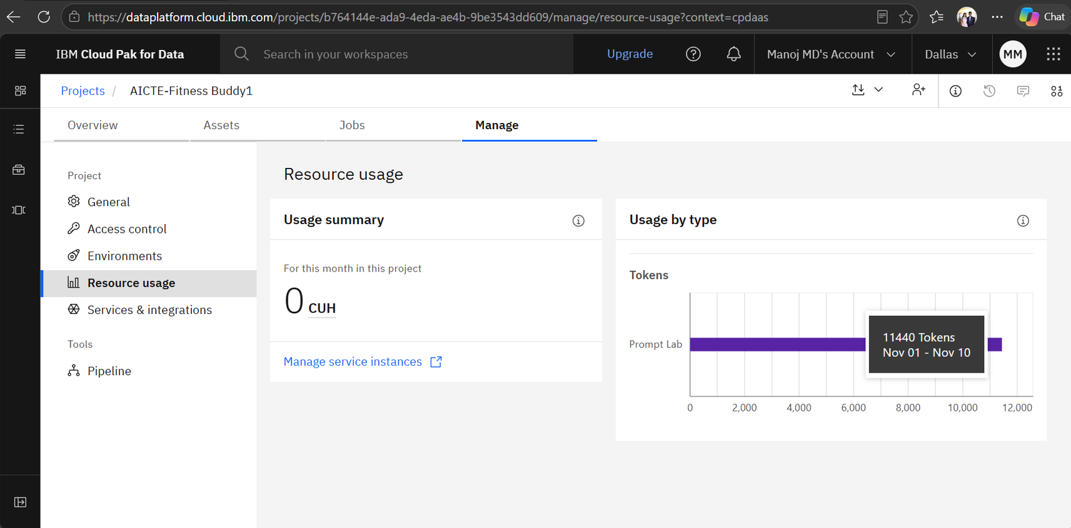
Token Usage
11,440 token are used
·
·
·

Slide 10
Novelty and Uniqueness
1. Intent-Aware Prompt Engineering Every message is auto-classified into 5 fitness intents. IBM Granite's system prompt adapts dynamically — acting like 5 specialized coaching agents in one model.
2. Fully No-Cost Stack Built entirely on IBM Cloud Lite + Render.com free hosting. Zero subscription fees. Accessible to anyone worldwide.
3. Structured Workout Catalogue 5 curated plans, 14 sessions, 54 exercises with sets, reps, rest periods and coaching tips — a real trackable fitness programme, not just AI chat.
4. Exercise Logging + Progress Dashboard Users log sets/reps, complete sessions, and view live progress bars per plan — bridging AI chat and structured workout tracking in one app.
5. Guest-Friendly Design Fully functional without an account. Guest progress is auto-tracked. Login enhances — never blocks — the experience.
6. Mobile-Ready & Always Online Deployed on Render.com over HTTPS. Works on any phone or browser worldwide at all times. No installation needed.
7. Conversational Memory Last 6 chat turns sent with every API call — enabling coherent multi-turn coaching, not just isolated Q&A.

Slide 11
Git Hub Link
https://github.com/manojgowdaa17/AICTE-Fitness-Buddy.git
·
·
·

Slide 12
Future Scope
1. Persistent Database Replace in-memory storage with MongoDB/PostgreSQL to save user data, workout logs and progress across sessions and devices.
2. Wearable Integration Connect with Google Fit, Apple Health or Fitbit to auto-log activity, calories burned and heart rate for smarter AI recommendations.
3. AI Meal Plan Generator Generate structured weekly meal plans based on BMI, caloric goals and dietary restrictions using IBM Granite's structured output.
4. Voice Input & Multilingual Support Add speech-to-text so users can interact hands-free during workouts. Support regional languages via IBM Watson Speech-to-Text.
5. Exercise Video Demos Embed short video demonstrations for each exercise to guide beginners with correct form and technique.
6. Social & Community Features Allow users to share milestones, compare progress with friends and join group fitness challenges.
7. IBM watsonx.ai Governance Integrate IBM OpenScale for AI fairness monitoring, bias detection and explainability on fitness recommendations.
·

Slide 13
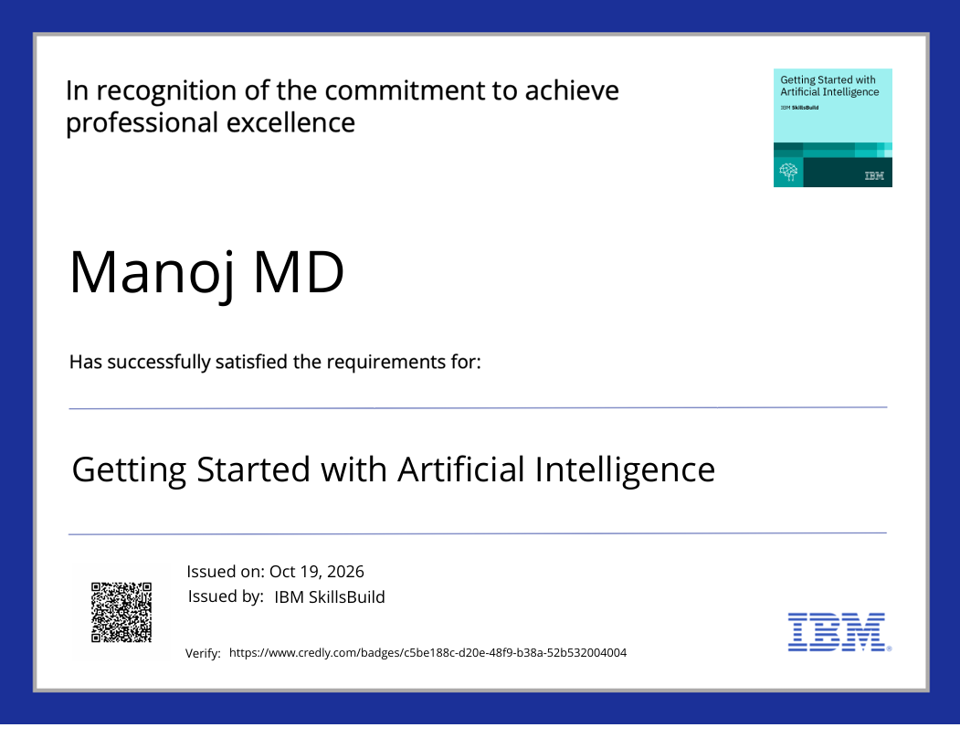
Certificates Earned:

Slide 14
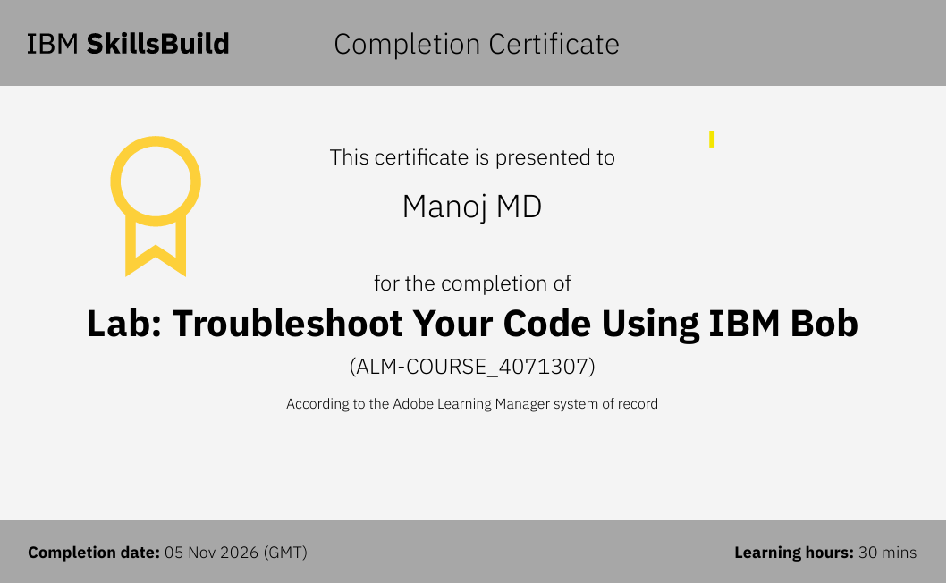
Certificates Earned:​

Slide 15
THANK YOU

