Slide 1
AI-CHATBOT USING PYTHON

Slide 2
Introduction:
Chatbots are computer programs that can simulate conversation with humans. They are often used in customer service applications, but they can also be used for other purposes, such as education, entertainment, and companionship.
This presentation will introduce a chatbot web app that is powered by the GPT-2 language model. The web app allows users to interact with the chatbot by typing in their questions and requests. The chatbot will then respond in a natural and informative way.

Slide 3
Features:
The chatbot web app has the following features:
It can answer a wide range of questions, including factual, open-ended, and challenging questions.
It can generate different creative text formats of text content, like poems, code, scripts, musical pieces, email, letters, etc.
It can translate languages.
It can be used in different ways, such as customer service, education, entertainment, and companionship.

Slide 4
Benefits:
The chatbot web app offers the following benefits:
It can provide users with 24/7 customer support.
It can help users to learn new things and to be more productive.
It can provide users with companionship and entertainment.

Slide 5
How to use?
To use the chatbot web app, simply type in your question or request in the text box and press the "Ask" button. The chatbot will then respond in a natural and informative way.

Slide 6
Demo:
The following is a demo of the chatbot web app:
User: What is the capital of France?
Chatbot: The capital of France is Paris.
User: Translate this sentence into Spanish: "I love you."
Chatbot: The Spanish translation of the sentence "I love you" is "Te amo."
User: Thank you!
Chatbot: You're welcome!

Slide 7
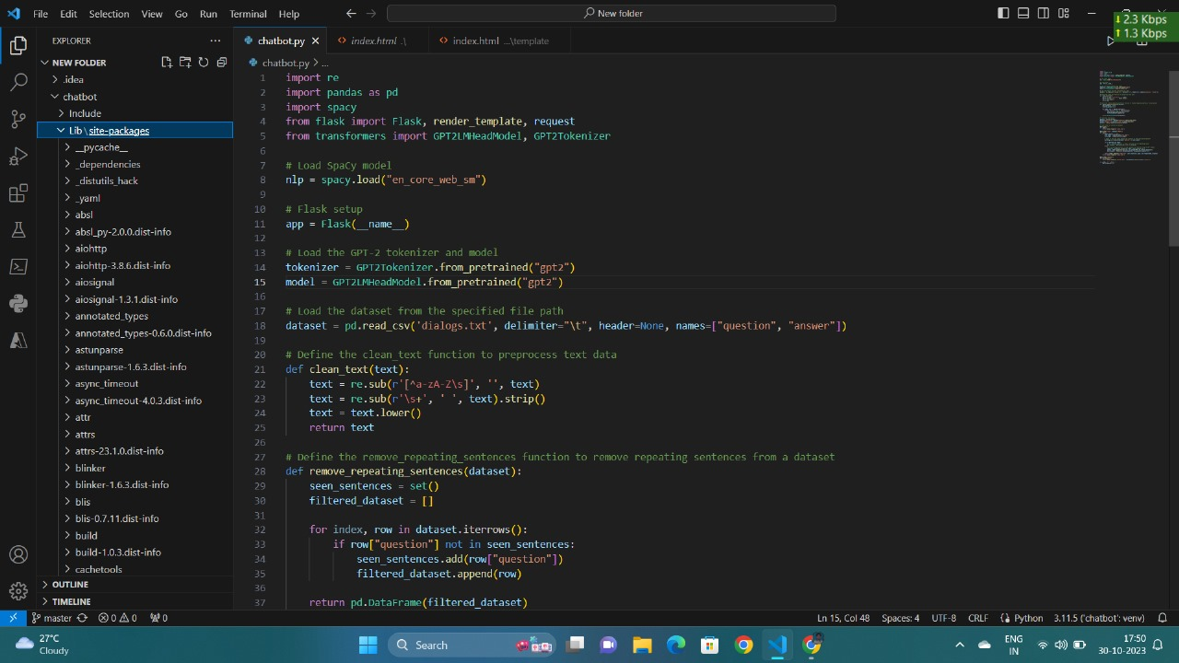
Coding:

Slide 8
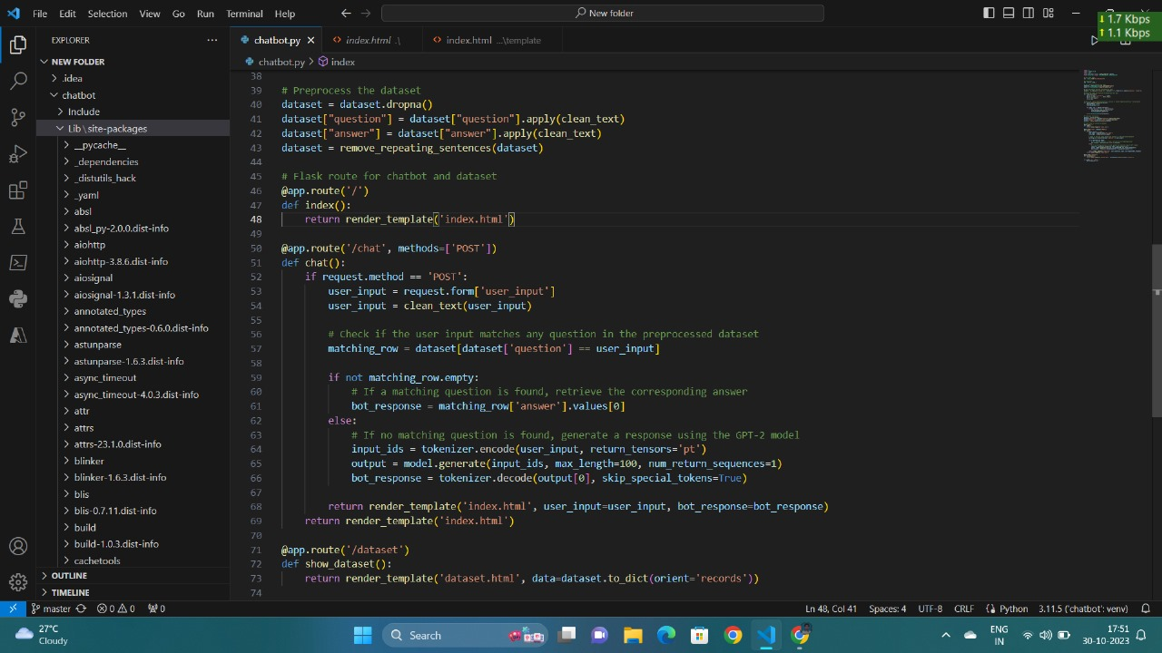

Slide 9
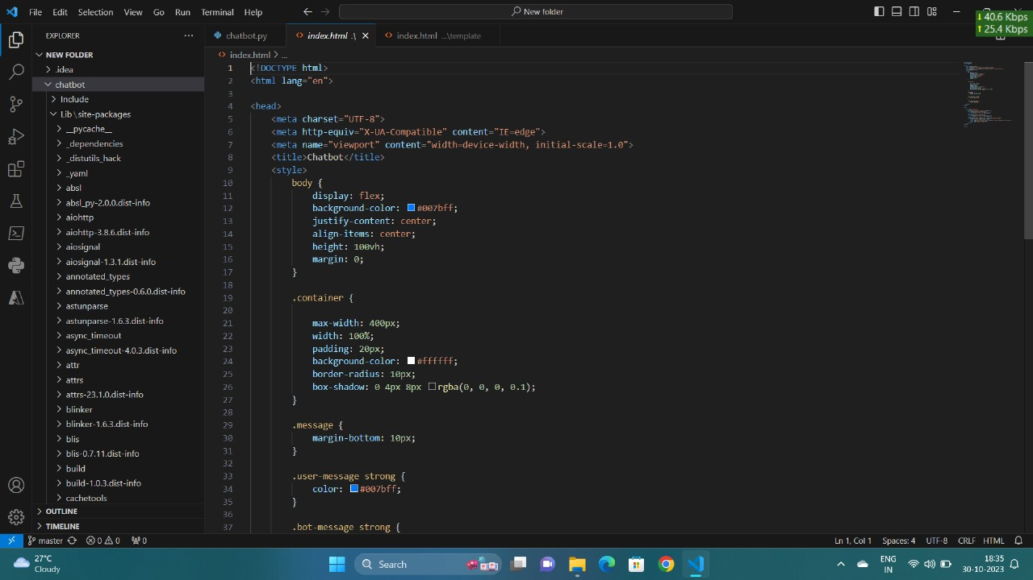

Slide 10
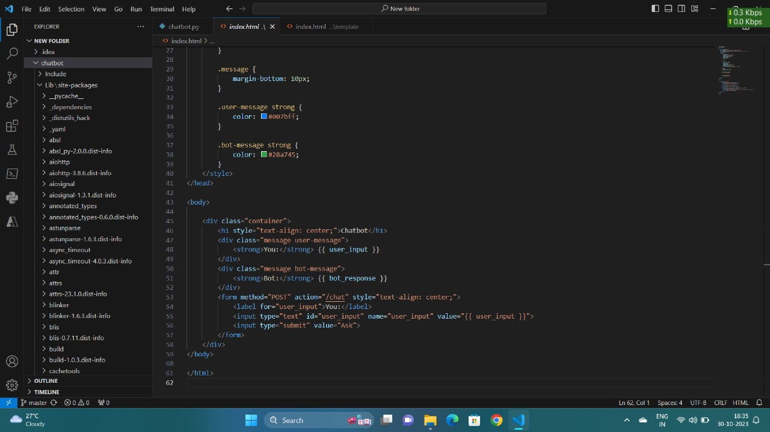

Slide 11
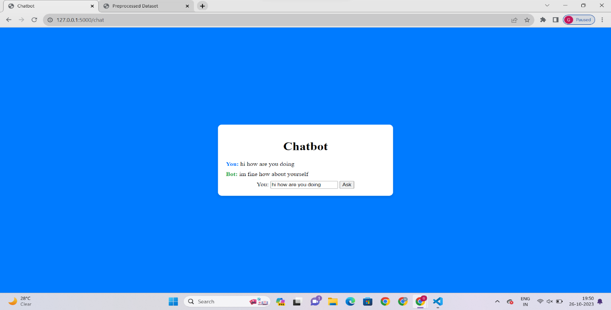
Output:

Slide 12
Conclusion:
The chatbot web app is a powerful and versatile tool that can be used for a variety of purposes. It is easy to use and offers a number of benefits, including 24/7 customer support, educational resources, and companionship.

