Slide 1
Scrum in the Real World

Slide 2
Scrum in the Real World
Starting Scrum Projects
Expressing Requirements with User Stories
Release Planning and Estimation
Release Tracking and Responding to Project Delays

Slide 3
Scrum Kickoff
ScrumMaster teaches Scrum to everyone and assign the Scrum roles
Product Owner communicates the vision and goals of the release
Product Owner leads the creation of the Product Backlog (with lots of input)
Team does the High-level size estimation of the Product Backlog
Product Owner does Initial prioritization of the Product Backlog (with lots of input)
Release Planning Meeting to estimate release date / budget
Team sets up their development and test environments
Team does the initial high-level design and architecture (just enough to get started)
Don’t forget - all of the above will evolve during project
Development Start
Release Date
Scrum
Kickoff
(brief)
Sprint 1
Sprint 2
Sprint 3
Sprint 4
Sprint 5
Sprint 6
Sprint 7
Sprint 8
Sprint 9
Sprint 10
Time

Slide 4
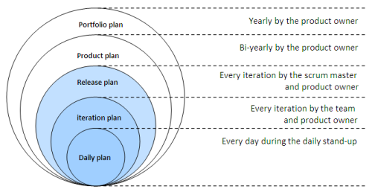
Agile Planning Onion

Slide 5
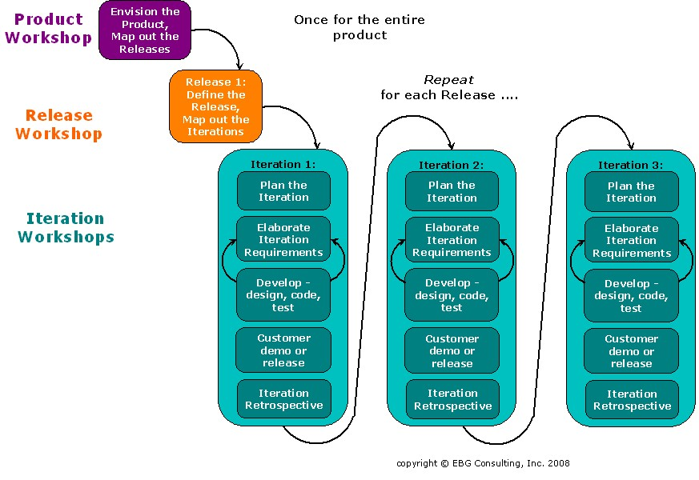

Slide 6
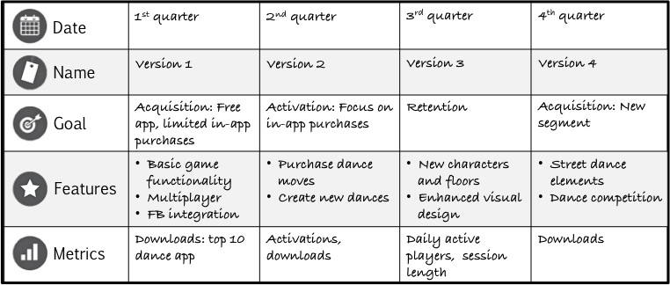
Sample Product Roadmap

Slide 7
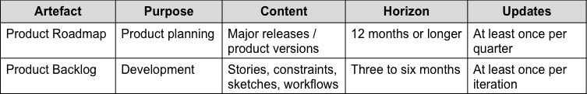
Product Roadmap vs Product Backlog

Slide 8
Elevator Pitch
An elevator pitch is a crisp message that communicates key features of the project in a succinct way so that others can easily understand it.
Imagine if your CEO asked about the project in the lift going up to your office. Can you communicate what the project is about before the elevator gets from the ground to the tenth floor?
Elevator Pitch
• Brings clarity and focus to project.
• Forces team to think about the customer.
• Forces hard decisions to be made:
• who is it for? how is it different?

Slide 9
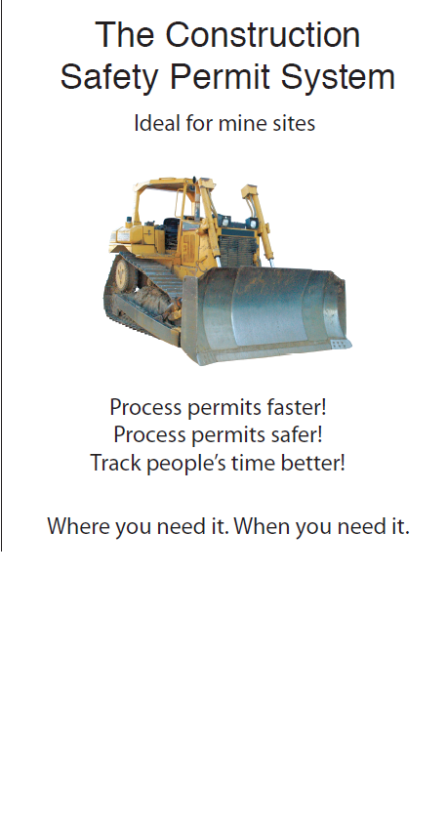
Elevator Pitch

Slide 10
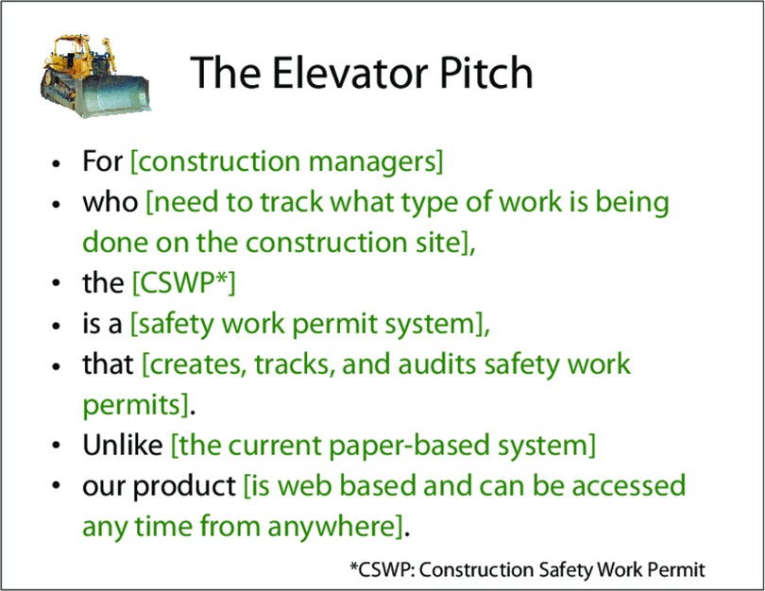
Defining Product from Customer Point of View

Slide 11
Scrum in the Real World
Starting Scrum Projects
Expressing Requirements with User Stories
Release Planning and Estimation
Release Tracking and Responding to Project Delays

Slide 12
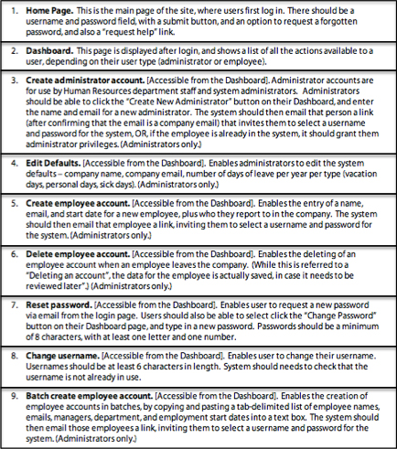
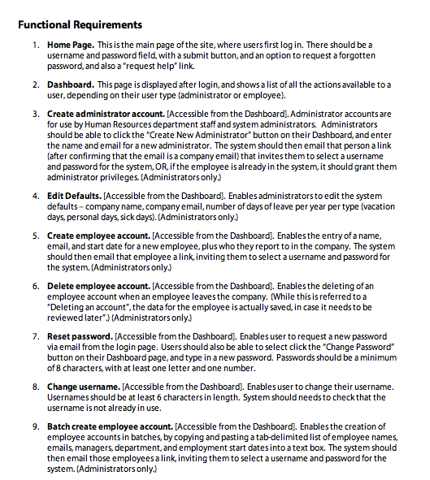
Creating the Product Backlog
1
2
3
4
5
6
7
8
9
10
11
12
Product Backlog

Slide 13
User Stories for Clarity
User stories are a widely used format for describing features on the Product Backlog
User Stories are short, plain-language descriptions of the feature, centered on the consumer of the feature, what they need it to do, and why
The 3 C’s: Card, Confirmation, Conversation

Slide 14
The Card
15. Review Pending Requests. [Accessible from the Dashboard]. Enables user to view all their currently unapproved requests in the system. The page should display a table that lists each of the pending requests, the date of the request, the type of the request (vacation day, personal day, or sick day), and the first 30 characters of the “explanation field”.
As an employee,
I want to see all the requests I’ve submitted that are pending my manager’s approval
So that I can see which have been approved and which have not been approved

Slide 15
The Confirmation – Back of Card
15. Review Pending Requests. [Accessible from the Dashboard]. Enables user to view all their currently unapproved requests in the system. The page should display a table that lists each of the pending requests, the date of the request, the type of the request (vacation day, personal day, or sick day), and the first 30 characters of the “explanation field”.
Acceptance Criteria
Notes
All pending requests are shown
Last 5 approved or denied requests are shown
Requests are shown in a table, in reverse chronological order
For each request, the date and type of request is shown, as well as the first 30 characters of the explanation
If no requests pending, “No requests pending” appears
For each request, show whether a reminder has been sent to the manager yet
Showing the last 5 approved or denied requests is not in the original specification, but it’s quick and easy to include

Slide 16
The Conversation
The card only covers the most basic information
The next level of detail comes in conversations between the Product Owner and the Team
Screen shots
Items out of scope
Process Flows
Baseline Estimate (Mandatory)
Data Migration
Non-functional requirements

Slide 17
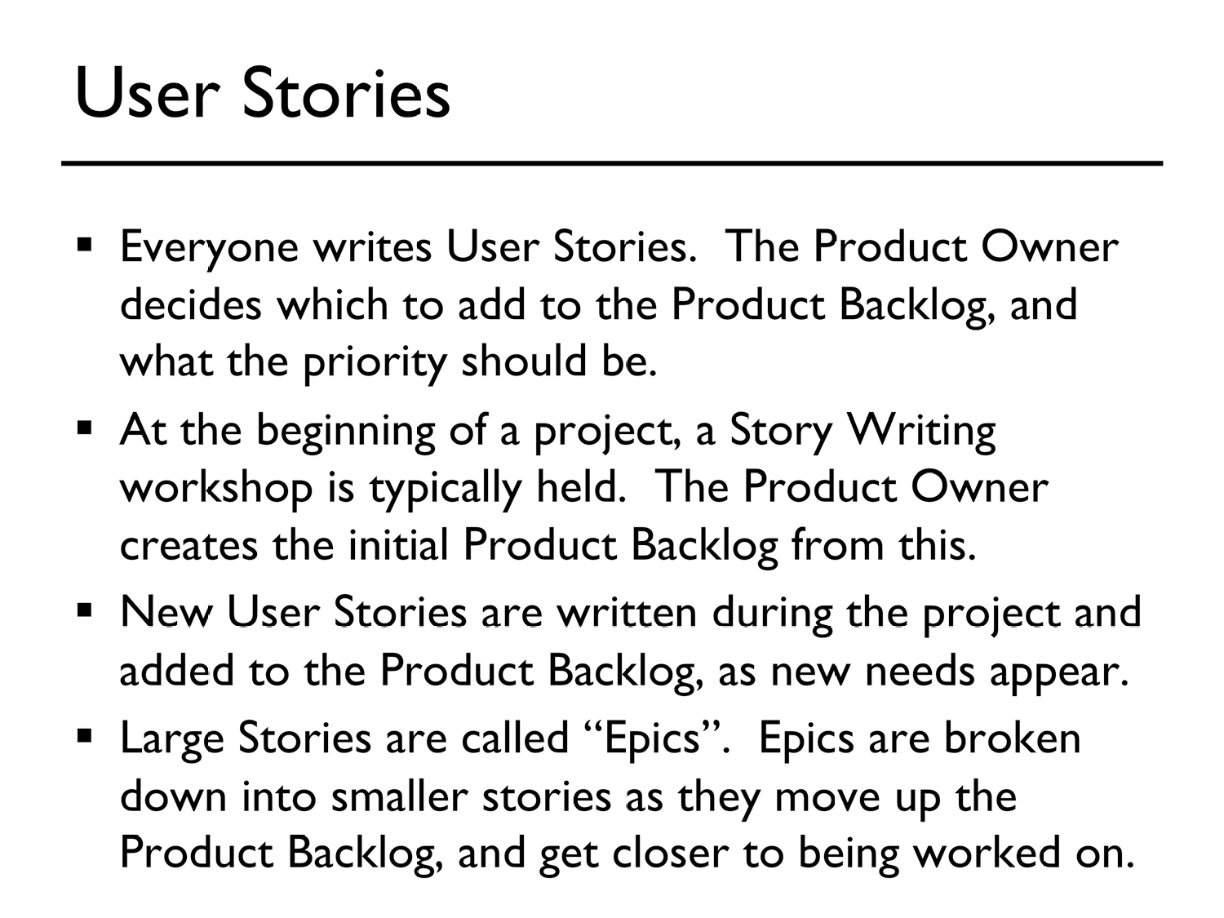

Slide 18
Scrum in the Real World
Starting Scrum Projects
Expressing Requirements with User Stories
Release Planning and Estimation
Release Tracking and Responding to Project Delays

Slide 19
What is Release Planning
How much will be done by August 30?
When can we ship with this set of features?
How much will it cost to get this set of features?

Slide 20
Big Picture Implications
Helps predict revenue and budget models
Ensures departmental readiness
Marketing
Sales
Training
Support

Slide 21
Release Planning
Product Owner responsibility
Driven typically by time but can be by scope
Velocity stability will increase release accuracy
Release planning should occur at end of every sprint:
Scrum team and relevant stakeholders
Discuss goals, risks, probable release dates
Estimate any new PBIs
Product Owner will adjust the Release Burndown and release plan

Slide 22
Release Options
Release after multiple sprints
Release every sprint
Release every feature

Slide 23

Who’s Involved In Release Planning?
Customers / Product Owners:
define stories;
set priorities; and
put stories into iterations.
Developers:
estimate stories;
point out significant technical risks; and
establish velocity, a measure of team development capacity.
© 2014 Intelliware Development Inc.
Notes:
Ideally most of the defining, priorities and estimating has been done before Release Planning.
Velocity – estimating units per iteration
The significance of technical risks is that risky stories should be done earlier to mitigate potential issues

Slide 24
Defining a Release Plan
Develop high level product backlog - the ‘what’ not the ‘how’
Estimate the size of the product backlog using relative estimation technique
Establish iteration lengths
Iterations are generally 1 to 3 weeks long.
Developers decide what will be in the iteration in collaboration with the customer / product owner.
Smaller projects tend to have shorter iterations.
Size is important as release dates are usually based on external constraints.
Determine the velocity
Estimate of how many estimating units can be completed per iteration.
Developer responsibility.
Unit of measurement used does not matter – be it points, ideal days, or something else.
Organize stories into iterations
Based on business and technical priorities.
The process of deciding what goes into a release
© 2014 Intelliware Development Inc.
Notes:
Release dates are often based on external constraints and can’t be moved
Setting iteration lengths is not a hard science and is largely based on the team’s prior experiences and comfort level and the size of the project
It is important to remember that the Release Plan is not set in stone and will change from Iteration to Iteration as business priorities change

Slide 25
Example of a Release Plan
Here’s an example of a
release that consists of 2
iterations with 12 stories.
.
Release | Iteration | Stories | Size
Alpha | 1 | Home Page | 1
 |  | Login | 1
 |  | Display Account Summary List | 2
 |  | Display Account Details | 1
 |  | List Transaction Summary for an Account | 1
 |  | Add New Transaction | 2
 |  | Logout | 1
 |  | TOTAL | 9
 | 2 | Add New Account | 2
 |  | Deactivate and Remove Existing Account | 1
 |  | Modify Account Information | 1
 |  | Delete a Transaction | 1
 |  | Modify Transaction or Move to Different Account | 2
 |  | TOTAL | 7
Iteration 1
Iteration 2
© 2014 Intelliware Development Inc.
Notes:
You can use an application like Jira or Mingle that sorts the cards into iterations for you, or a simple table produced using Word or Excel also works – whatever tool you choose doesn’t matter

Slide 26
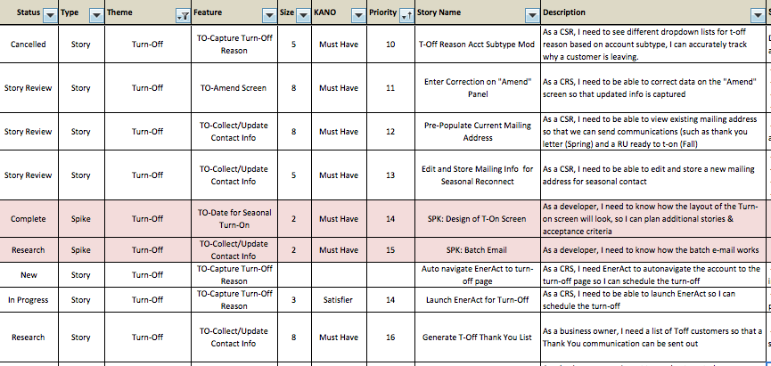
Release backlog

Slide 27
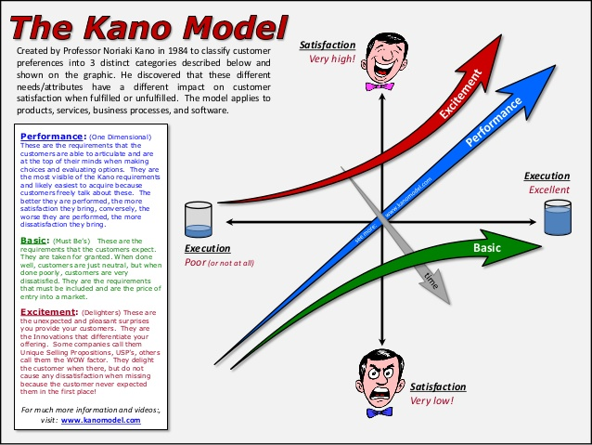

Slide 28
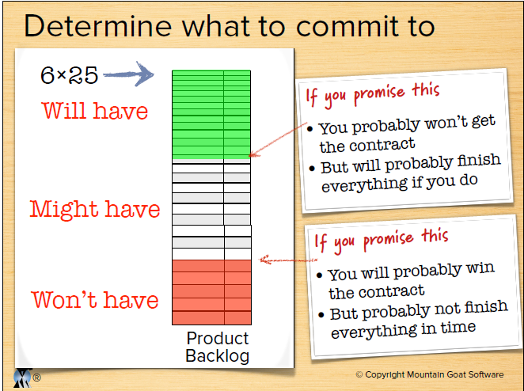

Slide 29
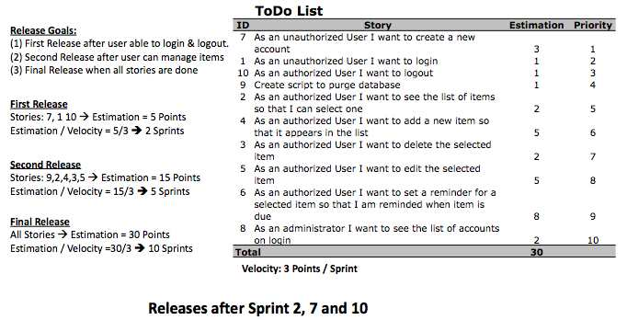
Feature Driven Release Planning
The sum of all features within in a release can be divided by the expected velocity. This will then result in the number of sprints needed to complete the requested functionality

Slide 30
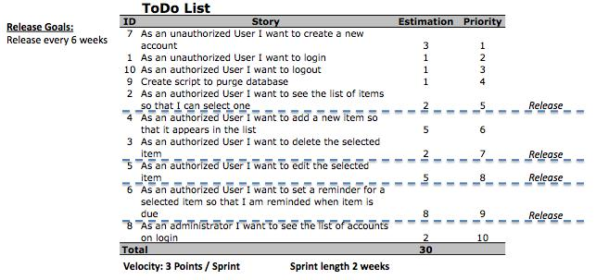
Date Driven Release Planning
Multiply the velocity by the number of Sprints and we'll get the total work that can be completed within the given timeline.

Slide 31
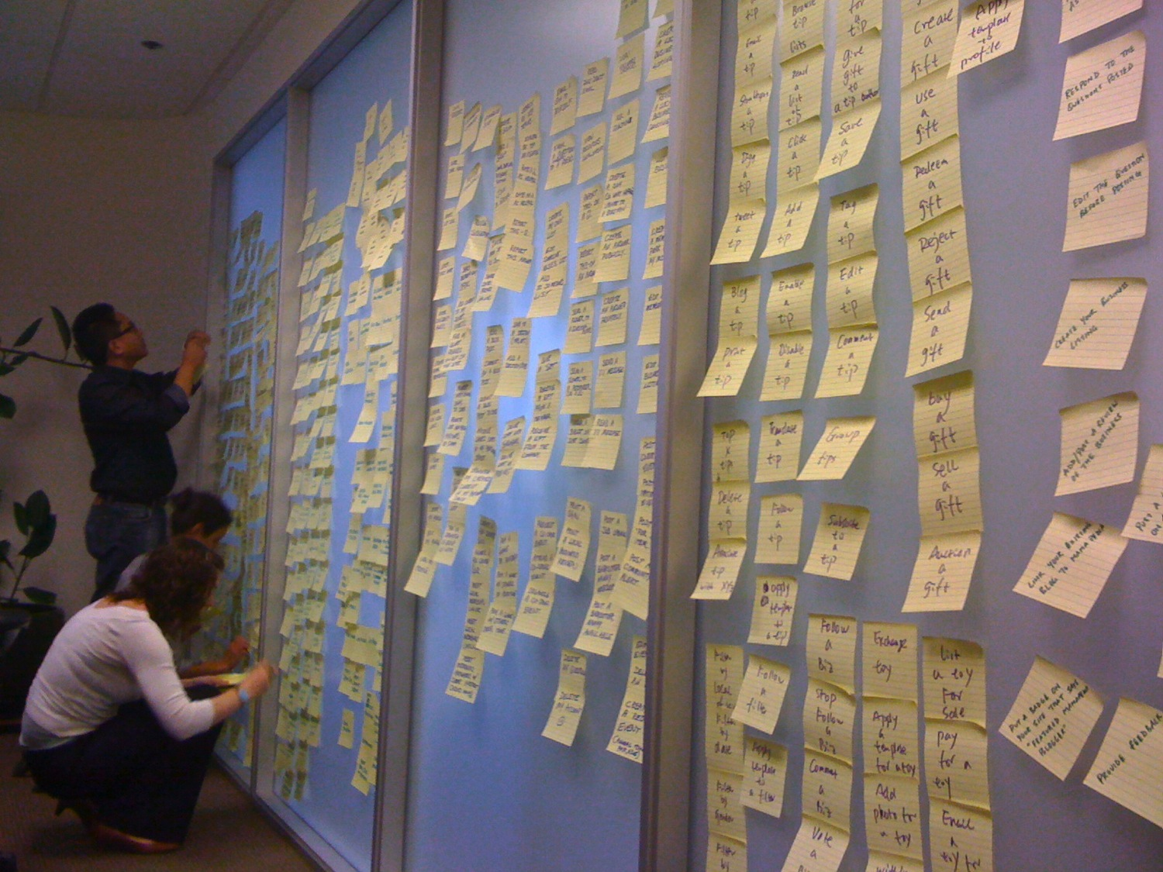
Getting Started…

Slide 32
120
points
Product backlog = 120 points
Sprint 1
Sprint 2
Sprint 3
Sprint 4
Sprint 5
Sprint 6
January
February
March

Slide 33
1+13+5
=
19
120
points
Product backlog = 120 points
Sprint 1
Sprint 2
Sprint 3
Sprint 4
Sprint 5
Sprint 6
January
February
March

Slide 34
1+13+5
=
19
5 + 8 + 5 + 2 +1
=
Full backlog delivery
21
120
points
Avg velocity = 20 points
per sprint
Product backlog = 120 points
Velocity = 20 points
Forecast for completion = 6 sprints
Sprint 1
Sprint 2
Sprint 3
Sprint 4
Sprint 5
Sprint 6
January
February
March

Slide 35
19
Increased scope
New Requirement
21
140
points
Full backlog delivery
T&M/ Fixed time ?
Product backlog = 140 points
Velocity = 20 points
Forecast for completion = 7 sprints
Sprint 1
Sprint 2
Sprint 3
Sprint 4
Sprint 5
Sprint 6
Sprint 7
January
February
March

Slide 36
Decreased scope
19
Full backlog delivery
21
100
points
Product backlog = 100 points
Velocity = 20 points
Forecast for completion = 5 sprints
Sprint 1
Sprint 2
Sprint 3
Sprint 4
Sprint 5
Sprint 6
January
February
March

Slide 37
Increased velocity
35
Full backlog delivery
124
points
35
Product backlog = 124 points
Velocity = 35 points
Forecast for completion = 3.5 sprints
Sprint 1
Sprint 2
Sprint 3
Sprint 4
Sprint 5
Sprint 6
January
February
March

Slide 38
Decreased velocity
16
18
Full backlog delivery
124
points
Product backlog = 124 points
Velocity = 17 points
Forecast for completion = 7 sprints
Sprint 1
Sprint 2
Sprint 3
Sprint 4
Sprint 5
Sprint 6
Sprint 7
January
February
March

Slide 39
Scheduling releases
Release 1
19
21
60 points
Full backlog delivery
R1
120
points
Velocity = 20 points
Product backlog = 120 points
Forecast for completion = 3 sprints
Velocity = 20 points
Product backlog = 60 points
Forecast for completion = 6 sprints
(release)
Sprint 1
Sprint 2
Sprint 3
Sprint 4
Sprint 5
Sprint 6
January
February
March

Slide 40
Enhanced Release Burndown
Original Release Date
March 7
Adjusted Release Date
April 11
240
Work Remaining
180
Project will
finish in this
range
120
60
0
60
Sprint 1
Sprint 2
Sprint 3
Sprint 4
Sprint 5
Time
Thanks to: Mike Cohn, Mountain Goat Software

Slide 41
Enhanced Release Burndown
Original Release Date
March 7
Adjusted
Release
Date
March 1
240
Work Remaining
180
120
Project will
finish in this
range
60
0
60
Sprint 1
Sprint 2
Sprint 3
Sprint 4
Sprint 5
Time
Thanks to: Mike Cohn, Mountain Goat Software

Slide 42
90
80
70
60
50
40
30
20
10
0
Release Burndown Chart
End Development
Release
Remove 13 points from Release Backlog to launch on time
2 extra Sprints needed to finish Release Backlog
1 | 2 | 3 | 4 | 5 | 6 | 7 | 8 | 9 | 10 | 11 | 12 | 13 | 14 | 15
Sprints

