Slide 1
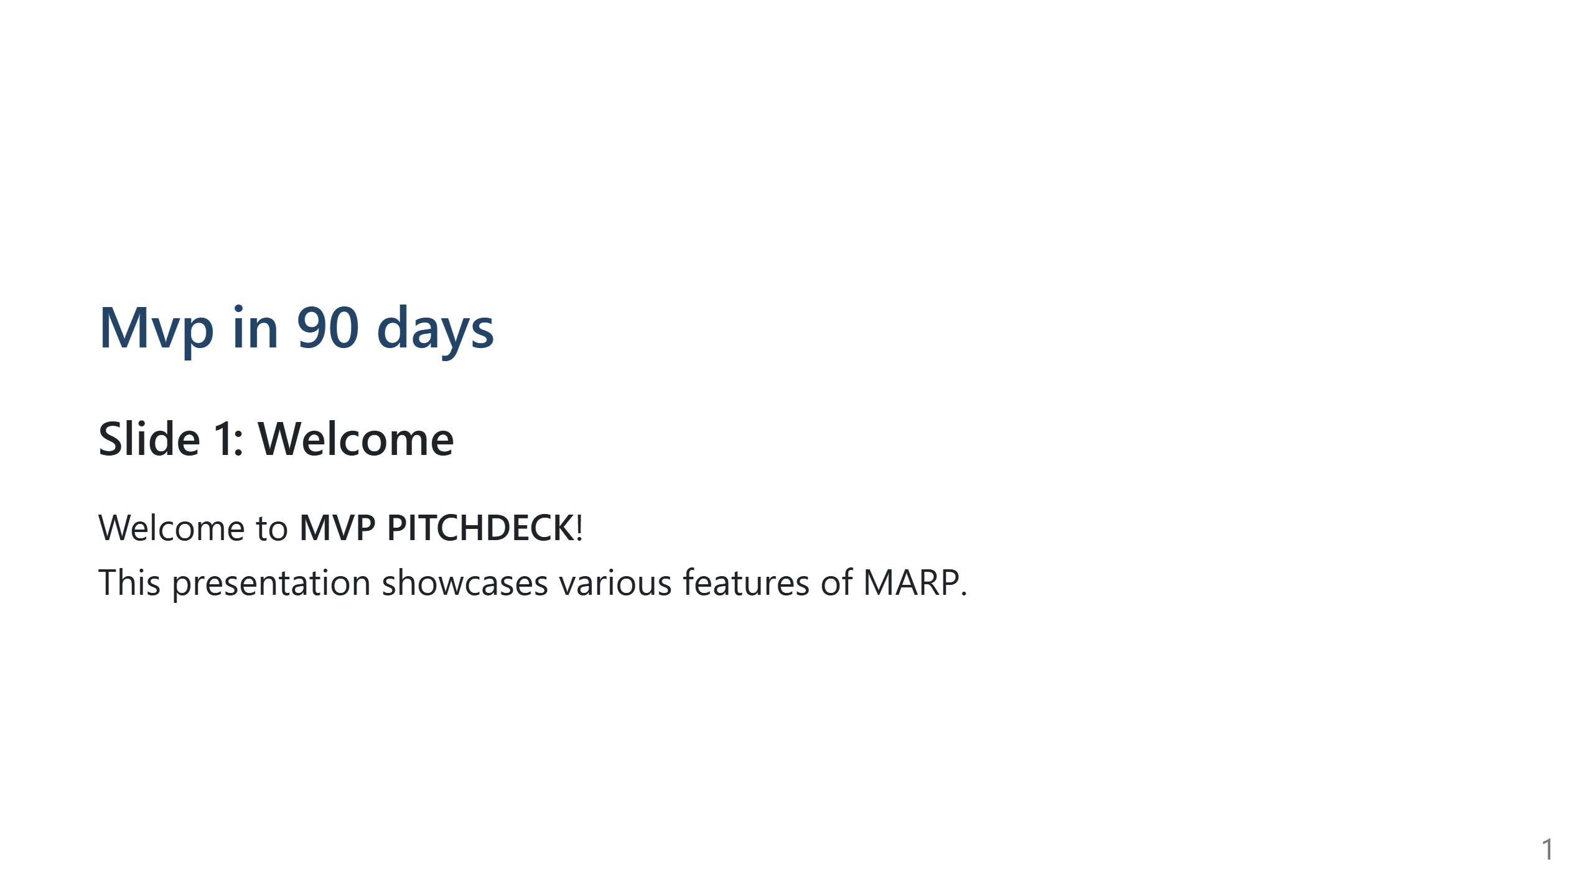

Slide 2
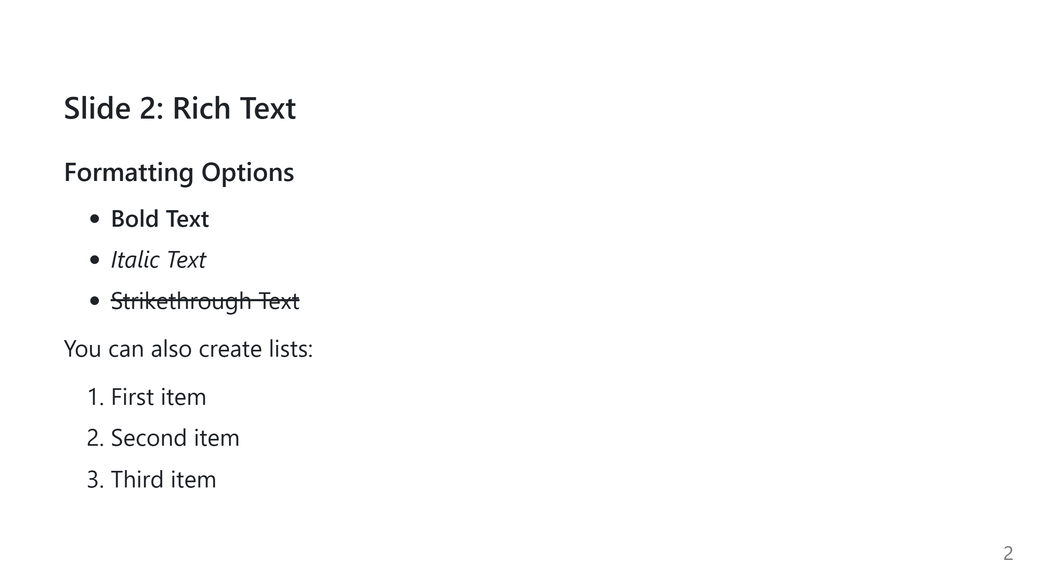

Slide 3


Slide 4

Notes:
<video width="800" controls> <source src="https://www.w3schools.com/html/mov_bbb.mp4" type="video/mp4"> Your browser does not support the video tag. </video>

Slide 5
