Slide 1



BLOOD DONOR MANAGEMENT SYSTEM
PROJECT GUIDE
Mrs.P.Ramya
Assistant Professor
PROJECT MEMBER
23ADR071-Janani V
23ADR099-Madhu Shree T
23ADR111-Manojit R B

Slide 2
PROJECT OBJECTIVE
The system facilitates connections between voluntary blood donors and recipients or organizations in need of blood.
It enables efficient search and matching of donors based on blood group and location.
It minimizes response time during medical emergencies.
It offers a user-friendly online platform for donor registration and information management.
It promotes awareness and encourages consistent participation in blood donation.

Slide 3
TECHNICAL STACK
React.js – Interactive frontend development
Tailwind CSS – Modern responsive styling
Node.js – Backend runtime environment
Express.js – Server-side API handling
MongoDB – NoSQL database storage
Mongoose – MongoDB data modeling
Postman – API testing tool
JWT – Secure user authentication
Git & GitHub – Code version control and collaboration

Slide 4
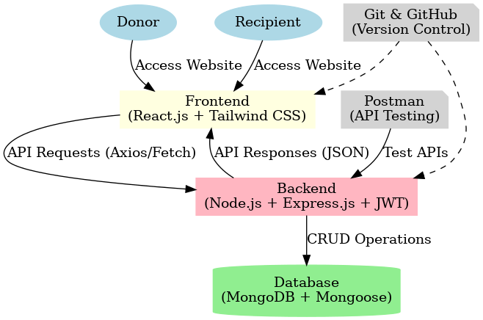
ARCHITECTURE

Slide 5
FEATURES AND FUNCTIONALITY
Features:
Donor and recipient registration
Search donors by blood group and location
Blood request and response system
Secure login and authentication
Mobile-friendly responsive design
Functionality:
Donors can update profiles and availability
Recipients can send and track requests
System matches donors with recipients
Stores and manages data in database
Tests APIs using Postman

Slide 6
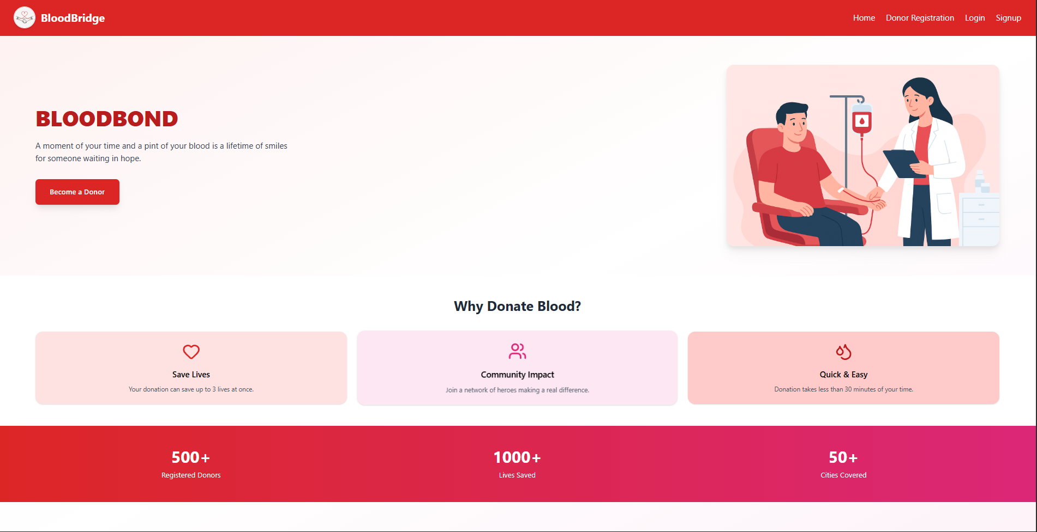
DEMO

Slide 7
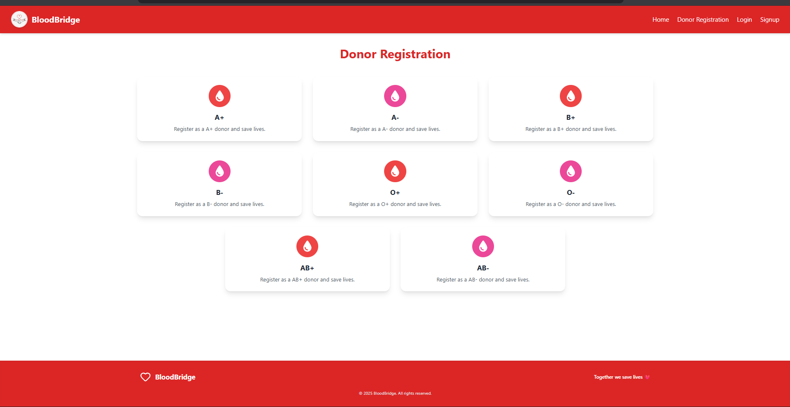

Slide 8
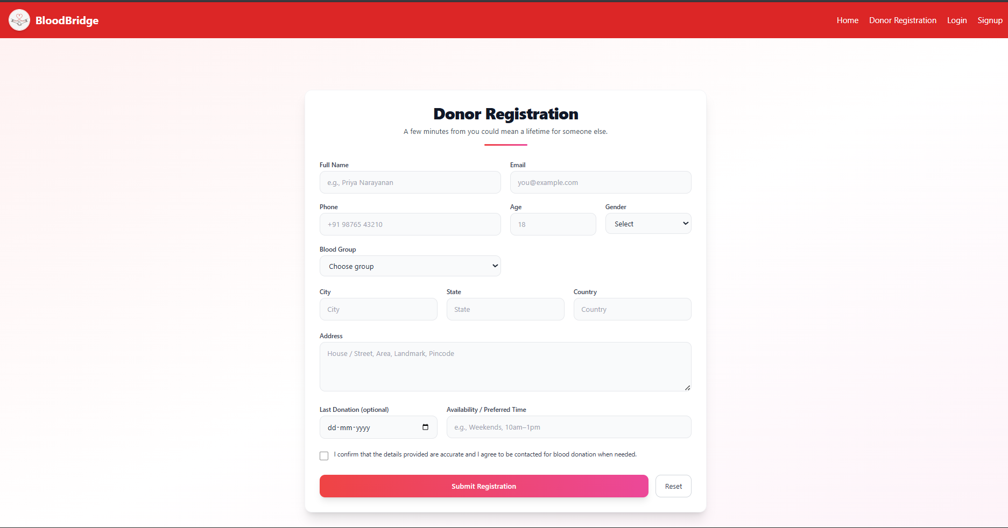

Slide 9
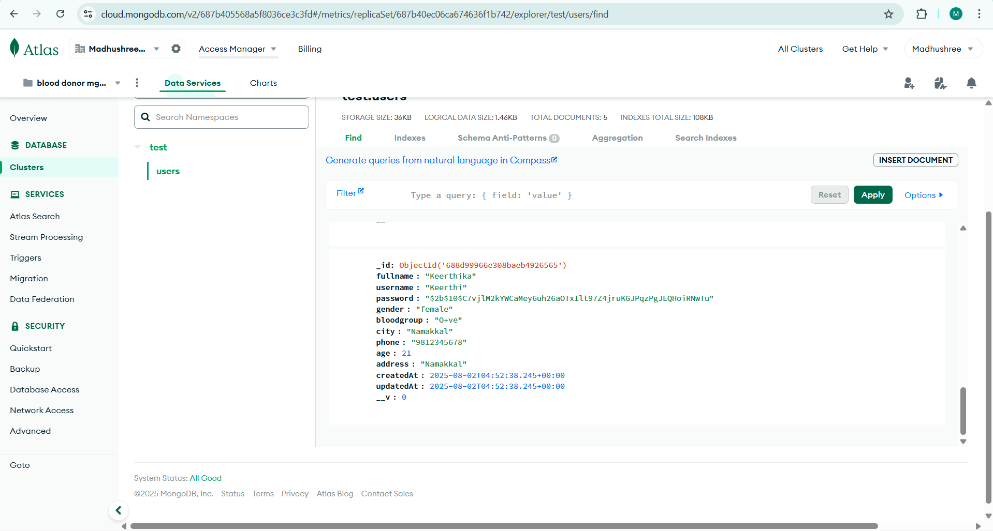
MONGO DB

Slide 10
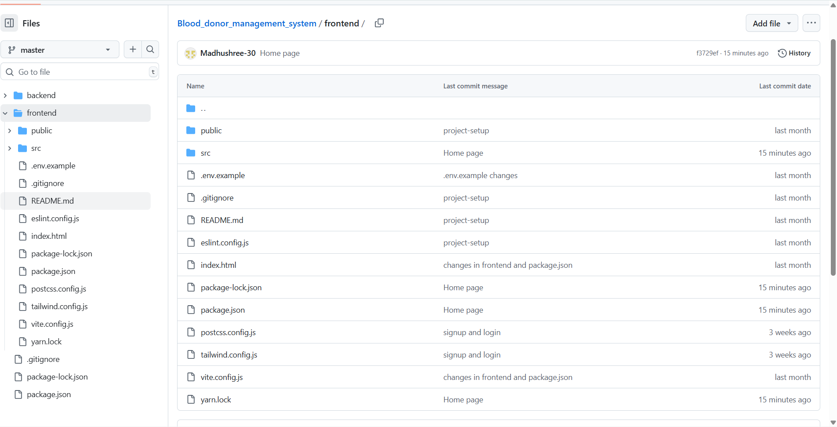
GITHUB REPOSITORY

Slide 11
REFERENCE
World Health Organization. (2023). Blood safety and availability. Retrieved from https://www.who.int/news-room/fact-sheets/detail/blood-safety-and-availability
Ministry of Health & Family Welfare, Government of India. (2024). National Blood Policy. Retrieved from https://main.mohfw.gov.in/
American Red Cross. (2023). Blood donation facts and statistics. Retrieved from https://www.redcrossblood.org/
React.js Documentation – https://react.dev/
Tailwind CSS Documentation – https://tailwindcss.com/docs
MongoDB Documentation – https://www.mongodb.com/docs/

Slide 12
THANK YOU

