Slide 1

FOUNDER | OPERATIONS ASSOCIATE | DATA ANALYST
MANOJIT DAS
Digital Operations and Analytical Dashboard Portfolio Review. Built with high-precision metrics, interactive AI integration models, and digital transformation layouts for offline traditional vendors.
Live Portfolio: portfolio-delta-nine-buockq1joj.vercel.app Location: Kolkata, India | Contact: manojitdas876@gmail.com

Slide 2

01 -- PROFILE DETAILS
Operations Mindset & Analytical Precision
• Core Professional Focus: Results-oriented Office & Operations Associate and Data Analyst with hands-on experience managing high-volume administrative workflows, data operations, and customer success targets.
• Founder of Growthlytics: Assists local traditional vendors and offline businesses in West Bengal to go digital, launch online ordering, and automate invoicing.
• Background & Experience: Managed 50+ daily inbound/outbound customer interactions at Tech Mahindra; completed Business Analytics internships at Bharat Intern; operations coordinator at E-Cell IIT Bombay.
• Core Philosophy: Bridging the gap between technical data structures (SQL, Power BI, Advanced Excel) and direct customer success and client-facing communication.

Slide 3

02 -- EXPERTISE MATRIX
Core Professional Competencies
• Digital Operations & Automation (85%) Process digitization, vendor onboarding, campaign tracking, and operations dashboards.
• Customer Success & SLA Handling (90%) CRM tools, SLA tracking, ticket resolution, and customer satisfaction (CSAT) optimization.
• Business Analysis & SQL Databases (80%) Writing complex relational queries, data cleansing, structuring data, and Power BI report building.
• AI Integration & Prompt Engineering (70%) Leveraging Google Gemini APIs, SDKs, and prompt models to automate text-based business advisories.
• Web Development & Static Layouts (75%) React, TypeScript, CSS custom templates, and responsive frontend design.
• Financial Accounting (72%) Capital markets, ledger posting, and invoicing (Tally ERP).

Slide 4
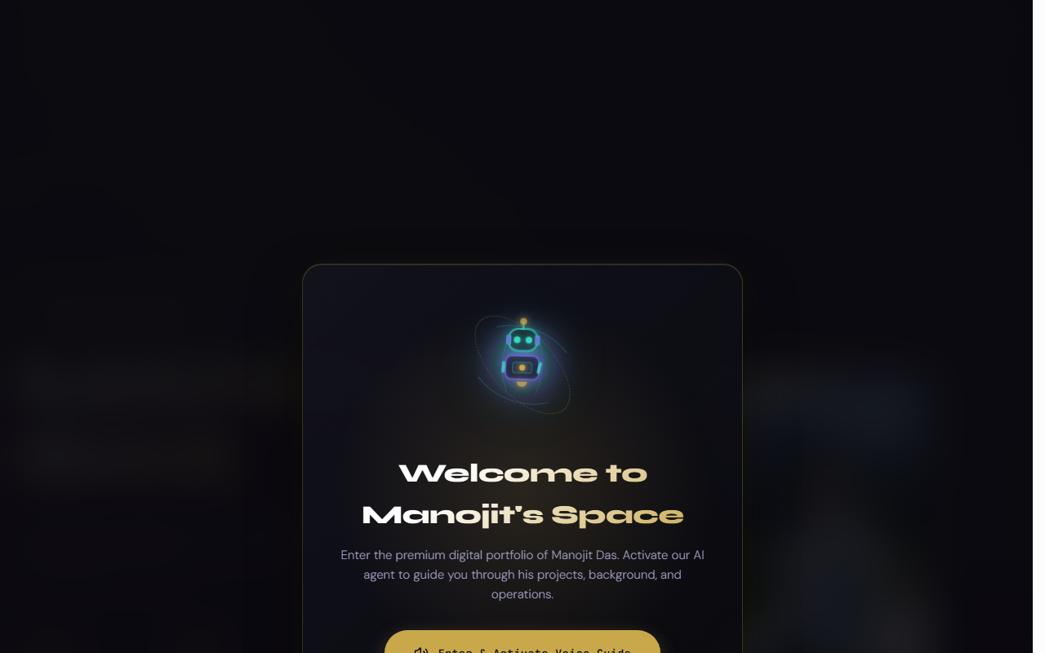
03 -- AI SOLUTIONS
Growthlytics AI Problem Solver
Interactive Terminal Simulation:
• Goal: Address the operational bottlenecks of local traditional shops converting to digital formats.
• Implementation: An embedded simulation terminal mimicking a server terminal node (`system@growthlytics:~#`).
• Dynamic Mechanics: Users type issues (e.g. 'manual entry mistakes') and the model generates operational solutions on-screen.
• Strategic Impact: Highlights the bridging of LLM APIs with real-world small business workflows.

Slide 5

04 -- FEATURED PRODUCT
Pinned Project: SkillsElevate Portal
• Core Description: An educational upskilling portal engineered to help working professionals and students upgrade their capabilities.
• AI Integration: Embedded Google Gemini API curates customized learning trajectories and maps real-time industry trends.
• Technical Stack: React, TypeScript, Google Gemini SDK, Node.js, and Vite build wrapper.
• Key Features: Generates interactive roadmaps, defines daily learning checkpoints, and supports multi-language learning tracks.

Slide 6
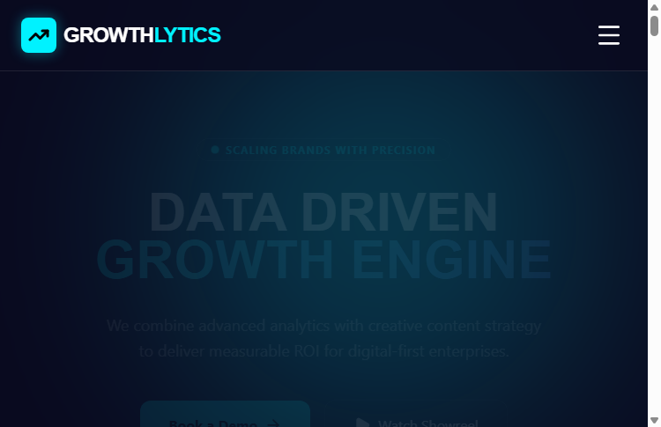
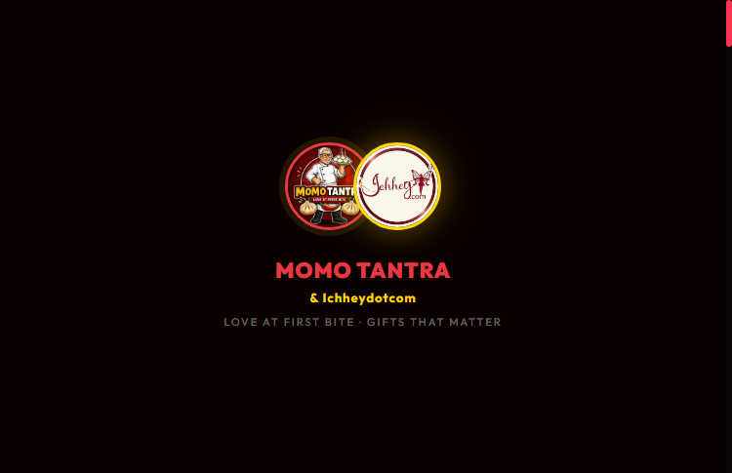
05 -- CLIENT CASE STUDIES
Growthlytics & Momotantra Deployed Apps
1. GROWTHLYTICS (Flagship Agency)
• Flagship agency portal offering local business scaling, AI diagnostics, and custom SEO management dashboards. • Purpose: Bridge the digital divide for small vendors in West Bengal. • Live Link: growthlytics-s6rd.vercel.app
2. MOMOTANTRA (Digital Menu & Billing)
• Premium interactive digital menu card and checkout panel designed for street-side food stalls and momo vendors. • Purpose: Accelerate checkout speeds, automate billing invoices, and minimize customer queues. • Live Link: momotantra-app-a3mw.vercel.app

Slide 7


06 -- DIGITAL UTILITIES
Rever Cafe & RetailFlow Deployed Apps
3. REVER GLASS HOUSE CAFE
• Luxury-themed sensory landing page and booking interface built for a modern aesthetic cafe network. • Features: Interactive booking scheduler, animated menus, and integrated feedback portals. • Live Link: revercafe.vercel.app
4. RETAILFLOW AI & TECHAI
• Retail inventory modeling and sales tracking application utilizing time-series forecasting modules to predict stock demand and run custom ledger reports. • TechAI: Secure OTP authentication dashboard with AI coding agents. • Live Link: retailflow-ai-opal.vercel.app

Slide 8

07 -- STRATEGIC ROADMAP
Growthlytics Vision & Expansion Hub
• Mission Statement: Connecting offline to online. Democratize enterprise-grade digital tools (AI, SEO, databases) for local micro-vendors and MSMEs in West Bengal.
• Hyper-Local SEO Node: Assisting vendors to expand local organic search discovery by optimized Google Business listings and custom SEO landing sheets.
• AI-Assisted Sales Modules: Deploying cost-effective database structures (Advanced Excel, SQL tables) so street-side stores can forecast weekly inventory requirements.
• Hub Contacts: Active Headquarters at 11/1 Arabinda Road, Konnagar, West Bengal, India. 24/7 hotline support (+91 98361 48511).

Slide 9

08 -- CAREER TRACK
Interactive Resume & Professional Credentials
• Work Experience: Founder of Growthlytics (Present); Customer Service Associate & Data Coordinator at Tech Mahindra (Jun 2025 - Feb 2026 - handled daily SLAs and weekly reports); Business Analytics Intern at Bharat Intern.
• Key Certifications: Google Digital Marketing & E-Commerce, Yale University Capital Markets, PwC Power BI Case, J.P. Morgan Global Finance, and J.P. Morgan Corporate Analyst Development.
• Academic Credentials: Bachelor of Arts (2021 - 2024) from MGKVP University with CGPA of 6.62 / 10; commerce stream background (Class XII, 69%).
• Operations Record: Coordinated outreach and data logging for 100+ entries as Campus Ambassador for E-Cell IIT Bombay.

