Slide 1
Internship work - IOT
Team Members
GOUTHAM K
KIRAN KARTHIKEYAN GS
MANOJ K
Government College of Technology- GCT

Slide 2
Problem statement:
Develop an Internet of Things system to calculate the number of people in a company’s reception room and give the information to the user.We must detect people entering and exiting the room,as well as show the number of people in the room.If we have a zero entry,we must indicate with an LED.Give the significant information to the supervisor for ongoing tracking.

Slide 3
1.What are the required components for this applications?
COMPONENTS | MODEL
Arduino Mega | MEGA 2560
Arduino UNO (ALTERNATIVE) | UNO (A.Uno, 2016)
Motion Sensors(PIR Sensors) | DYP-ME003 (Motion, 2011).
Ultra Sonic Sensor | HC-SR04 (Ultrasonic,2011)
Arduino WiFi Module | ESP8266
LED | 5mm Red LED
Display | Liquid Crystal Display (LCD)
BreadBoard | Generic
Smart Phones or Smart Devices | (any model)(For information sharing)
Connecting Wires and other Tools | As Required

Slide 4
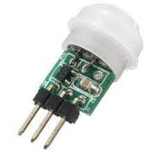
For this application,the type of detecting system will you use?
MOTION SENSOR
Model: DYP-ME003 (Motion,2011)
A motion sensor is a device used to detect movements in a certain area.There are two types of motion sensors:
PASSIVE SENSOR:It detects variation in energy in surrounding area,but it does not emit any energy.
ACTIVE SENSOR:It transmits energy and waits for its response,and this consumes a larger amount of energy.
Supply voltage: 4.5 V to 20 V DC
Voltage output high level: 3.3 V
Maximum detection distance Adjustable between 3 m and 7 m
Maximum detection angle: 110° solid angle
Delay time Adjustable between 5 s and 200 s (default 5 s)
Blocking time: 2.5 s

Slide 5
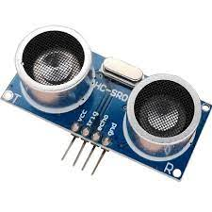
ULTRASONIC SENSOR
Model: HC-SR04 (Ultrasonic,2011)
The operation of an ultrasonic sensor is based on the transmission of ultrasonic pulses and the times response of the pulses.
The Ultrasonic device informs the distance of an object that is ahead of it.
Working Voltage: DC 5V
Working Current: 15mA
Working Frequency: 40Hz
Max Range: 4m
Min Range: 2cm
Measuring Angle: -15 degree to +15 degree
Trigger Input Signal: 10µS TTL pulse
Echo Output Signal Input TTL lever signal and the range in proportion
Dimension 45 * 20 * 15mm

Slide 6
Advantages of Ultrasonic sensor over IR Sensor.
There are a lot of limitations in infrared sensors, like the inability to use them in sunlight due to interference.
It can make outdoor applications or dark indoor applications difficult.
Ultrasonic sensors work using sound waves, detecting obstacles is not affected by as many factors.
If reliability is an important factor in your sensor selection, ultrasonic sensors are more reliable than IR sensors.
If you’re willing to compromise reliability for cost, infrared sensors are ideal for your application.

Slide 7
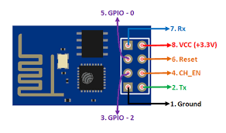
3.What system is needed to send the information about person’s entry & exit record?
ARDUINO WI-FI Module
Model: Wi-Fi Module ESP8266
Power Supply: +3.3V only
Current Consumption: 100mA
I/O Voltage: 3.6V (max)
I/O source current: 12mA (max)
Built-in low power 32-bit MCU @ 80MHz
512kB Flash Memory
Can be used as Station or Access Point or both combined
Supports Deep sleep (<10uA)

Slide 8
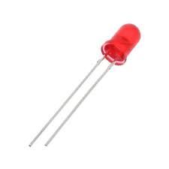
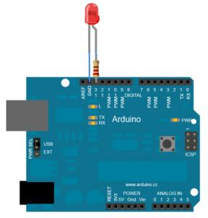
LED
4.What device is needed to indicate when no one is available inside the room?
Colour: Red
Nominal Voltage (Vn): 24V ac/dc
Frequency (ac): 50 - 60Hz
Insulation Resistance ≥ 2MΩ
Insulation Withstand 2.5kVac, 1 minute
Current Draw ≤ 20mA
IP Rating (from front, panel mounted) IP40
Brightness ≥ 60 cd/m3
Operational Life 30,000 hours
Relative Humidity ≤ 98%
Operating Temperature Range: -25°C to +55°C
Operating Voltage Range Vn +/- 15%

Slide 9
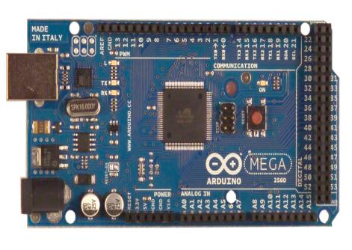
Which Arduino Board do you prefer based on Detecting,Communication and Indication device?
Arduino MEGA 2560
Input Voltage (recommended): 7-12V
Input Voltage (limit): 6-20V
Digital I/O Pins: 54 (of which 15 provide PWM output)
Analog Input Pins : 16
DC Current per I/O Pin: 20 mA
DC Current for 3.3V Pin: 50 mA
Operating Voltage: 5V
Clock Speed 16 MHz
Length 101.52 mm
Width 53.3 mm
Weight 37 g

Slide 10
Arduino MEGA Board PIN Connections
Component Name | Number of Pins
Ultrasonic Sensor | 4
Motion Sensor | 3
LED Indicator | 1
WiFi Module | 5
LCD Display | 12
Total | 25

Slide 11
ALTERNATIVE:
Arduino UNO
Model: UNO (A.Uno, 2016)
Operating Voltage: 5 Volts
Input Voltage: 7 to 20 Volts
Digital I/O Pins: 14 (of which 6 can provide PWM output)
UART: 1
I2C: 1
SPPI: 1
Analog Input Pins: 6
DC Current per I/O Pin: 20 mA
Flash Memory: 32 KB of which 0.5 KB used by bootloader
SRAM: 2 KB
EEPROM: 1 KB
Clock Speed: 16 MHz
Length: 68.6 mm
Width: 53.4 mm
Weight: 25 g
DC Current for 3.3V Pin: 50 mA

Slide 12
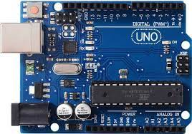
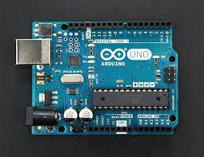
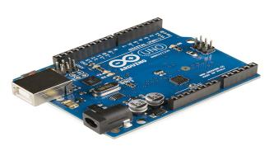
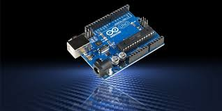
ARDUINO UNO

Slide 13
What are all the additional components needed for this application?
USB Cable
Connecting Wires
Hardware
Nuts and Bolts
Arduino IDE
Software

Slide 14
What kind of Power supply is needed for this application?
Power supply
DC Power Adapter(5V)
USB Connector(5V)
VIN pin of the board(7-12V)
(Battery)

Slide 15
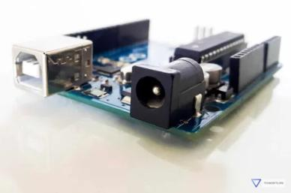
Different Types of Power Supply
The Arduino Uno power supply can be done with the help of a USB cable by simply connecting it to an computer.
The external power supplies mainly include AC to DC adapter otherwise a battery.
The AC to DC adapter can be connected to the Arduino Board by plugging into the power jack of the Arduino board.
Similarly, the battery leads can be connected to the input(Vin) pin and the Ground(GND) pin of the POWER connector.
The suggested voltage range will be 7 volts to 12 volts.

Slide 16
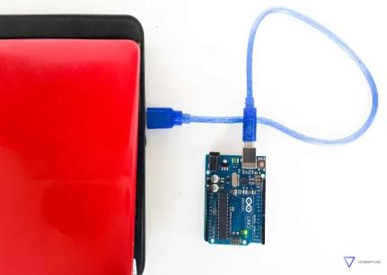
1.Using USB Cable
The USB port of the Arduino Uno can be connected to a desktop/laptop.
If the connection is enumerated, i.e. the computer recognizes the device, the current supplied to the board is 500mA at 5V.
If the connection is not enumerated, 100mA is supplied at 5V.

Slide 17
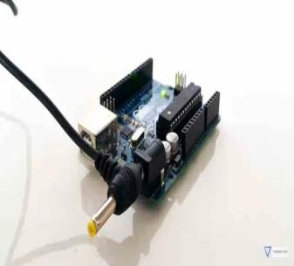
2.Using an AC to DC adapter plugged into the barrel connector
The barrel connector is 2.1mm in diameter.
The center pin is positive, and the outer sleeve is grounded
The mega Board has an limit of 40mA on each pin, and 200mA in total for all pins.
The barrel connector can be supplied with an input of 7-12V.
This is regulated to 5V by the onboard voltage regulator, and the board is powered on.
*DC Power Adapter is choosen as primary power supply because it provides more stability and portability as the adapter offers a Stable supply voltage whereas the battery supply may vary which leads to damage of the Arduino board and other circuit connections.

Slide 18
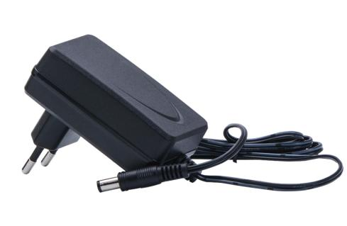
Input DC Voltage: The onboard power supply allows you to use any wall adapter that gives you 7 Volts to 12 Volts and will regulate (adjust) that voltage down to a very clean 5 volts.
Input Voltage: 5volts
Output Current: When powering off of the DC jack, you can pull at most 1 Amps. This is not a guarantee because you also have to make sure that the regulator doesn't overheat.
Specifications of DC Power Adapter:-
Input - 100-240 VAC 50/60Hz
Output Current:1 Amp
Output Type - DC
Output Voltage- 9Volts
DC Adapter

Slide 19
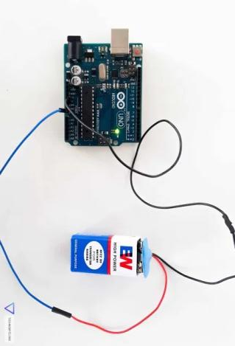
3.Using Batteries(through Vin pin of the board)
Connect a battery with the positive terminal connected to the Vin pin and the negative terminal connected to the GND pin. The Vin port allows an input between 7 and 12 Volts.
*The 5V pin bypasses the voltage regulator and all the safety measures present on the Arduino Board, so if the input exceeds the operating voltage,the board can be damaged.
*It is generally advised to avoid powering up the Arduino Uno using this method.

Slide 20


8.Methodology
Start
Person Enters
Person Exits
Motion sensor and ultrasonic sensor detects
Motion sensor and ultrasonic sensor detects
Arduino Microcontroller reads
Arduino Microcontroller reads
LED Glows
Counts Increaments
Counts Decreaments
If (count==0)
Displays the number of people in LCD.
Displays the number of people in LCD.

Slide 21
Budget
Components Name | Quantity | Price
Arduino Mega | 1 | 1*1300 | 1300
Ultra-Sonic Sensor (HC-SR04) | 2 | 2*75 | 150
PIR Sensor | 2 | 2*100 | 200
Arduino WiFi Module | 1 | 1*600 | 600
LCD Display (16*2) | 1 | 1*160 | 160
LED (Indicator)(5mm) | 1 | 1*50 | 50
Total = 2460 |  | Total = 1760 | 1760
Connecting Wires | - | - | -
Other Required Tools | - | - | -
Approximate Total Price = 2,500/.

Slide 22
After you have selected all of the components,create a timeline for each phase leading up to the finished product.
Process | Duration
Project idea and mindmap | 5 Hours
Buying of all Components | 5 Hours
Circuit Connection | 3 Hours
Proper Fixation of Circuit | 2 Hours
Software (Coding for Arduino) | 6 Hours
Testing of the Circuit | 1 Hours
Total Time of Complete Work | ≈3 days

Slide 23
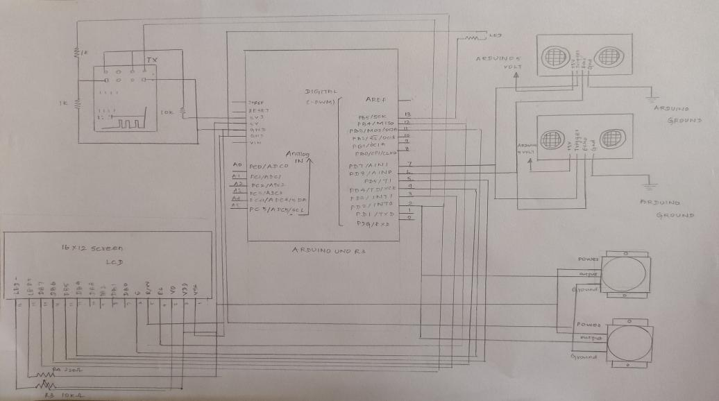
Hand Sketch of Circuit Conne-ction
(UNO Board Conne-ctions)

Slide 24
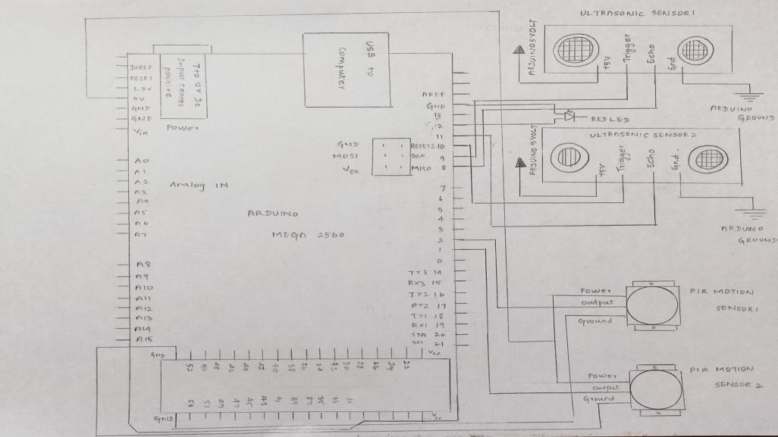
Hand Sketch of Circuit Connection
(part1)
(Connection with Mega Board)
(Connection of Sensors[
Ultrasonic and
PIR Sensors]
With
Mega Board.

Slide 25
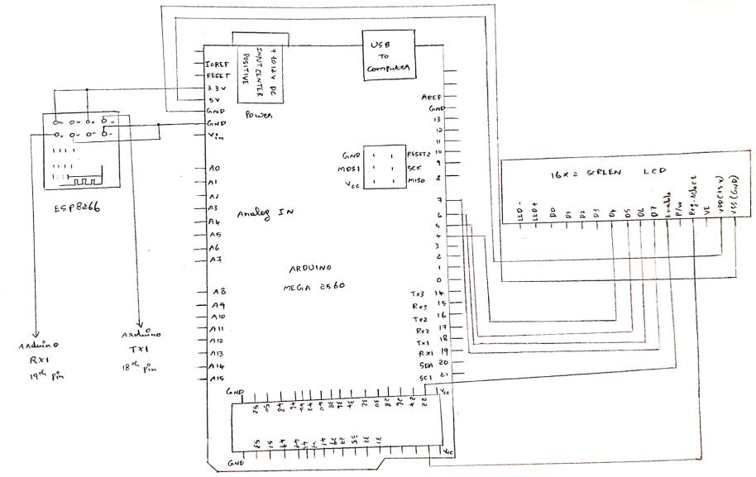
Hand Sketch of Circuit Connection
(part2)
(Connection with Mega Board)
(Connection of Wifi Module and
LCD Display
With MEGA
Board)

Slide 26
THANK
YOU !

