Slide 1
SENTINEL-NIDS
Network intrusion detection for critical infrastructure — evaluated honestly
Machine-learning intrusion detectors report 97–99% accuracy. I changed only the train/test split. Accuracy fell to 75.28%.
Manoj Kharkar
ML Bubble 2026 · Army Institute of Technology, Pune · Track: TE-BE (Design & Solve — Advanced)
Round 1
SENTINEL-NIDS · ML Bubble 2026 · TE-BE Advanced
1
Notes:
Opening: state the claim in the first 20 seconds. One model, one pipeline, one seed; only the split differs; 99.51% becomes 75.28%.

Slide 2
THE PROBLEM
Critical networks are defended by systems that cannot see a new attack
Defence networks, power grids and military logistics are still largely protected by signature-based intrusion detection — traffic is flagged only if it matches a known pattern.
That is structurally blind to any attack never seen before. Machine learning is the obvious replacement.
Intrusion detection is not pattern matching. It is a distribution-shift problem: the adversary actively invents traffic the model has never seen.
The rarest attack classes are the most dangerous ones, and a missed intrusion costs incomparably more than a wasted analyst minute.
So the question that decides whether an ML-IDS number is meaningful is not which model was used. It is how the data was split.
Why the published numbers can't be trusted
Standard supervised learning assumes the test data is drawn from the training distribution.
In intrusion detection that assumption is false by definition — the attacker's job is to violate it.
So the way a benchmark is split is not a technical detail. It decides whether the reported number means anything at all.
SENTINEL-NIDS · ML Bubble 2026 · TE-BE Advanced
2
Notes:
Frame ML as necessary but the evaluation as broken. Do not oversell ML here.

Slide 3
THE HYPOTHESIS
The high accuracies reported for ML-based intrusion detection are an artefact of evaluating on a random split of a single dataset.
Under a realistic protocol — where the test set contains attack types absent from training — performance collapses, and the collapse is concentrated precisely in the rarest and most severe attack categories.
This is a falsifiable claim, and the experiment that tests it is one command.
SENTINEL-NIDS · ML Bubble 2026 · TE-BE Advanced
3
Notes:
Say the hypothesis out loud. Emphasise that it could have come out the other way.

Slide 4
THE DATASET
NSL-KDD — chosen because it ships a built-in zero-day benchmark
125,973
22,544
17
16.6%
training flows (KDDTrain+)
test flows (KDDTest+)
attack types that appear ONLY in the test set
of test flows are an attack type never trained on
Two properties — both destroyed by pooling the splits
Why not a newer dataset?
17 of the 37 attack types occur only in KDDTest+ — 3,750 flows. The model must generalise to attacks it has never observed.
The class priors move: R2L is 0.79% of training data but 12.2% of test data (15.5×); U2R moves 0.04% → 0.89% (21.5×).
0 duplicate rows in training — so this is NOT classical row leakage. It is distribution shift, which is a more interesting failure.
UNSW-NB15, CIC-IDS2017 and HuggingFace NIDS corpora were all attempted and are unreachable from the build environment (verified 403).
But NSL-KDD is also the right choice on merit: it is the only common benchmark with a documented unseen-attack test protocol — which is what makes the experiment possible.
Its age (1999 traffic) is a genuine limitation, stated in the model card rather than hidden.
SENTINEL-NIDS · ML Bubble 2026 · TE-BE Advanced
4
Notes:
If asked why not a modern dataset, lead with the merit argument, not the availability one.

Slide 5
THE EXPERIMENT
One model. One pipeline. One seed. Only the split changes.
A
PROTOCOL A
B
PROTOCOL B
The common error
Honest
Concatenate KDDTrain+ and KDDTest+ (148,517 rows), shuffle, stratified 80/20 split.
This is what a large share of tutorials, blog posts and student projects do.
Train on KDDTrain+ (125,973). Test on KDDTest+ (22,544) — as the dataset authors designed it.
The test set keeps its 17 unseen attack types and its shifted class priors.
Used ONLY for this comparison. Never to report our performance.
Every performance number we claim comes from here.
Held constant across both protocols
RandomForestClassifier(n_estimators=300) · 122 one-hot features · identical preprocessing · random_state=42 · no tuning on either split
SENTINEL-NIDS · ML Bubble 2026 · TE-BE Advanced
5
Notes:
The controlled-experiment framing is what makes this more than a caveat.

Slide 6
THE RESULT
Accuracy falls 24 points. Macro-F1 falls 47. The error rate is 50× higher.
0.995
0.753
accuracy reported under Protocol A
accuracy under the honest protocol
50.4× more errors
under honest evaluation, same model
Nothing about the model changed. Only the way it was measured.
SENTINEL-NIDS · ML Bubble 2026 · TE-BE Advanced
6
Notes:
Gap: 24.23 accuracy points, 46.79 macro-F1 points.

Slide 7
PER-CLASS BREAKDOWN
The collapse lands on the two families that mean an attacker got in
R2L — remote-to-local intrusion
0.915 → 0.038
2,754 of these in the test set. The model finds 106.
U2R — privilege escalation
0.780 → 0.005
200 in the test set. The model finds one.
Recall, by attack family
SENTINEL-NIDS · ML Bubble 2026 · TE-BE Advanced
7
Notes:
These two families signify actual compromise rather than disruption. Accuracy cannot see this.

Slide 8
MECHANISM
Why: the test set is not the training distribution — by design
15.5×
more R2L in test than in training (0.79% → 12.2%)
21.5×
more U2R in test than in training (0.04% → 0.89%)
Pooling the two files forces the priors to match — and deletes the whole problem.
SENTINEL-NIDS · ML Bubble 2026 · TE-BE Advanced
8

Slide 9
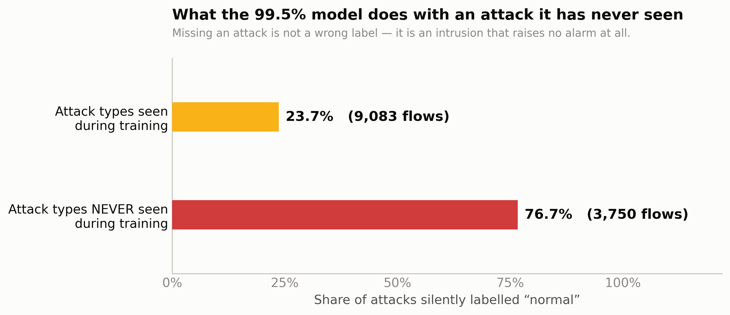
THE OPERATIONAL CONSEQUENCE
A missed attack is not a mislabelled row. It is an intrusion that raises no alarm at all.
76.7% of attack types never seen in training are silently cleared as “normal”
18.6% of unseen attacks are assigned the correct attack family
The model that reports 99.5% accuracy is, against a genuinely new attack, close to useless — and it says nothing to warn you.
SENTINEL-NIDS · ML Bubble 2026 · TE-BE Advanced
9

Slide 10
COMPARATIVE ANALYSIS
Eight models, identical splits — the protocol dominates the model
Model | Macro-F1 (honest) | CV F1 (in-dist.) | Shift penalty | R2L recall | Unseen missed
mlp | 0.546 | 0.889 | 0.343 | 0.106 | 51%
logistic regression | 0.540 | 0.840 | 0.300 | 0.037 | 58%
xgboost | 0.528 | 0.940 | 0.412 | 0.060 | 62%
random forest | 0.494 | 0.910 | 0.415 | 0.048 | 76%
decision tree | 0.487 | 0.912 | 0.425 | 0.069 | 59%
random forest balanced | 0.468 | 0.904 | 0.435 | 0.005 | 86%
lightgbm | 0.460 | 0.322 | -0.138 | 0.046 | 76%
baseline majority | 0.120 | 0.139 | 0.019 | 0.000 | 100%
Three findings
1
The protocol beats the model.
Every real model scores 0.84–0.94 in-distribution and 0.46–0.55 under shift. The gap between columns (~0.40) dwarfs the gap between best and worst model (~0.09).
2
Capacity does not help.
The two simplest models — a small MLP and plain logistic regression — generalise best. XGBoost has the highest CV score and a worse test score than logistic regression.
3
Rebalancing makes it worse.
class_weight='balanced_subsample' cut macro-F1 from 0.494 to 0.468 and R2L recall from 0.048 to 0.005. Reweighting cannot invent information about absent attack types.
SENTINEL-NIDS · ML Bubble 2026 · TE-BE Advanced
10
Notes:
LightGBM's negative shift penalty is an artefact of collapse on rare classes inside small CV folds — reported as measured.

Slide 11
ZERO-DAY EVALUATION
Controlled zero-day: delete an attack family, then test on it
Why run this as well?
The test-set result confounds two things: novelty and the prior shift. This isolates novelty.
For each family: delete every one of its rows from training, refit from scratch, then measure detection on it.
Probe detection falls 0.749 → 0.369 purely from removing Probe. The novelty effect is real and not an artefact of the priors.
0.369
Probe detection when Probe is unseen (0.749 when seen)
Detection rate on the held-out family. Each bar pair is a model retrained from scratch.
SENTINEL-NIDS · ML Bubble 2026 · TE-BE Advanced
11

Slide 12
THE SOLUTION
The fix: give the detector a way to say “I don't recognise this”
A softmax over five known classes cannot express “none of these”. Forced to choose, it picks the class with the largest prior mass — Normal. The failure is structural, not a tuning problem.
A
Channel A — Supervised + abstention
B
Channel B — Unsupervised novelty
Logistic regression over the 5 known families.
If the argmax is Normal but confidence < τ, do not clear the flow — emit SUSPICIOUS_UNCLASSIFIED and route to an analyst.
IsolationForest fitted on the 67,343 NORMAL training flows only.
It never sees a single attack during training, so it cannot be biased toward the 22 known attack types.
alarm = A says attack OR A abstains OR B says outlier
verdict ∈ { NORMAL , ATTACK:family , SUSPICIOUS_UNCLASSIFIED }
Configuration | Unseen-attack detection | Seen-attack detection | False-alarm rate
Channel A alone (plain 5-class classifier) | 0.415 | 0.756 | 0.070
Channel B alone (trained on zero attacks) | 0.566 | 0.638 | 0.020
A OR B, no abstention | 0.624 | 0.770 | 0.076
A + abstention (τ=0.95) OR B — recommended | 0.659 | 0.804 | 0.092
SENTINEL-NIDS · ML Bubble 2026 · TE-BE Advanced
12
Notes:
Channel B alone beats Channel A on unseen attacks at a third of the false-alarm rate. That is the most informative row.

Slide 13
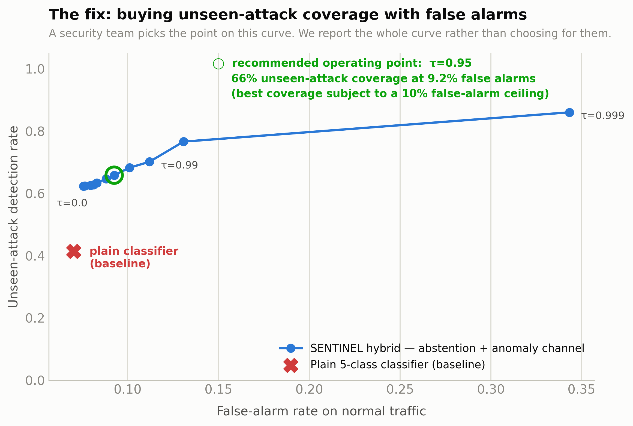
THE SOLUTION WORKS
Unseen-attack coverage rises 24 points for 2 points of false alarms
41.5%
65.9%
unseen attacks caught — plain classifier
unseen attacks caught — SENTINEL hybrid
+24.4 pp
coverage gained, for only +2.23 pp of false alarms
An unsupervised model that never saw a single attack detects unseen attacks better than the supervised one — 0.566 vs 0.415.
SENTINEL-NIDS · ML Bubble 2026 · TE-BE Advanced
13
Notes:
τ is a staffing decision, not a hyperparameter. Report the curve, don't pick for the operator.

Slide 14
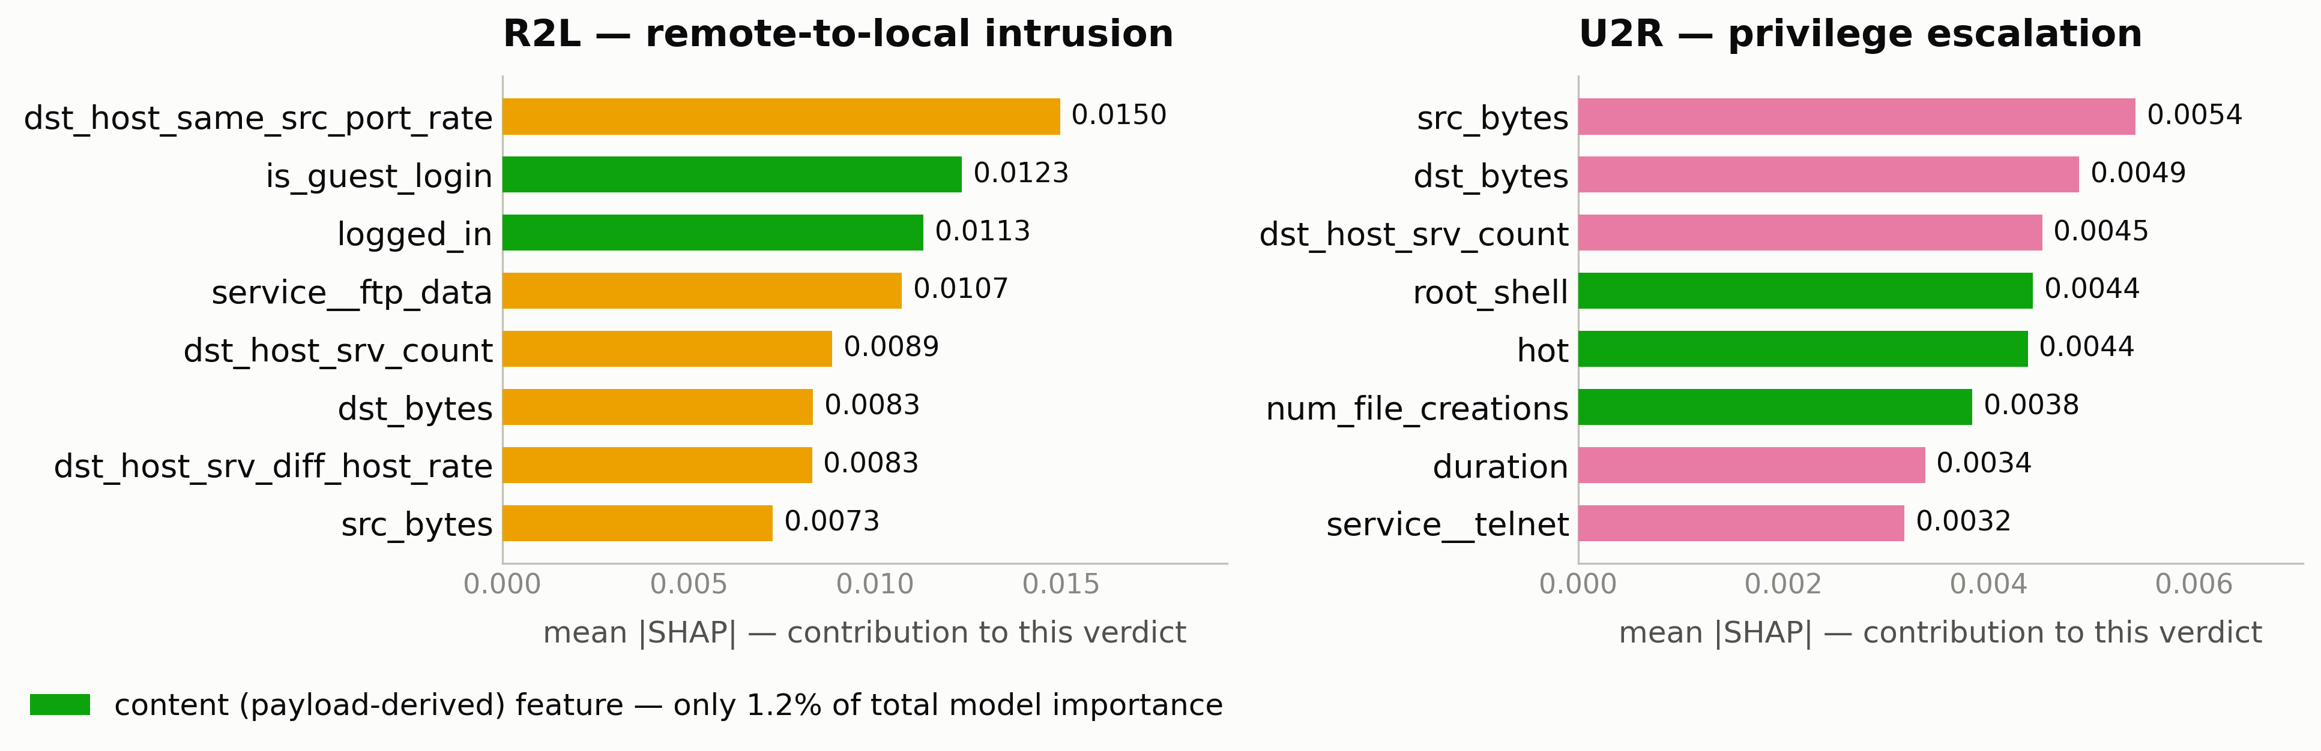
EXPLAINABILITY
Why R2L and U2R fail — a mechanistic answer, not a shrug
1.23% of total model importance sits in CONTENT features
51.72% sits in basic header / byte-count features
The model became a traffic-pattern detector, because that is 99% of its training signal. A successful password guess just looks like one ordinary login.
SENTINEL-NIDS · ML Bubble 2026 · TE-BE Advanced
14
Notes:
Round 2 is a Model Explanation round — this slide is the one to expand if they push.

Slide 15
DEPLOYMENT CONSIDERATIONS
Deployment: the best model is also the cheapest to run
0.0129 ms
4.9 KB
per flow, ONNX Runtime single-threaded
deployed model size on disk
810k flows/s
single-threaded throughput — about 8× a saturated 1 Gbps link
Random forest — the reflexive choice — is 5,055× slower and 8,027× larger, for 0.05 LOWER macro-F1.
p50 inference latency per flow (ms). Random forest is off-scale at 65.206 ms.
SENTINEL-NIDS · ML Bubble 2026 · TE-BE Advanced
15
Notes:
Caveat to volunteer: this measures inference on pre-computed features. Feature extraction from a live packet stream is the harder problem and is out of scope.

Slide 16
WHAT THIS PROJECT DOES NOT CLAIM
Stated here rather than buried
Dataset age
Single dataset
NSL-KDD is 1999-era simulated traffic. The methodological finding transfers to any dataset with a designed shift; the absolute numbers do not describe a 2026 network.
The strongest remaining criticism. Cross-dataset validation was planned; UNSW-NB15 and CIC-IDS2017 hosts are unreachable from the build environment.
The fix is partial
R2L and U2R remain unsolved
Even at the recommended operating point, 34% of unseen attacks are still missed. That is a real gap, not a rounding error.
Best-case recall 0.106 and 0.105 across all eight models. We explain the cause mechanically; we do not fix it.
No adversarial robustness
Feature extraction out of scope
We evaluate against a fixed dataset, not an adaptive adversary. A linear model is easy to evade with white-box knowledge.
Latency figures measure inference on pre-computed flow aggregates. Computing them from live packets is the harder engineering problem.
For a defence evaluator, a system whose limits are known is worth more than one whose headline number cannot be trusted.
SENTINEL-NIDS · ML Bubble 2026 · TE-BE Advanced
16

Slide 17
Everything here is reproducible
Every number on every slide is read from a JSON file in reports/metrics/. None was typed by hand.
Reproduce the whole project
Reproduce just the headline
git clone <repo> && cd sentinel-nids
pip install -r requirements.txt
python run_all.py
python run_all.py --only leakage
≈ 35 seconds. Prints both protocols
and the gap between them.
Submitted artefacts
Source code (9 modules, all idempotent and checkpointed) · dataset provenance + SHA-256 manifest · 6 metrics JSON files · 12 figures · README, methodology, model card, deployment notes · FastAPI inference service · 4.9 KB ONNX model · this deck
A detector that reports 99.5% accuracy silently clears 77% of never-before-seen attacks. Measuring it honestly is the whole job.
SENTINEL-NIDS · ML Bubble 2026 · TE-BE Advanced
17

