Slide 1
CareAssist
Project Presentation
Medical Billing and Claims
Management System
CareAssist
Student Name
MANOJKANNA S
Trainer Name
Javeed
Project Name
CareAssist - Medical Billing and Claims Management System

Slide 2
Project Description
A healthcare web application for billing, invoices, claims, and role-based operations.
What the system does
Patient
Provider
View invoices, pay bills, submit claims, manage insurance and profile.
Generate invoices, notify patients, view provider invoices and requests.
CareAssist connects patients, healthcare providers, insurance companies, and administrators in one platform. It supports medical invoice generation, payments, claim submission, claim approval, and user account management.
Insurance
Admin
Review submitted claims and approve or reject insurance coverage.
Monitor dashboard, manage users, patients, providers, payments, and claims.
Main goal: reduce manual billing and claim tracking work.
02

Slide 3
Technology Used
Frontend, backend, database, security, and deployment tools used in CareAssist.
Frontend
Backend
Database
React, JSX, Axios, CSS, Bootstrap-style layout
Java 21, Spring Boot, REST API, Service layer
MySQL, Spring Data JPA, Hibernate ORM
Security
Documents
Deployment
Spring Security, JWT authentication, GitHub OAuth2 login
PDF invoice generation and email notification
Docker, AWS EC2 backend, AWS S3 frontend hosting
Layered architecture used: Controller → Service → Repository → MySQL Database
03

Slide 4
Application Flow
How users move through the CareAssist system.
1
2
3
4
5
Login / OAuth2
Role Dashboard
Invoice & Claim
Approval & Payment
PDF + Email
User signs in and receives role-based access.
Patient, provider, insurance, and admin see separate modules.
Provider generates invoice; patient pays or submits claim.
Insurance/admin track claim and payment status.
Invoice PDF can be downloaded and notification can be sent.
Security control: JWT tokens and role authorization protect each dashboard and API route.
04

Slide 5
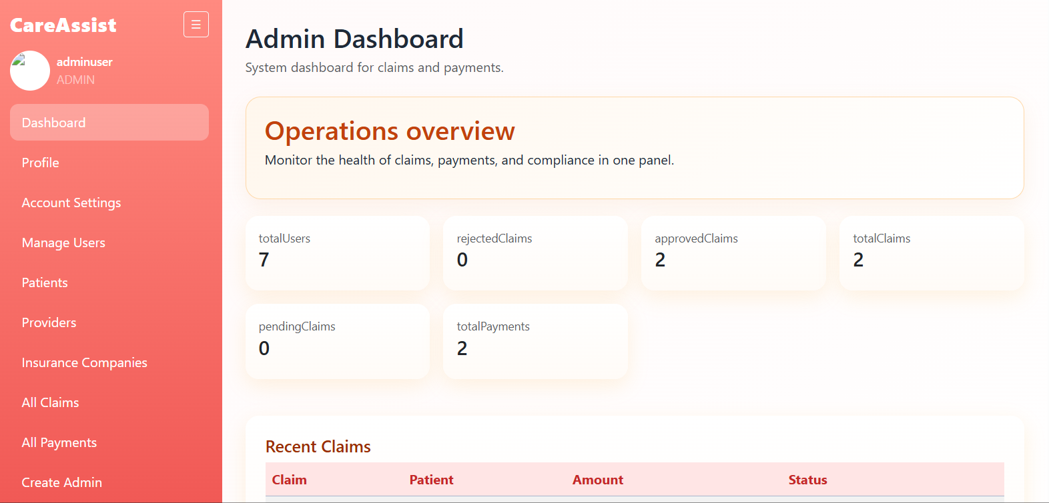
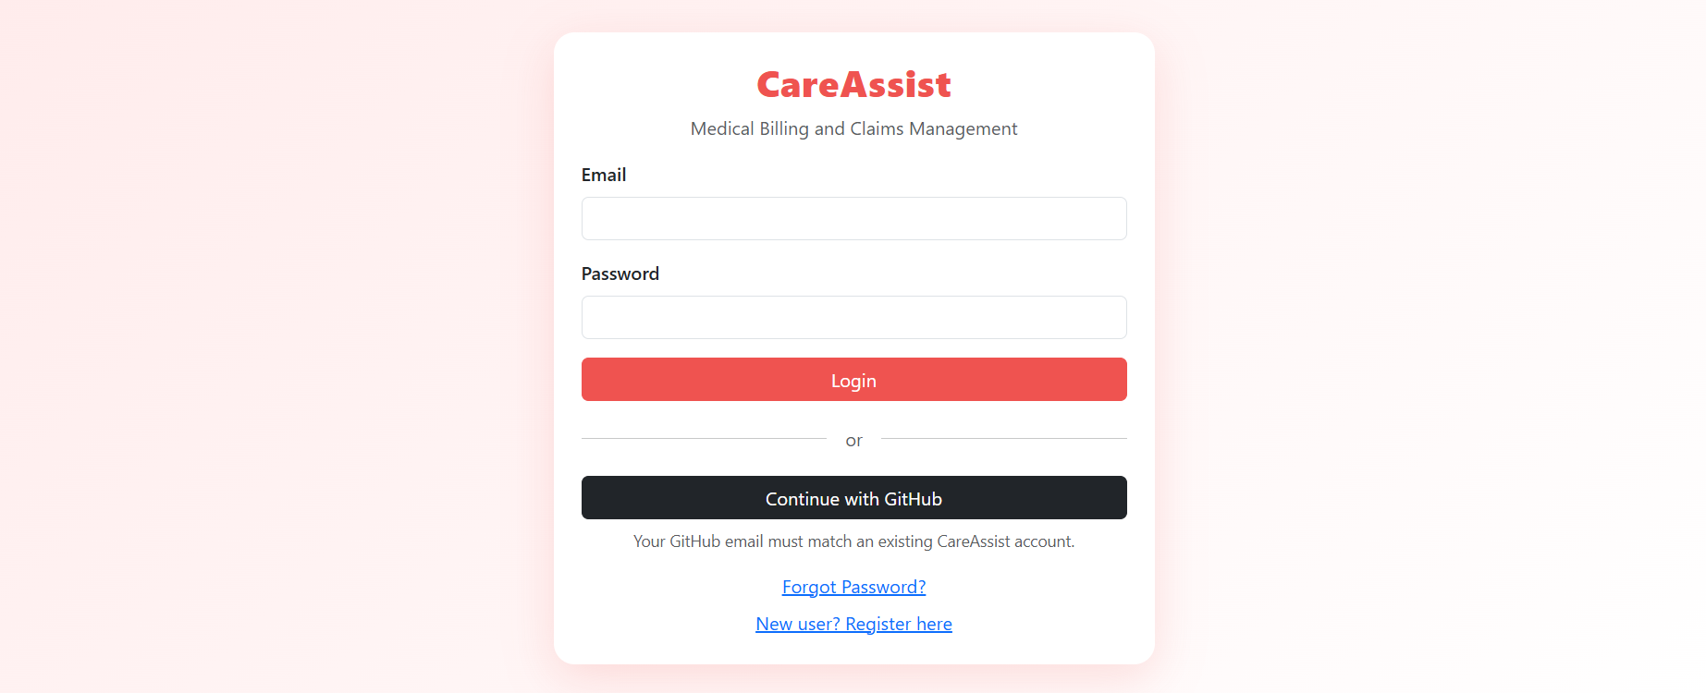
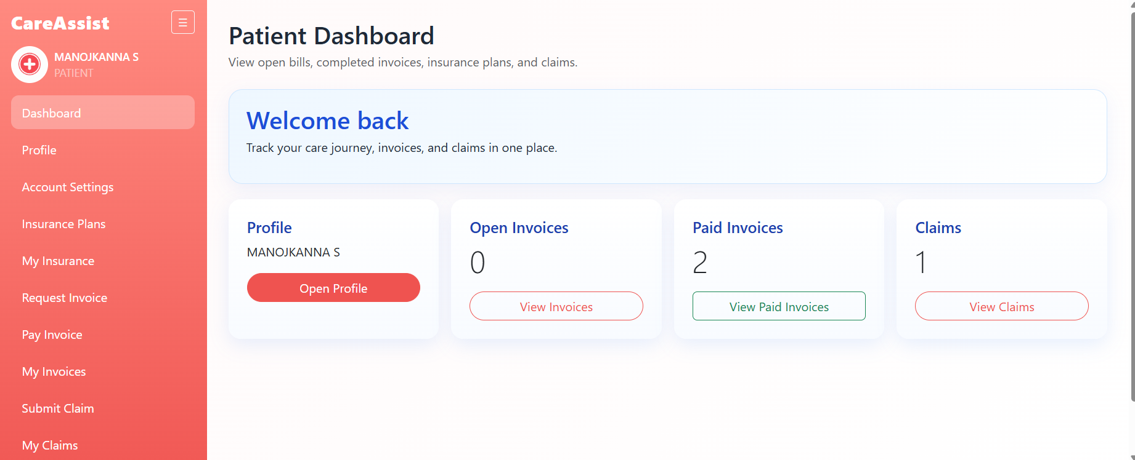
Output Images: Login and Dashboards
Screens captured from the CareAssist frontend.
Login page with GitHub OAuth option
Admin dashboard: overview metrics
Role-based UI
Each login role opens different navigation and features. The admin panel focuses on operations, while patient pages focus on invoices, payments, plans, and claims.
Patient dashboard: invoices and claims
05

Slide 6
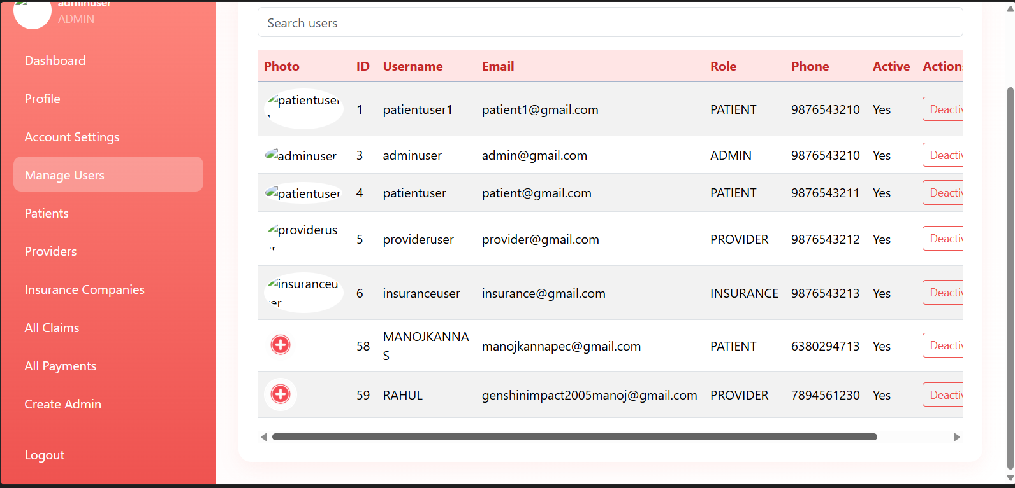
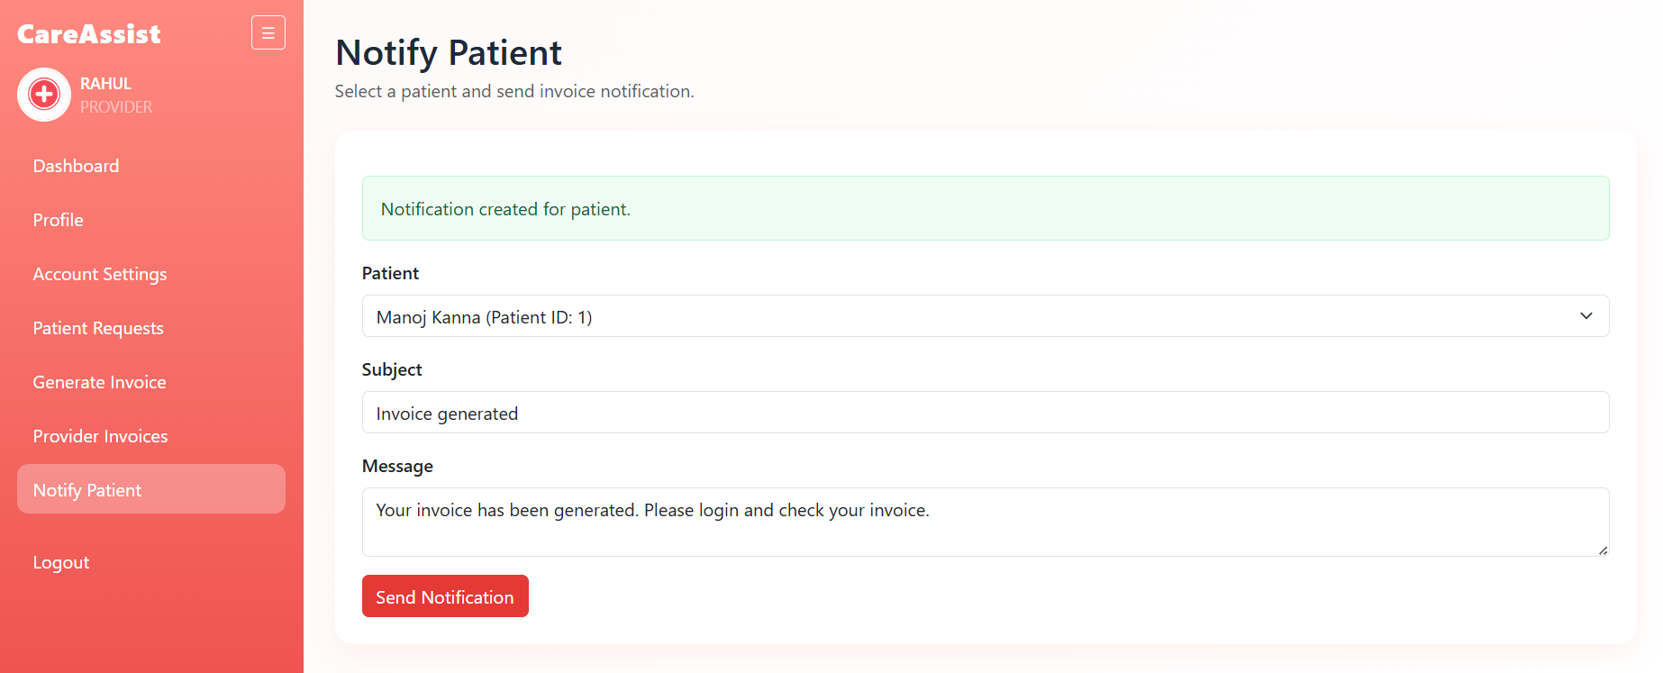
Output Images: Provider Features
Provider side account update and patient notification screens.
Account settings and profile picture management
Notify patient after invoice creation
06

Slide 7
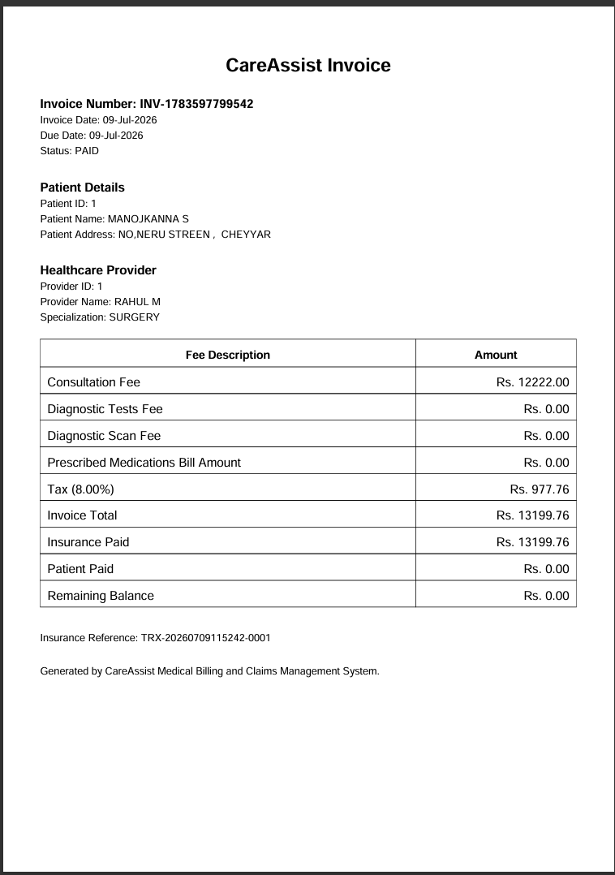
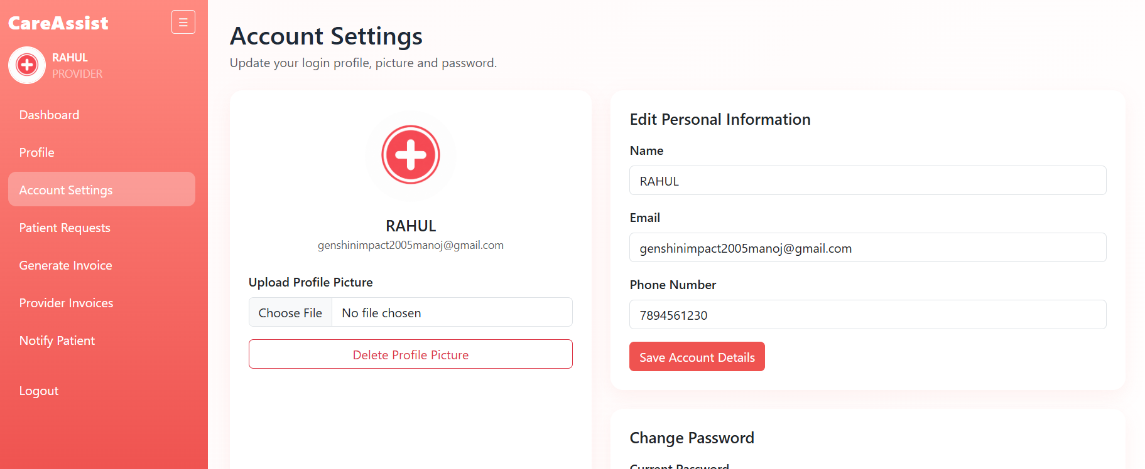
Output Images: Invoice PDF and User Management
Generated invoice document and admin user management view.
Generated PDF invoice
Verified outputs
Admin manages users and active status
The PDF includes invoice number, patient details, provider details, charges, tax, insurance paid amount, patient paid amount, and remaining balance.
07

Slide 8
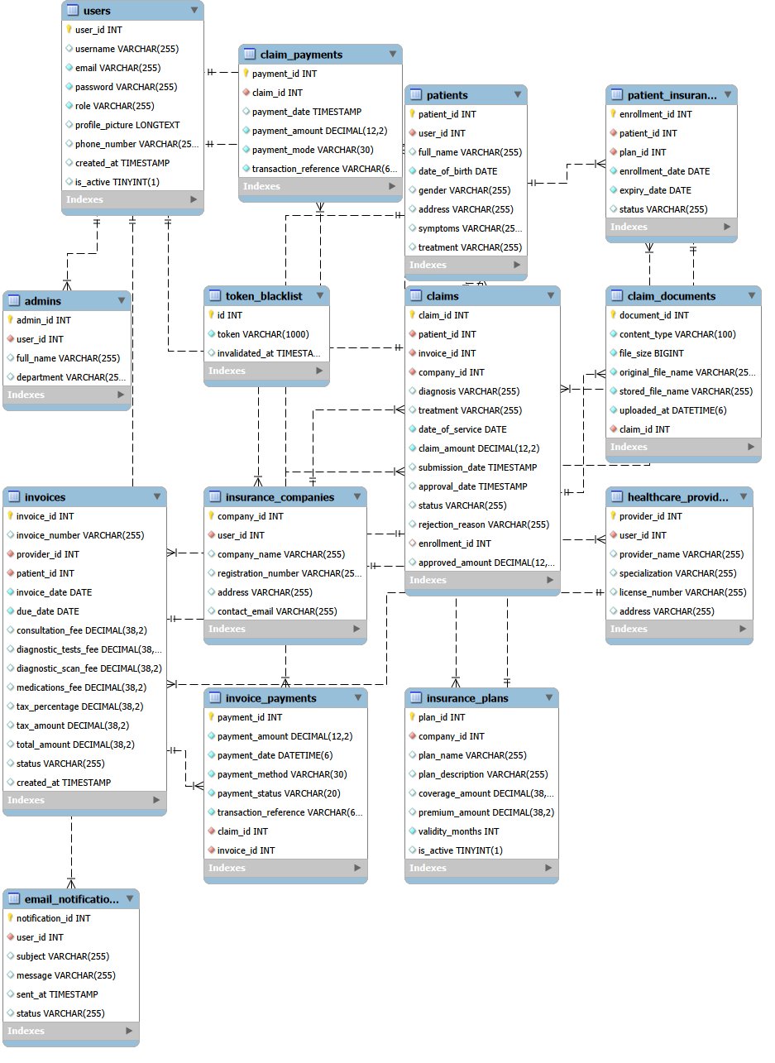
ER Diagram
Core tables and relationships for the CareAssist MySQL database.
08

Slide 9
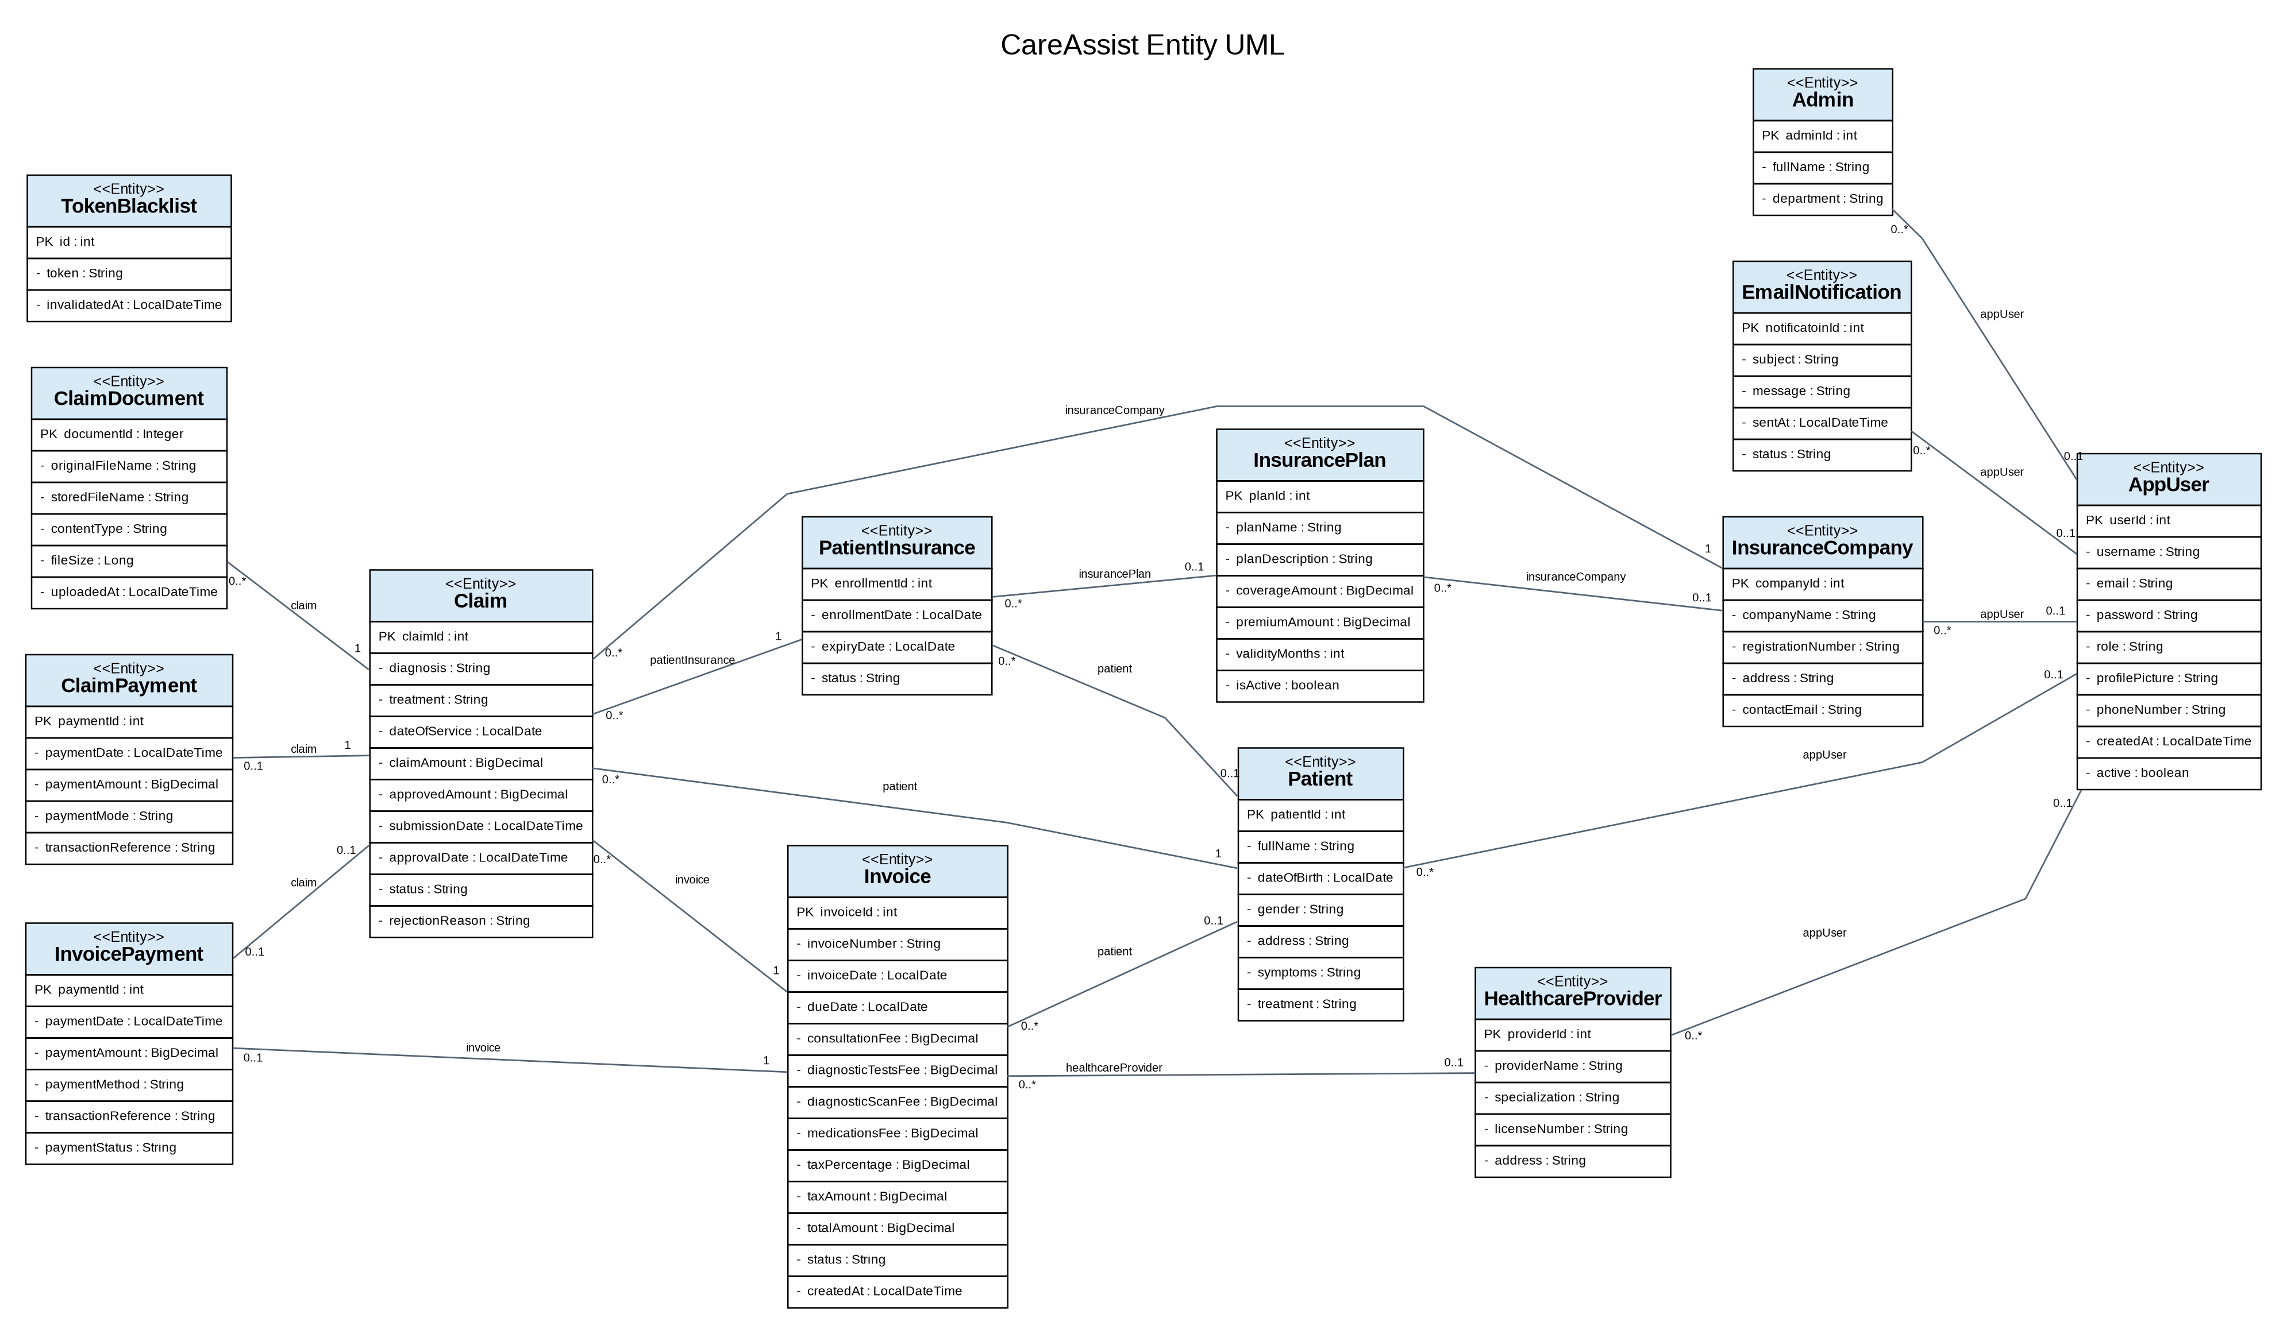
UML Diagram: Entity Classes
Entity-level class relationships used by the backend domain model.
09

Slide 10
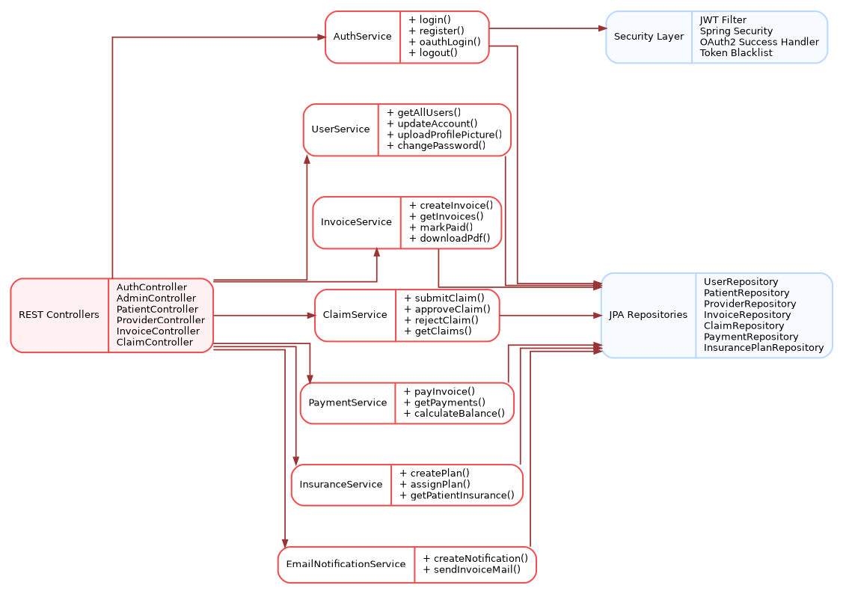
UML Diagram: Service Layer
Service classes connect API controllers, security, repositories, and business operations.
10

Slide 11
Conclusion
CareAssist completed a full-stack workflow from login to invoice, payment, claim, PDF, and notification.
Final Outcome
Implemented separate dashboards for Admin, Patient, Provider, and Insurance roles.
Integrated Spring Boot APIs with the React frontend using secure role-based access.
Generated invoices, handled payments, submitted claims, and created PDF invoice output.
Added email notification and profile picture/account management features.
Prepared database and UML diagrams to explain the backend structure clearly.
Thank You
11

