Slide 1

CodeGenie
Multi-Modal Offline Chatbot
Privacy-Focused, Local AI Assistant
Presented by Karri Manoj

Slide 2

Core Capabilities
Text-based chat with intelligent responses
Document processing (PDF, DOCX)
A Versatile, Offline Conversational Agent
Image analysis with OCR technology
Voice interaction for hands-free queries
Technology Stack
Streamlit for dynamic web interface
Ollama LLM for local AI processing
EasyOCR for text extraction

Slide 3

The Challenge
The Solution
Over-Reliance on External Services
CodeGenie: Self-Contained Local Bot
Dependency on cloud-based AI services for routine tasks
Offline capability with local Ollama LLM
Privacy concerns with data transmission to external servers
Complete data privacy – conversations stay local
Requires constant internet connectivity
Multi-modal input – text, PDF, images, voice
Limited control over data and processing
Reduces dependency on external AI services

Slide 4

Streamlit and Local LLM Integration
Frontend
Backend & Core Logic
Integration Flow
Streamlit UI – Interactive web interface
Ollama LLM – Local language model at localhost:11434
1. Input Reception – User provides text, file, or voice
Session State – Manages chat history and user inputs
EasyOCR – Text extraction from images
2. Processing – Extract text using appropriate library
Input Handlers – Text, file upload, microphone
PyPDF – PDF document processing
Chat Display – Renders messages and responses
Python-DOCX – Word document parsing
3. Context Building – Add to message history
4. LLM Query – Send to Ollama API
User Interactions
Processing Libraries
5. Response – Receive and display result
Text input area and chat history
PIL – Image handling and conversion
File uploader for documents and images
Speech Recognition – Voice-to-text conversion
Key Feature
Requests – HTTP calls to Ollama API
All processing occurs locally – no external dependencies

Slide 5

Conversational Flow with Local LLM
Step-by-step process of user input through response generation
1
User Input
User types a query into the Streamlit text area and submits the message.
2
Message Append
The user's message is added to the st.session_state.messages list for conversation history.
3
API Call to Ollama
A requests.post call is made to the local Ollama API at http://localhost:11434/api/chat with the full message history as payload.
4
Response Generation
The local LLM (Llama 3.2) processes the request and generates an intelligent response based on the conversation context.
5
Display Output
The assistant's response is received, appended to the message history, and rendered in the chat interface for the user to see.

Slide 6

Extracting Text from Images and Documents
1
File Upload
User uploads an image (PNG, JPG) or document (PDF, DOCX) through the file uploader interface.
2
File Type Detection
The extract_text_from_file() function identifies the file type by checking the MIME type.
3
Image Processing with OCR
For images, PIL opens the file and easyocr.Reader(['en']) processes the image array to extract text using optical character recognition.
4
Document Processing
For PDFs, pypdf.PdfReader extracts text page by page. For DOCX files, docx.Document extracts text paragraph by paragraph.
5
LLM Context Integration
The extracted text is added to the chat history as a user message, providing context for the local LLM to process and generate intelligent responses.

Slide 7

Voice-to-Text Integration Workflow
1
Microphone Activation
User clicks the microphone button, setting st.session_state.mic_active to True
2
Listening Mode
The capture_voice_input() function activates the microphone
Uses speech_recognition.Microphone() to capture audio
3
Voice Recognition
Recorded audio is sent to Google's Speech Recognition service
Uses recognizer.recognize_google() for transcription
4
Text Conversion
Spoken words are converted into a text string
Error handling for unrecognized speech or network issues
5
Query Submission
Transcribed text is used as user_input in the main chat loop
Follows the same workflow as text-based search with Ollama LLM

Slide 8

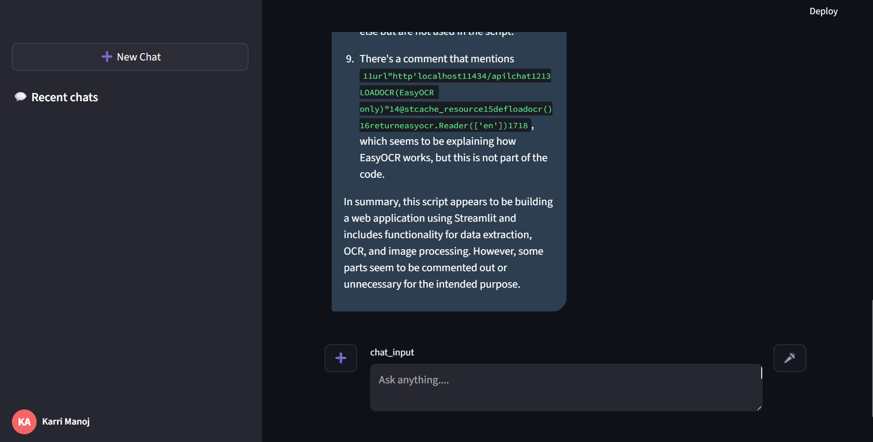
Live Demo
Showcasing Multi-Modal Capabilities
CodeGenie successfully integrates multiple input modalities with a powerful, privacy-focused local LLM architecture.

