Slide 1


TCS302: Data Structures with C
Unit 1, Lecture 1
Introduction to Data Structures
Today we will understand why computers need data structures before we start coding arrays, stacks, queues, trees and graphs.
Mr. Manoj Kaushik
Assistant Professor, Department of CSE
Graphic Era Hill University, Bhimtal
Notes:
Begin with a question: before using an app, where is the data kept and how does the app find it quickly? Tell students this lecture builds the foundation for the entire subject.

Slide 2
TCS302: Data Structures with C
Unit 1 | Lecture 1
2
Why are we studying Data Structures?
A program is not only a set of instructions. It also needs a smart way to store, access and update data.
Example 1
Searching a contact by name in a phonebook app.
Example 2
Undo operation in an editor or IDE.
Example 3
Finding the shortest route on Google Maps.
Fast access
Less memory waste
Clear logic
Scalable programs
Teaching cue: Ask: Which app on your phone uses the largest amount of data?
Notes:
Explain that the same data can be stored in many ways, and the chosen structure decides how fast or slow the program becomes.

Slide 3
TCS302: Data Structures with C
Unit 1 | Lecture 1
3
Opening Question: Think Before Coding
Suppose we have marks of 60 students. We need to store them, calculate average, find the highest marks and display all failed students.
1. Store
Where will marks be kept?
2. Access
How will we read each mark?
3. Update
How will we change a wrong entry?
4. Process
How will we find average and highest marks?
Notes:
Use this as a warm-up. Do not immediately give the definition. Help students realize that data organization comes before algorithm design.

Slide 4
TCS302: Data Structures with C
Unit 1 | Lecture 1
4
Data, Information and Organization
Data
Processing
Information
Raw facts
Marks: 78, 52, 91
Names: Ravi, Asha
Roll numbers: 101, 102
Organize + compute
Search
Sort
Update
Compare
Meaningful result
Class average = 73.6
Topper = 91
Failed students = 4
Teaching point: Data structures help us move from raw data to useful information efficiently.
Teaching cue: Give one example from attendance, library books, or exam marks.
Notes:
Use an everyday example: raw attendance entries become useful information only after we organize and count them.

Slide 5
TCS302: Data Structures with C
Unit 1 | Lecture 1
5
What is a Data Structure?
A data structure is a particular way of organizing data in memory so that operations like access, insertion, deletion, searching and traversal can be performed efficiently.
Key idea 1
It stores data.
Key idea 2
It defines relationships among data items.
Key idea 3
It supports useful operations.
In C, we build data structures using variables, arrays, structures, pointers and dynamic memory allocation.
Teaching cue: Write the definition on board and ask students to underline “organizing data in memory”.
Notes:
After reading the definition, slow down on memory and operations. Students often memorize the definition but miss the purpose.

Slide 6
TCS302: Data Structures with C
Unit 1 | Lecture 1
6
Elementary Data Organization
Bit
0 or 1
Byte
8 bits
Field
Roll No.
Record
One student
File
All students
Database
Many files
Example: A university result system stores bit-level values, characters, fields such as roll number, complete student records, result files and a database.
Teaching cue: Ask students to identify field and record from their ID card.
Notes:
Use an ID card or attendance sheet as a concrete object. Explain that a record is a collection of related fields.

Slide 7
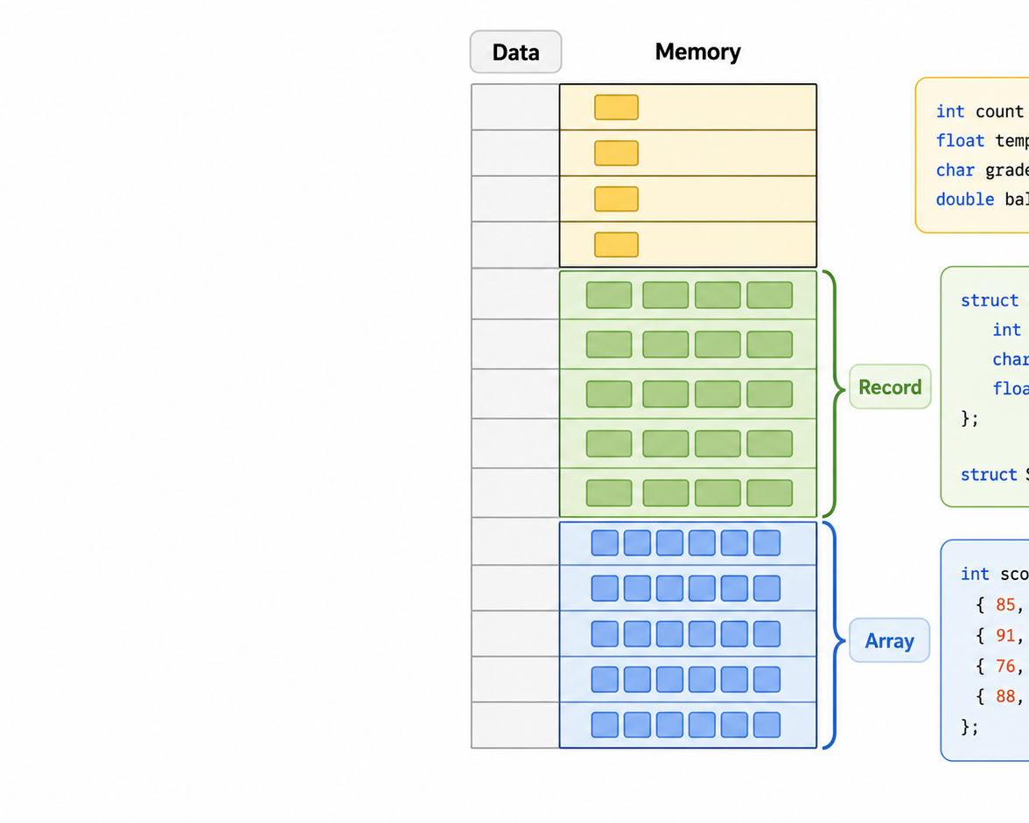
TCS302: Data Structures with C
Unit 1 | Lecture 1
7
How Data Looks Inside Memory
When we write a C program, data is stored in memory blocks. The way we group these blocks creates a data structure.
A variable stores one value.
An array stores similar values together.
A structure groups different fields.
Pointers help create dynamic structures.
Preview: In the next lectures, we will connect C syntax with memory organization.
Teaching cue: Explain memory using boxes, not abstract theory.
Notes:
Point to the image: individual values, arrays and records. Keep it simple because pointer and structure details will come later.

Slide 8
TCS302: Data Structures with C
Unit 1 | Lecture 1
8
Common Operations on Data Structures
A data structure is useful only when we can perform operations on it.
Create
Make the structure
Traverse
Visit each item
Search
Find an item
Insert
Add new data
Delete
Remove data
Update
Modify data
Example: In a contact list, adding a new contact is insertion; finding “Satish” is searching; showing all contacts is traversal.
Teaching cue: Ask: Which operation happens when we delete a WhatsApp chat?
Notes:
Use a contact list. Ask students to map each operation to their mobile phone.

Slide 9
TCS302: Data Structures with C
Unit 1 | Lecture 1
9
Types of Data Structures: First Classification
Data Structures
Primitive
Built-in basic data types
int, char, float, double
Non-Primitive
Derived or user-defined structures
array, stack, queue, list, tree, graph
In this course, our main focus is non-primitive data structures implemented using C.
Teaching cue: Clarify that int is data type, but array/list/tree are data structures.
Notes:
Students may confuse data type and data structure. Mention that data structures are built using data types.

Slide 10
TCS302: Data Structures with C
Unit 1 | Lecture 1
10
Linear and Non-Linear Data Structures
Linear Data Structures
Non-Linear Data Structures
Elements are arranged sequentially. Each item has a clear previous and next item.
Elements are arranged hierarchically or as networks. One item may connect to many items.
Examples
Array, Linked List, Stack, Queue
Examples
Trees, Graphs
Quick check: Is a railway route map linear or non-linear?
Teaching cue: Pause for answers; students usually say graph after thinking of stations and connections.
Notes:
Use a line of students for linear and a family tree or road map for non-linear.

Slide 11
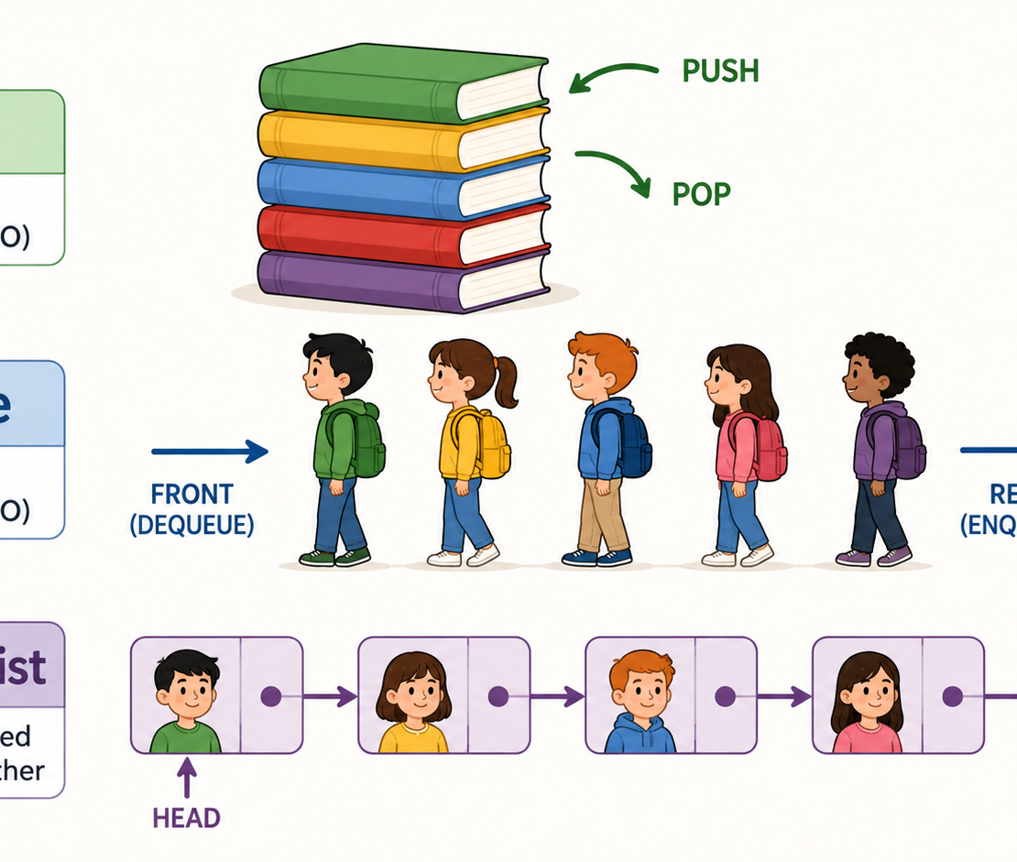
TCS302: Data Structures with C
Unit 1 | Lecture 1
11
Static and Dynamic Data Structures
Static
Dynamic
Size is fixed before execution or at declaration time.
Size can grow or shrink during program execution.
Example:
int marks[60];
Example:
linked list using pointers
Teaching point: static is simple and fast, dynamic is flexible but requires careful pointer handling.
Teaching cue: Do not go deep into malloc yet; this is a preview for coming lectures.
Notes:
Explain through class strength. If exactly 60 students, array is fine. If students can join and leave frequently, a linked list may be more flexible.

Slide 12
TCS302: Data Structures with C
Unit 1 | Lecture 1
12
Real-World Analogies Make It Easy
Array
Stack
Queue
Graph
Roll-number wise bench seats
index-based access
Pile of books
last book added comes out first
Line at a ticket counter
first person enters first
Cities and roads
many-to-many connections
Classroom activity: Ask each group to give one more example for any one data structure.
Teaching cue: Let examples come from students; correct gently if analogy is incomplete.
Notes:
This slide helps create memory hooks. Encourage students to give examples from campus life: mess queue, library shelves, bus routes.

Slide 13
TCS302: Data Structures with C
Unit 1 | Lecture 1
13
How Do We Choose the Right Data Structure?
1. What operation is most frequent?
search, insert, delete, traverse
3. Is order important?
sequence, priority, hierarchy
2. How much data will come?
small, large, growing, fixed
4. What memory is available?
fixed storage or dynamic allocation
Important rule for students: Never choose a data structure only because it is familiar. Choose it because it fits the problem.
Teaching cue: Connect this to engineering problem-solving, not memorization.
Notes:
This slide develops thinking habits. State that the best programmers first understand operations and constraints.

Slide 14
TCS302: Data Structures with C
Unit 1 | Lecture 1
14
Bridge to C Programming
In C, data structures are built step by step from simple language features.
Variables
store single values
Arrays
store similar values
Structures
group different fields
Pointers
connect memory locations
struct Student {
int roll;
float marks;
};
struct Student s[60];
Teaching cue: Read the code aloud and ask what s[60] represents.
Notes:
Explain that structures and arrays can be combined. Do not go into deep syntax; this is a preview.

Slide 15
TCS302: Data Structures with C
Unit 1 | Lecture 1
15
Mini Classroom Activity
Problem
A library wants to store book records. Each book has book ID, title, author and availability status.
Discuss in pairs for 3 minutes:
Expected direction: A book record can be represented using a structure; multiple book records can be stored in an array if total size is fixed.
What should be one record?
What fields should it contain?
Would you store all books in an array or linked list?
Which operations will be frequent?
Teaching cue: Use this as formative assessment before the recap.
Notes:
Let students discuss. Then pick two responses. This checks if students understood fields, records and choosing a structure.

Slide 16
TCS302: Data Structures with C
Unit 1 | Lecture 1
16
Recap and Exit Questions
What we learned today
Exit Questions
Data structures organize data in memory.
Good organization improves program efficiency.
Data can be arranged as fields, records, files and databases.
Common operations include traversal, searching, insertion and deletion.
Data structures may be primitive/non-primitive, linear/non-linear and static/dynamic.
Define data structure in your own words.
Give one example of a linear data structure.
Why is a graph useful for road networks?
What is the difference between field and record?
Next Lecture: Basic terminology continued, pointers, structures and dynamic memory allocation in C.
Teaching cue: Ask students to write answers to exit questions in 5 minutes.
Notes:
Use exit questions to close the session. Collect a few answers orally or in notebook.

