Slide 1


TCS302: Data Structures with C
Unit 1, Lecture 2
Data Structure Operations and ADT
How data structures become useful through operations and abstraction.
Manoj Kaushik
Department of Computer Science and Engineering
Manoj Kaushik
Department of Computer Science and Engineering
Notes:
Welcome the students. Tell them that Lecture 1 introduced basic data organization. Lecture 2 focuses on the operations and the idea of ADT.

Slide 2
TCS302: Data Structures with C
Unit 1 | Lecture 2
Where Are We in Unit 1?
We are moving from storing data to working with data.
Lecture 1
Basic terminology
Lecture 2
Operations + ADT
Lecture 3
Pointers + structures
• A data structure is not only a storage format.
• We must also define what operations are allowed.
• ADT helps us separate usage from implementation.
Question: Is a stack only a pile of data, or also a set of rules?
Teaching cue: Ask students to recall one example from Lecture 1.
Notes:
Use this slide to create continuity. Mention that the next lecture will use C features to implement these ideas.

Slide 3
TCS302: Data Structures with C
Unit 1 | Lecture 2
Learning Outcomes
By the end of today’s lecture, students should be able to:
1
Identify common operations
3
Define Abstract Data Type
2
Explain why operation cost matters
4
Separate interface from implementation
Class rule: always ask, “Which operation is most important here?”
Teaching cue: Read outcomes as promises to students.
Notes:
Keep this slide short. The goal is to make students clear about the purpose of the lecture.

Slide 4
TCS302: Data Structures with C
Unit 1 | Lecture 2
What Is an Operation?
An operation is an action performed on stored data.
Create
Traverse
Search
Insert
Delete
Update
Access
• Different structures support these operations differently.
• Choosing the wrong structure makes the program slower or harder.
Teaching cue: Ask which operation happens when a student record is corrected.
Teaching cue: Ask which operation happens when a student record is corrected.
Notes:
Introduce operation names. Avoid deep complexity details here; focus on meaning.

Slide 5
TCS302: Data Structures with C
Unit 1 | Lecture 2
Create and Initialize
Before using a structure, we must prepare it correctly.
• Creation allocates or reserves space.
• Initialization gives meaningful starting values.
• Uninitialized data may produce wrong results.
int marks[5] = {72, 85, 91, 68, 77};
• Creation allocates or reserves space.
• Initialization gives meaningful starting values.
• Uninitialized data may produce wrong results.
72
72
85
85
91
91
68
68
77
77
Ask students: What may happen if marks[] is declared but not initialized?
Ask students: What may happen if marks[] is declared but not initialized?
Teaching cue: Connect this with garbage values in C.
Teaching cue: Connect this with garbage values in C.
Notes:
Explain that creating a data structure is the first operation. In C, uninitialized variables are a common source of errors.

Slide 6
TCS302: Data Structures with C
Unit 1 | Lecture 2
Traversal
Traversal means visiting every element exactly once.
for (int i = 0; i < n; i++) {
printf("%d ", marks[i]);
}
72
85
91
68
77
• Used for printing, summing and scanning data.
• For n elements, each element is visited once.
• Time complexity is usually O(n).
Quick check: Can traversal be O(1) if all n elements must be visited?
Teaching cue: Let students answer before showing O(n).
Notes:
Use the highlighted cell to show that a loop moves step by step.

Slide 7
TCS302: Data Structures with C
Unit 1 | Lecture 2
Searching
Searching means finding an element with a given value or key.
• Linear search checks elements one by one.
• Binary search needs sorted data.
• The best method depends on data organization.
12
25
37
49
58
Target = 49
if (arr[i] == key)
return i;
Teaching cue: Ask students why binary search cannot be applied directly to unsorted data.
Notes:
Explain that searching is a common operation in databases, contact lists and student records.

Slide 8
TCS302: Data Structures with C
Unit 1 | Lecture 2
Insert, Delete and Update
These operations change the contents of a data structure.
Insert
Delete
Update
• Add a new element
• May require shifting
• May require free space
• Remove an element
• May require searching
• May cause underflow
• Modify an existing value
• Needs correct position
• Useful in records
Real example: changing a student’s wrong marks is an update operation.
Teaching cue: Ask students to give one example of each operation from daily life.
Notes:
These are mutation operations. Explain that they may be costlier than traversal depending on structure.

Slide 9
TCS302: Data Structures with C
Unit 1 | Lecture 2
Why Operation Cost Matters
The same operation may be easy in one structure and costly in another.
Operation
Array
Array
Linked List
Linked List
Access by index
Access by index
Fast
Fast
Slow
Slow
Insert at beginning
Insert at beginning
Costly
Costly
Fast
Fast
Traversal
Traversal
Linear
Linear
Linear
Linear
Engineering decision: choose the structure according to the most frequent operation.
Engineering decision: choose the structure according to the most frequent operation.
Teaching cue: Relate this with designing a contact list or marks table.
Teaching cue: Relate this with designing a contact list or marks table.
Notes:
Keep comparison qualitative here. Detailed complexity will follow in later lectures.

Slide 10
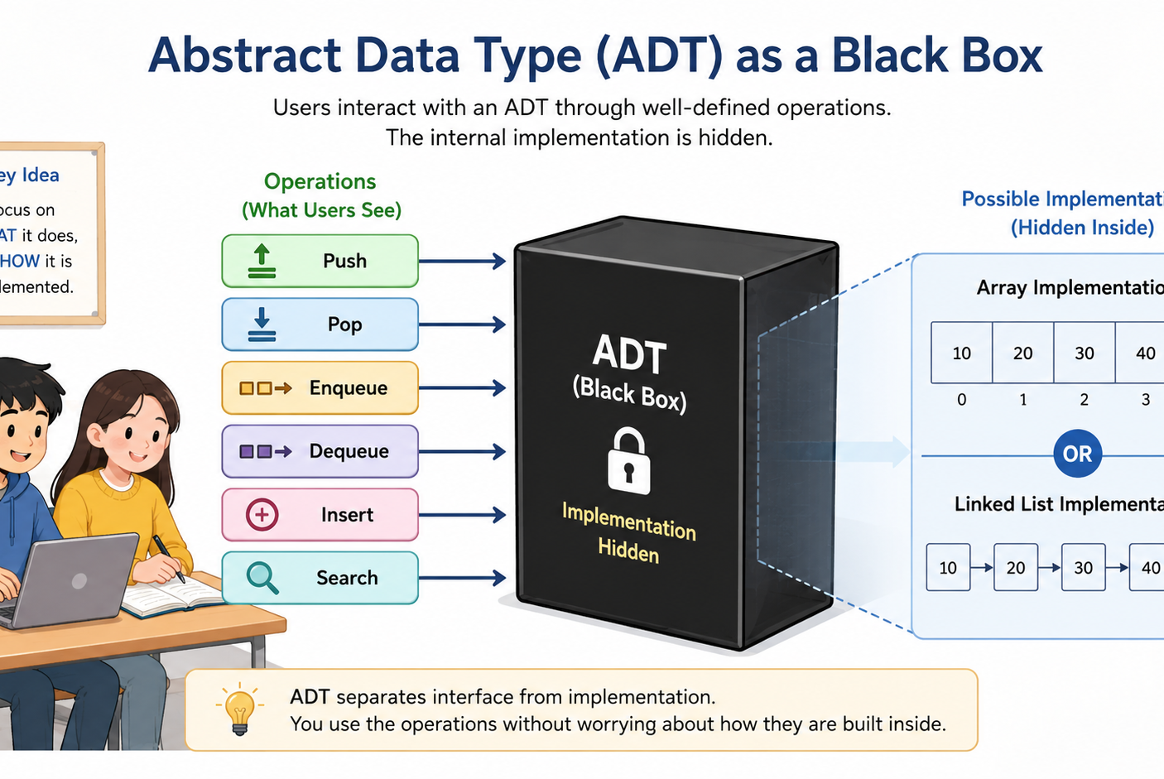
TCS302: Data Structures with C
Unit 1 | Lecture 2
Abstract Data Type: Main Idea
ADT focuses on what can be done, not how it is implemented.
• The user sees operations.
• The internal representation is hidden.
• This makes programs easier to change and reuse.
Analogy: We use an ATM by pressing buttons; we do not see the internal banking code.
Teaching cue: Use the black-box analogy slowly.
Notes:
ADT is a major conceptual point. Make sure students understand the separation between interface and implementation.

Slide 11
TCS302: Data Structures with C
Unit 1 | Lecture 2
ADT = Data + Operations + Rules
A clear ADT description has three parts.
Data
What is stored?
Operations
What can be done?
Rules
When is it valid?
Example: Stack ADT stores elements, supports push/pop/peek, and does not allow pop on an empty stack.
Teaching cue: Ask students to repeat the three parts: data, operations, rules.
Notes:
This is the central formula for the lecture.

Slide 12
TCS302: Data Structures with C
Unit 1 | Lecture 2
Stack as an ADT
A stack follows Last-In, First-Out behaviour.
push
• push(x): insert at top
• pop(): remove from top
• peek(): read top element
• Rule: pop is invalid when empty
Book 4
Book 3
Book 2
pop
Book 1
Question: Why is the last book kept the first book removed?
Teaching cue: Demonstrate using a pile of notebooks.
Teaching cue: Demonstrate using a pile of notebooks.
Notes:
Use physical analogy to reinforce LIFO.

Slide 13
TCS302: Data Structures with C
Unit 1 | Lecture 2
ADT vs Implementation
The behaviour may remain same while storage changes.
Array implementation
Stack ADT
push, pop, peek
Same user
experience
Same user
experience
Linked-list implementation
Linked-list implementation
Key idea: ADT is the promise; implementation is the method.
Key idea: ADT is the promise; implementation is the method.
Teaching cue: Say: the user calls pop(), but does not ask how memory is arranged.
Teaching cue: Say: the user calls pop(), but does not ask how memory is arranged.
Notes:
Make the interface versus implementation distinction explicit.

Slide 14
TCS302: Data Structures with C
Unit 1 | Lecture 2
ADT Thinking in C
C can express ADT ideas using structs and functions.
typedef struct {
int data[100];
int top;
} Stack;
void push(Stack *s, int x);
int pop(Stack *s);
• struct stores internal data.
• functions define legal operations.
• users should call functions, not directly modify top.
This is why pointers and structures are important in the next lecture.
Teaching cue: Explain Stack *s as access to the actual stack object.
Notes:
Do not go too deep into pointers yet. Just preview why pointers and structures are needed.

Slide 15
TCS302: Data Structures with C
Unit 1 | Lecture 2
Mini Classroom Activity
Design a simple LibraryBook ADT in pairs.
Problem: A library wants to manage books with ID, title, author and availability status.
• What data will the ADT store?
• Which operations are required?
• Which operation should be rejected as invalid?
• Which implementation may be suitable?
Expected operations:
addBook(), searchBook(),
issueBook(), returnBook()
Teaching cue: Give students 3 minutes, then take two answers.
Notes:
This activity reinforces ADT design: data, operations and rules.

Slide 16
TCS302: Data Structures with C
Unit 1 | Lecture 2
Recap and Exit Questions
Close the lecture with quick oral or written responses.
Today’s Recap
Exit Questions
• Operations make data structures useful.
• ADT hides implementation details.
• C uses structs and functions to support ADT thinking.
• Define ADT in one sentence.
• Why is pop invalid on an empty stack?
• Give one real example of update operation.
Next Lecture: Pointers, structures and dynamic memory allocation in C
Teaching cue: Ask students to submit one exit answer before leaving.
Notes:
End by previewing Lecture 3.

