Slide 1


TCS302: Data Structures with C
Unit 1, Lectures 3 & 4
Pointers, Structures, Dynamic Memory and Algorithm Complexity
How C memory tools influence program performance and design.
Manoj Kaushik
Department of Computer Science and Engineering
Manoj Kaushik
Department of Computer Science and Engineering
Notes:
Welcome the students. Tell them that Lecture 1 introduced basic data organization. Lecture 2 focuses on the operations and the idea of ADT.

Slide 2
TCS302: Data Structures with C
Unit 1 | Lectures 3 & 4
Where Are We in Unit 1?
We now connect C memory organization with algorithm performance.
Lecture 1
Basic terminology
Lecture 2
Operations + ADT
Lectures 3 & 4
Memory + complexity
• Pointers access memory through addresses.
• Structures group related fields into records.
• Dynamic allocation creates data at run time.
Question: Why must a data-structure programmer understand memory addresses?
Teaching cue: Relate the question to linked lists and dynamic arrays.
Notes:
Use this slide to create continuity. Mention that the next lecture will use C features to implement these ideas.

Slide 3
TCS302: Data Structures with C
Unit 1 | Lectures 3 & 4
Learning Outcomes
By the end of this combined lecture, students should be able to:
1
Use address and dereference operators
3
Allocate and release heap memory
2
Build and access structures
4
Analyse time and space growth
Class rule: draw the memory picture before tracing pointer code.
Teaching cue: Connect each outcome with one short C example.
Notes:
Keep this slide short. The goal is to make students clear about the purpose of the lecture.

Slide 4
TCS302: Data Structures with C
Unit 1 | Lectures 3 & 4
Pointer Vocabulary
A pointer is a typed variable that stores a memory address.
Address (&)
Pointer (*)
Dereference
NULL
Pointer arithmetic
Structure pointer
Dynamic pointer
• Type tells C how many bytes to read and how far p+1 moves.
• An uninitialized pointer must never be dereferenced.
Teaching cue: Read int *p as “p points to an integer.”
Teaching cue: Read int *p as “p points to an integer.”
Notes:
Introduce operation names. Avoid deep complexity details here; focus on meaning.

Slide 5
TCS302: Data Structures with C
Unit 1 | Lectures 3 & 4
Declare and Initialize a Pointer
Always give a pointer a valid address or NULL before using it.
• &x obtains the address of x.
• p stores that address.
• *p accesses the value at that address.
int x = 25;
int *p = &x;
• &x obtains the address of x.
• p stores that address.
• *p accesses the value at that address.
x
x
25
25
p
p
&x
&x
1000
1000
Ask students: If p stores 1000, what does *p produce?
Ask students: If p stores 1000, what does *p produce?
Teaching cue: Draw x and p as separate memory boxes.
Teaching cue: Draw x and p as separate memory boxes.
Notes:
Explain that creating a data structure is the first operation. In C, uninitialized variables are a common source of errors.

Slide 6
TCS302: Data Structures with C
Unit 1 | Lectures 3 & 4
Dereferencing Reads or Changes the Original Value
The operator * follows an address to the stored value.
int x = 10;
int *p = &x;
*p = 35;
10
20
30
40
50
• p gives the address of x.
• *p reads the current value of x.
• Assigning to *p changes x itself.
Quick check: After *p = 35, what value is stored in x?
Teaching cue: Trace each statement while pointing to the memory box.
Notes:
Use the highlighted cell to show that a loop moves step by step.

Slide 7
TCS302: Data Structures with C
Unit 1 | Lectures 3 & 4
Pointer Arithmetic with Arrays
For an int pointer, p+1 advances to the next integer element.
• The array name acts like the address of its first element.
• *(p+2) accesses the third element.
• Movement depends on the pointed-to type.
10
20
30
40
50
p points here
printf("%d", *(p + 2));
Teaching cue: Emphasize that pointer arithmetic must stay inside the array.
Notes:
Explain that searching is a common operation in databases, contact lists and student records.

Slide 8
TCS302: Data Structures with C
Unit 1 | Lectures 3 & 4
Three Ways Pointers Work in C
The same address idea supports reading, modifying and linking data.
Read
Modify
Link
• int value = *p;
• obtains pointed value
• no change to memory
• *p = 35;
• updates original value
• used in functions
• node->next = q;
• connects structures
• builds dynamic lists
Real example: swap(&a, &b) lets a function change both variables.
Teaching cue: Ask which operation needs the dereference operator.
Notes:
These are mutation operations. Explain that they may be costlier than traversal depending on structure.

Slide 9
TCS302: Data Structures with C
Unit 1 | Lectures 3 & 4
Structure Access: Object versus Pointer
Choose . for an object and -> for a pointer to an object.
Expression
Direct object
Direct object
Structure pointer
Structure pointer
Access name
Access name
s.name
s.name
ps->name
ps->name
Access CGPA
Access CGPA
s.cgpa
s.cgpa
ps->cgpa
ps->cgpa
Equivalent form
Equivalent form
(*ps).cgpa
(*ps).cgpa
ps->cgpa
ps->cgpa
Key idea: ps->field is a readable form of (*ps).field.
Key idea: ps->field is a readable form of (*ps).field.
Teaching cue: Keep parentheses around *ps before applying the dot operator.
Teaching cue: Keep parentheses around *ps before applying the dot operator.
Notes:
Keep comparison qualitative here. Detailed complexity will follow in later lectures.

Slide 10
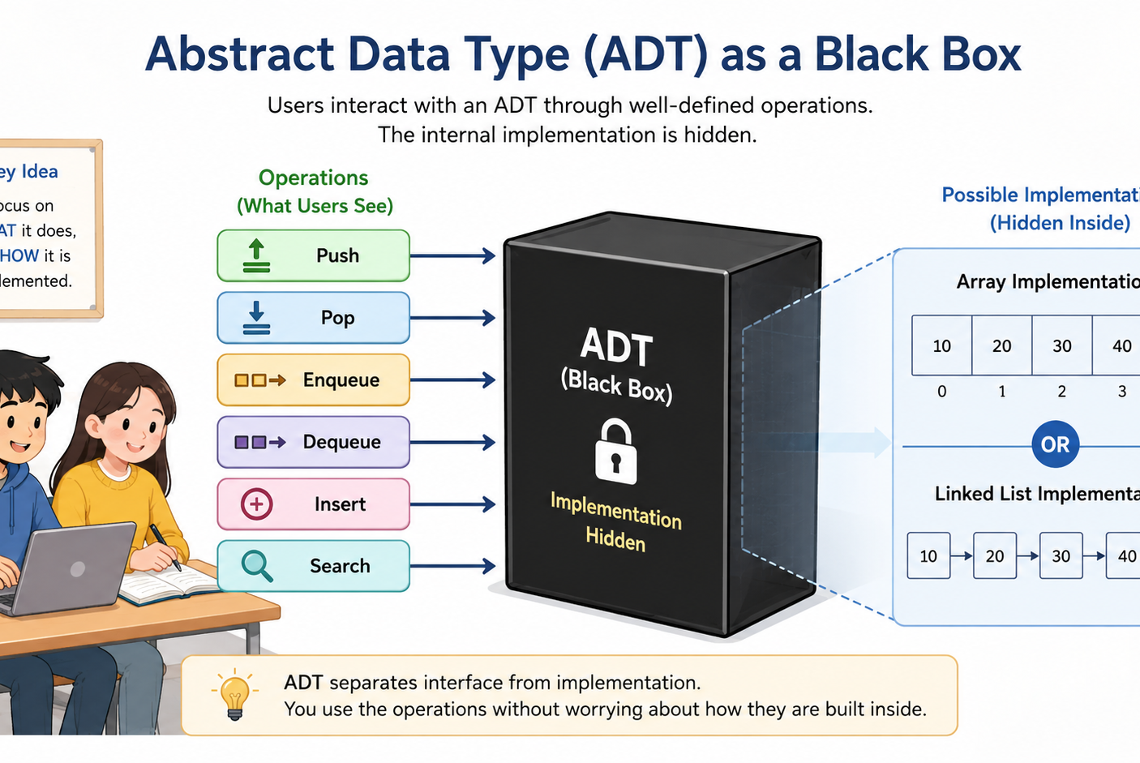
TCS302: Data Structures with C
Unit 1 | Lectures 3 & 4
Dynamic Memory: Main Idea
Heap memory is requested while the program is running.
• Use malloc or calloc when size is known only at run time.
• The returned address is stored in a pointer.
• The program must release the block using free.
Analogy: Borrow a memory block, use it carefully, then return it.
Teaching cue: Contrast automatic stack lifetime with manual heap lifetime.
Notes:
ADT is a major conceptual point. Make sure students understand the separation between interface and implementation.

Slide 11
TCS302: Data Structures with C
Unit 1 | Lectures 3 & 4
Dynamic Memory = Request + Check + Release
A safe allocation sequence has three essential responsibilities.
Request
malloc / calloc
Check
pointer != NULL
Release
free(pointer)
Example: int *a = malloc(n * sizeof *a);
Teaching cue: Ask what happens if malloc returns NULL.
Notes:
This is the central formula for the lecture.

Slide 12
TCS302: Data Structures with C
Unit 1 | Lectures 3 & 4
Heap Allocation in C
malloc reserves bytes; free returns the same block to the heap.
malloc
• int *p = malloc(4 * sizeof *p);
• check p != NULL
• use p[0] ... p[3]
• free(p); p = NULL;
byte 4
byte 3
byte 2
free
byte 1
Question: Why should p not be used after free(p)?
Teaching cue: Explain dangling pointers using the released block.
Teaching cue: Explain dangling pointers using the released block.
Notes:
Use physical analogy to reinforce LIFO.

Slide 13
TCS302: Data Structures with C
Unit 1 | Lectures 3 & 4
Growth Notation Describes Algorithm Performance
Focus on how cost changes when input size n becomes large.
O(g(n))
upper growth bound
T(n)
actual operation count
Θ(g(n))
tight growth bound
Θ(g(n))
tight growth bound
Ω(g(n))
lower growth bound
Ω(g(n))
lower growth bound
Key idea: 3n² + 5n + 8 belongs to Θ(n²).
Key idea: 3n² + 5n + 8 belongs to Θ(n²).
Teaching cue: Ignore constants only after identifying the dominant term.
Teaching cue: Ignore constants only after identifying the dominant term.
Notes:
Make the interface versus implementation distinction explicit.

Slide 14
TCS302: Data Structures with C
Unit 1 | Lectures 3 & 4
Analyse Loops by Counting Repeated Work
Consecutive blocks add their costs; nested loops multiply them.
for (int i = 0; i < n; i++) {
sum += a[i];
}
for (int i = 0; i < n; i++)
for (int j = 0; j < n; j++)
count++;
• First loop performs Θ(n) work.
• Nested loops perform Θ(n²) work.
• Keep the dominant term for large n.
Space question: Does either loop allocate an n-element auxiliary array?
Teaching cue: Ask students to count executions before naming complexity.
Notes:
Do not go too deep into pointers yet. Just preview why pointers and structures are needed.

Slide 15
TCS302: Data Structures with C
Unit 1 | Lectures 3 & 4
Classroom Analysis: Find Time and Extra Space
Trace the code first; then state complexity using n.
Problem: Count how many pairs are tested in the nested loops.
• How many times does the outer loop run?
• How many times does the inner statement run?
• What is the dominant term?
• Is extra storage dependent on n?
for (i=0; i<n; i++)
for (j=0; j<n; j++)
count++;
Time: Θ(n²)
Extra space: Θ(1)
Teaching cue: Let students justify both answers from the code.
Notes:
This activity reinforces ADT design: data, operations and rules.

Slide 16
TCS302: Data Structures with C
Unit 1 | Lectures 3 & 4
Time–Space Trade-off
A faster operation may require additional memory.
Using less memory
Using more memory
• Linear search: O(n) time
• Extra space: O(1)
• No preprocessing
• Hash table lookup: average O(1)
• Extra space: O(n)
• Requires table construction
Decision: choose according to input size, memory limit and frequent operations.
Teaching cue: Ask whether speed or memory matters more on a small embedded device.
Notes:
End by previewing Lecture 3.

