Slide 1


Understanding Data Mining
A Beginner’s Guide
- Manoj Kumar Kola

Slide 2
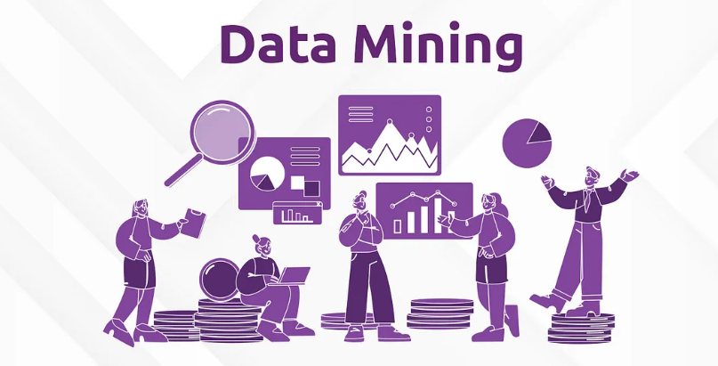
Definition
Data mining is a collection of technologies, processes and analytical approaches brought together to discover insights in business data that can be used to make better decisions.
Data mining is the process of discovering patterns, trends, and insights in large datasets.
It's like digging through mountains of data to find valuable gem.
The information that can help with decisions, predictions, or understanding behaviors.
Notes:
Data mining involves extracting meaningful patterns from large datasets using a blend of statistics, machine learning, and database systems. The data mining process turns raw data into actionable insights, aiding decision-making in fields such as marketing, finance, healthcare, and retail.

Slide 3
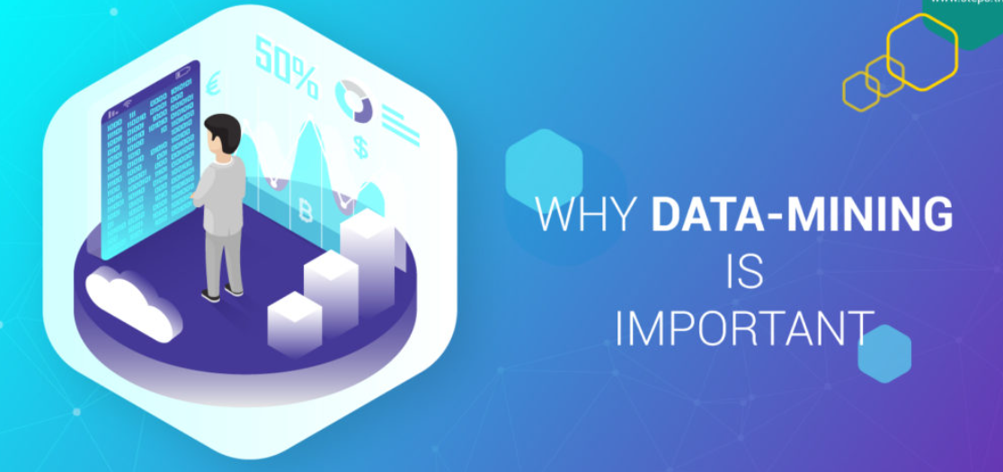
Why Data Mining is Important?
Data mining gives companies a competitive edge by helping to rapidly find business insights hidden in all the data from all those digital business transactions.
Understanding customer behaviors can lead to new product, service or marketing ideas.
Detecting intrusions can prevent a devastating theft of customer data.
Without Data Mining, valuable insights stay buried in the data we collect every day.
Notes:
More products are becoming digital, as are more payment transactions and customer interactions. As this happens, more companies are finding that their data, often already stored in a data warehouse waiting to be analyzed, is just as valuable as their products and services. In this context, data mining gives companies a competitive edge by helping to rapidly find business insights hidden in all the data from all those digital business transactions. The benefits are almost endless.

Slide 4
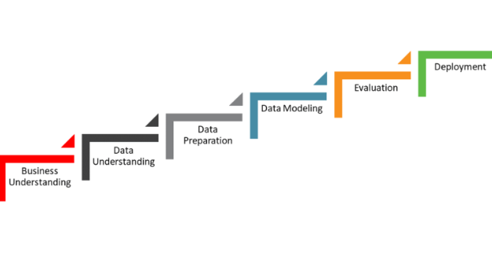
Steps of Data Mining
Collect data
Prepare and clean the data
Explore the data (patterns, visuals)
Apply models and algorithms
Interpret the results
Use insights to guide the actions

Slide 5
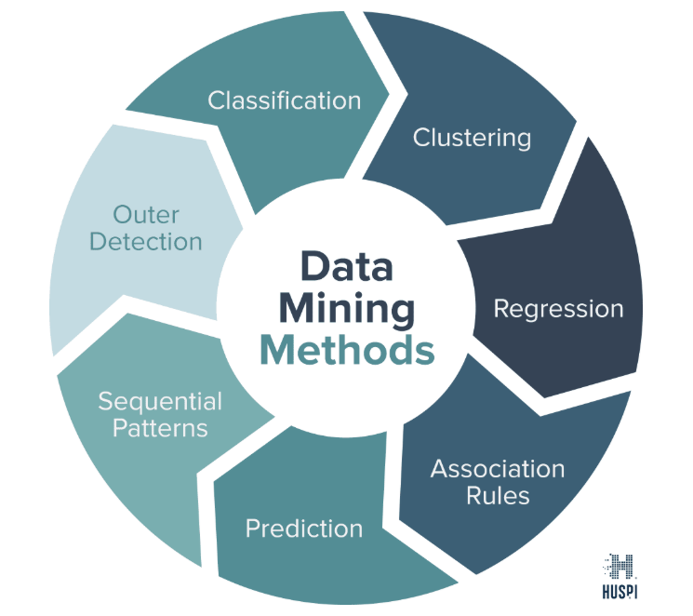
Data Mining Methods
Predictive Methods
Classification
Regression
Descriptive Methods
Clustering
Association Rules
Prediction
Sequential Patterns
Outlier Detection Analysis

Slide 6
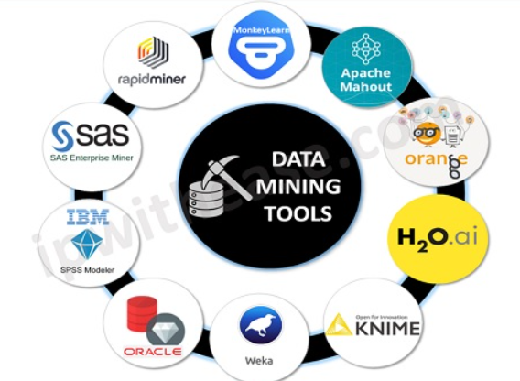
Tools Often used in Data Mining
Python & R: Used for advanced modeling, automation, and ML.
SQL: Used to extract or update data from databases.
Excel: Great for small datasets and initial exploration.
Weka/RapidMiner: GUI-based tools for those who don’t want to code.

Slide 7

Ethical Considerations
Privacy: Respect users’ rights and protect their data.
Transparency: People should know how their data is used.
Fairness: Algorithms can accidentally introduce bias.

Slide 8
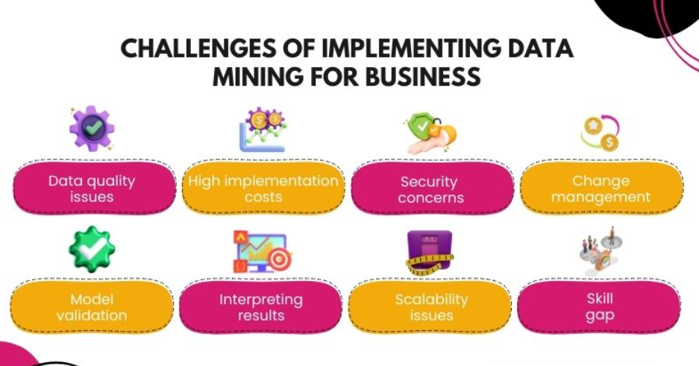
Challenges in Data Mining
Data Quality: Incomplete or inaccurate data makes it hard to analyze.
Model Validation: Not every method works for every problem.
Interpretation: Models must produce results we can trust and explain.
Privacy: Sensitive data must be handled carefully.

Slide 9

Summary
"Data mining turns information into insight. But we must use it wisely."
It’s an incredible tool to support smart decisions.
The power of data mining grows as data grows, but so does the responsibility.
Whether you're in business, healthcare, or government, using it ethically matters.

Slide 10

Finally…

