Slide 1
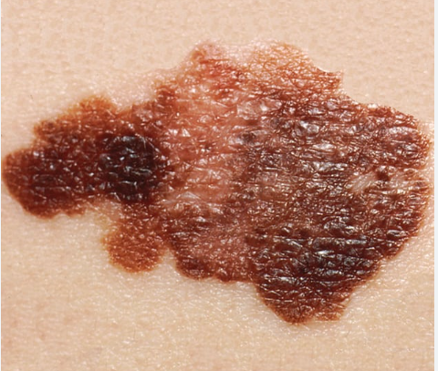
Is Cancer from Sunscreen More Dangerous than Skin Cancer?
Final Project Summary
- Manoj Kumar Kola

Slide 2
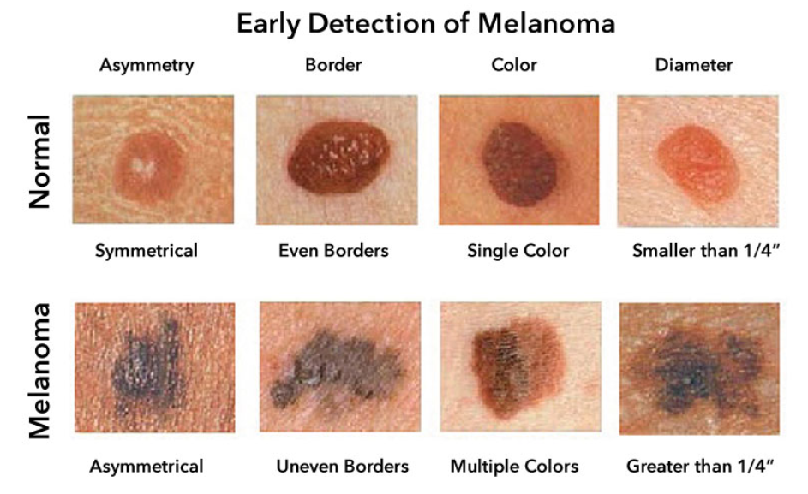
Background & Purpose
Sunscreen is widely used to prevent skin cancer, especially Melanoma.
Concerns have arisen over chemical ingredients possibly being carcinogenic.
This project investigates whether sunscreen-induced cancer poses a greater threat than UV-induced skin cancer.
We aim to uncover the proper balance of risk by challenging presumptions with a series of layered questions.

Slide 3

Research Questions
What are the risks of skin cancer vs. sunscreen-induced cancer?
What sunscreen ingredients are under scrutiny?
Is there scientific or epidemiological evidence supporting these concerns?
How does public perception reflect these concerns?
What are the alternatives to chemical sunscreens?
Are we measuring the right risks?

Slide 4

Scientific Evidence
Sunscreens contains chemical filters, such as oxybenzone and octinoxate, have been suspected as potentially contributing to cancer development.
Studies show some sunscreen chemicals (e.g., oxybenzone) can enter the bloodstream.
Animal tests suggest endocrine disruption, but human evidence is inconclusive.
FDA has flagged several chemicals for further safety testing.
Mineral sunscreens are generally considered safer.

Slide 5

Public Perception
Google Trends data reveals increasing interest in the search term "sunscreen causing cancer" over the last ten years.
Spikes in search frequency align with news articles, media coverage but not actual case data.
Public concern often stems from the spread of misinformation or exaggerated media reports or unclear science.

Slide 6

Key Findings
Sunscreen is effective in preventing melanoma and other UV-related skin cancers.
Certain chemical ingredients, particularly oxybenzone, warrant more in-depth safety reviews and possibly reformulation or restriction.
No definitive link between sunscreen use and human cancer has been found.
Mineral sunscreens offer a safer alternative for concerned users.

Slide 7
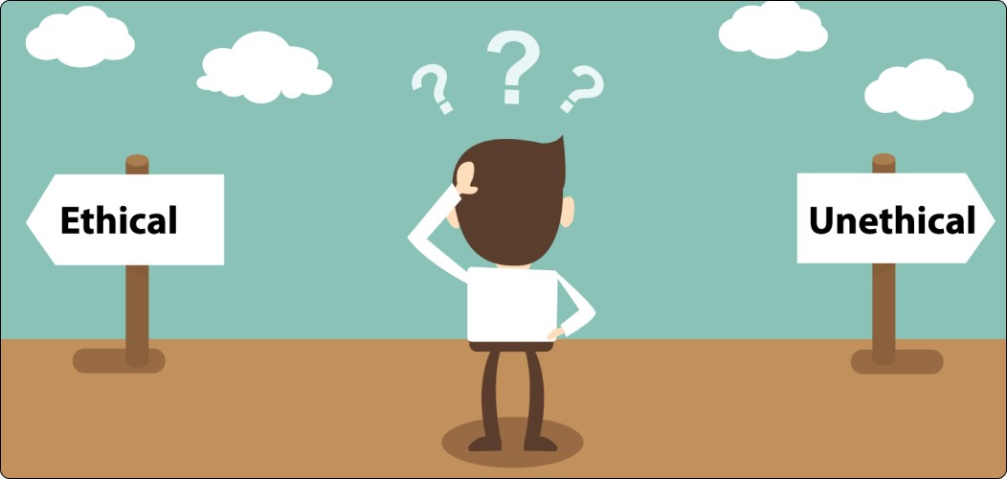
Ethical Considerations
Importance of transparency in labeling and ingredient safety.
Ethical duty to protect vulnerable populations (e.g., children, pregnant women).
Risk of public misinformation leading to sun avoidance or improper use.
Ethical responsibility to counteract fear-driven narratives about sunscreen use.

Slide 8

Challenges
Lack of long-term human trials.
Conflicting or limited data on chemical absorption.
Public confusion is fueled by inconsistent messaging.

Slide 9

Opportunities
Develop safer, more effective formulations (e.g., improved mineral sunscreens).
Improved public education and labeling.
Enhance global regulatory alignment and labeling standards.

Slide 10

Conclusion & Recommendations
The question “Is cancer from sunscreen more dangerous than skin cancer?” may currently lean toward “NO” based on existing evidence.
Based on current evidence, skin cancer is a greater proven risk than sunscreen-induced cancer.
Promote informed sunscreen use and protective habits.
Encourage long-term studies and reformulations.
Maintain vigilance and transparency in sunscreen safety.

Slide 11

References
Matta, M. K., Zusterzeel, R., Pilli, N. R., Patel, V., Volpe, D. A., Florian, J., ... & Bashaw, E. D. (2020). Effect of sunscreen application on plasma concentration of sunscreen active ingredients: A randomized clinical trial. JAMA, 323(3), 256–267. https://doi.org/10.1001/jama.2019.20747
Schlumpf, M., Cotton, B., Conscience, M., Haller, V., Steinmann, B., & Lichtensteiger, W. (2001). In vitro and in vivo estrogenicity of UV screens. Environmental Health Perspectives, 109(3), 239–244. https://doi.org/10.1289/ehp.01109239
U.S. Food & Drug Administration. (2019). FDA advances new proposed regulations to make sure that sunscreens are safe and effective. Retrieved from https://www.fda.gov/news-events
Environmental Working Group. (2021). EWG’s Guide to Sunscreens. Retrieved from https://www.ewg.org/sunscreen/
European Commission. (2020). Safety of sunscreen ingredients. Scientific Committee on Consumer Safety (SCCS). Retrieved from https://ec.europa.eu/health

Slide 12

Finally…

