Slide 1
The Rising Cost of
Childcare in America
An Analysis of the National Database of Childcare Prices
(NDCP, 2008–2018)
NDCP
2008–2018
Manoj K Kola | DSC 640 — Data Presentation & Visualization | Milestone 5
$9,755
~28%
~21%
Avg. annual CB infant care cost
(national avg, 2018)
Real cost increase
2008 → 2018
Median household income
growth over same period

Slide 2
About the Dataset
National Database of Childcare Prices (NDCP), U.S. DOL Women's Bureau — county-level, 2008–2018
Source
Key Variables Analyzed
U.S. Women's Bureau / National Database of Childcare Prices (NDCP)
MCInfant / MFCCInfant
Median weekly cost — Infant (0–23 mo.)
Coverage
2008–2018 — 11 years, county-level across all 50 states + D.C.
MCToddler / MFCCToddler
Median weekly cost — Toddler (24–35 mo.)
MCPreschool / MFCCPreschool
Care Types
Median weekly cost — Preschool (36–54 mo.)
Center-Based (CB) and Family/Home Care (FCC)
MHI
Median household income (county-level)
Age Groups
AnnualCost_CBInfant
Infant · Toddler · Preschool · School-Age
MCInfant × 52 — derived annual cost
PctIncome_Infant
AnnualCost_CBInfant ÷ MHI × 100
Source: NDCP, 2008–2018. National Database of Childcare Prices, U.S. DOL Women's Bureau.

Slide 3
Childcare Cost Trends Over Time
National average weekly costs, all care types (2008–2018)
+28%
Center-based infant
care increase
2008 → 2018
+21%
Median household
income growth
over same period
~$48
Weekly CB vs. FCC
infant care gap
(2018)
Source: NDCP, 2008–2018. National Database of Childcare Prices, U.S. DOL Women's Bureau.

Slide 4
State-Level Cost Disparities (2018)
Average weekly center-based infant care cost — selected states, sorted by cost tier
High-Cost
Mid-Cost
Low-Cost
Source: NDCP, 2008–2018. National Database of Childcare Prices, U.S. DOL Women's Bureau.

Slide 5
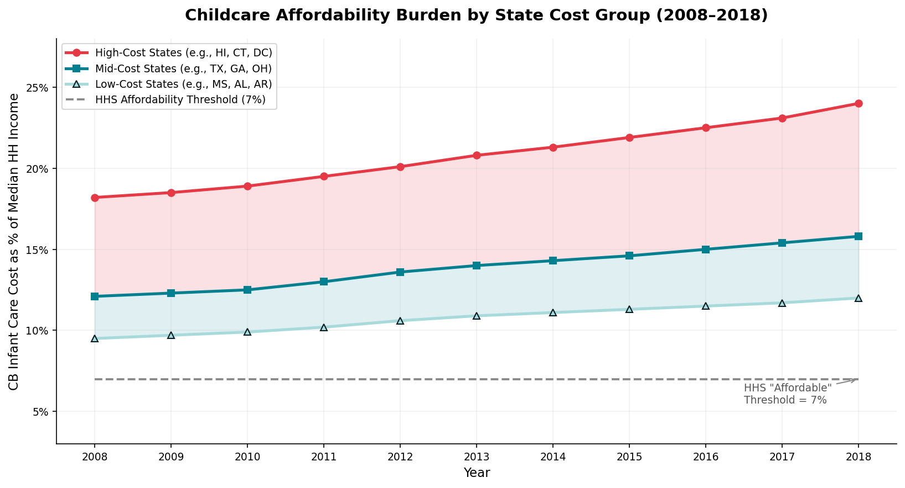
Childcare Affordability Burden by State Group (2008–2018)
CB infant care cost as % of median household income — High-Cost, Mid-Cost, and Low-Cost state groups vs. HHS 7% affordability threshold.
Source: NDCP, 2008–2018. National Database of Childcare Prices, U.S. DOL Women's Bureau.

Slide 6
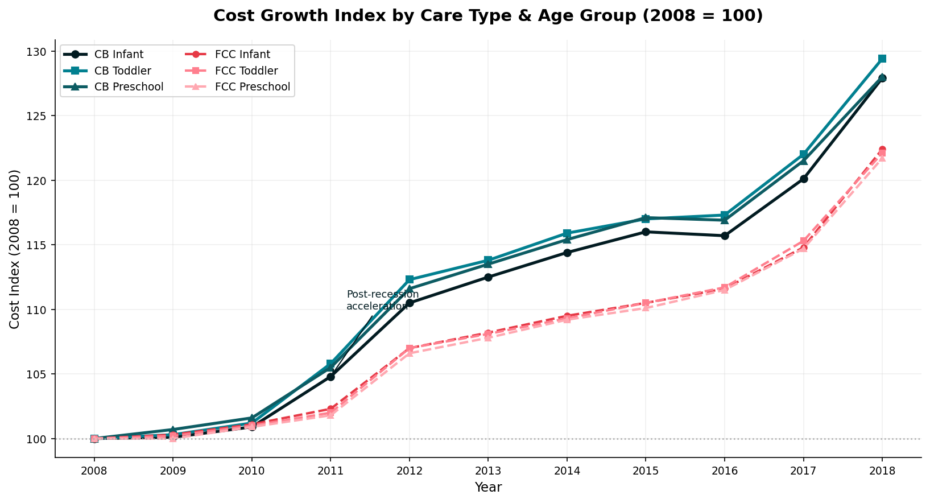
Cost Growth Index by Care Type & Age Group (2008–2018)
All six care type × age group combinations indexed to 2008=100. Solid lines = center-based; dashed = family/home-based. Toddler CB rose fastest at +29.4%.
Source: NDCP, 2008–2018. National Database of Childcare Prices, U.S. DOL Women's Bureau.

Slide 7
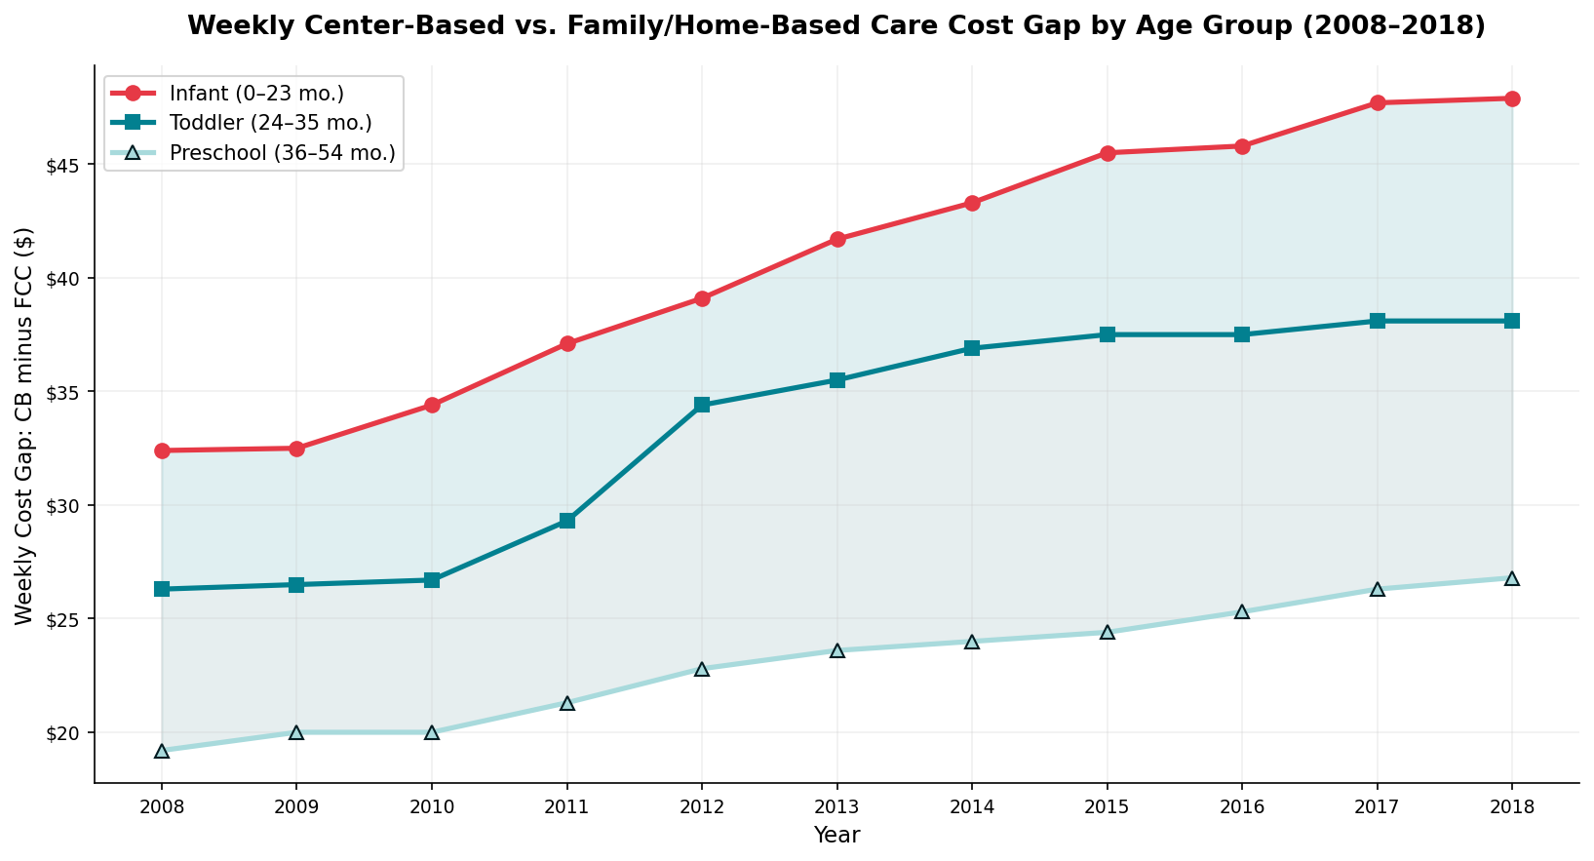
Weekly CB vs. FCC Care Cost Gap by Age Group (2008–2018)
Dollar difference (CB minus FCC) for each age group. The infant gap grew from $32/wk in 2008 to $48/wk in 2018 — both types still rising in tandem.
Source: NDCP, 2008–2018. National Database of Childcare Prices, U.S. DOL Women's Bureau.

Slide 8
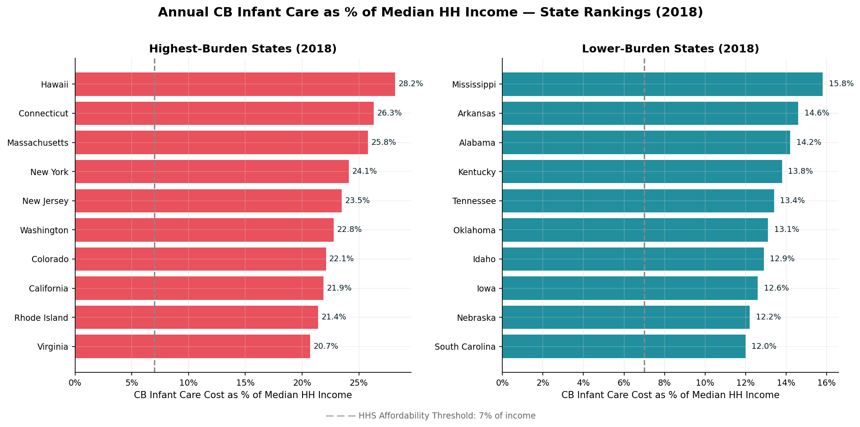
State Affordability Rankings: CB Infant Care as % of Income (2018)
Highest- and lowest-burden states ranked by annual CB infant cost as % of median HH income. All states exceed HHS’s 7% affordability threshold — even the “low-cost” group.
Source: NDCP, 2008–2018. National Database of Childcare Prices, U.S. DOL Women's Bureau.

Slide 9
Key Findings
Insights derived from NDCP 2008–2018 analysis
01
Costs Rising Faster Than Income
02
Geographic Disparities Are Large & Growing
CB infant care rose ~28% nationally (2008–2018): $146.7 → $187.6/week. Median household income grew only ~21% — families lost ground on affordability every year after 2011.
Hawaii ($338/wk) and Connecticut ($277/wk) lead nationally; Mississippi ($70/wk) is the lowest. The widening box-plot spread post-2013 confirms growing state-level divergence.
03
CB Care Costs ~$48/wk More Than FCC
04
Toddler Care Saw the Steepest Growth
CB infant care averaged $187.6/week vs. $139.7/week for FCC infant care in 2018 — a $48 gap. Both tracks follow the same upward trajectory, indicating systemic rather than provider-specific cost drivers.
Toddler CB care rose +29.4% (2008–2018), outpacing infant (+27.9%) and preschool (+28.0%) — the 24–35 month age group is becoming a critical pressure point requiring targeted policy attention.
Source: NDCP, 2008–2018. National Database of Childcare Prices, U.S. DOL Women's Bureau.

Slide 10
Impact on Families & the Broader Economy
Childcare affordability affects labor supply, gender equity, and economic growth
15.8%
1 in 3
$122B
Avg. share of median HH
income spent on CB infant
care (national, 2018)
Families report changing
jobs or hours due to
childcare costs
Estimated annual
economic loss from
childcare gaps (CED)
▸ Women's Labor Force Participation
▸ Gender Pay Gap Amplification
Unaffordable childcare keeps women — especially single mothers and lower-income earners — out of the labor force, reducing household income and tax revenue.
Women who reduce work hours or exit jobs for caregiving lose career trajectory, seniority, and retirement savings at disproportionate rates.
▸ Business Productivity & Retention
▸ Child Development Outcomes
Employers report increased absenteeism, turnover, and recruitment costs when employees lack reliable childcare access.
Lower access to quality early care is correlated with weaker cognitive and social outcomes, increasing long-term public costs in education and social services.
Source: NDCP, 2008–2018 | CED (Committee for Economic Development) | U.S. DOL Women's Bureau.

Slide 11
Recommendations & Call to Action
Policy priorities informed by the NDCP analysis
01
Expand Childcare Subsidy Programs
Increase CCDBG funding and eligibility thresholds to cover families earning up to 150% of the state median income — prioritizing high-cost-state families where costs exceed 20% of household income.
02
Implement Cost Transparency Requirements
Mandate annual public reporting of childcare costs by county, enabling families and policymakers to benchmark local markets against state and national averages.
03
Support Provider Wage Parity
Address the affordability–quality paradox: provider wages through wage supplements for certified early educators to improve supply without raising parent costs.
04
Promote Employer-Sponsored Childcare
Offer enhanced tax credits to businesses that provide on-site childcare, FSA expansion, or childcare referral programs for employees.
Affordable childcare is economic infrastructure. Every $1 invested in early childhood returns $7–$13 in long-term economic value. (Heckman, 2013)

