Slide 1

EEG-Based Neuromarketing: Tracking Brain Responses to Video Advertisements with a Dry‑Electrode Cap
Siddhant Sawhney
1BM23CS327
Manoj Kulkarni
1BM23CS184
Pranav Easwar
1BM23CS365
Padma Deepak
1BM23CS222
Amit Pradhan
Professor
Department of Computer Science and Engineering
B.M.S. College of Engineering
23-10-2026
EEG Neuromarketing Department of CSE, BSMCE
1

Slide 2
OUTLINE
1. Problem Statement
2. High level Design
3. Detailed Design
4. Implementation
5. Results (Table, Graphs, Datasets Used) and Snapshots of the output
6. Conclusion and Future Enhancements
7. Paper published
8. References
23-10-2026
EEG Neuromarketing Department of CSE, BSMCE
2

Slide 3
Sustainable Development Goals (SDGs) Addressed
SDG 9 – Industry, Innovation and Infrastructure (primary): a low-cost, open Python pipeline that turns a 19-channel dry EEG cap into a working ad-testing tool, instead of expensive commercial neuromarketing services
SDG 12 – Responsible Consumption and Production (secondary): measuring how ads actually affect viewers (attention, liking, purchase intent) supports more transparent study of advertising influence on consumers
SDG 3 – Good Health and Well-Being (carried over from Review 1): the same signal-quality checks and EEG features are reusable in cognitive/clinical EEG work
This is a research prototype tested in the lab; no field deployment is claimed yet
23-10-2026
EEG Neuromarketing Department of CSE, BSMCE
3

Slide 4
Collaboration
Multidisciplinary project: combines neuroscience (EEG rhythms), signal processing (filtering, ICA), consumer psychology / marketing (ad liking, purchase intent) and software engineering
Field work: our own EEG recordings with volunteer participants using the Mitsar amplifier, SmartDRY 19-channel cap and EEGStudio software
Change from Review 1: Review 1 only reanalysed a public dataset (OpenNeuro ds002739). This phase collects new data
External partner: none yet. Data collection is done in-house
23-10-2026
EEG Neuromarketing Department of CSE, BSMCE
4

Slide 5
Problem Statement
Review 1 recap: pre-decisional EEG predicted the upcoming choice (LDA AUC 0.558). A compact CNN (EEGNet) did not beat LDA (0.544 vs 0.563, p = 0.019) with ~150 trials per subject
Next step: apply EEG decision research to a real everyday decision, which is how people respond to ads
Gap: ad testing mostly relies on questionnaires, which give one number after the ad and are biased. They cannot show which moment of the ad held attention
Our questions:
Q1: Can a low-cost dry-electrode cap and our own pipeline produce a reliable second-by-second engagement timeline for each ad?
Q2: Do four EEG measures (frontal asymmetry, engagement index, frontal theta, posterior alpha suppression) track viewers' liking and purchase-intent ratings?
23-10-2026
EEG Neuromarketing Department of CSE, BSMCE
5

Slide 6
Overview of the Experiment
One recording session, one participant:
Eyes-open baseline
60 s, fixation cross
Eyes-closed baseline
60 s, beep to open
Fixation
4 s
Video ad
32–90 s
Gray
screen 3 s
Two
ratings
repeated for each of the 5 ads (random order per participant)
Baseline
Personal reference level for every measure; eyes-closed also checks cap contact (alpha should rise)
Buffers
Fixation hides the key-press artefact from the last rating; gray screen catches the delayed reaction to the logo
Ratings (1–9)
"How much did you like this ad?"
"How likely would you be to buy this product?"
23-10-2026
EEG Neuromarketing Department of CSE, BSMCE
6

Slide 7
High level Design
Acquisition (live, during the session)
Mitsar amp +
SmartDRY 19-ch cap
EEGStudio
LSL Outlet (~252.6 Hz)
Our LSL recorder +
PsychoPy task markers
Session file (.fif)
EEG + markers, one clock
Analysis (offline, per recording)
Electrode quality
check
1–40 Hz filter +
ICA blink removal
Sliding-window
4 EEG measures
Relative to
personal baseline
Per-ad numbers,
plot, replay viewer
EEG and task markers are timestamped on the same Lab Streaming Layer (LSL) clock, so no manual alignment is needed. Measured marker accuracy: within ~0.1 s.
23-10-2026
EEG Neuromarketing Department of CSE, BSMCE
7

Slide 8
Detailed Design
Measure | Electrodes | Band | Computed as | Higher value means
Frontal alpha asymmetry | Fp1 / Fp2 | α 8–13 Hz | ln(α right) − ln(α left) | approach / wanting
Engagement index | Cz, Fz | β 13–25, α 8–13 Hz | log10(β / α) | more alert / engaged
Frontal theta | Fz | θ 4–8 Hz | power change in dB | more mental processing
Posterior alpha suppression | O1/O2/Pz (else P3/P4) | α 8–13 Hz | % drop in power | more visual attention
Sliding window: 3 s long, moved in 1 s steps; Welch spectrum inside each window (1 s segments, 50% overlap)
Per-ad value = median over windows inside the ad (robust to short artefact bursts), compared with the eyes-open baseline
F3 and F8 are permanently dead on our cap, so asymmetry uses Fp1/Fp2 (frontal-pole asymmetry)
β capped at 25 Hz to limit jaw/forehead muscle noise on the dry cap
23-10-2026
EEG Neuromarketing Department of CSE, BSMCE
8

Slide 9
Implementation
Module | What it does
ad_viewing_task.py | PsychoPy session: baselines, ads, buffers, ratings, markers
lsl_recorder.py | Records EEGStudio's LSL stream, maps channels, saves .fif
calibrate_channels.py | Finds channel order (stream has no labels)
preprocess_mne.py | Quality check, 1–40 Hz filter, ICA blink removal
extract_neuromarketing_features.py | 4 measures, baseline comparison, plots
build_replay.py | Offline HTML: video + 4 graphs in sync
Stack: Python 3.11 venv, PsychoPy, pylsl, MNE, NumPy/SciPy, Matplotlib
Channel map: found by correlating our recording with EEGStudio's labelled EDF export, then a tap test
Quality rule: electrode rejected if it copies an unconnected input (|r| > 0.8) or is above 150 µV
Safety: data saved even if a session is stopped midway; refuses to overwrite a participant ID
23-10-2026
EEG Neuromarketing Department of CSE, BSMCE
9

Slide 10
Results – Pipeline Validation
Each processing step checked on synthetic EEG where the correct answer is known:
Test | Injected (expected) | Measured by pipeline
Eye-blink removal (ICA) | Blink on Fp1, 127 µV | Reduced to 21 µV; asymmetry kept
Posterior alpha suppression | 50% drop | 49.4%
Frontal theta change | +3.0 dB | +2.87 dB
Engagement index | β doubled (+100%) | +92%
Robustness of per-ad median | 2 s, 150 µV artefact burst | Result changed by < 1%
Timing on the real system
Stream rate measured at ~252.6 Hz, not the nominal 250 Hz (using nominal would drift markers ~6%)
Ad marked as 59.8 s vs 60.1 s video length
Limit found
With ~30 s of data, pure noise gives asymmetry changes of SD ≈ 0.18, so asymmetry is only meaningful as a group average
23-10-2026
EEG Neuromarketing Department of CSE, BSMCE
10

Slide 11
Results – Lab Test Run (test1)
Datasets: our own recordings. pilot01 (29-09-2026, ad02) and test1 (19-10-2026, ad04, Budweiser), 1 participant
Check | Result
Usable electrodes | 10 of 19 (Fp1, Fp2, F7, Fz, F4, C3, Cz, C4, T5, P3)
Rejected | F3, F8 (dead), T3, T4, T6, Pz, P4, O1, O2 (poor contact)
Blink components removed | 1 (r = 0.78 with Fp1/Fp2)
Cap check (eyes closed / open α) | 1.35× on P3: OK (≥ 1.3)
ad04 vs baseline | Value
Frontal asymmetry change | +0.06
Engagement index | +14.5%
Frontal theta | −1.1 dB
Posterior alpha suppression | 45.4%
Liking / Purchase intent | 8 / 4 (of 9)
Whole chain worked end to end on the real cap: record → clean → measures → plot → replay
Strong alpha drop and higher engagement during the ad; asymmetry change is inside the noise range (single person)
23-10-2026
EEG Neuromarketing Department of CSE, BSMCE
11

Slide 12
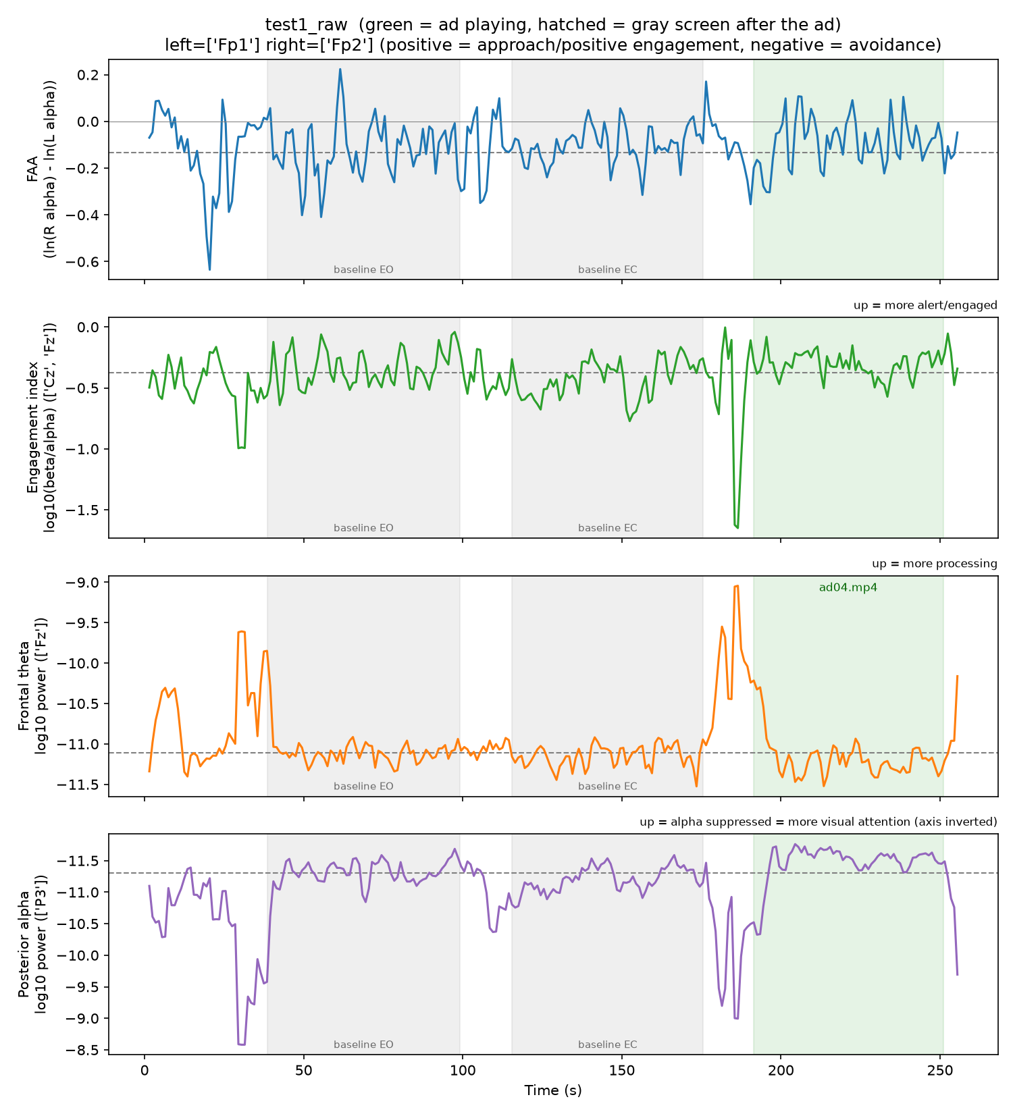
Results – Engagement Timeline (snapshot)
Output of extract_neuromarketing_features.py for test1
Gray: eyes-open and eyes-closed baselines. Green: ad04 playing
Dashed line: the person's eyes-open baseline
Before the ad: large swings from the participant settling and pressing keys. This is why the 4 s fixation buffer was added
Posterior alpha axis is inverted, so up = more attention
23-10-2026
EEG Neuromarketing Department of CSE, BSMCE
12

Slide 13
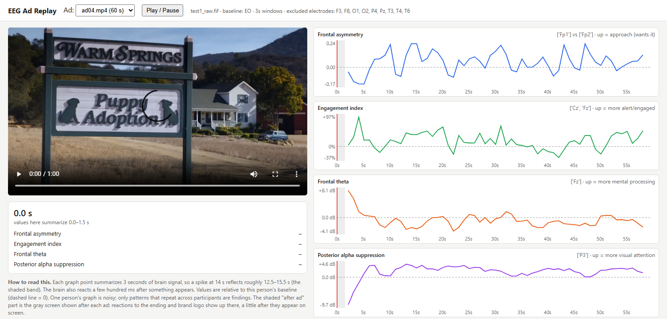
Results – Replay Viewer (snapshot)
Ad plays next to the 4 measures; a red cursor follows the video and clicking a graph jumps the video to that moment.
23-10-2026
EEG Neuromarketing Department of CSE, BSMCE
13

Slide 14
Conclusion
Built a complete, low-cost neuromarketing system: session task, synchronised recording, cleaning, 4 EEG measures and a video replay tool
Solved practical problems of the dry cap: unlabelled stream, dead/poor electrodes detected automatically, measured (not assumed) sampling rate
Every analysis step was validated on synthetic data before use on real recordings
First real recording shows the expected pattern during an ad (alpha drop, higher engagement), but one participant is not evidence. Group data is needed
Continuation of Review 1: same EEG decision theme, now with our own data and a real-world use
23-10-2026
EEG Neuromarketing Department of CSE, BSMCE
14

Slide 15
Future Enhancements
Full sessions: all 5 ads per participant, then recruit ~20 participants (with consent forms)
Better contact: fix posterior electrodes (O1/O2/Pz) so alpha does not depend on P3 alone
Group statistics: test whether each measure tracks liking and purchase intent across people
Inter-subject correlation (ISC): how similar brains are across viewers, a strong predictor in the literature
Opening-seconds "hook" score: engagement in the first 5 s of each ad
Prediction model: predict the ratings from EEG, tested on unseen participants
Controls: ask if the ad was seen before (familiarity), consider equal-length ad clips
23-10-2026
EEG Neuromarketing Department of CSE, BSMCE
15

Slide 16
Papers published
Not yet published
Planned: journal paper on the neuromarketing study after group data collection (target venues: MDPI Sensors / Brain Sciences, IEEE Access, Frontiers)
Review 1 work (EEG decision decoding, LDA vs EEGNet): manuscript in preparation
23-10-2026
EEG Neuromarketing Department of CSE, BSMCE
16

Slide 17
References
1. Davidson, R. J. (1992). Anterior cerebral asymmetry and the nature of emotion. Brain and Cognition, 20(1), 125–151.
2. Allen, J. J. B., Coan, J. A., & Nazarian, M. (2004). Issues and assumptions on the road from raw signals to metrics of frontal EEG asymmetry in emotion. Biological Psychology, 67(1–2), 183–218.
3. Pope, A. T., Bogart, E. H., & Bartolome, D. S. (1995). Biocybernetic system evaluates indices of operator engagement in automated task. Biological Psychology, 40(1–2), 187–195.
4. Klimesch, W. (1999). EEG alpha and theta oscillations reflect cognitive and memory performance. Brain Research Reviews, 29(2–3), 169–195.
5. Vecchiato, G., et al. (2011). On the use of EEG or MEG brain imaging tools in neuromarketing research. Computational Intelligence and Neuroscience, 2011, 643489.
6. Dmochowski, J. P., et al. (2014). Audience preferences are predicted by temporal reliability of neural processing. Nature Communications, 5, 4567.
7. Boksem, M. A. S., & Smidts, A. (2015). Brain responses to movie trailers predict individual preferences for movies and their population-wide commercial success. Journal of Marketing Research, 52(4), 482–492.
8. Venkatraman, V., et al. (2015). Predicting advertising success beyond traditional measures. Journal of Marketing Research, 52(4), 436–452.
9. Hakim, A., et al. (2021). Machines learn neuromarketing: Improving preference prediction from self-reports using multiple EEG measures and machine learning. Int. J. of Research in Marketing, 38(3), 770–791.
10. Gramfort, A., et al. (2013). MEG and EEG data analysis with MNE-Python. Frontiers in Neuroscience, 7, 267.
11. Peirce, J., et al. (2019). PsychoPy2: Experiments in behavior made easy. Behavior Research Methods, 51(1), 195–203.
12. Gherman, S., & Philiastides, M. G. (2018). Human VMPFC encodes early signatures of confidence in perceptual decisions. eLife, 7, e38293.
23-10-2026
EEG Neuromarketing Department of CSE, BSMCE
17

Slide 18
Thank You
23-10-2026
EEG Neuromarketing Department of CSE, BSMCE
18

