Slide 1
HOTEL BOOKING MANAGEMENT SYSTEM
MCA 272
Presented by:
Balla Koushik (2347217)
Chris Alister(2347218)
Manoj Kumar D(2347237)

Slide 2
ABSTRACT
The Hotel Booking System is an innovative and user-friendly web application designed to streamline the hotel reservation process, offering a seamless experience for both customers and hotel administrators. This project leverages the power of React for the front-end and Spring Boot for the back-end, creating a robust and efficient system.

Slide 3
KEY FEATURES
User-friendly Interface
Real-time Availability
Admin Dashboard
Secure Authentication and Authorisation
Responsive Design

Slide 4
TECHNOLOGIES
FRONT-END :
Java, Spring Boot, and ReactJS for the frontend, and we will be using JWT Authentication with Spring Security.
BACK-END :
MySQL

Slide 5
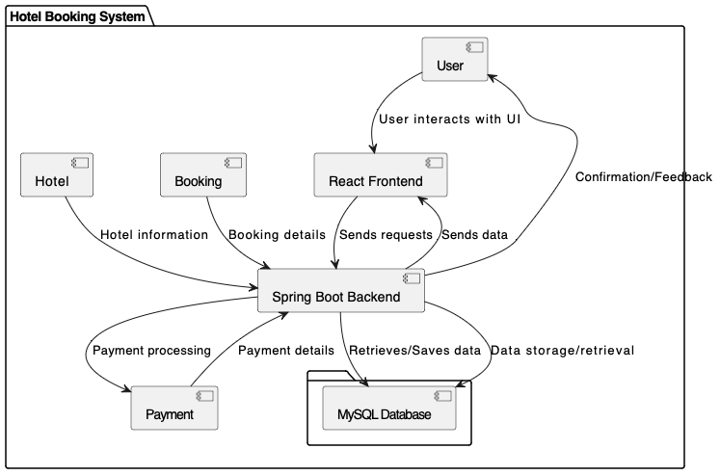
OVERALL DESIGN

Slide 6
DATABASES AND TABLES
Booked_room
Role
Room
User
User_roles

Slide 7
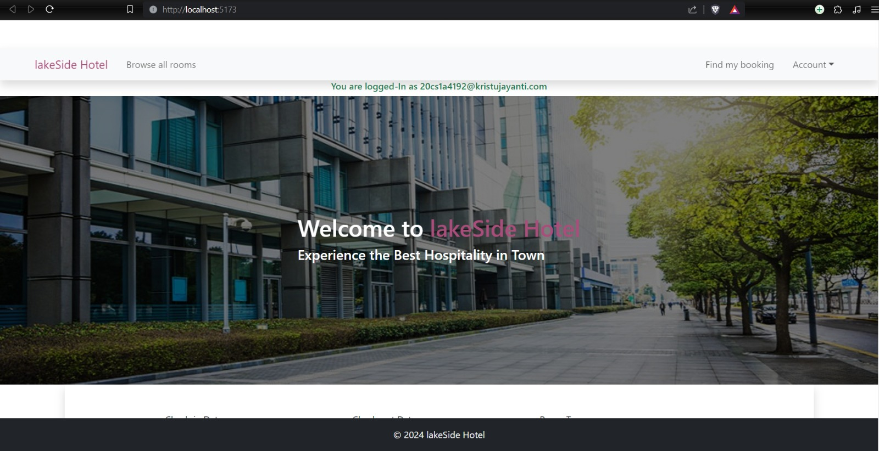
SCREENSHOTS

Slide 8
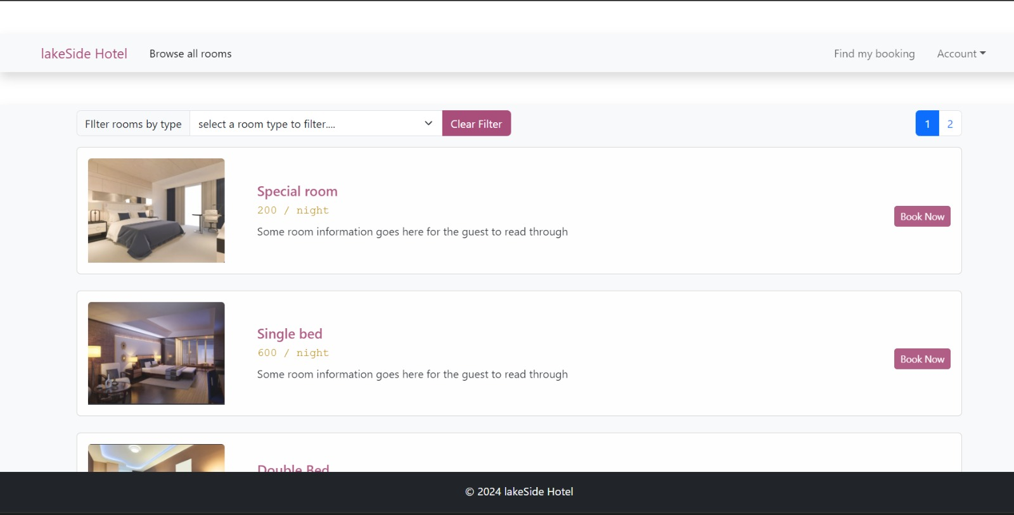

Slide 9
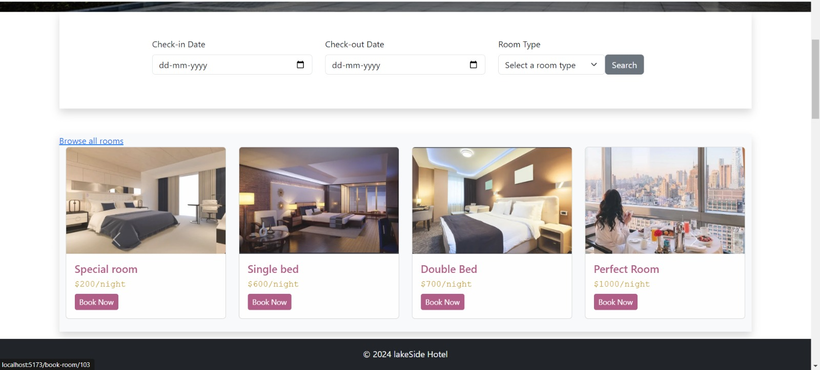

Slide 10
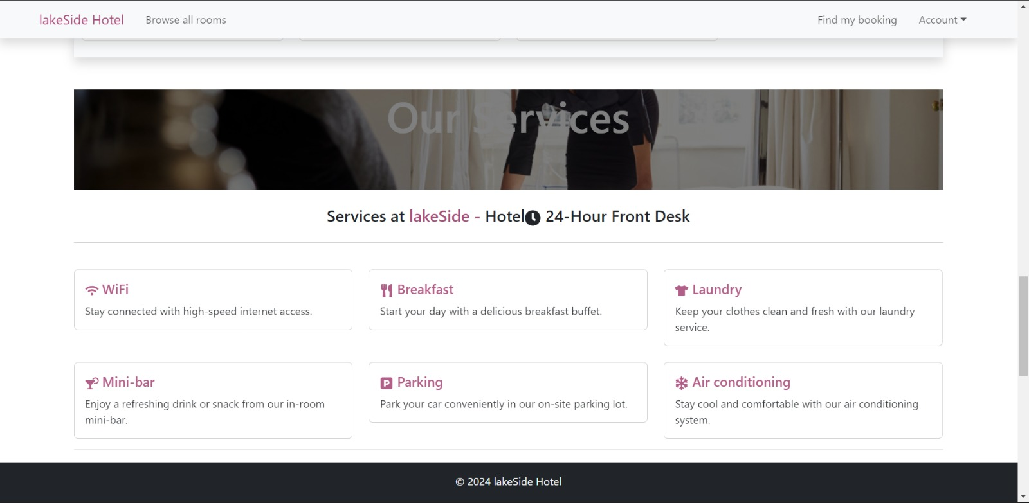
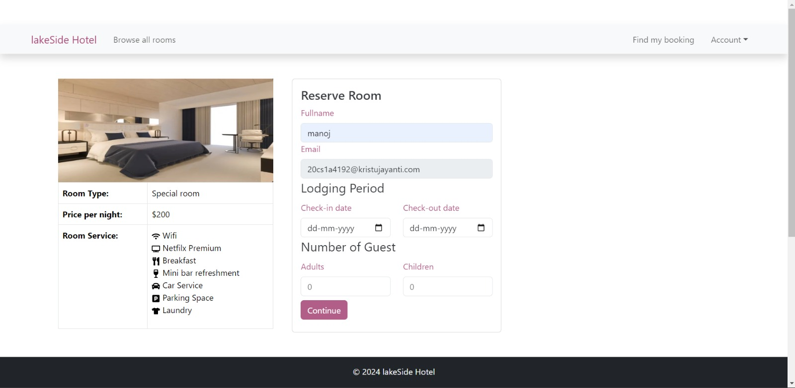

Slide 12
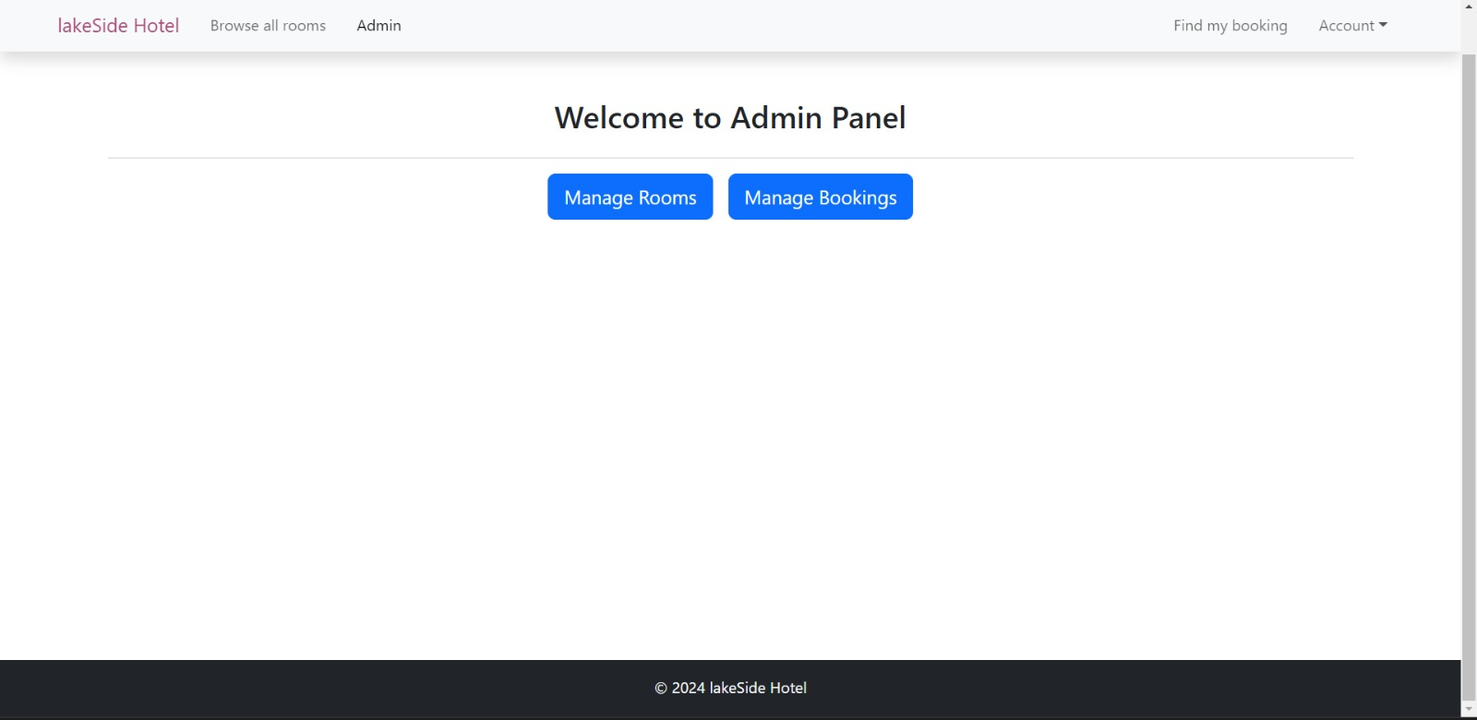
ADMIN SCREENSHOTS

Slide 13
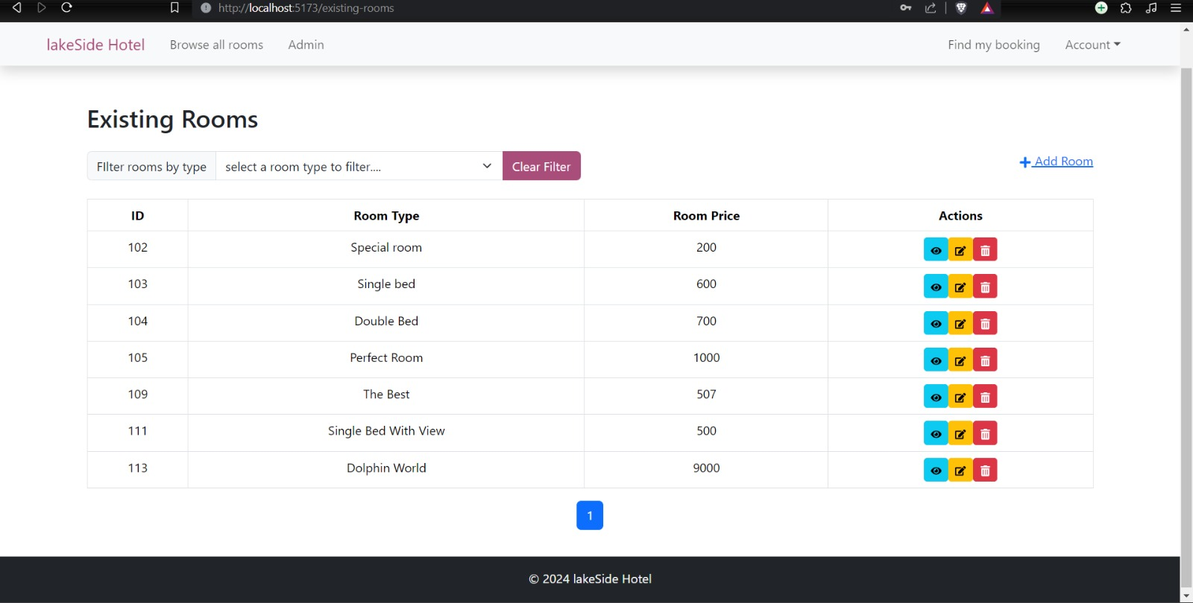

Slide 14
THANK YOU 😊

