Slide 1
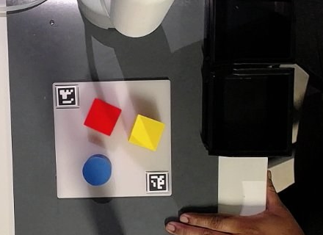
Lab 9 – Pick and Place with MoveIt
Tasks, method and status of our deliverables
Our table: plate with 2 ArUco markers, bins on the right
CoRobot Lab, TU Dortmund
myCobot 280 Pi · vacuum pump · USB camera · ROS 2 Jazzy + MoveIt 2
Lab 9 – Pick and Place with MoveIt · status 2026-10-11
1 / 6
Notes:
Lab 9 adds vision-based object selection to a MoveIt pick-and-place pipeline on the myCobot 280 Pi. We show what the lab asks, how we solved it, and which deliverables are done, partly done or open.

Slide 2
What the lab asks: Part 0 plus two of five tasks
PDF Pick and Place (Sep 23): Part 0 is required; we chose the two tasks that extend the same object query
0
Part 0 – Explore the original system
1
Task – Detect object colour and shape
2
Task – Extend the object interface
required · p. 14
pp. 22–25
pp. 20–22
• Run the course nodes: sort (mode 2) and stack (mode 1)
• Record positions, choices, bins, outcomes
• Name at least 2 limitations
• Data flow: camera image → pick-and-place
• Mask per colour; area, perimeter, circularity, vertices
• Cube / cylinder / unknown, thresholds from our camera
• Several objects per colour, labels + centres
• Queries: existing, absent, several; 1 uncertain case
• Service by colour + shape → found, unique id, pose
• BOX / CYLINDER scene objects, one id end to end
• Menu lists matches; loops instead of recursion
• Compare with the original system
Lab 9 – Pick and Place with MoveIt · status 2026-10-11
2 / 6
Notes:
Part 0 is the baseline: the original system as delivered. The two tasks build on each other: vision recognises colour and shape, the object interface lets the brain ask for exactly that object and pick it by its id.

Slide 3
Method: our packages on the course system
lab9_interfaces + lab9_pick_place; the course packages stay unchanged, so Part 0 still runs the original
Camera
opencv_camera
(course)
vision_lab9
markers, colour,
shape, ids
brain_lab9
menu, scene,
pick / drop
MoveIt
move_group
(plans paths)
controller_lab9
Pi: serial,
pump + valve
Arm + pump
myCobot 280 Pi
camera/image
/get_object
move_action
follow_joint_
trajectory
serial, GPIO
Course code unchanged
Calibration from 2 markers
Real-robot fixes
All our code is in two new packages. The original vision, brain and controller stay runnable for Part 0.
Two ArUco markers at ruler-measured positions give scale, rotation and shift (≈ 0.99 mm/px), plus a correction for the object height.
Controller copy: release valve, smooth execution, arrival wait. MoveIt time limits ×4 + 5 s. All measured values in lab9.yaml.
Lab 9 – Pick and Place with MoveIt · status 2026-10-11
3 / 6
Notes:
Data flow for one pick: the camera publishes images, vision finds the objects and answers /get_object, the brain adds them to MoveIt's planning scene and sends goals; MoveIt plans, the controller on the Pi executes over serial and switches the pump. Joint states go back from the controller to MoveIt.

Slide 4
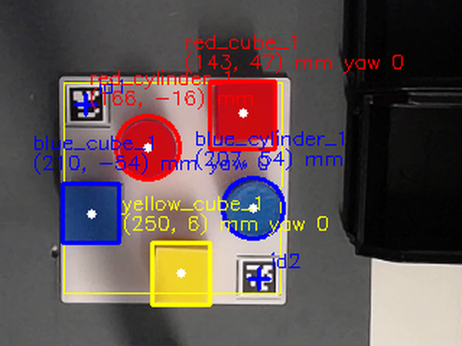
Method: colour and shape from one top view
vision_lab9 builds a new object list every frame; nothing older than 1 s is returned
1
Colour mask
HSV range per colour, only inside the plate area
2
Clean-up
opening + closing; keep 30–75 mm objects
3
Shape features
circularity C = 4πA/P², fill = area / enclosing circle, corners
4
Decision
cylinder if fill and C ≥ 0.75; cube if fill ≤ 0.72 and 4–6 corners; else unknown
Fill is the key feature
square 0.64 · circle 1.0 in theory; measured: cubes 0.66–0.72, cylinders ≈ 0.88
10-05 14:44: red and blue cube + cylinder, yellow cube – all labelled correctly
Lab 9 – Pick and Place with MoveIt · status 2026-10-11
4 / 6
Notes:
Each colour gets its own mask; the contour of each blob gives circularity, fill and the number of corners. Fill separates squares (0.64) from circles (1.0) better than circularity, which pixel noise lowers for both. Objects that fall between the limits are labelled unknown instead of being forced into a class.

Slide 5
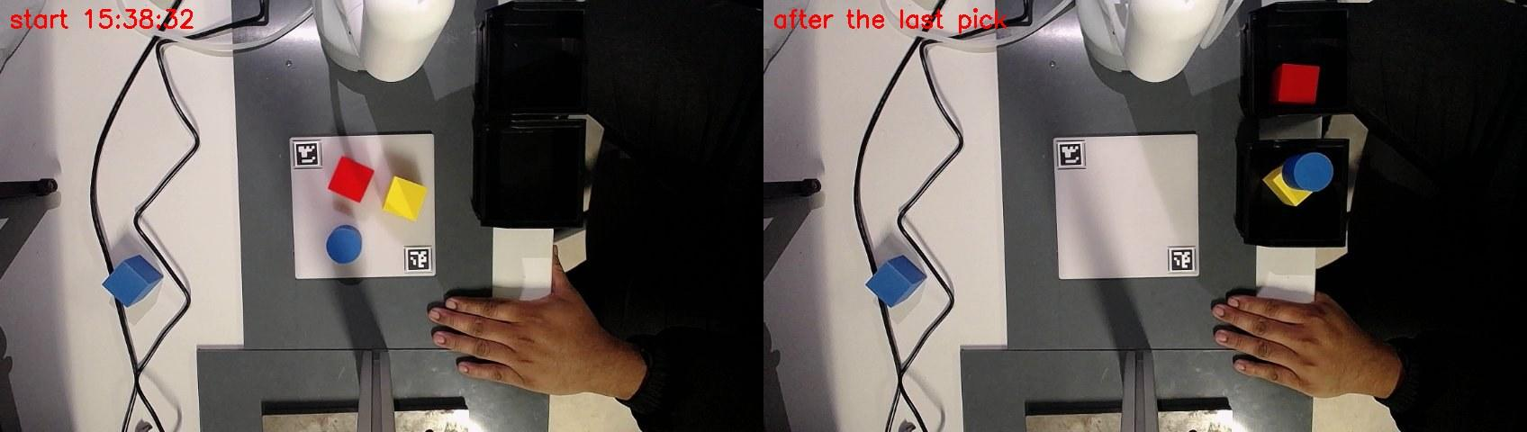
Method: object interface on the real robot
GetObject service + brain_lab9; the course planning methods are kept
• The id (e.g. red_cube_1) adds, attaches, detaches and removes the MoveIt object
• BOX 35 mm or CYLINDER [height, radius] in the planning scene
• Menu as a loop: colour → shape → choose a match → bin; plus auto sort
• Several matches: nearest first, all ids listed
Auto sort, 10-09 15:38: before (left) and after the last pick (right)
GetObject.srv
Request: color · shape · id
Response: found · id · shape ·
coords · height · matches
Old: color → coords, [1.0]×6 = not found
3 / 3
21.6 s
≈ 6 mm
objects placed in the last run, tool vertical
mean time per pick
constant xy offset, target → arm at contact
Lab 9 – Pick and Place with MoveIt · status 2026-10-11
5 / 6
Notes:
On 10-09 the full chain ran on the real robot. Fixes that day: contact 9 mm lower, pump on at hover with a 1 s dwell, bins approached at hover height, MoveIt error 99999 retried. Last run: 3 of 3 placed; the previous run also 3 of 3. The xy difference is a constant offset of about +5.6 mm in y that we still need to explain.

Slide 6
Deliverables: where we stand
3 done · 3 partly done · 3 open; the biggest gap is the Part 0 baseline
Deliverable | Status | Evidence / gap
Part 0 – run the original system, limitations | Open | not run yet
Part 0 – data-flow diagram | Done | report §1.1
Shape – masks, features, labels, several per colour | Done | vision_lab9, frames
Shape – thresholds from our camera, uncertain case | Partial | 19 % of cube samples → cylinder
Shape – queries: existing / absent / several | Open | logger ready
Interface 1–4 – service, client, BOX/CYL by id | Done | used in every robot run
Interface 5–6 – match list, loops, bins A–D, exit | Partial | bins per colour, q = exit
Evaluation – extended vs original system | Open | needs Part 0; 6/6 placed so far
Report | Partial | draft with TODOs
Next
1
Run Part 0 with the course nodes and record it
2
Record queries and ruler positions
3
Tighten the cylinder rule (fill ≥ 0.80)
4
Bins A–D and exit as in the PDF
5
Finish the report
Lab 9 – Pick and Place with MoveIt · status 2026-10-11
6 / 6
Notes:
Implementation of both tasks is in place and runs on the robot; what is missing is mostly evidence: the Part 0 baseline, the query table and ruler positions, and the comparison of the extended with the original system.

