Slide 1
DATA WAREHOUSING WITH IBM CLOUD DB2 WAREHOUSE
TEAM MEMBERS:
MANOJ R
KAVIN N
BOOBALAN V
SHAM KUMAR P
MANOJ KUMAR SETHY F
JEEVANATHAM A

Slide 2
INTRODUCTION:
The project "Implementing a Scalable Data Warehousing Solution with IBM Cloud Db2 Warehouse" aims to address the growing need for efficient and adaptable data management in contemporary enterprises. With data volumes expanding rapidly, the significance of a scalable and secure data warehousing solution cannot be overstated. Leveraging the capabilities of IBM Cloud Db2 Warehouse, this project endeavors to establish a robust infrastructure that not only facilitates seamless data ingestion, storage, and retrieval but also ensures the implementation of comprehensive security measures to safeguard sensitive information.
By integrating advanced analytics and reporting functionalities, the project aims to enable data-driven decision-making, fostering a culture of informed and strategic business practices. Through a well-structured and step-by-step approach, this project aims to provide a blueprint for organizations looking to optimize their data management capabilities and leverage the potential of cloud-based data warehousing solutions.

Slide 3
PROJECT OVERVIEW:
The project aims to create a comprehensive data warehousing solution by leveraging IBM Cloud Db2 Warehouse.
This data warehouse will serve as a centralized repository for data from diverse sources, enabling advanced data integration, transformation, and analysis.
Key components of the project include defining the data warehouse structure, integrating data sources,
Implementing ETL (Extract, Transform, Load) processes, and facilitating data exploration and analysis.

Slide 4
OBJECTIVES:
The primary objectives of this project are as follows:
Design Data Warehouse Structure: Define the architecture, schema, and data models for the data warehouse, ensuring it meets the specific requirements of the organization.
Data Integration: Implement mechanisms to collect, cleanse, and integrate data from various sources, including databases, APIs, and external files.
ETL Processes: Develop Extract, Transform, Load (ETL) processes to efficiently move data into the data warehouse, ensuring data quality and consistency
Data Analysis Tools: Provide data architects with the necessary tools and platforms to explore and analyze data for decision-making purposes.

Slide 5
SCOPE:
The project scope encompasses:
Identifying and profiling data sources.
Designing the data warehouse schema.
Developing ETL processes for data extraction, transformation, and loading.
Implementing security and access controls.
Setting up data visualization and analytics tools.
Conducting user training and documentation.

Slide 6
KEY DELIVERABLES:
The key deliverables for this project include:
Data Warehouse Architecture and Schema Design Document.
ETL Process Implementation.
Data Integration Framework.
Security and Access Control Configuration.
Data Analysis and Visualization Platform Setup.
User Training Materials and Documentation.
Task 1
Task 2
Task 3

Slide 7
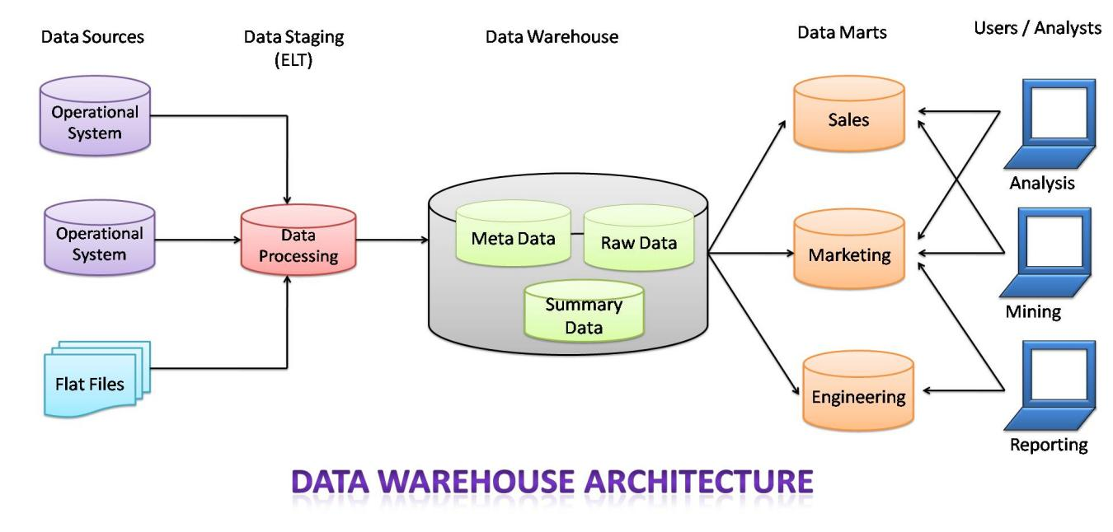
Data Warehouse Structure
THIS Use automation and AI-driven schema design tools that can analyze query patterns and data relationships to suggest optimal schema structures dynamically. Consider hybrid data warehousing, which combines structured and unstructured data to meet evolving analytical needs.

Slide 8
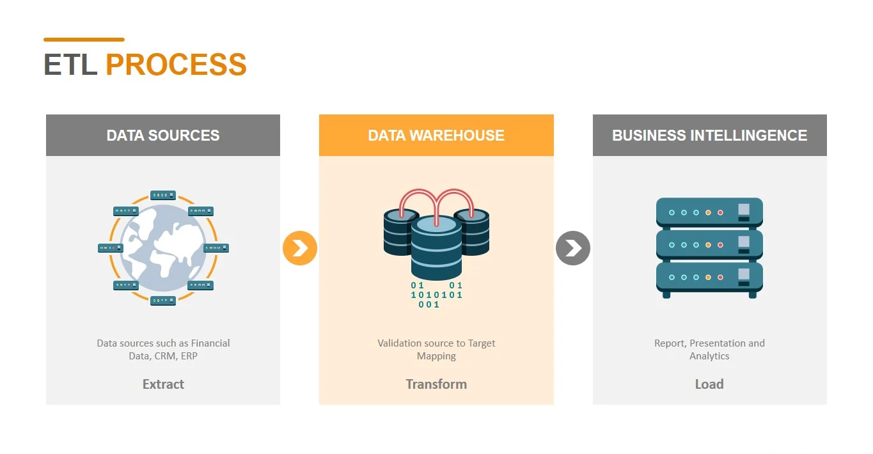
ETL PROCESSES:
Implement event-driven ETL pipelines that can automatically trigger ETL jobs based on changes in source data. Use containerization and orchestration (e.g., Docker and Kubernetes) for scalable and efficient ETL processing

Slide 9
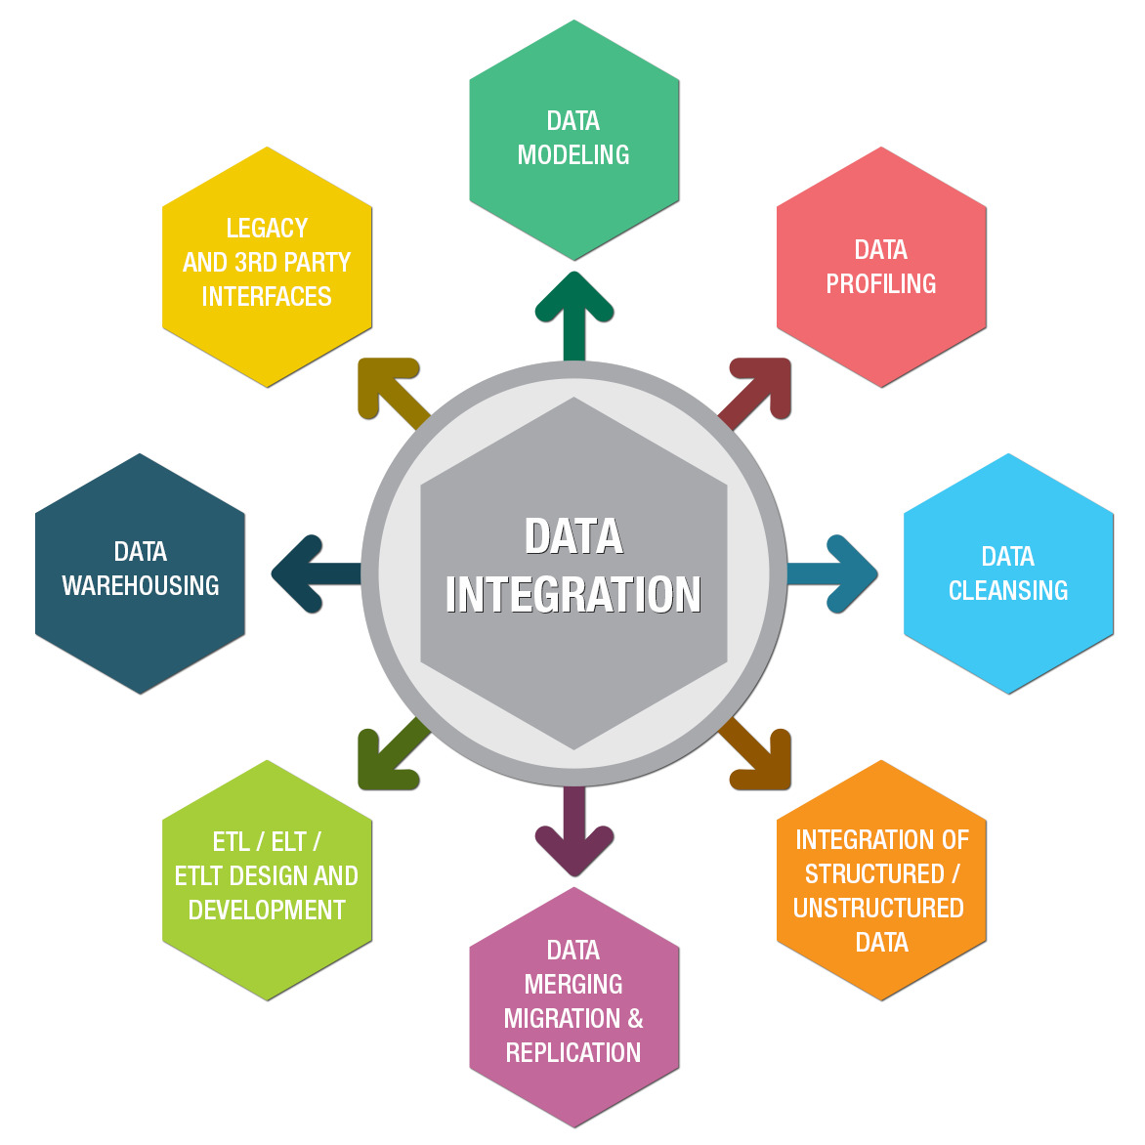
DATA INTEGRATION:
Utilize automated data integration tools with machine learning capabilities. These tools can learn from previous data integration processes to automate mapping and transformation tasks more accurately over time

Slide 10
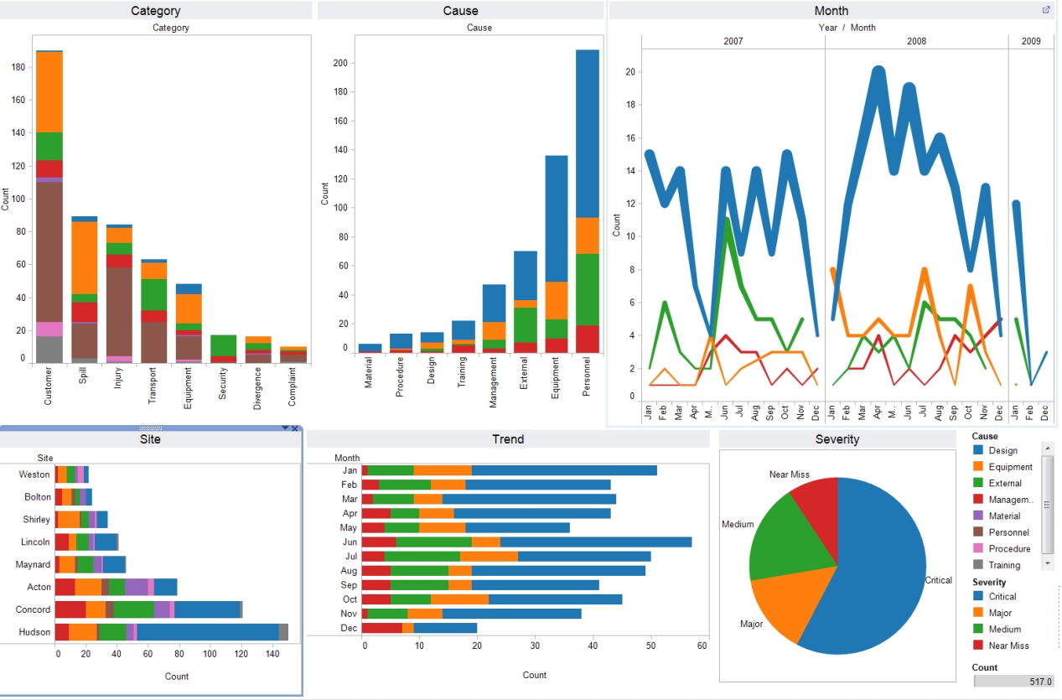
DATA ANALYSIS TOOLS:
Implement augmented analytics tools that use machine learning to assist users in finding relevant insights within the data. Incorporate natural language query interfaces, making it easier for non-technical users to access and analyze data.

Slide 11
Designing a Data Warehouse Schema and Integration
SCHEMA:
In the context of a data warehouse, schema design pertains to the strategic organization and structuring of data for efficient storage and retrieval. It involves the establishment of a logical blueprint that outlines the relationships and dependencies between different data elements.
INTEGRATION:
Characterized by a centralized fact table connected to multiple dimension tables, and the snowflake schema, which extends the star schema by normalizing dimension tables, are commonly employed in data warehousing. Effective schema design optimizes query performance, simplifies data analysis, and facilitates the execution of complex analytical tasks.

Slide 12
DATA SOURCES IDENTIFICATION
CSV Files: Structured data files stored in CSV format, commonly used for exporting and importing data between systems. These files often contain information such as sales transactions, customer details, and product data.
Databases: Various types of databases, including relational databases (like MySQL, PostgreSQL, and SQL Server) and NoSQL databases (such as MongoDB and Cassandra), which serve as repositories for structured and unstructured data. These databases might contain customer information, product catalogs, and transactional data.
APIs (Application Programming Interfaces): Interfaces that enable the interaction between different software applications, providing access to data from external sources such as web services, social media platforms, and third-party applications.

Slide 13
SQL CODE FOR STAGING TABLES
1.Creating staging table for sales data:
2.Creating staging table for customer data:
3.Creating staging table for customer data:
CREATE TABLE staging_sales (
sales_id INT,
date_id INT,
product_id INT,
customer_id INT,
quantity_sold INT,
total_amount DECIMAL(10, 2),
-- Additional columns as needed
);
CREATE TABLE staging_products (
product_id INT,
product_name VARCHAR(255),
category VARCHAR(100),
-- Additional columns as needed
);
CREATE TABLE staging_customers (
customer_id INT,
customer_name VARCHAR(255),
address VARCHAR(255),
-- Additional columns as needed
);

Slide 14
INTEGRATING DATA FROM CSV FILES:
Integrating data from CSV files into a data warehouse involves the process of pre processing, loading, and mapping the data to the appropriate tables within the data warehouse.
Firstly, the CSV data is validated and cleaned to ensure accuracy and consistency. Subsequently, a staging table is created in the data warehouse to hold the CSV data temporarily.
The data is then loaded into the staging table using specific SQL commands, followed by necessary transformations and formatting adjustments to align the data with the data warehouse schema.
Finally, the data is mapped to the corresponding tables within the data warehouse using SQL INSERT statements, ensuring that constraints are applied to maintain data integrity throughout the integration process.

Slide 15
MAPPING DATA TO DATA WAREHOUSE SCHEMA
Mapping data to a data warehouse schema involves the process of aligning the structure and content of the source data with the corresponding tables and fields in the data warehouse. This process ensures that the data from various sources, such as CSV files or databases, can be accurately integrated into the appropriate tables within the data warehouse.
It requires identifying corresponding data elements in the source data and the data warehouse schema, ensuring that the data types, formats, and relationships match between the source and target. Effective mapping is crucial for maintaining data consistency and integrity, enabling smooth data integration and facilitating comprehensive and reliable analysis within the data warehouse environment.

Slide 16
DATA QUALITY AND CLEANSING:
Data Quality :
Refers to the accuracy, completeness, and consistency of data. Ensuring high data quality involves maintaining data integrity, eliminating duplicates, and resolving inconsistencies within the dataset. It aims to guarantee that the data is reliable and suitable for analysis and decision-making processes.
Data cleansing :
Involves the process of identifying and rectifying errors or inconsistencies within a dataset. It includes activities such as handling missing data, correcting inaccuracies, standardizing data formats, and removing duplicates. Data cleansing aims to enhance data quality and ensure that the dataset is uniform and consistent for effective analysis and reporting.

Slide 17
DATA WAREHOUSE OPTIMIZATION
Performance optimization in IBM Cloud Warehouse focuses on enhancing the efficiency and responsiveness of the data warehouse system. This includes optimizing query performance through indexing, partitioning, and data caching techniques, as well as fine-tuning system configurations to accommodate varying workloads. Additionally, performance optimization involves monitoring system resources, identifying potential bottlenecks, and implementing measures to enhance system scalability and responsiveness, ensuring smooth and efficient data processing and analysis

Slide 18
ETL IMPLEMENATION STRATEGY:
Requirement Analysis and Data Profiling: Before initiating the ETL implementation, it is crucial to conduct a comprehensive analysis of the data requirements and perform data profiling to gain insights into the data structure, quality, and relationships. This step helps in understanding the data sources and defining the scope of the ETL process.
Selection of ETL Tools and Technologies: The next step involves the careful selection of appropriate ETL tools and technologies based on the specific project requirements. Evaluate the tools based on their capabilities for data extraction, transformation, and loading, as well as their scalability, compatibility with existing systems, and support for different data formats.
Development of ETL Workflows and Testing Procedures: Develop clear ETL workflows that define the sequence of data extraction, transformation, and loading. Implement robust testing procedures to validate the accuracy and integrity of the data throughout the ETL process. This includes unit testing, integration testing, and performance testing to ensure that the ETL workflows function seamlessly and deliver reliable results.

Slide 19
ETL PROCESSES IN ACTION
The ETL process begins with data extraction from various source systems, such as databases, applications, or files. The extracted data is then transformed to meet the specific requirements of the data warehouse. This transformation may involve data cleaning, standardization, aggregation, or other operations that ensure data consistency and quality. Finally, the processed data is loaded into the data warehouse, making it readily available for analysis and reporting.
ETL processes are often implemented using specialized tools and technologies that automate the extraction, transformation, and loading tasks. These tools enable data engineers to define complex ETL workflows, manage data dependencies, and monitor the entire process for any potential issues. By incorporating robust ETL processes, organizations can maintain a centralized and consistent data repository, facilitating comprehensive data analysis and informed decision-making.

Slide 20
DATA WAREHOUSE OVERVIEW
Centralized Repository:
Optimized for Analytics:
A data warehouse serves as a centralized repository for storing large volumes of structured and unstructured data collected from various sources within an organization. It facilitates the efficient management and analysis of historical and current data to support strategic decision-making.
Data warehouses are optimized for complex querying and analytical processing, enabling users to perform in-depth analysis, generate reports, and extract valuable insights from the stored data. They often incorporate online analytical processing (OLAP) and data mining capabilities to facilitate multidimensional analysis.
Scalable and Secure:
Modern data warehouses are designed to be scalable, allowing for the seamless integration of new data sources and the handling of large datasets. They also prioritize data security, implementing robust access controls and encryption mechanisms to safeguard sensitive information, ensuring compliance with data privacy regulations.

Slide 21
ENABLING DATA EXPLORATION IN DB2 WAREHOUSE USING PYTHON AND SQL
Efficient Data Retrieval: Db2 Warehouse, through the use of the ibm_db library, allows for efficient data retrieval from the database, enabling users to execute SQL queries and fetch data for further analysis and visualization. This streamlined process facilitates seamless data exploration and analysis directly from the Db2 Warehouse.-
Integrated Data Analysis and Visualization: By leveraging Python's data analysis libraries such as Pandas and visualization tools like Matplotlib, data architects can perform in-depth data analysis and create interactive visualizations, empowering them to gain valuable insights and effectively communicate complex findings to stakeholders. This integrated approach simplifies the data exploration process, making it more accessible and actionable for users.
import ibm_db
Conn=ibm_db.connect("DATABASE=your_database;HOSTNAME=your_hostname;PORT=your_port;PROTOCOL=TCPIP;UID=your_username;PWD=your_password;", "", "")
Querystmt =ibm_db.exec_immediate(conn, "SELECT * FROM your_table")
dictionary = ibm_db.fetch_both(stmt)
pandas as pdimport matplotlib.pyplot as pltdf = pd.DataFrame(dictionary, columns=dictionary.keys()).
IBM_db.close(conn)

Slide 22
Data Extraction: import pandas as pd source_data = pd.read_csv('source_data.csv’) data_transformation(data): data['date'] = pd.to_datetime(data['date’]) data['revenue'] = data['revenue'].astype(float) data['product_name'] = data['product_name'].str.upper() return datatransformed_data = data_transformation(source_data import sqlite3 conn = sqlite3.connect('example.db') databasetransformed_data.to_sql('transformed_data', conn, if_exists='replace)

Slide 23
DATA EXPLORATION TECHNIQUES
import pandas as pdimport matplotlib.pyplot as plt
Warehousedata = pd.read_sql("SELECT * FROM your_table", conn)
print(data.head())
datasetprint(data.describe())
data.plot(x='column1', y='column2', kind='scatter') plotplt.show()
Data Loading and Summary: Using Python's Pandas library, data can be loaded from Db2 Warehouse into a DataFrame, allowing for easy data manipulation and summary. The head() function displays the initial rows of the dataset, while the describe() function provides statistical insights such as mean, standard deviation, and quartiles, aiding in understanding the central tendencies and distribution o.
Data Visualization: Leveraging the capabilities of Matplotlib, data exploration can be further enhanced through various visualization techniques. In the provided example, a scatter plot is generated to visualize the relationship between two specific columns. Visualizations help in identifying patterns, trends, and correlations within the dataset, enabling data architects to communicate complex insights effectively and make informed
decisions.Advanced Analysis: In addition to these basic techniques, advanced analysis can be performed using statistical functions and machine learning algorithms to uncover more complex patterns and trends within the data, enabling data architects to extract deeper insights and make data-driven recommendations for strategic decision-making

Slide 24
CONCLUSION:
The successful execution of the project "Implementing a Scalable Data Warehousing Solution with IBM Cloud Db2 Warehouse" has demonstrated the transformative potential of modern data warehousing strategies. By harnessing the power of IBM Cloud Db2 Warehouse, the project has established a resilient and adaptable data management framework, equipped to handle the evolving demands of data-intensive environments. Through meticulous planning and execution, the project has showcased the significance of a well-designed schema, robust security protocols, and effective monitoring and optimization practices in ensuring the integrity and performance of the data warehouse. The integration of advanced analytics and reporting tools has empowered stakeholders with actionable insights, fostering a culture of data-driven decision-making and enhancing overall business agility. With a focus on scalability and future enhancements, the project serves as a guiding beacon for organizations seeking to harness the full potential of cloud-based data warehousing solutions in an ever-evolving digital landscape

