Slide 1



DBS Hack2Hire02
#Challenge2 - Recommendation System
Aditi Raghuvanshi
Manoj Kumar
PrathapManoharJoshi
Ashwin Nair

Slide 2



Slide 3
Technologies Used
Framework | Languages | Web API | Platforms
Yii | PHP | Google maps | Amazon AWS
 | Java | IPython notebook | Amazon RDS
 | Python
 | SQL

Slide 4





Architecture
Interest
Request
Location
Processed Data
Amazon AWS
Amazon RDS – Database Server

Slide 5
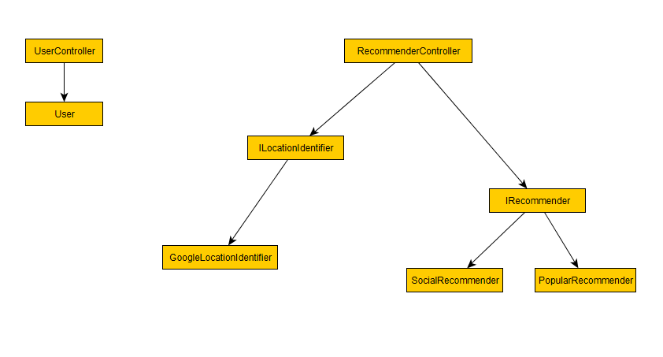
Initial Design

Slide 6
Initial Plan
User Management
User login
User logout
Registration
Recommendation System
Filtering criteria
Place Type
Rating
Choice – popular/social
Radius
Client
Bot
Web App

Slide 7
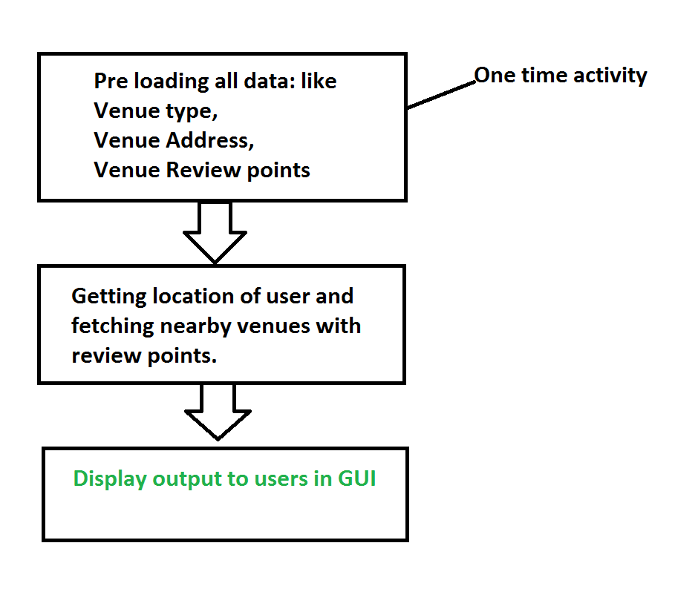

Workflow

Slide 8
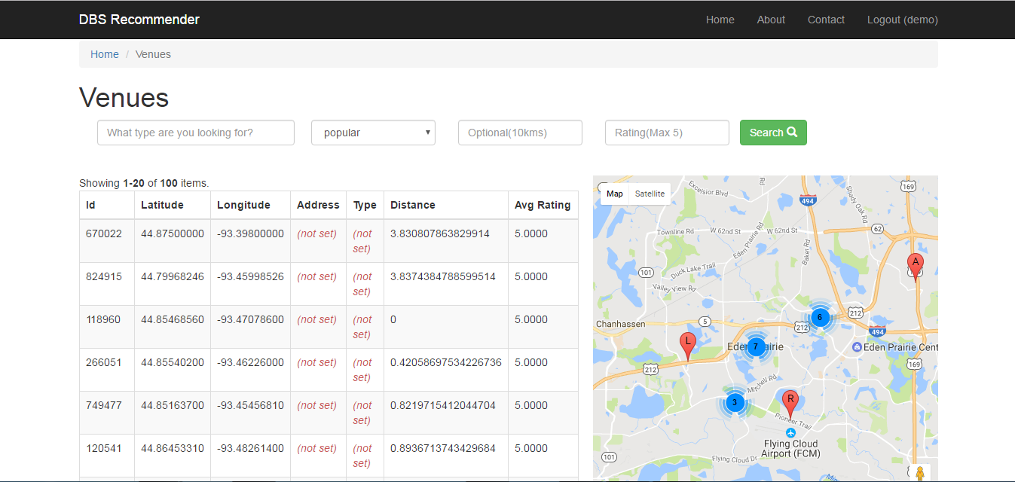
Show Time!
Demo Url :
http://sample-env.ymg5mpbr6i.ap-south-1.elasticbeanstalk.com/web/venue/index

Slide 9
Future Scope
Use Map/Reduce framework for doing collaborative filtering and for scalability.
Extend it as Mobile Application.
Navigate user based on choice of selection
Invite friends and send notification to group of close friends.

Slide 10

Questions, Answers and Feedback!

Slide 11

Thank You! ☺

