Slide 1
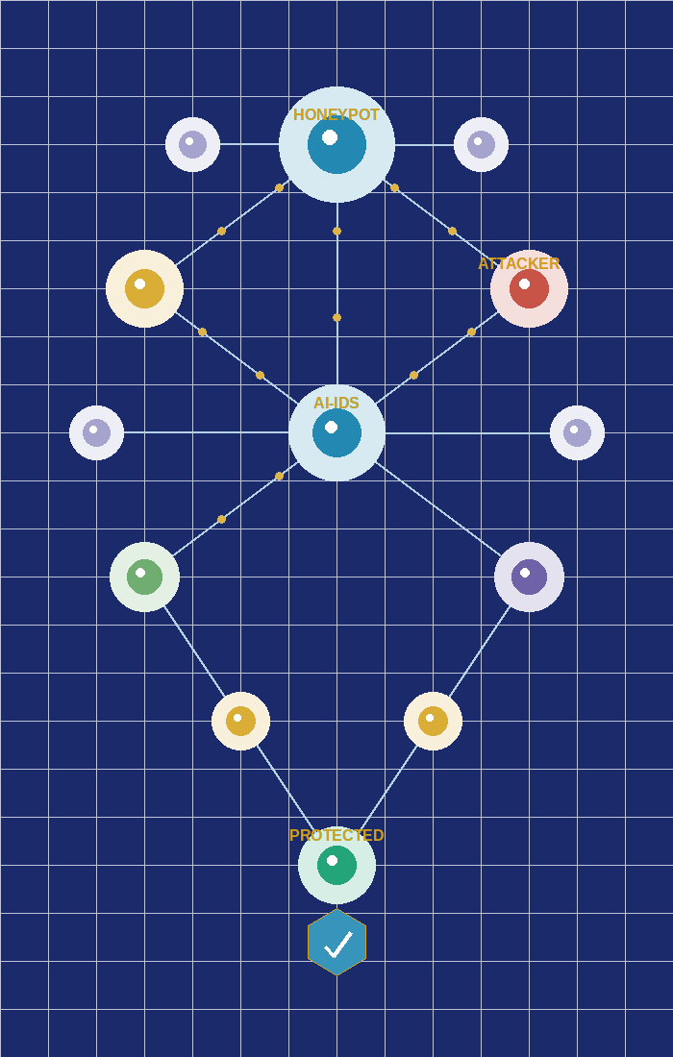
AI-Powered Intrusion Detection & Attack Prediction System
Presented by
Manojkumar M · Thirumalai Raman N · Harish Raj S · Balaji E
B.Tech – Artificial Intelligence & Data Science | 1st Year

Slide 2

Introduction to Network Security & IDS
Why protection matters — and what an IDS does
IDS – Intrusion Detection System
Network-Based IDS (NIDS)
Host-Based IDS (HIDS)
Monitors all network traffic for suspicious activity in real time
Alerts administrators when malicious behaviour is detected
Acts as a digital security camera for your entire network
Detects both known attacks (signatures) and unknown threats (anomalies)
Logs events for forensic analysis and compliance reporting
Monitors all traffic at the network segment. Detects threats at the perimeter before reaching any endpoint device.
Installed on individual machines. Monitors local logs, file changes, and user activities in real time for internal threats.
AI-Powered IDS · Manojkumar M · Thirumalai Raman N · Harish Raj S · Balaji E

Slide 3
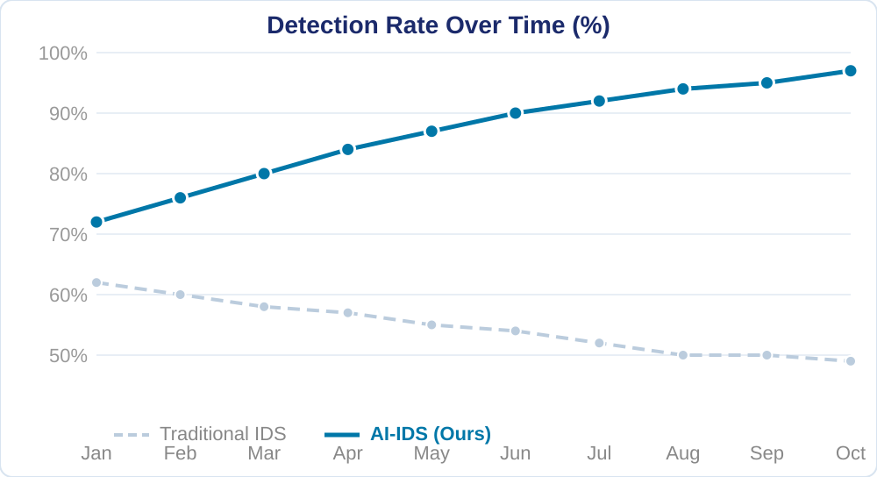
Problem Statement — Why Traditional Security Fails
Signature-based IDS vs real-world attack complexity
Zero-Day Attacks
New vulnerabilities exploited before any patch exists — traditional IDS is completely blind.
Polymorphic Malware
Self-modifying code constantly changes its signature, evading every rule-based engine.
APT Threats
Advanced Persistent Threats operate at low intensity over months, below all thresholds.
High False Positives
Rule-based engines flag legitimate traffic causing alert fatigue and missed real threats.
Slow Rule Updates
Attacker techniques evolve daily; signatures update weekly — a dangerous detection gap.
AI-Powered IDS · Manojkumar M · Thirumalai Raman N · Harish Raj S · Balaji E

Slide 4
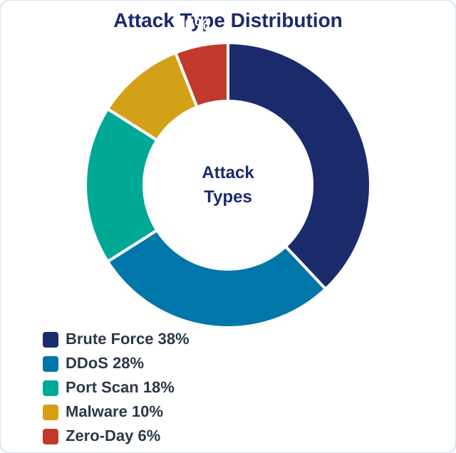
Notable Real-World Cyber Incidents
The scale of the threat demands an intelligent response
Notable Real-World Incidents
2023
40,000 Dota 2 cheaters caught via honeypot — proving real-world honeypot effectiveness.
2022
Uber breach — social engineering bypassed MFA, exposing internal systems.
2021
Colonial Pipeline ransomware — $4.4M paid, US fuel supply disrupted for days.
2020
SolarWinds — 18,000 organisations compromised including US government; undetected for months.
2018
Chalubo botnet found by SophosLabs honeypot — early detection prevented wider infection.
AI-Powered IDS · Manojkumar M · Thirumalai Raman N · Harish Raj S · Balaji E

Slide 5
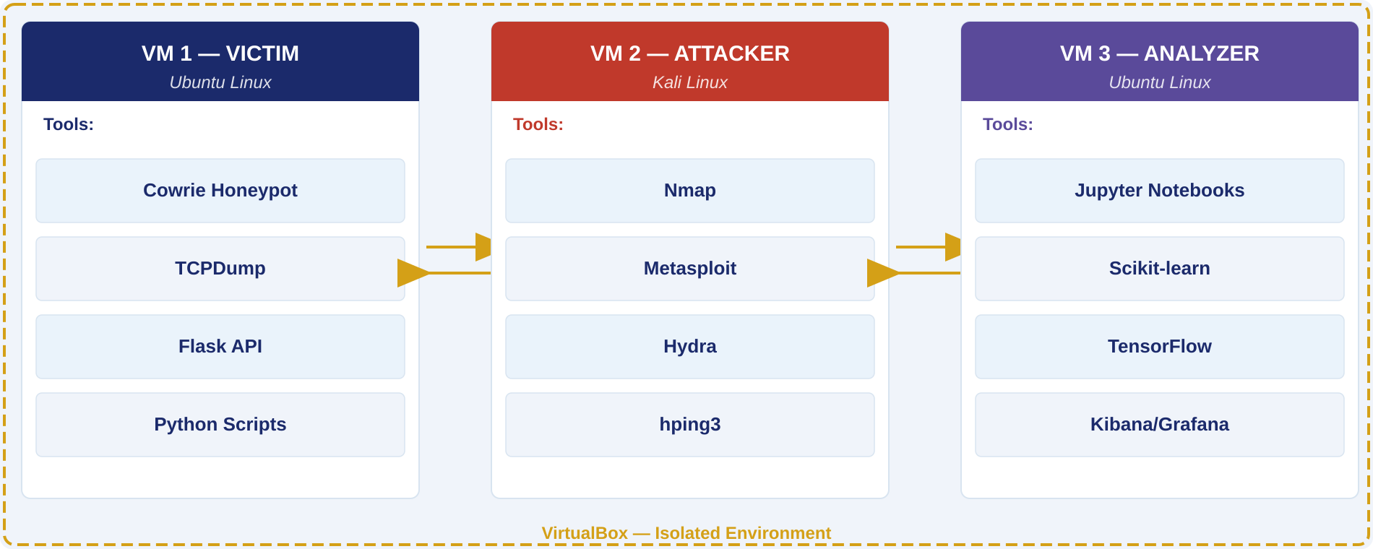
System Architecture Overview
3 isolated Virtual Machines — safe, repeatable, and realistic
AI-Powered IDS · Manojkumar M · Thirumalai Raman N · Harish Raj S · Balaji E

Slide 6
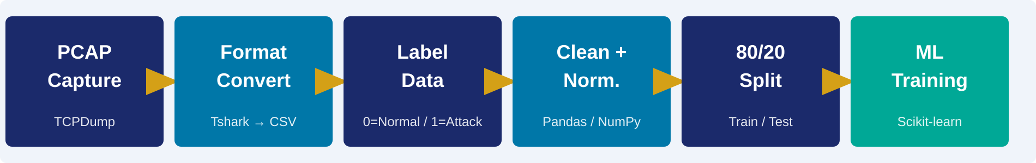
Data Collection, Preprocessing & Feature Extraction
From raw attack traffic to model-ready intelligence
Honeypot (Cowrie)
TCPDump — Packet Capture
Tshark / Wireshark
Emulates SSH/Telnet server, silently trapping attackers. Logs every command, credential and file transfer. Every interaction is malicious by definition. Output: JSON logs → ML training data.
Runs continuously on VM1. Captures ALL network packets — both benign and attack traffic simultaneously — as binary .pcap files ready for conversion.
Converts .pcap to structured .csv. Extracts: source/dest IP, protocol, packet length, TCP flags, port numbers, and inter-arrival timing between packets.
AI-Powered IDS · Manojkumar M · Thirumalai Raman N · Harish Raj S · Balaji E

Slide 7
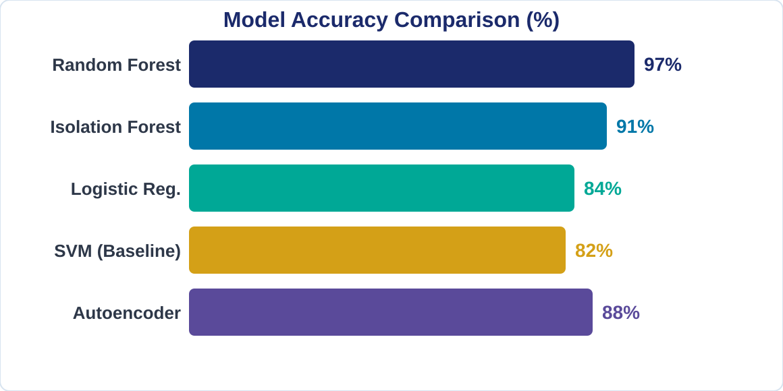
Machine Learning Models Used
Supervised + unsupervised methods for complete threat coverage
Random Forest
>95% accuracy. Ensemble of hundreds of decision trees. Primary classifier for known attack detection.
Isolation Forest
Unsupervised anomaly detection. No labels needed. Catches zero-day and novel unknown threats.
Logistic Regression
Fast, interpretable baseline model. Validates Random Forest results against a simpler approach.
Autoencoders (Future)
Deep learning: learns to reconstruct normal traffic. High reconstruction error = anomaly.
AI-Powered IDS · Manojkumar M · Thirumalai Raman N · Harish Raj S · Balaji E

Slide 8
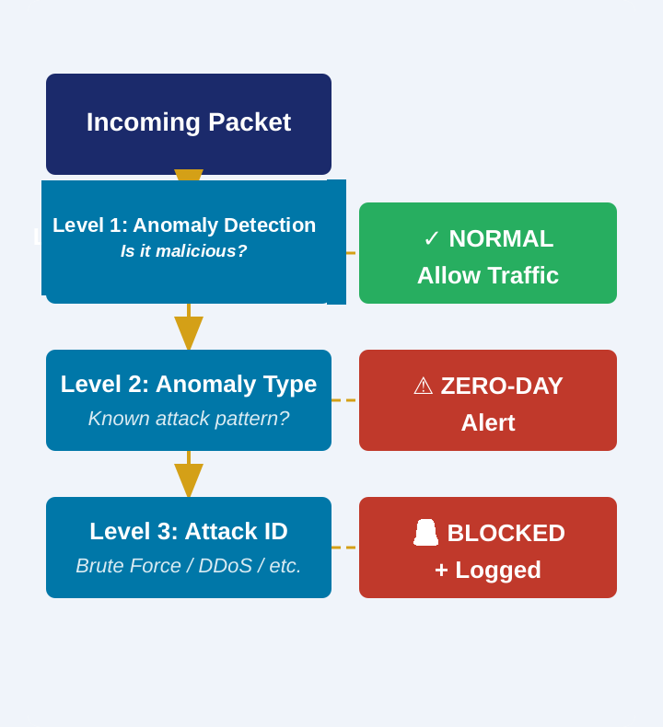
Proposed System: Attack Detection & AI Prediction
3-level cascade classification + proactive attack anticipation
AI-Powered Attack Prediction
Beyond detection — anticipating attacks BEFORE they fully materialise
Behavioural Baseline
AI learns normal traffic patterns. Any significant deviation is flagged immediately as suspicious before a full attack even begins.
Early-Stage Pattern
Initial port scans trigger alerts before the full brute-force attack begins — giving critical response time to analysts.
Time-Series LSTM (Future)
LSTM networks will detect slow multi-stage APT attacks unfolding over days — invisible to threshold methods.
Automated Response
On prediction: auto-trigger alerts, block offending IPs, and isolate compromised network nodes instantly.
AI-Powered IDS · Manojkumar M · Thirumalai Raman N · Harish Raj S · Balaji E

Slide 9
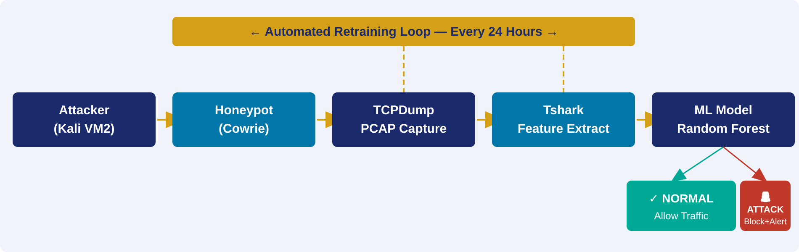
System Workflow Diagram
End-to-end data and decision flow with automated retraining
✓ NORMAL TRAFFIC — Flow Continues
🚨 ATTACK DETECTED — Immediate Response
Traffic passes uninterrupted. Session logged for baseline learning and queued for next 24-hour model retraining cycle.
Alert raised instantly. IP blocked. Security dashboard notified. Event logged and queued for retraining — model improves.
AI-Powered IDS · Manojkumar M · Thirumalai Raman N · Harish Raj S · Balaji E

Slide 10
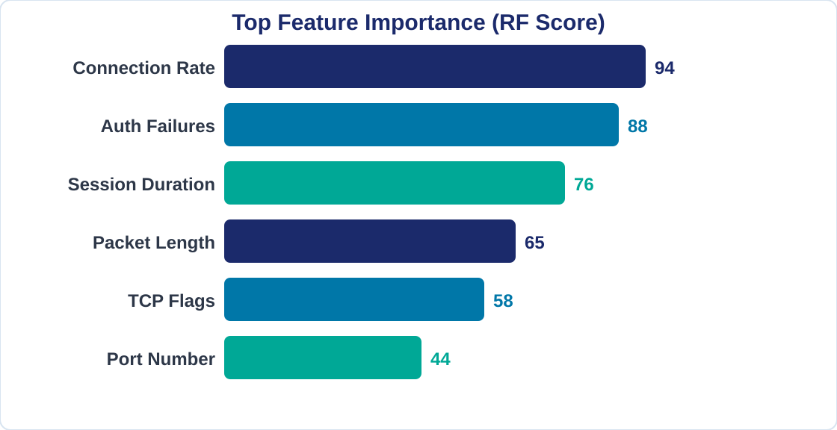
Implementation Technologies
Tools, libraries, and frameworks powering the system
Programming & ML
Python, Bash, Scikit-learn, TensorFlow / Keras
Data Processing
Pandas, NumPy, Matplotlib, Seaborn
Network Tools
TCPDump, Tshark, Wireshark, VirtualBox
Web & Dashboard
Flask REST API (<10ms), Kibana, Power BI
AI-Powered IDS · Manojkumar M · Thirumalai Raman N · Harish Raj S · Balaji E

Slide 11
Advantages & Real-World Applications
Six key strengths + critical industry impact
01
Known & Unknown Attacks
02
Real Attacker Data
03
Real-Time Flask API
>95% accuracy on known. Isolation Forest catches zero-day threats automatically.
Cowrie captures authentic hacker commands — far more realistic than synthetic datasets.
Predictions in <10ms. Any SIEM can query for live traffic classification instantly.
04
Low False Positive Rate
05
Continuous Self-Improvement
06
Scalable Architecture
F1-score approaching 1.0 — legitimate traffic rarely flagged, reducing alert fatigue.
Cron job retrains every 24 hours. If new model outperforms old, it auto-deploys.
3-VM design expands easily. Integrates with any SIEM or cloud security infrastructure.
REAL-WORLD APPLICATIONS
Cloud / AWS / Azure
Banking & Finance
IoT Networks
Government & Defence
Industrial Control
Telecommunications
AI-Powered IDS · Manojkumar M · Thirumalai Raman N · Harish Raj S · Balaji E

Slide 12
Brute Force Attack – Attack Scenario
How the system detects and responds in real time
01
Attack Initiated
02
Honeypot Traps
03
Traffic Captured
Attacker on VM2 runs Hydra targeting SSH on VM1 — hundreds of password attempts per second.
Cowrie intercepts all attempts. Logs every username, password and session. Attacker is unaware.
TCPDump records SSH packets — rapid-fire connections from single IP — classic brute force signature.
04
Feature Extraction
05
ML Classifies
06
Response & Retrain
Tshark to CSV: high connection rate, repeated auth failures, short sessions, single source IP.
Random Forest: ATTACK = 1. Confidence: 99.2%. Alert triggered in under 10 milliseconds.
IP blocked. Dashboard alerts team. Event logged and queued for 24-hour model retraining.
AI-Powered IDS · Manojkumar M · Thirumalai Raman N · Harish Raj S · Balaji E

Slide 13
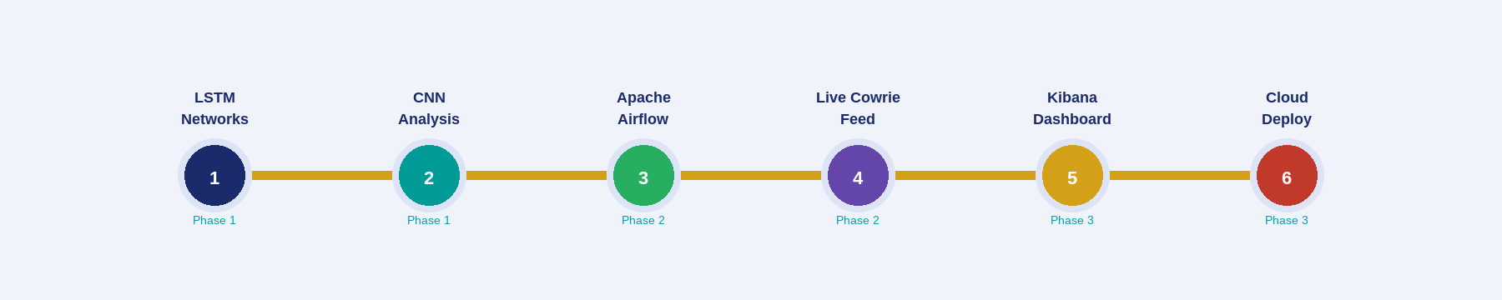
Future Improvements
Roadmap to a fully autonomous, self-healing IDS
LSTM Networks
CNN Analysis
Apache Airflow
Learns temporal sequences — ideal for slow multi-stage APT attacks unfolding over days or weeks.
Convolutional layers detect local patterns in network data — effective for DDoS and protocol anomalies.
Fully automated retrain → validate → deploy pipeline. Zero manual intervention required.
Live Cowrie Feed
Kibana Dashboard
Cloud Deployment
Real-time log streaming into detection engine — eliminates the 24-hour retraining delay completely.
Real-time visual monitoring of attack trends, model confidence, and alert frequency.
AWS Security Hub and Azure Sentinel integration — monitor thousands of cloud nodes simultaneously.
AI-Powered IDS · Manojkumar M · Thirumalai Raman N · Harish Raj S · Balaji E

Slide 14
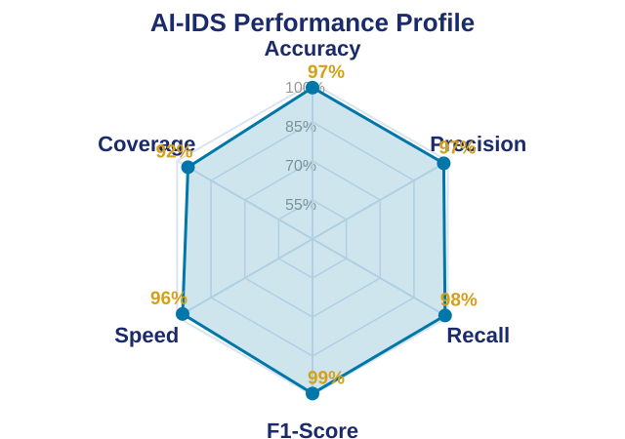
Conclusion
Bridging the gap between reactive rules and adaptive intelligence
This AI-IDS system proves that combining Machine Learning with Honeypot technology creates a security system that is smarter, faster, and more adaptive than any traditional approach.
Traditional IDS is Not Enough
Signature-based systems fail against zero-day attacks, APTs, and polymorphic malware.
AI Learns — Traditional Rules Don't
ML adapts continuously. Random Forest >95% accuracy. Unsupervised models cover the rest.
Honeypots Provide Real Intelligence
Cowrie captures authentic attacker behaviour — far more realistic than synthetic datasets.
Real-Time, Scalable, Future-Ready
Sub-10ms Flask API. Scales from 3-VM lab to cloud-level deployment across thousands of nodes.
AI-Powered IDS · Manojkumar M · Thirumalai Raman N · Harish Raj S · Balaji E

Slide 15
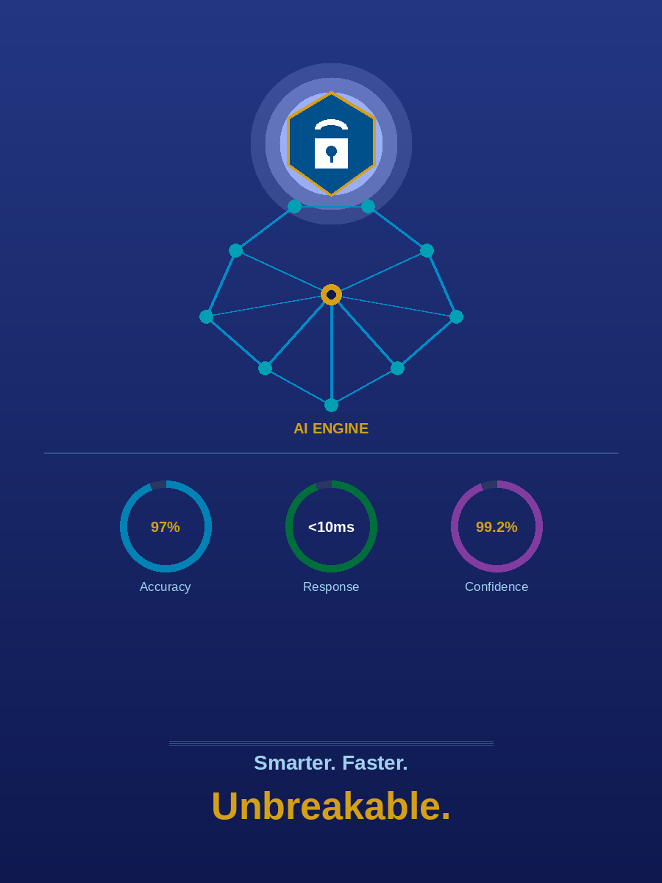
THANK YOU
AI-Powered Intrusion Detection
& Attack Prediction System
Manojkumar M · Thirumalai Raman N · Harish Raj S · Balaji E
B.Tech – Artificial Intelligence & Data Science | 1st Year
Questions & Discussion Welcome

