Slide 1
Open Options
Modeling and measuring risk/return
- Chetan Gadgil

Slide 2
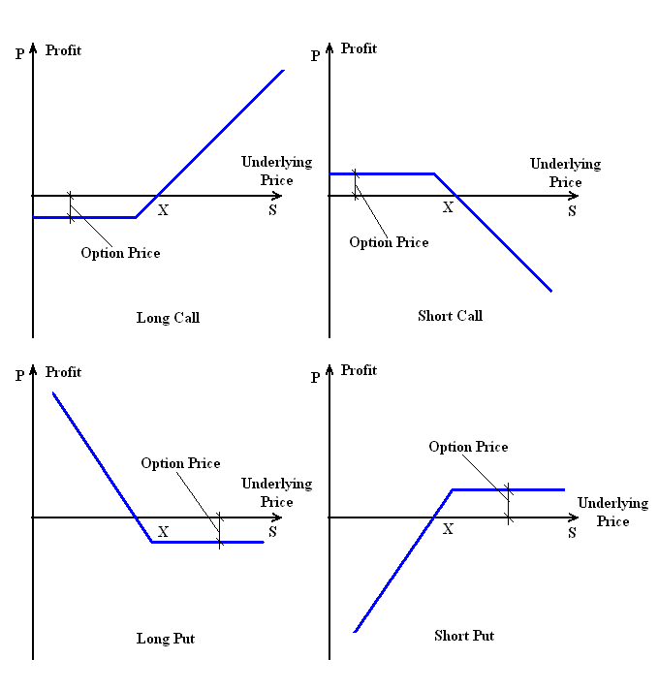
Option Value Primer
Price of an option just about to expire
Source: http://bit.ly/12xfS1C

Slide 3
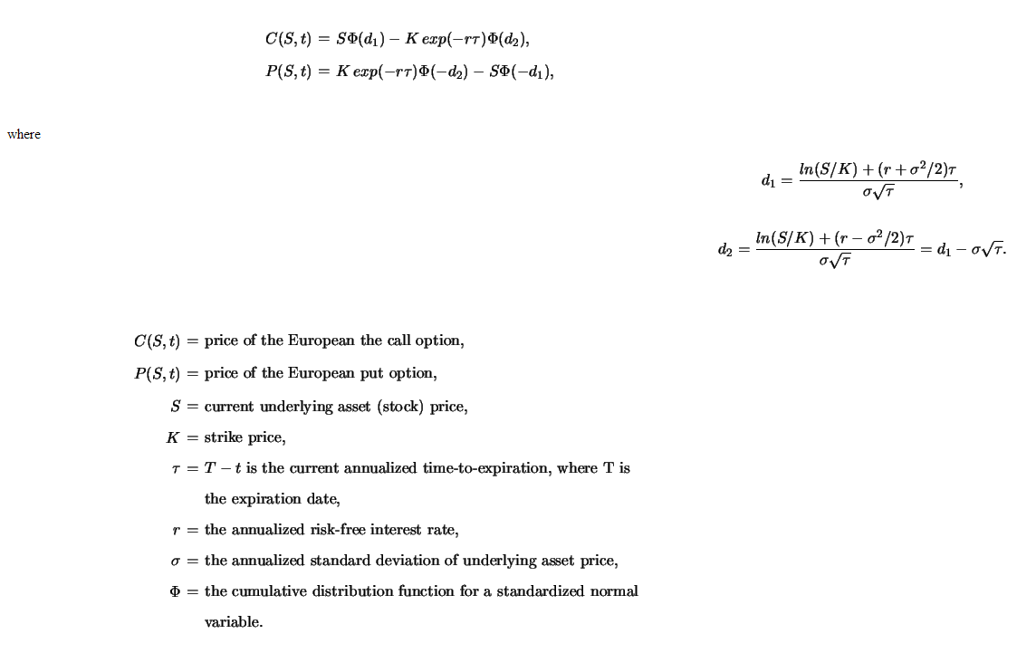
Price of Option (cost of risk)
Black & Scholes Formula. Source: http://bit.ly/13pHQZP

Slide 4
“Choice. The problem is choice”.
Risk Pricing
Market Data
Sentiment Data
…
?

Slide 5
Open Options
Risk Assessment
Algorithmic Trading
Portfolio Construction
“Pay by the drink” cloud service for
Financial Risk Management

Slide 6
Open Options Overview
Price of Risk
Market
Regulations
Sentiment

Slide 7



Architecture
API Client
Analyst UI Services
Analysis Bus
Analysis
Analysis
Analysis
Analysis Market
Market Data Feed Bus
Machine Learning
Price
Sentiment
Regulatory
Complex
Feed Processor
Market Data Store
Commodities
Options
ETL
…
…
Workflow
Integration Bus
Murex
Numerix
Sungard
…
All trademarks or registered trademarks are the property of their respective owners.

Slide 8
Technology Details
Play Framework
Guice Container
Open Options
Open Mind
Open Positions
Open Eyes
Apache Camel
Commons HTTP
Apollo/
STOMP
Apollo/
JMS
Jetty
Twitter
Scala/Akka/Slick/Anorm
H2DB
MySQL

Slide 9
Roadmap
Aug 2013
(Open Positions)
Aug 2014
(Open Mind)
Apr 2014
(Open Options)
Equity Portfolio Modeling
Market Data Store
Analyzer UI framework
Analysis Repository
Workflow (BPMN 2.0)
Sentiment Feed (Twitter)
Machine Learning (Neural Network)
Aug 2015
(Open Eyes)
Algorithmic Trading and Investment
Equity Options
Genetic Programming Algorithms
Automatic Monitoring
Strategy Generation

Slide 10
Demo
Open Positions
Library
Integration Example (UI)
Open Options
Library
Integration Examples (Scala/Java)
Open Mind
TODO
TODO
Open Eyes
TODO
TODO

Slide 11
Java Sample
<dependency>
<!-- net/gadgil/cgoptprice/options.pricing_2.10/0.0.1 -->
<groupId>net.gadgil.cgoptprice</groupId>
<artifactId>options.pricing_2.10</artifactId>
<version>0.0.1</version>
</dependency>
<!-- optionpricing / finance.portfolio / releases / net / gadgil / finance.portfolio_2.10
/ 0.1.0-SNAPSHOT -->
<dependency>
<groupId>net.gadgil</groupId>
<artifactId>finance.portfolio_2.10</artifactId>
<version>0.1.0-SNAPSHOT</version>
</dependency>
public void testBlackScholesGeneralizedCallOption()
{
double optionValue = net.gadgil.cgoptprice.BlackScholes.callOptionGeneralizedBlackScholes(60, 65, 0.25, 0.08, 0.08, 0.3);
double diff = Math.abs(2.1334 - optionValue);
if(diff < 0.0001)
assertTrue( true );
else
assertTrue(false);
}
https://github.com/cgadgil/optionpricing/tree/master/javasamples

Slide 12
Questions?

