Slide 1

UE19CS353 – Object Oriented Analysis and Design with Java
Theory ISA (Mini Project)
Presentation on
Banking Application
By:
MANOJ KUMAR K - PES2UG19CS222
MAHANTESH M - PES2UG19CS210
NIKHIL V R - PES2UG19CS258
6th Semester D
PES University, Bengaluru
(Established under Karnataka Act 16 of 2013)
Department of Computer Science & Engineering
Session: Jan - May 2022

Slide 2
Object Oriented Analysis and Design with Java (Mini Project)
Project Description
This application provides banking applications using java. This app
provides users with various banking transaction facilities.
https://github.com/manojkumar402/OOAD_TEAM_17.git

Slide 3
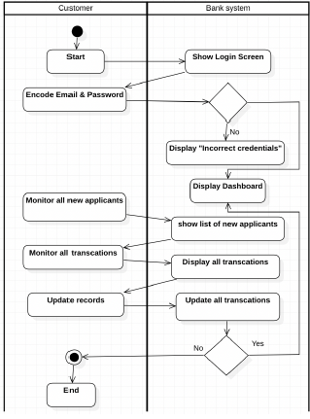
Object Oriented Analysis and Design with Java (Mini Project)
Activity Diagram

Slide 4
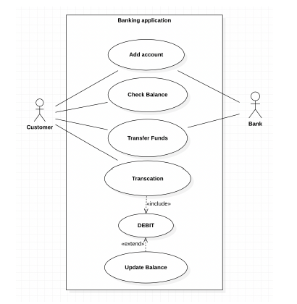
Object Oriented Analysis and Design with Java (Mini Project)
USE CASE Diagram

Slide 5
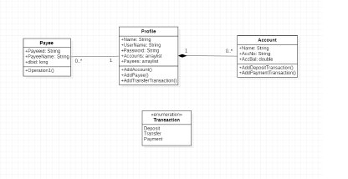
Object Oriented Analysis and Design with Java (Mini Project)
CLASS Diagram

Slide 6
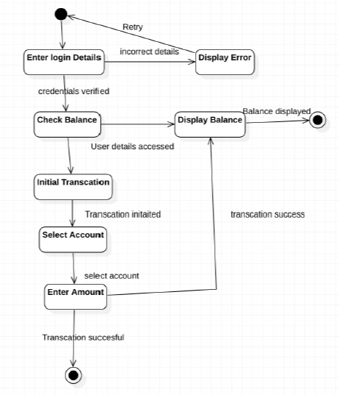
Object Oriented Analysis and Design with Java (Mini Project)
STATE Diagram

Slide 7
Object Oriented Analysis and Design with Java (Mini Project)
Tools and Frameworks Used
Front-end: Android Studio
Database: SQLite database
Version Control: Git
Class, activity and state diagrams: StarUML

Slide 8
Object Oriented Analysis and Design with Java (Mini Project)
Design Principle and Design Patterns Applied
Design Pattern used:
● MVC architectural pattern
MVC is an architectural pattern that consists of 3 parts:
1. Model - Handles the data logic
2. View - It displays the information about the customer, bank
accounts and transaction history from the model to the user.
3. Controller - It controls the data flow into a model and
updates the view whenever data changes.
Design Principles used:
● Prototype - Creating different user accounts.
●Adapter - Used for transactions.
● Observer - To notify transaction changes to different classes.

Slide 9
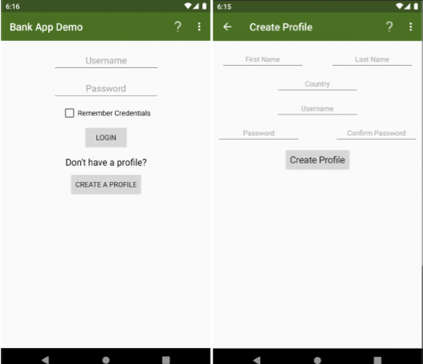
Object Oriented Analysis and Design with Java (Mini Project)
Screenshots

Slide 10
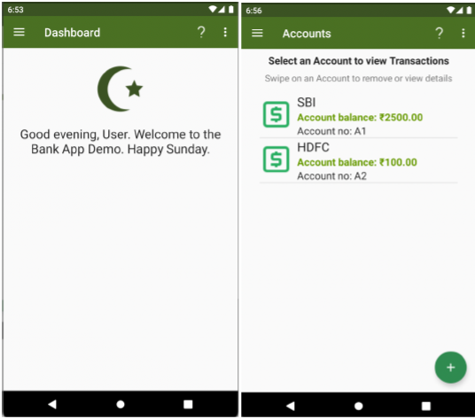
Object Oriented Analysis and Design with Java (Mini Project)
Screenshots

Slide 11
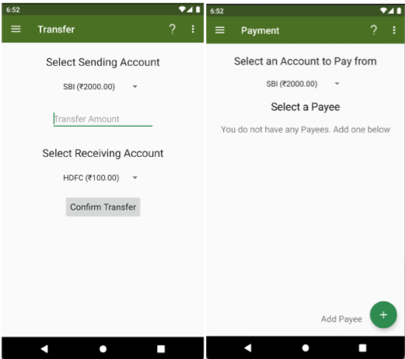
Object Oriented Analysis and Design with Java (Mini Project)
Screenshots

Slide 12
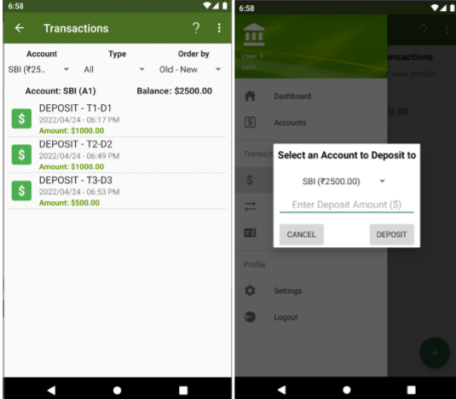
Object Oriented Analysis and Design with Java (Mini Project)
Screenshots

Slide 13
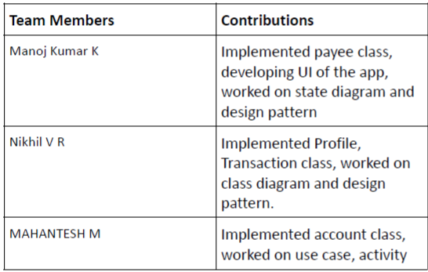
Object Oriented Analysis and Design with Java (Mini Project)
Team member contributions

