Slide 1
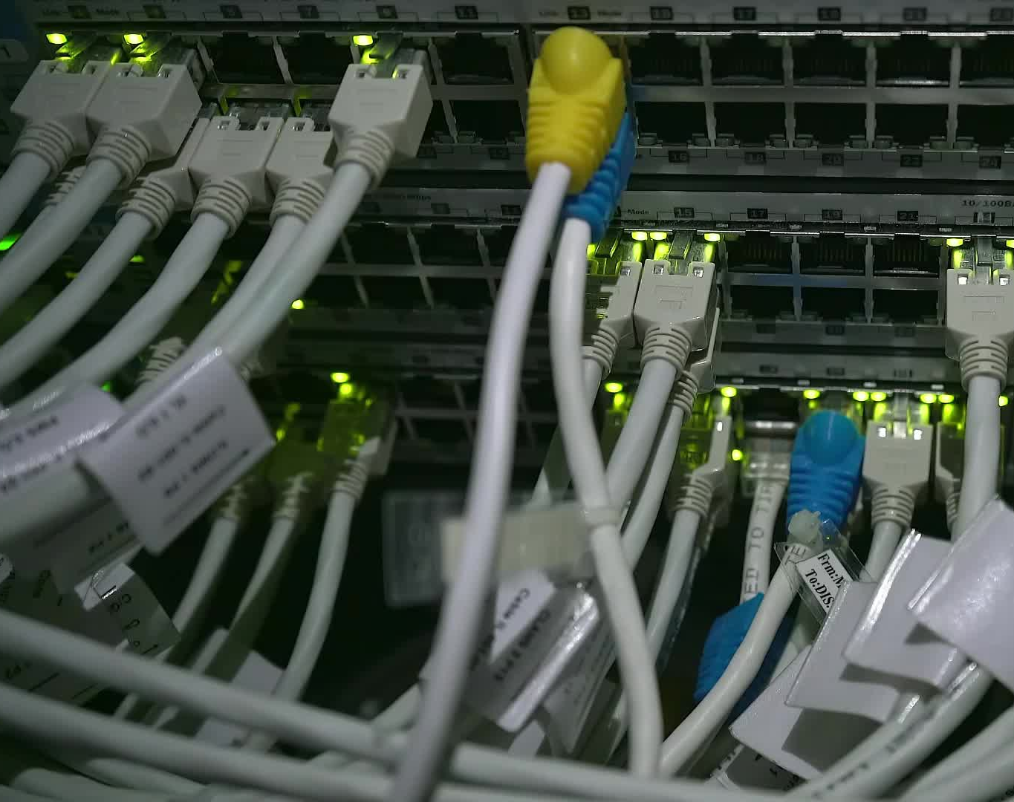
CLOUD SERVERLESS COMPUTING 20CS3281AA
AWS Amplify Hosting
2000030055
MANOJ KUMAR ANKEM

Slide 2

Contents
Description
Architecture
Services Used
Working
Output
Conclusion

Slide 3
Description
Basically, this project is about "Hosting a wab applicaion on aws amplify"

Slide 4
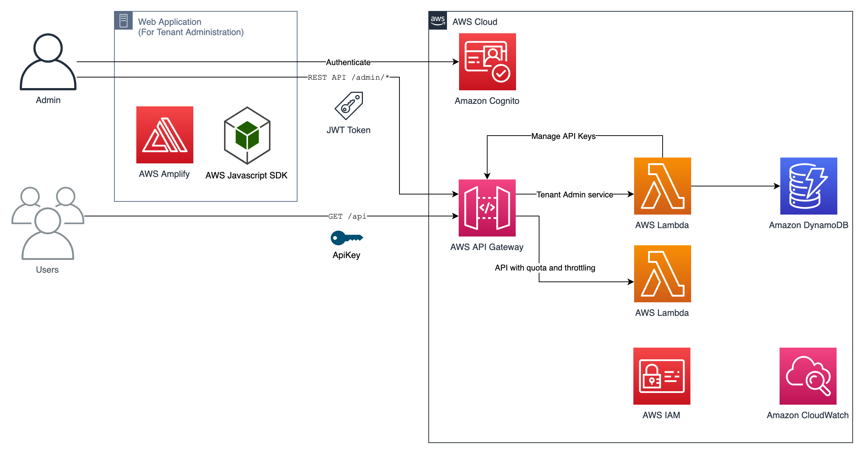
Architecture

Slide 5
Services Used
AWS Amplify
Amazon Cognito
AWS API Gateway
AWS Lambda
Dynamo DB
AWS Cloud Watch

Slide 6

Cont..
AWS Amplify : AWS Amplify is a development platform that allows developers to easily create and deploy scalable, secure, and feature-rich web and mobile applications.
AWS Lambda : AWS Lambda is a serverless computing service provided by AWS that lets you run your code without provisioning or managing servers.
AWS API Gateway : API Gateway is a fully managed service provided by AWS that enables developers to create, deploy, and manage secure APIs at any scale, making it easy to connect applications to data and services hosted in AWS or outside of AWS.

Slide 7
Cont..
AWS DynamoDB : Amazon DynamoDB is a fully managed NoSQL database service provided by AWS that provides fast and predictable performance with seamless scalability, making it an ideal choice for applications that require low-latency data access at any scale.
AWS Cloud Watch : Amazon CloudWatch is a monitoring and observability service provided by AWS that provides real-time monitoring and logging for AWS resources and applications, enabling you to collect, monitor, and analyze metrics, logs, and events to ensure that your infrastructure and applications are running smoothly.

Slide 8

Working
Go to the AWS Amplify console (console.aws.amazon.com/amplify/).
Click "Create app" to create a new app.
Choose your preferred development platform (Web, iOS, or Android).
Connect your app to a Git repository (GitHub, Bitbucket, GitLab, or AWS CodeCommit).
Select the branch that you want to deploy.

Slide 9
Working
Choose your build settings (for example, the framework and build commands).
Choose your hosting settings (for example, the domain name and SSL certificate).
Click "Create app" to create the app.
the application will be created,and all the operations done onthe application will be recorded in Dynamo DB

Slide 10

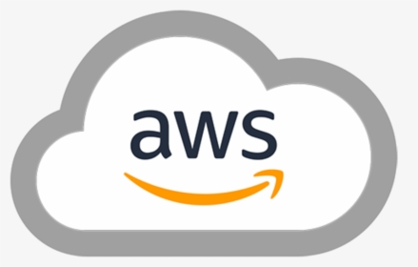
Conlusion
Finally, we are done with our simple web application which can be used by any user to get run their projects

Slide 11

Thank you

