Slide 1
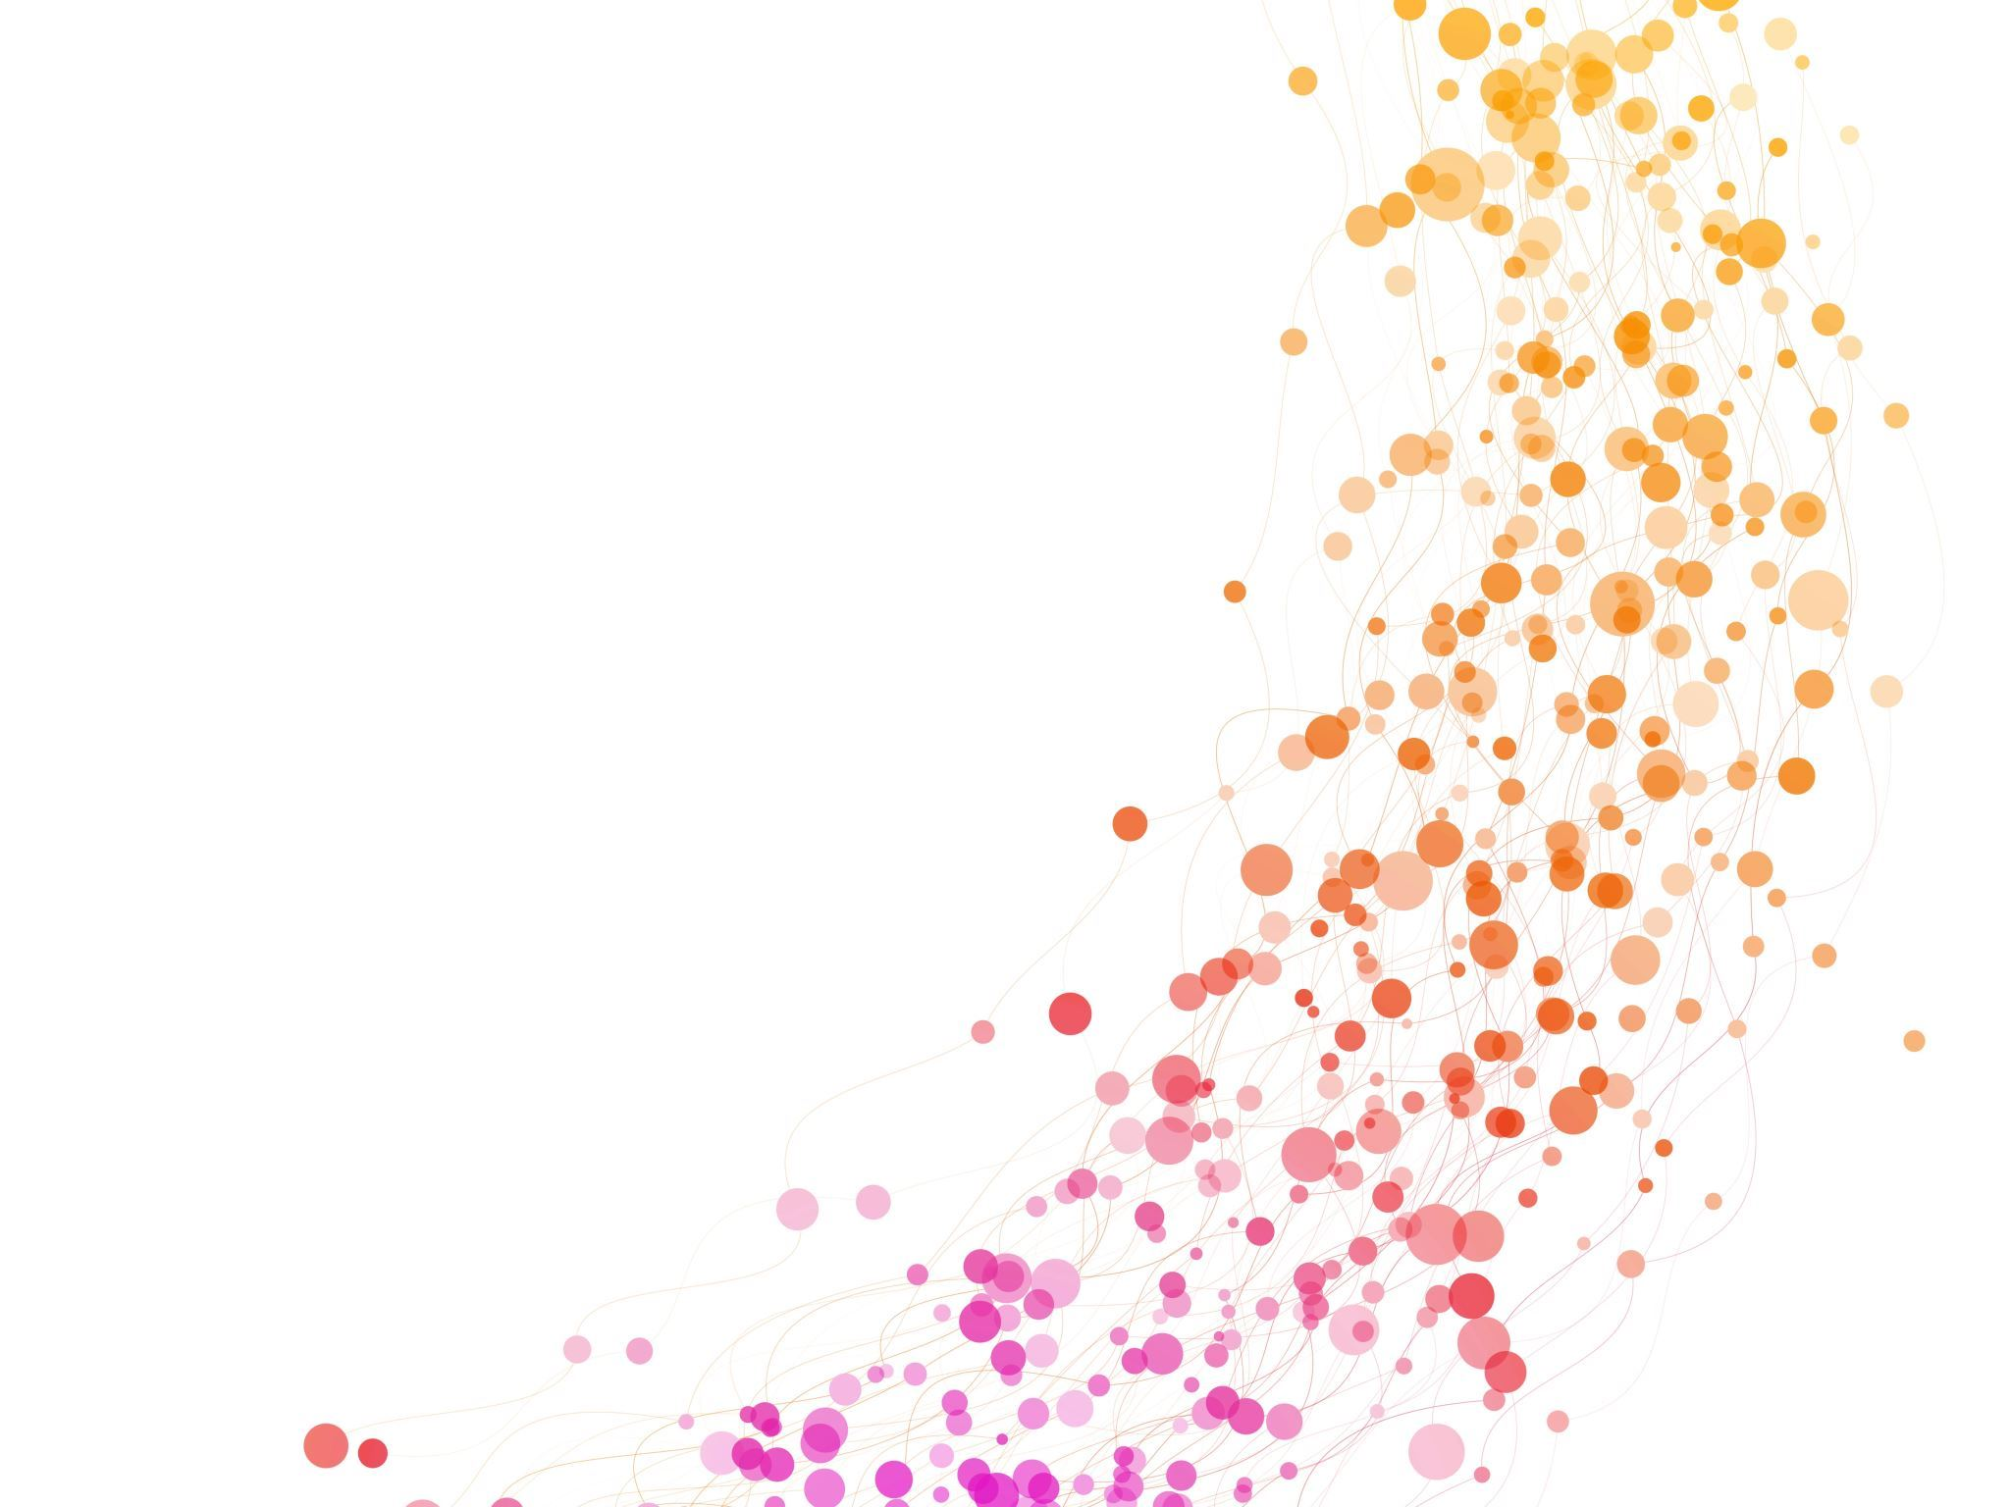
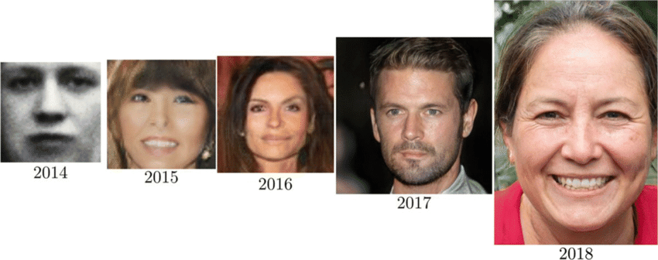
Differentially Private Generative Adversarial Network
Manoj kumar sial
21114059

Slide 2
Introduction: DPGAN is an innovative approach that combines the power of generative adversarial networks (GANs) with the principles of differential privacy. GANs are a type of artificial intelligence model used for generating new data that mimics a given dataset, while differential privacy is a privacy-preserving technique that ensures individual data points remain protected even when the model is trained on sensitive information.

Slide 3
What is Generative Adversarial Network
GAN have two components generator and discriminator.
The generator takes random noise as input and learns to transform it into meaningful data, such as images, audio, or text.
The goal is to produce data that is indistinguishable from real data samples.
The discriminator acts as a binary classifier that distinguishes between real data and fake data samples generated by the generator.
The goal of the discriminator is to correctly differentiate between real and fake data samples.

Slide 4
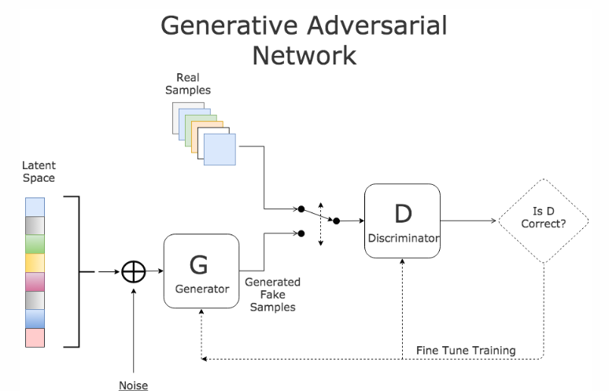
How GAN works:

Slide 5
Applications of GAN
To create new data from available data.
Image to image generation.
Prediction of next frame in image and video
Low resolution to high resolution image.
And it is also apply in text.

Slide 6
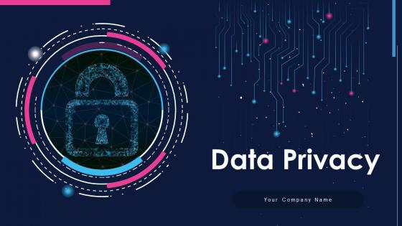
Differentially Private in GAN
k
It involves ensuring that the training process and the generated samples preserve the privacy of individual data points. This is achieved by adding noise into the dataset in training procedure.

Slide 7
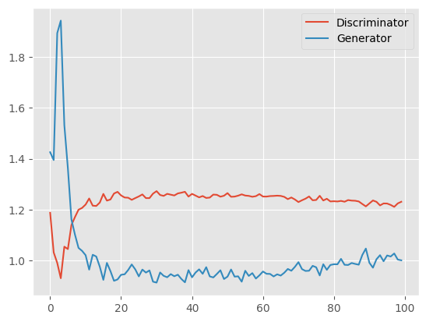
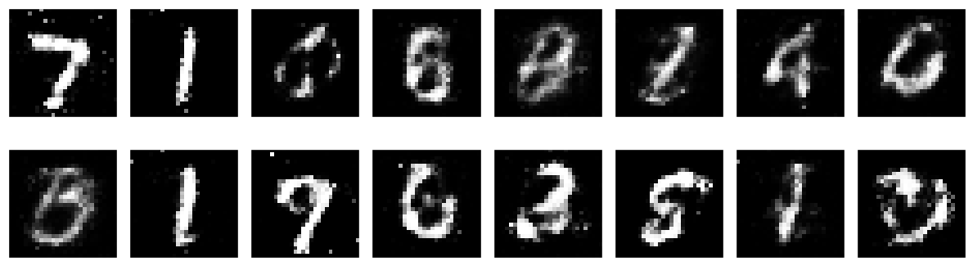
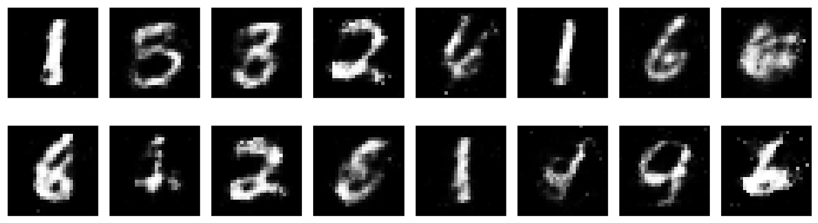
Results:
Loss vs no. of epochs:

Slide 8

Limitations of GAN:
Quality may degrade in obtained dataset.
Implementation of DPGAN model is complex and it is challenging.

Slide 9

Conclusion:
In this paper, it proposed a privacy preserving generative adversarial network (DPGAN) that preserves privacy of the training data. Here the privacy is preserved by add noise by Gaussian noise mechanism. Mainly privacy is required in sensitive data like hospital data, so that we can generate new health record data by considering the privacy of patients.

Slide 10

Thanks You

