Slide 1

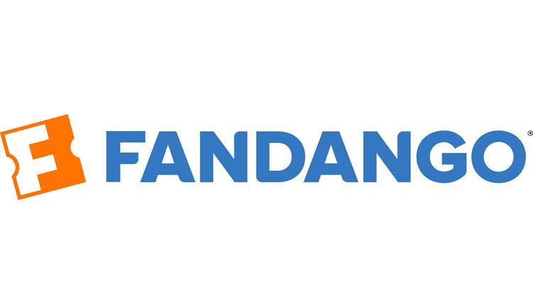
VS

Slide 2

Overview
Started in 1999 as a Software Reseller of VISTA Group. (Big Tree Entertainment)
Started by Ashish | Parikshit | Rajesh.
Start BookmyShow, an online movie & entertainment ticketing platform in 2007.
5 countries|650+ cities in india with 5000+ screens
Funded by Accel partners, Saif partners, Network18
Tickets Sold record-Single weekend-3M and 1M a day

Slide 3
Overview
Fandango is an American ticketing company that sells movie tickets via their website as well as through their mobile app.
It was founded in April 27, 2000 at Beverly Hills, California, USA.
Current parent Company Comcast Corporation.
It is owned by NBC Universal and Warner Media.
They Have more than 26,000 screens nationwide.
App downloads already reached 46MN and still counting.
Competitor Tickets.com, LLC, Flixster, Inc.

Slide 4


BiZ Model
B2C
B2B
B2C
B2B
Charges
Charges
Tie-ups with other comp.
Advertisements
Technology
Online
Offline
Online
Offline
VOD
Web/app
phone
DVD

Slide 5
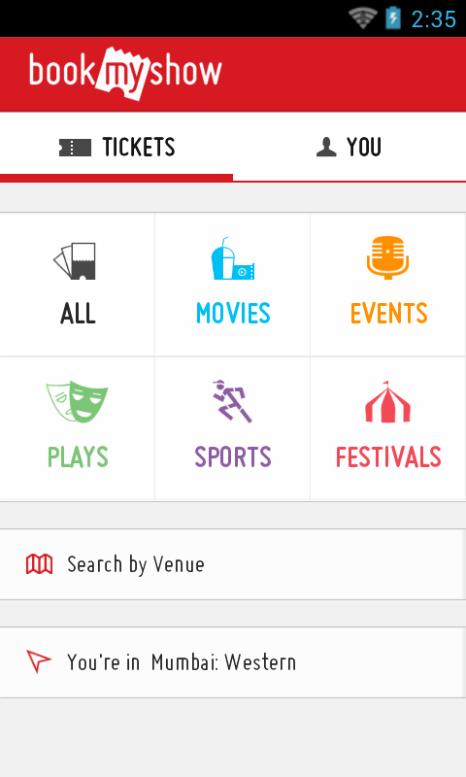
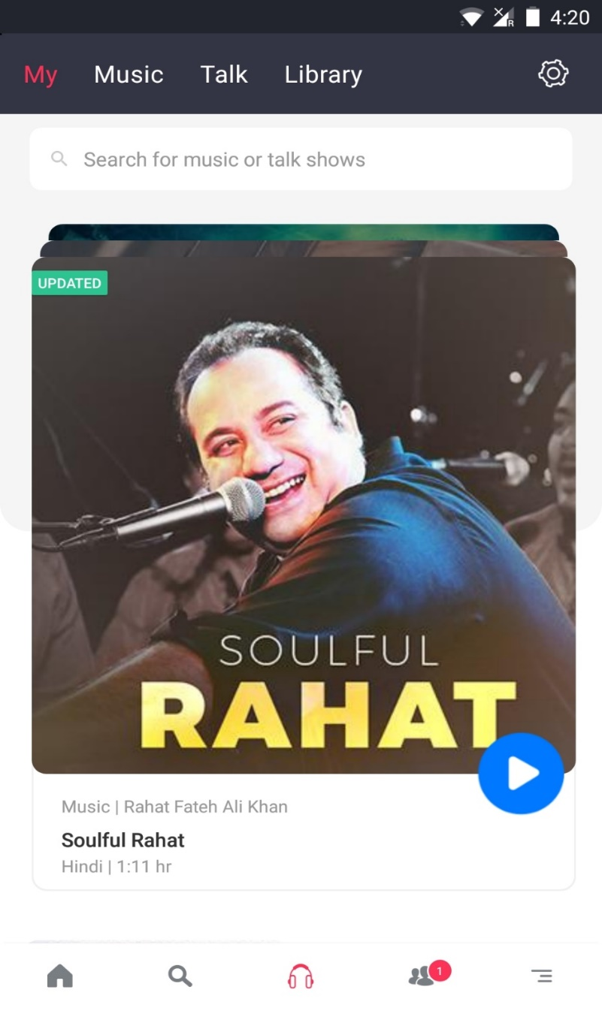
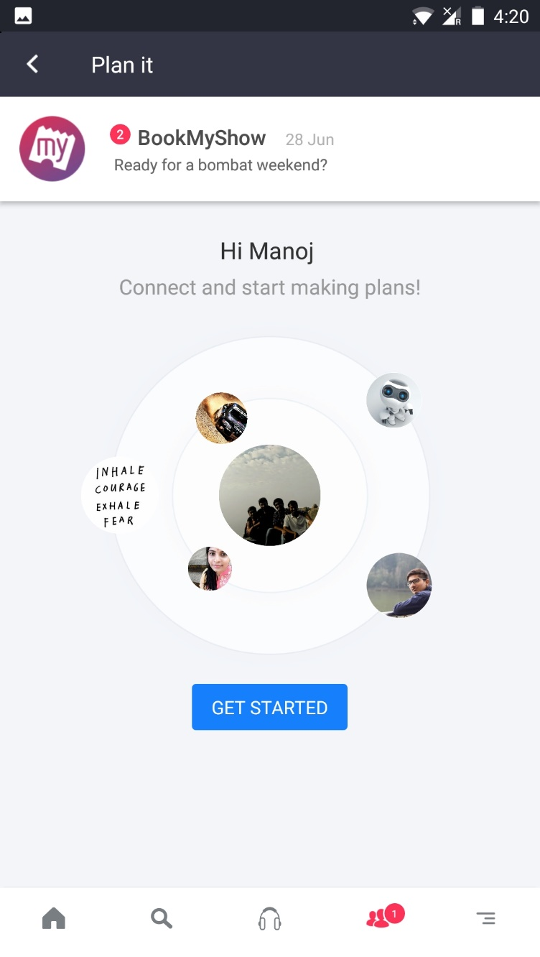
Services

Slide 6
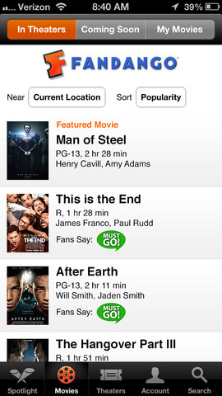
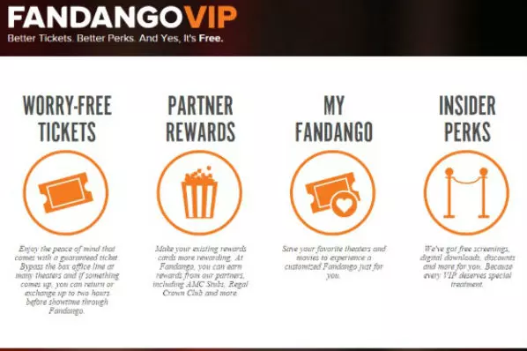
Services

Slide 7
Functions
Business
Content Strategy
Customer Experience
Engineering
Finance & Legal
Food & Beverages- Cinemas
Marketing & Sales
Product & Design
Strategy & Business Development
Creative Department
Customer Experience
Engineering
Finance & Legal
Marketing & Sales
Product & Design

Slide 8
Process
Movie
Want to book ticket
Open BMS App/Web
App/web
Select Movie & Language
Register +VIP(Free)
Select Seats
Select Movie
Pay using online/(cash)
Select Seats
payment
E-ticket email/whatsapp/message
E-ticket/Ticket delivery
Enjoy Movie
Enjoy Movie

Slide 9
REVENUE
COSTS
Ticket Sales- 65%
(% commission)
Non ticketing like logistics and manpower
Advertisement and promotion
VISTA ERP systems
Employee
Advertising
Payment Gateway(Rs.3)
Whatsapp/google/messages
Promotion Include-Marathons,workshops

Slide 10
REVENUE
COSTS
Movie tickets
FabdangoNow(VOD)
VOD-Hulu
DVD
MovieClips
RottenTomatoes
TheTake
Employees
Production(VOD)
Payment gateway
Marketing & Promotions

Slide 11
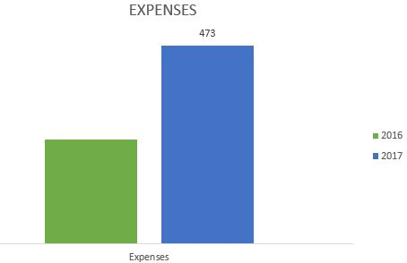
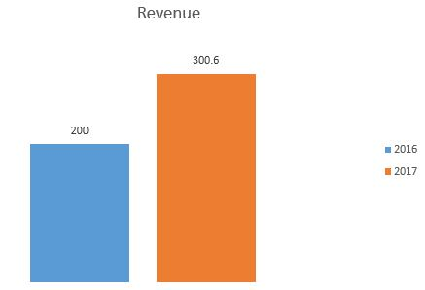
Financials
(In Crores)
278
200
Online ticket booking service- Rs 230 crore(30% increase)
Losses-138 times to come in at Rs 139 crore (1Cr in 16)
Advertising Rs 146.5 crore

Slide 12
Financials
(In USD)
Revenue : $10.1M (ESTIMATED)
Sales : 7.64(Million USD)
Total Funding: $15.3M(Technology Crossover Ventures)
Administrative expenses: $101430
Operating Expenses :$263410

Slide 13
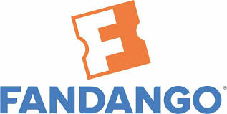
Metrics
Volume of overall ticket sales
Fandango’s percentage of the sales
Mobile & Web visitors day/ month
Number of seats sold a day(Occupancy)
No of shows per day
No of online transactions
Tickets sold day/ month
App downloads
Page views day/ month
Number of seats sold a day(Occupancy)
No of shows per day
No of online transactions(chargeable)
VS

Slide 14
Analytics
comScore Audience Analytics-
--comScore provides audience measurement.
Google Analytics-Detailed statistics Visitors of website.
IBM Digital Analytics (Coremetrics)-platform for web analytics, data monitoring and comparative benchmarking.
VS
Alteryx --demographic, consumer, smarter location decisions, Pricing
Google Analytics 360
Tatvic -Page Level User Behaviour

Slide 15
My pitch
Bookmyshow customers are slowly shifting their loyalties to paytm. So I want to use analytics and find the exact reason why this is happening. It may be due to offering Good Service which gives BMS to be in right path again.
Fabdango ticket sales depend largely on which movie is getting released. For suppose when you consider Gravity movie, ticket sales was due to hype created around the movie. So we should market more on ratings. This is where my training in data analytics comes into use.

