Slide 1


Slide 2
Overview
Started in 1999 as a Software Reseller of VISTA Group. (Big Tree Entertainment)
Started by Ashish | Parikshit | Rajesh.
Start BookmyShow, an online movie & entertainment ticketing platform in 2007.
5 countries|650+ cities in india with 5000+ screens
Funded by Accel partners, Saif partners, Network18
Tickets Sold record-Single weekend-3M and 1M a day

Slide 3
BiZ Model
B2C
B2B
Tickets (% commission)
Advertisements
Technology
Online
Offline

Slide 4
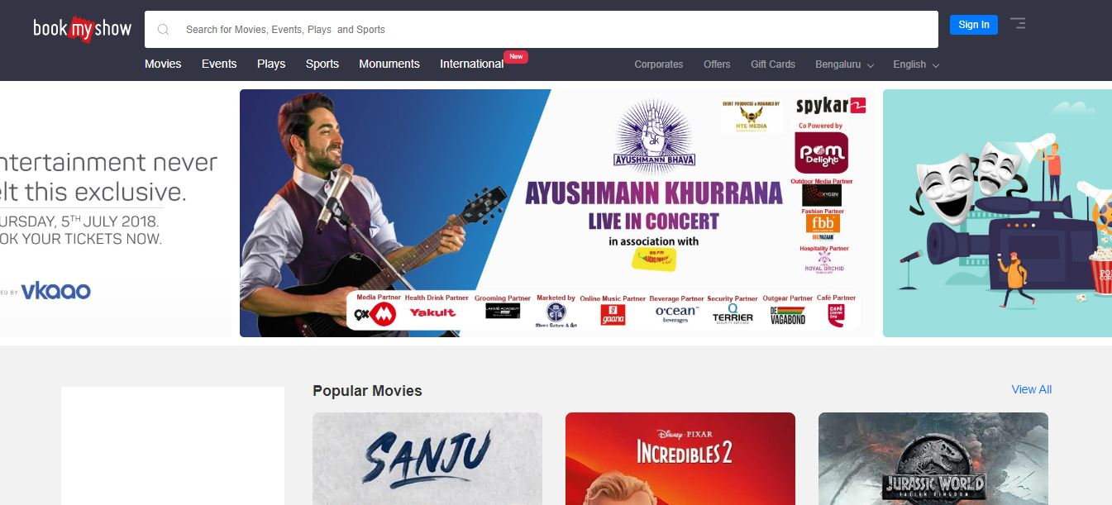
Services
-Movie Tickets -Event Tickets -Sporting Events – IPL, ISL, Pro Kabaddi, World Cup, T20, ISL etc. -Comedy Shows -Theatre Performing Arts -Kids Activities -Theme Parks -Corporate Trainings and Sporting Events
-Music
-Plan it(Group plan)

Slide 5
Functions
Business
Content Strategy
Customer Experience
Engineering
Finance & Legal
Food & Beverages- Cinemas
Marketing & Sales
Product & Design

Slide 6
Process
Want to watch movie?
With friends-plan using BMS chat
Open bookmyshow app/web
Choose location/language
Book your seat
Any issue-call customer support
Bored enroute ? - listen to music on BMS app
Go to theatre and have a hassle free experience

Slide 7
REVENUE
COSTS
Ticket Sales- 65%
(% commission)
Non ticketing like logistics and manpower
Advertisement and promotion
VISTA ERP systems
Employee
Advertising
Payment Gateway(Rs.3)
Whatsapp/google/messages
Promotion Include-Marathons,workshops

Slide 8
Financials (2017)
Revenue
27 per cent increase in operational revenues at Rs 300.6 crore
Online ticket booking service- Rs 230 crore(30% increase)
Expenses
Expenses almost doubling to Rs 473 crore(4X increase)
Advertising expenses to Rs 146.5 crore
Loss
Losses by a whopping 138 times to come in at Rs 139 crore (1Cr in 16)

Slide 9
Metrics
Tickets sold day/ month
App downloads
Page views day/ month
Number of seats sold a day(Occupancy)
No of shows per day
No of online transactions(chargeable)

Slide 10
Analytics
Alteryx --demographic, consumer, smarter location decisions, Pricing
Google Analytics 360
Tatvic -Page Level User Behaviour

Slide 11
My Pitch
For long Bookmyshow was the undebatable leader in indian online ticket market. But loosing ground to the aggressive strategies of paytm resulting in loss of revenue. I want to bring in my marketing ideas for the betterment of future of the company.

