Slide 1
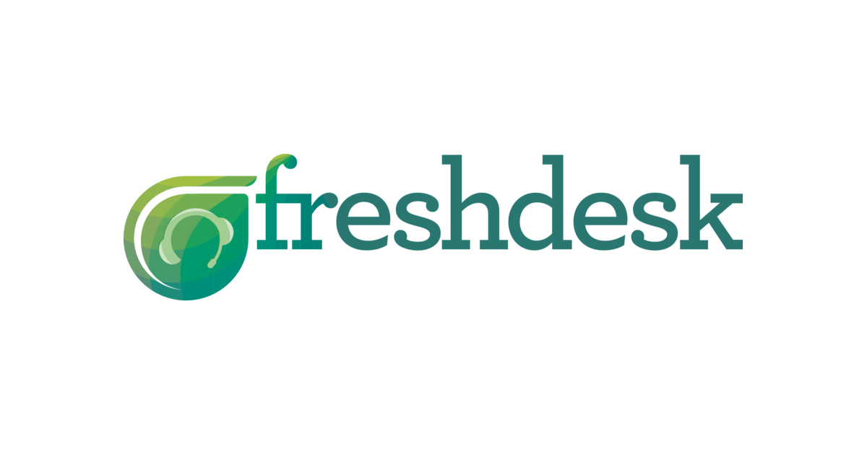

Slide 2
Overview
Freshdesk is a very popular Cloud-based Customer support software & Ticketing system from Freshworks.
Freshdesk first started in 2010 by Shan Krishnasamy, Girish Mathrubootham
Objective is to enable businesses of all sizes to offer outstanding customer service.
Freshdesk proved to be the most efficient and reliable service by Finances online.
Freshdesk has over 1000 passionate employees.
Serving over 150000 organisations.

Slide 3
With Freshdesk you can….
Email
Ticketing
Automations
Social
Knowledge base
Community
Time-tracking
Multi-product
Global support
Insights
Game mechanics

Slide 4
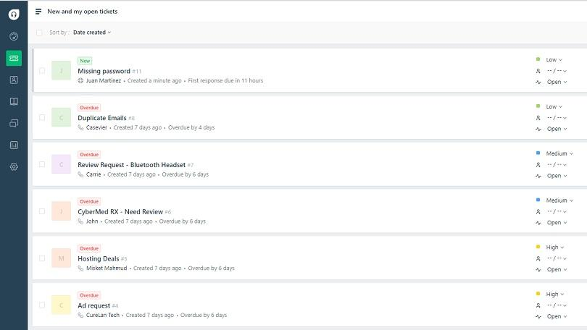

Slide 5
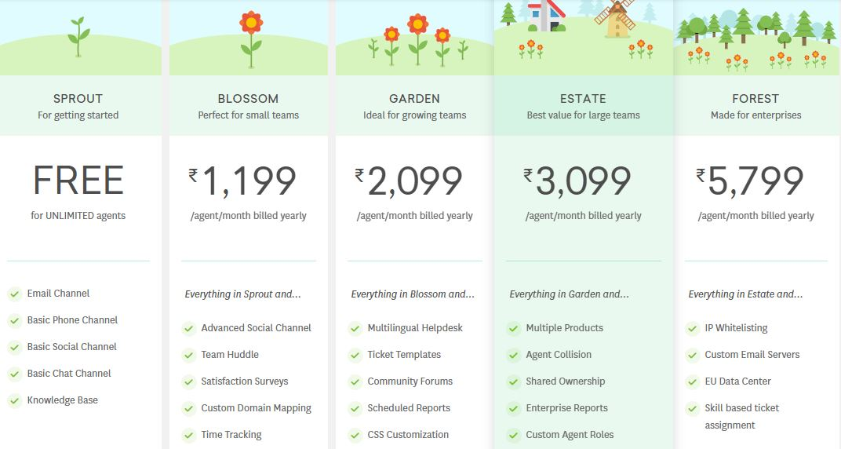

Slide 6
REVENUE EXPENSES
Freshdesk
Freshsales
Freshcaller
FreshTeam
Fundings from Accel partners,Google,Sequoia
Employee benefit expenses(major share)
Marketing
Free product trials
Training and Support

Slide 7
FUNCTIONS
Admin
Technology
Customer Support
Social Network
Human Resources

Slide 8
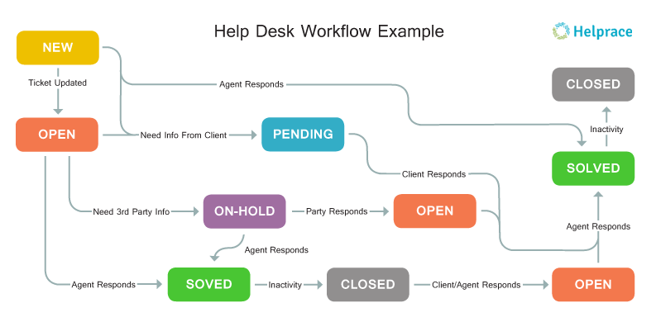

Slide 9
Financials
Freshdesk posted gross revenues of Rs 94.89 crore, up from Rs 44.08 crore in Fy2015-16
profit for FY16 rose to Rs 8.6 crore from Rs 3.86 crore from Fy15
FreshWork’s reported that revenues are likely to have grown to $70 million for FY17 from $50million.
Freshdesk CEO Mathrubootham had said that the company had been registering 70% year-on-year growth over the last two years.

Slide 10
Metrics
Ticket Volume: Ticket volume can tells team a lot about the products. Ticket growth over time that tracks your customer growth is mostly a good thing—it just means your business is growing.
Average response Time: Averages how long it takes you to respond to requests.
Time to first response: It shows how long your customers have to wait for the first reply on average.
Response time bands give you a percentage of tickets that are replied to within certain time frames.
Net Promoter Score—survey to get a more precise look at how customers feel.
Ticket trends are one of the most actionable metrics, since they tell you what tickets are about

Slide 11
Analytic tools
8x8 cloud communications :unifies phone, contact centers, video, im, and meetings.
CustomerSuccessBox is an actionable Customer Success platform which brings together all customer communication, including emails, calls
Frame for Slack (frame.ai) is the essential add-on for working with customers.
Userlane is the navigation system for software. Tackle and take on Customer Success solutions by optimizing your user onboarding processes.
Noticeable is a changelog as a service that helps improving customer retention,

