Slide 1


Slide 2
Introduction
•Online Retail Industry
•It is one of the leading e-commerce players in the country.
•Started as a online book seller
•Initial capital of 4lakh
•Founded by Sachin bansal & Binny bansal in Bangalore, Karnataka in 2007.
•30000+ employees
• Flipkart has 26 million registered users clocking over 8 million daily visits
• Flipkart First- an annual subscription service for frequent shoppers

Slide 3
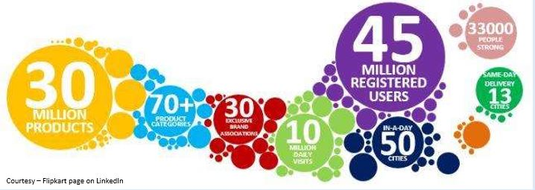

Slide 4
Flipkart
Supply Chain Market place, Retail& Technology
Marketing
Logistics Warehouses Delivery boys
Engineering Research and Development (innovation)
Customer Acquisition and Relations
Sellers & Buyers
day-to-day technology management
FDP- Flipkart Data platform Coders

Slide 5
PROCESS
Order Placed By Customer
Order Download in OMS
Inventory Allocation
Order Picking
Order Packing and generation of labels
Order Shipment
Shipment Delivered
Payment-COD/Online Payment Gateway/Gift cards

Slide 6
REVENUE MODEL
income Model of Flipkart is “X% commission on the total selling value given to the vendor”.
Listing and convenience fee
Logistics- ekart
Digital media: Ads, Target Search results

Slide 7
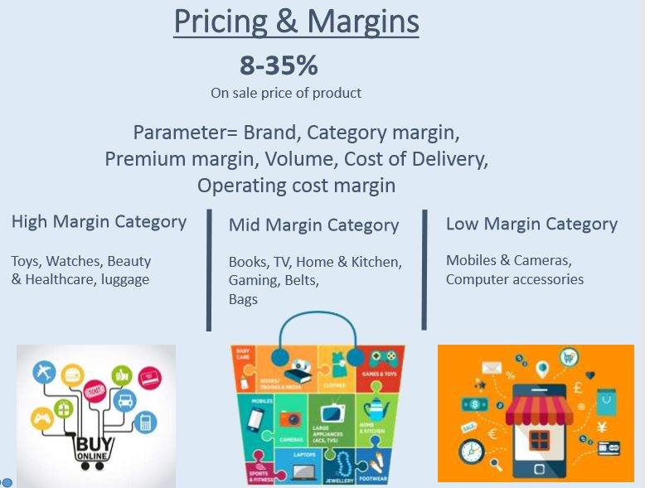

Slide 8
Financials
The reported growth of the company in 2017 stood at 23%.
However, Flipkart continued to record high losses, which reached $1.3 Bn
Loss after tax widened from Rs 5,223 crore to Rs 8,771 crore.
Cost of talent (including salaries and stock-based compensation) was recorded at $319 Mn (INR 2,052 Cr), a rise of 9% against 124% hike in FY16.
Advertising and business promotion expenses were $185 Mn, a rise of 9.4% against 100% of FY16.
Cash-in-hand reached $557 Mn (INR 3,579 Cr), a fall of 13%.
Investments in mutual funds or bonds fell by 78% to $173 Mn (INR 1,114 Cr).

Slide 9
Metrics(Operational)
Registered Users- 100million
Active Sellers-100K
Categories-80
Daily Page Views-10 million
Monthly Shipments-8million
Products-80million
Warehouses-21
Rs.800-1,500 to acquire a customer(Customer Acquisition).

Slide 10
Metrics Used by Flipkart
Net promoter score (NPS, a key measure of customer satisfaction and loyalty)
Monthly gross sales
break even at the gross profit level by cutting staff costs, discounts and other expenses.
GMV(Gross Merchandise value)
Calls per month(Outgoing and Incoming calls)
Average order size
Number of transactions
Shopping cart abandonment rate
Customer lifetime value (CLV)
Mobile site traffic
Newsletter subscribers

Slide 11
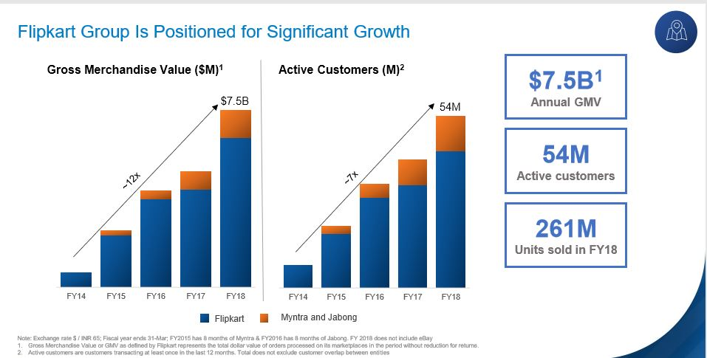

Slide 12
Analytics in flipkart
Almost every vertical in flipkart uses analytics.
FDP currently manages a 800+ nodes Hadoop cluster to store more than 35 PB of data.
Qlikview -visual analytics and improved inventory management tool to optimise stock levels.
Hadoop -Bigdata
DBMS-MySQL

