Slide 1


Slide 2
PRACTO IS.....
Personnel need to checkout a doctor’s profile urged Shashank and his classmate Abhinav Lal to set up PractoTechnologies Pvt.Ltd.
Practo was started in around 2008 with focus on booking doctor appointments within your comfort zone through online platform.
200000 doctors registered on their platform as well over 8000 hospitals .
A Single, Trusted, And Familiar Place Where Consumers Can
Find Doctors,
Book Appointments,
Chat Online With Doctors,
Insurance
Order Medicines, Medical Devices,
Get Lab Tests,
Store Health Records in cloud vault,
Read Health Articles Written By Doctors

Slide 3
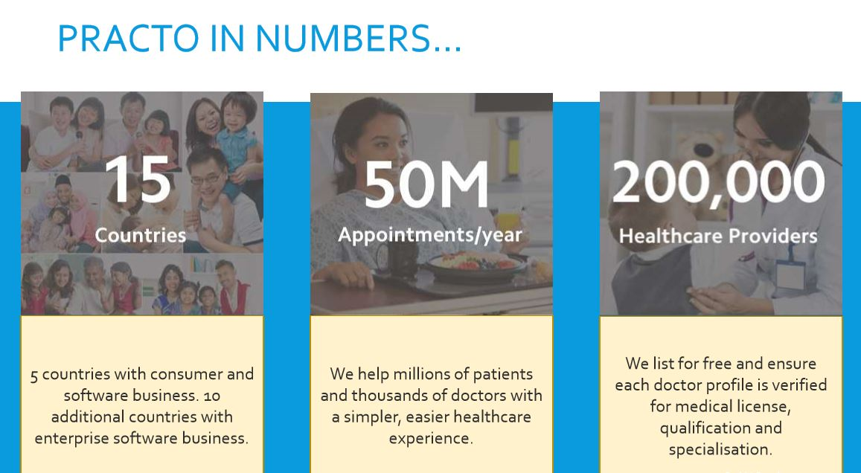

Slide 4
Practo Functions(employees: 2,300)
1.Marketing &Sales
2.Developer
3.Finance and Accounting
4.Customer Support
5.Product Design
6.Productivity and Operations
7.Analytics and Data science
8.Sales and Business development
9.HR
10.Devops and IT

Slide 5
PRACTO Process
1.New to the place
2.Caught with flu
3.Search for Doctor on Practo
4.Look at the testimonals and select best doctor near to you
5.Book appointment at your conviniece
6.Visit Doctor
7.Update prescription on practo vault
8.Buy medicines on practo and get delivered to home.
9.Not satisfied with the service contact Practo support team

Slide 6
Revenue stream
Practo Ray(SaaS platform-Rs. 999 and Rs. 1999 per month. with IVR)
Practo Search(App & Website)
Practo Health Feed(Blog for Doctors and Patients)
Practo Consult(Q&A tool for patients)
Practo Tab(Doctors)
Medicine Delivery
Pathological Test Booking(% commissions from the Lab Owners)
Querent-AI platform with analytics & dashboards & KPI
Qikwell- Intelligent patient relationship management system for hospitals

Slide 7
Channels
• Websites
• Application
• Software
• B2b & b2c
Customer segment
• Normal unhealthy people.
• Doctors.
• Pathology labs.
• Moving crowd.
Cost structure
•Application and website and software hosting charges.
•Website updating charges.
•Software development and maintenance charge.
•Travelling visiting cost sales person.
•Pay to google for marketing.

Slide 8
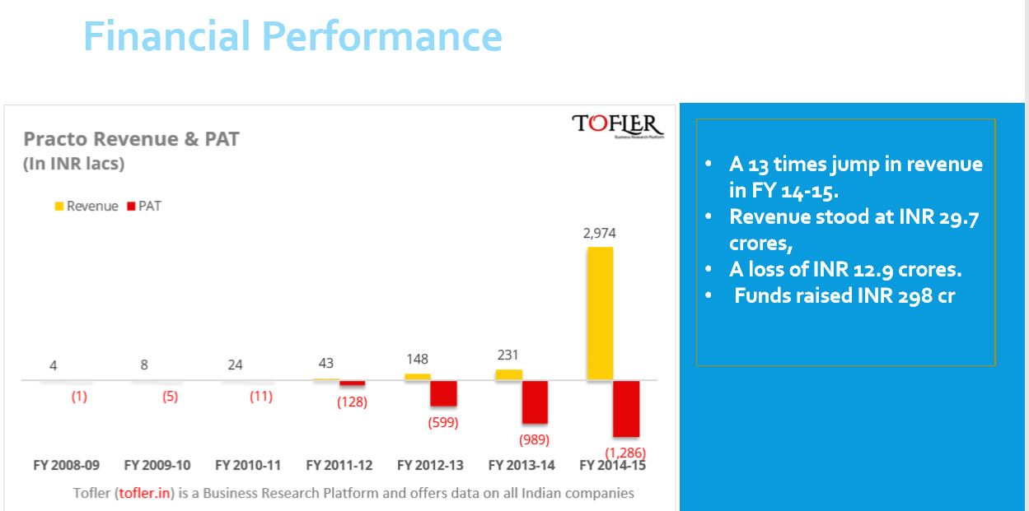

Slide 9
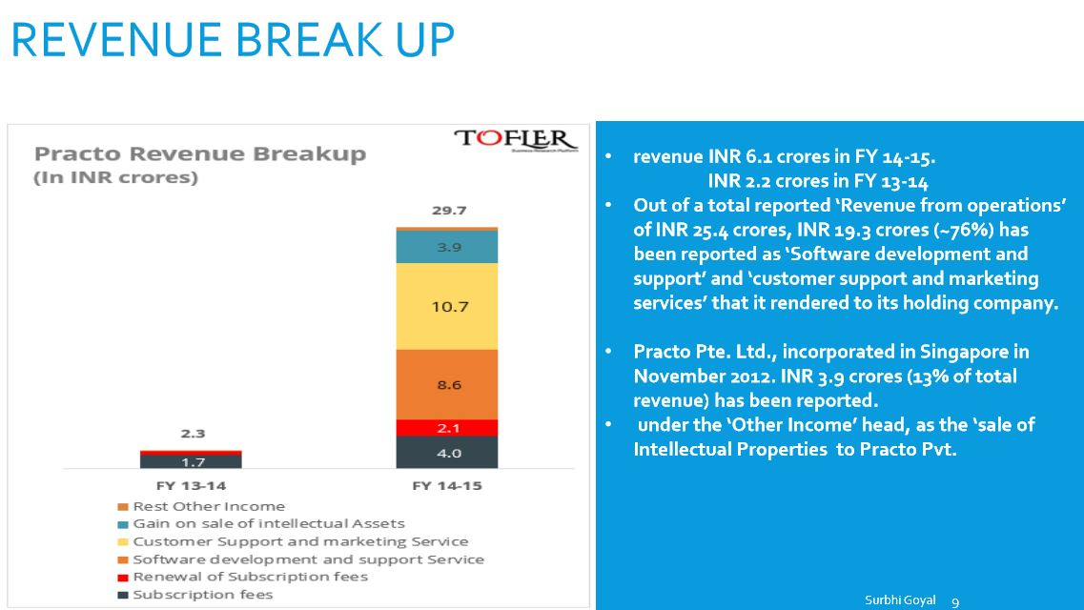

Slide 10
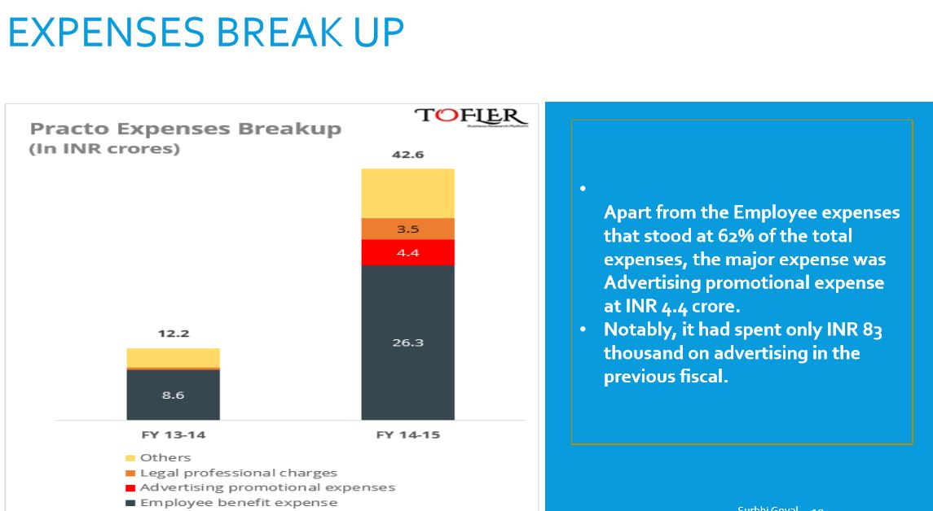

Slide 11
METRICS Used By PRACTO
Pageviews
Appointments Booked every month
Website Traffic
Happy Support Ratings(Customer Satisfaction)
Number of searches every month(4 million)
Retention Rate

Slide 12
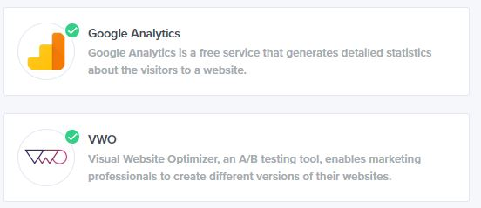

Analytics Software used by Practo

