Slide 1


Slide 2
Overview
Founded in 2008 by Deepinder Goyal and Pankaj Chaddah.
It is named by foodiebay in 2008 but in 2010 it was changed as ZOMATO.
The scenario has changed from previous practice when we had to actually go to restaurants to select the restaurant and have the experience.
Today, choice for the best places to have food is just a click away.
One can choose the best rated place and then decide to enjoy there with friends and family.

Slide 3
What Does It Do?
Zomato is an online website/app which provides restaurant search and discovery service and online delivery.
It provides its customers a platform to evaluate choices for great places to eat.
It currently operates in 23 countries, including India, Australia and the United States.
The Gurgaon headquartered company Zomato was named among the top 25 most promising internet companies in India by SmartTechie Magazine.
Service provided by zomato ,i.e. restaurant searching , discovery, online ordering and table reservation etc.
Employees working in industry 2000+.
Because of its consistent performance and success, it has been successful in getting regular investments from Info Edge (India).

Slide 4
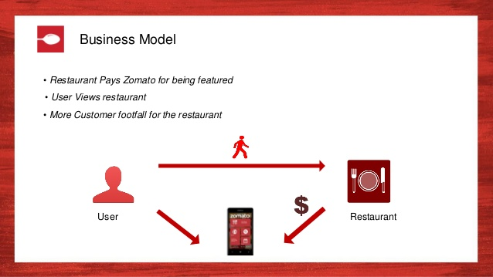

Slide 5
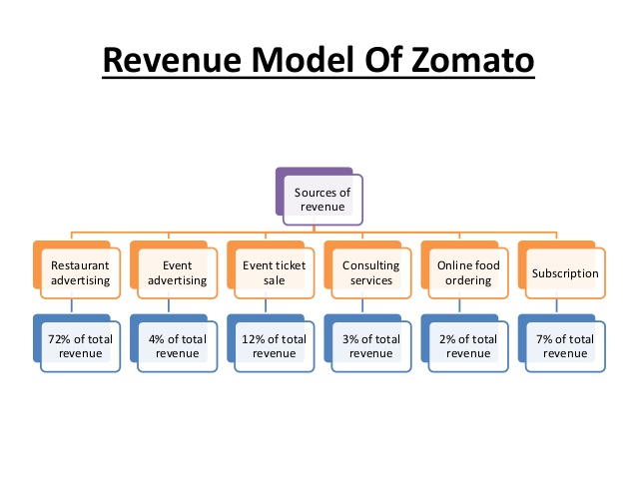

Slide 6
DIFFERENT FUNCTIONS
1.Restaurant Search & Discovery 2.Online Ordering 3.Table Reservations & Management 4.POS Systems 5.Subscription Services

Slide 7
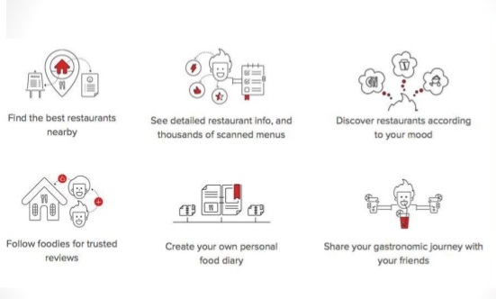
WORK FUNCTION

Slide 8
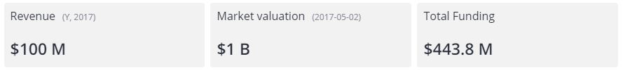
Financial
Revenue
~$74m in topline in FY18 ,~45% growth over last year.
Cost/Burn Operating burn for FY18 was ~$11m compared to $15m in FY17
Ordering Food ordering - 30% of total revenues.
Zomato in 15 cities in India and 5 cities in the Middle East.
5.5m monthly food orders
Subscriptions (Zomato Gold and Zomato Treats) As on March 31, 2018, zomato had 280k+ active user subscribers
Advertising
grew by ~20% y-o-y. ~15,000 restaurants

Slide 9



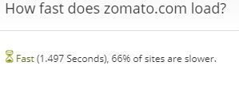

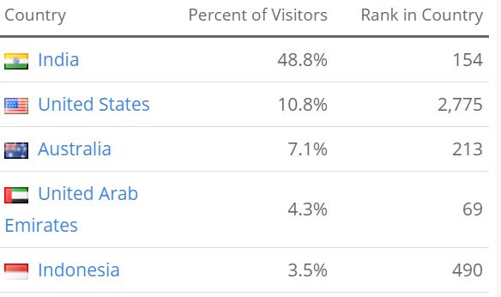
METRICS

Slide 10
Types of analytics
Personalized home page and listings in the app (recommendation engine)
Payment fraud prediction
Predicting food delivery time by accounting for meal preparation time and travel time
Classification and quality assessment of images uploaded by users
NLP on reviews to extract key information from text

Slide 11
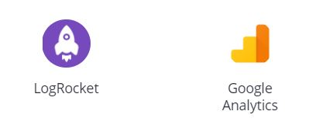
Analytics Software

