Slide 1
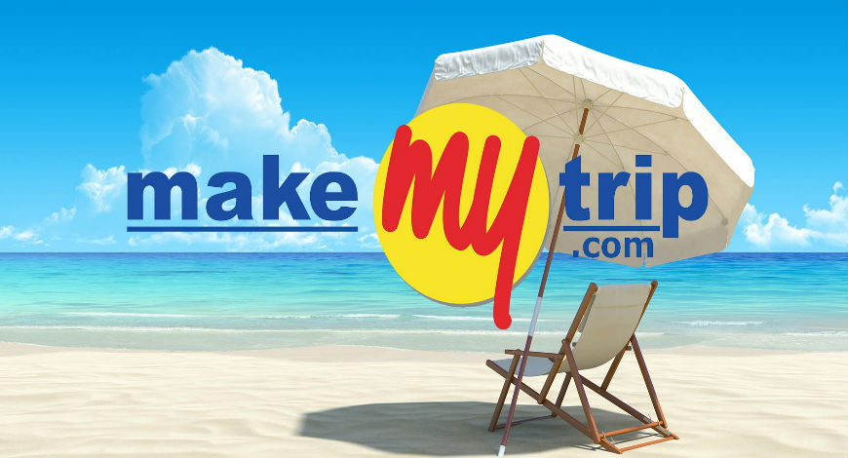

Slide 2
Introduction
MakeMyTrip is an Indian online travel company founded in 2000 Headquartered in Gurugram, Haryana.
MakeMyTrip was founded by Deep Kalra, an alumnus of IIM-Ahmedabad.
It was launched in the US market in 2000 to cater to the overseas Indian community for their US-to-India travel needs.
MakeMyTrip started its Indian operations in September 2005, offering online flight tickets to Indian travelers.
The company provides online travel services including flight tickets, domestic and international holiday packages, hotel reservations, rail and bus tickets, etc.
The company also operates through 51 retail stores across 47 cities in India, along with offices in New York City.
MakeMyTrip and ibibo group merged through a stock transaction, representing the coming together of India’s largest travel booking portals.
MMT shareholders own 60 % whereas ibibo Shareholders get a 40 % stake, making Naspers and Tencent the single largest shareholder in MakeMyTrip.

Slide 3
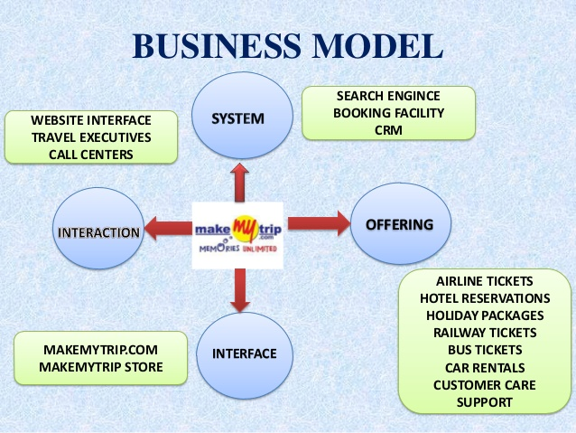

Slide 4
Services
International and Domestic Air Tickets
Holiday Packages and Hotels
Domestic Bus and Rail Tickets
Private Car and Taxi Rentals
MICE (Meetings, Incentives, Conferences & Exhibitions)
Travel insurance.
In 2018, MMT introduced corporate booking tool “myBiz” -a complete travel solution for corporates.

Slide 5
Departments
Business Development: Their priority is to assist their companies acquire new customers and sell additional products or services to existing ones
CRM : Customer relationship management
SMT: Search engine marketing (SEM)
Marketing & Content: Push the limits of product marketing and entire customers with a booking experience like never before.
Technology, UX & online products: Riveting displays, inventive travel tech, poetic coding and wordplay.
Customer Support: A great support system means taking care of finances , creating delight for customers.
Travel: From ticketing to contracting new hotels and airlines.

Slide 6
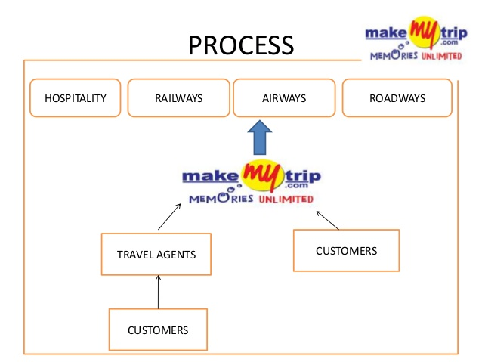

Slide 7
Revenue
Expenses
Airline bookings
Hotel and packages revenue
% of Commission
Travel Insurance
Ticket Sales
Goibibo
Redbus
Employee Expenses
Marketing expenses
Promotion expense(discounts)
Customer acquisition program

Slide 8
Key Metrics
Revenue Less Service Cost- represent commission , fees
Gross bookings-Total amount paid by customers for the travel services
Number of Transactions
Monthly Average Active Mobile users
Monthly Shopper Visits via mobile & web
Total Unique visitors
Retention rate
Conversion rate

Slide 9
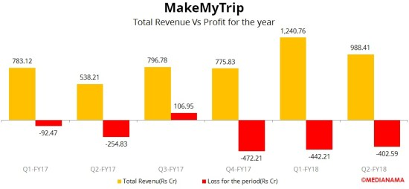
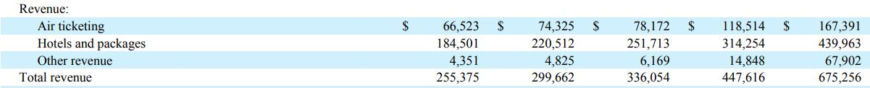
Financials : Revenue

Slide 10
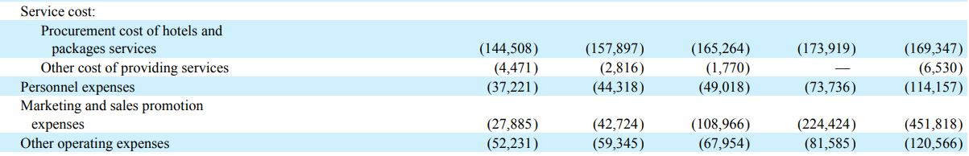
Financials : Expenses

Slide 11
Analytics
Adobe (Analytics, Target)-Marketing Analytics
Inspectlet - User-Interaction Analytics
Mouseflow - session replay and heatmap
Mixpanel - Customer behaviour analytics
Brach Metrics
Yahoo Analytics(Flurry)-app's Session Length, Frequency of Use and Retention

Slide 12
How can I contribute to the growth of the company?
I can contribute my ability to streamline processes. Makemytrip deals with numerous dealers from different industries. I would love to bring my organisational skills to the company to increase the operational efficiency.
For make my trip the business is all customer centric. I want to use data analysis at large. I believe I can add value to the company and I’d really love to continue to build upon my skills and grow with the company.

