Slide 1
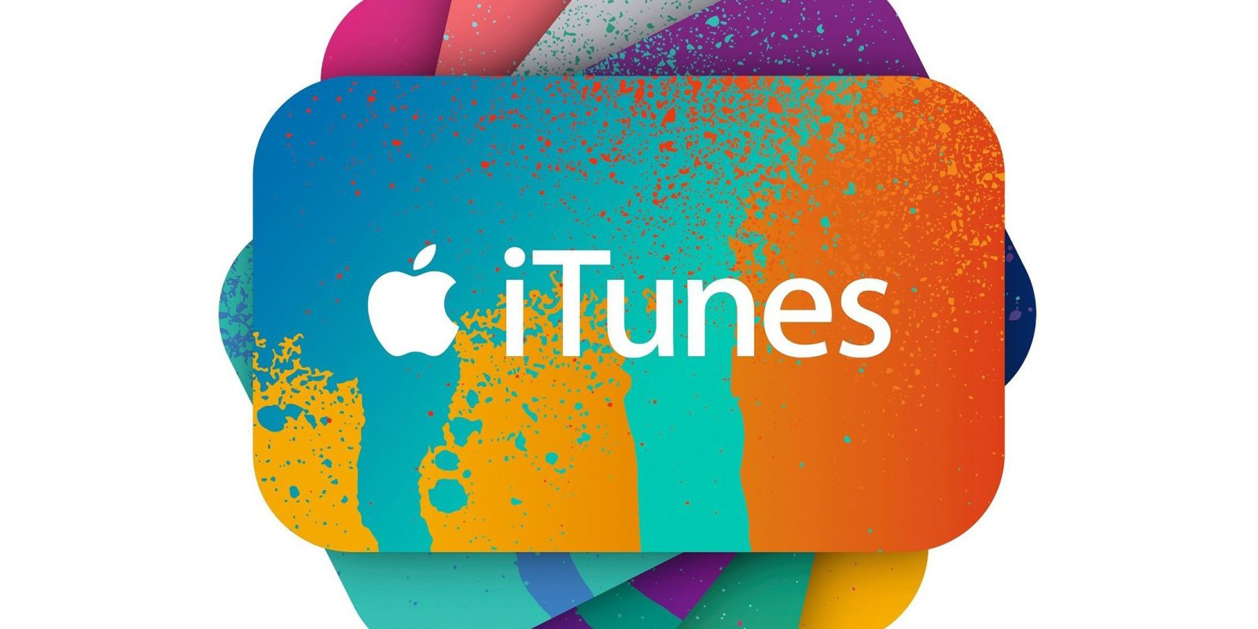

Slide 2

OVERVIEW
iTunes is the best way to organize and enjoy the music and movies you already have — and shop for the ones you want.
iTunes is a media player, media library, Internet radio broadcaster, and mobile device management application developed by Apple Inc.
Based on SoundJam MP by Casady & Greene
iTunes was launched in 2001
Initially it was a music player and later transformed itself as content manager, ecommerce platform.
45 million songs
iTunes 1 → iTunes 12.7.5.9
iTunes accounts for 60% of the global digital music download market.

Slide 3
Business Model
iTunes Store
35-40 million Songs
2.2million Apps
25,000 TV shows
65,000 films
Apple Music

Slide 4

Services
Services
Music
Special playlists-iTunes DJ
Library sharing-Home Sharing
Artwork printing
Sound processing- equalization
Video
iTunes Store
iTunes U
Internet radio- Beats 1

Slide 5
Functions
Business specialist: marketing & promotional
Technology Development
Visual Design-deliver end to end designs across iTunes
Finance
Data Science
Music & TV programmer- curation & discovery
Legal

Slide 6
Process
Download latest version of iTunes
Open iTunes
Open iTunes
Enjoy the music
Sync your phone to iTunes library

Slide 7
Revenue
Costs
Subscription service
iTunes store
Music Downloads
iTunes video, book and magazine
Employees
Musicians(0.33C)
Copyrights
Marketing

Slide 8
Financials
YOY- 31%
Revenue in millions
Q2 2017-7041
Q1 2018- 8471
Q2 2018- 9190

Slide 9
KEY METRICS
The Number of subscribers
In-App Purchases
Downloads per user
The Retention Rate
Revenue per User - The revenue is going to be calculated off of your app’s downloading cost, any in-app purchases, and conversions.
Active Devices and Crashes reports
Product Page Views-how many people tapped into our product.

Slide 10
Analytics
Musicmetric- industry clients to track data on sales,downloads
iTunes Connect App

