Slide 1
Network Analysis Chart Visualization using Alteryx Designer
Presented By
ManojKumar Reddy Peddamallu
44-599-02 Introduction to Data Visualization

Slide 2

Outline
Introduction
Sample workflow
Market Basket Analysis
Dataset
Goal
Demo
Apriori algorithm
Association rules
Network centrality measures
Pros and Cons of Alteryx Designer
Lessons learnt

Slide 3
Introduction
Alteryx Designer is a data analytical and visualization tool which offers higher flexibility for data blending and data modification
It is one of the best data analytical and visualization tool ranked in a higher priority in Gartner Magic Quadrant

Slide 4
Introduction(Cont…)
Alteryx is the fastest analytics platform to empower data analysts & their productivity
It can blend complex data, build analytics in a much easier way and simplify how analytics insights are consumed by business users
Save time and enable your business to make the right decision

Slide 5
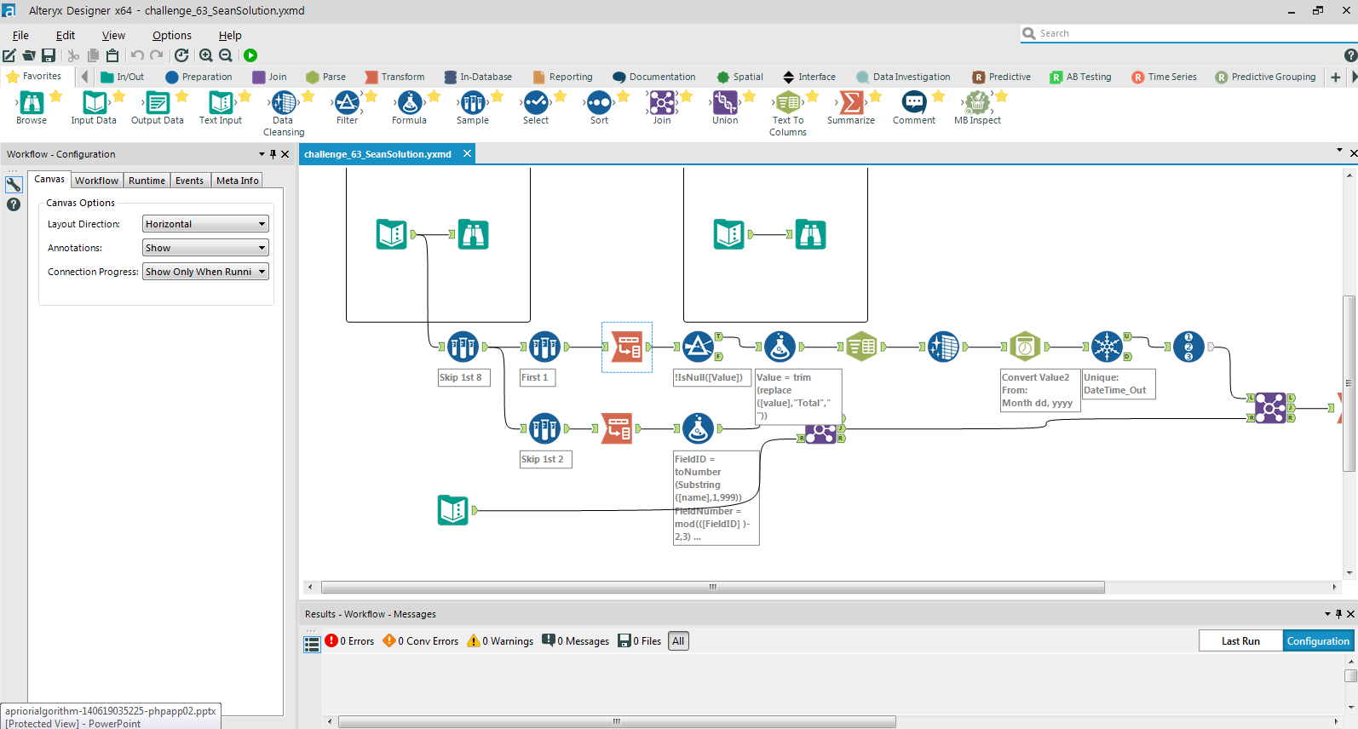
Sample Workflow of Alteryx Designer
Fig 1:Sample workflow
Notes:
As shown in the above diagram workflow contains a series of data processing tools connected with each other.

Slide 6
Market Basket Analysis
Market Basket Analysis (Association Analysis) is a mathematical modeling technique based upon the theory that if you buy a certain group of items, you are likely to buy another group of items
To analyze the customer purchasing behavior and helps in increasing the sales
Given a dataset, the Apriori Algorithm trains and identifies product baskets and product association rules
Notes:
and maintain inventory by focusing on the point of sale transaction data.

Slide 7
Market Basket Analysis
To find which products are bought together frequently
Helps where to place the products in a store
What products to be bundled in online purchases in order to drive the purchases

Slide 8
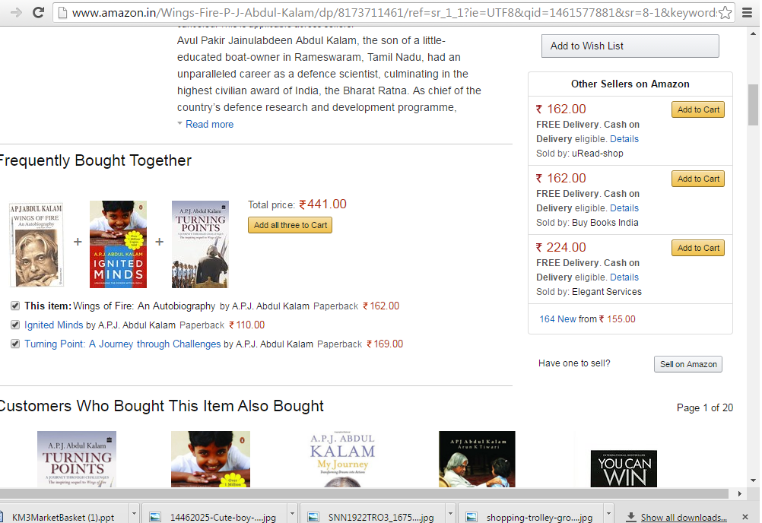
Market Basket Analysis(Cont..)

Slide 9
Market Basket Analysis
Transaction: It is a set of items
Confidence : It is the measure of uncertainty or trust worthiness associated with each discovered pattern
Support : It is the measure of how often the collection of items in an association occur together as percentage of all transactions
Frequent item set : If an item set satisfies minimum support, then it is a frequent item set
Association rules: Rules that satisfy both a minimum support threshold and a minimum confidence threshold
Notes:
In Association rule mining, we first find all frequent itemsets and then generate strong association rules from the frequent itemsets

Slide 10
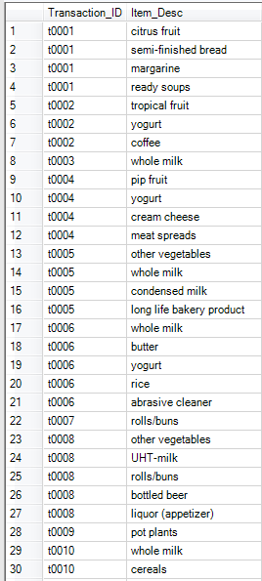
Sample Data
The data set consists of 1000 records.

Slide 11
Goal
To find frequently purchased item sets from large transactional database by making use of market basket analysis tool in Alteryx

Slide 12
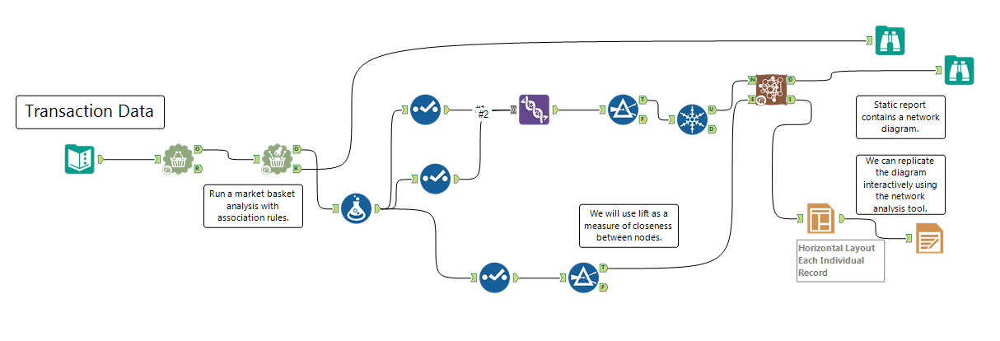
Demo

Slide 13
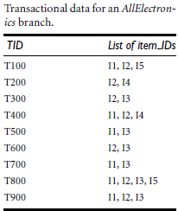
The Apriori Algorithm
Step1: This step simply scans all of the transactions in order to count the number of occurrences of each item, named it as C1
Step2: Apply minimum support count, and items set that satisfies the condition named as L1(min support count =2)

Slide 14
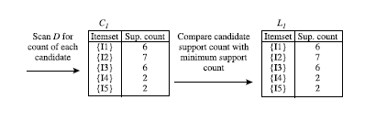
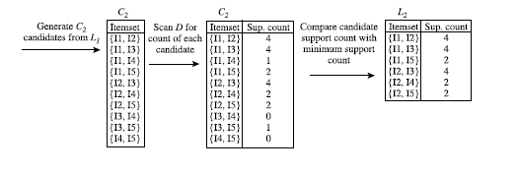
The Apriori Algorithm
Step3:To discover the set of frequent 2-itemsets, L2, the algorithm uses the join to generate a candidate set of 2-itemsets, and count the occurrences of each set
Step4: Apply min support count on C2, result will be 2-frequent item set L2

Slide 15

The Apriori Algorithm(Cont..)
Step5:To generate 2-frequent item set, generate 3-item and apply min support count which will be 3-frequent item set
Step6:Use the frequent item sets to generate association rules

Slide 16
Association rules
Transaction ID | Item description
T1 | Shoes | Trousers | Shirt | Belt
T2 | Shoes | Trousers | Shirt | Hat | Belt | Scarf
T3 | Shoes | Shirt
T4 | Shoes | Trousers | Belt
Association rule: Trousers=>Shirt

Slide 17
Association rule(Cont..)
This step simply scans all of the transactions in order to count the number of occurrences of each item.
Transaction ID | Shoes | Trousers | Shirt | Belt | Hat | Scarf
T1 | 1 | 1 | 1 | 1 | 0 | 0
T2 | 1 | 1 | 1 | 1 | 1 | 1
T3 | 1 | 0 | 1 | 0 | 0 | 0
T4 | 1 | 1 | 0 | 1 | 0 | 0
Minimum support = 40%
Minimum confidence = 65%
Support (Trousers=>Shirt):
P(A U B) /N= 2/4 = 0.5 = 50%
Confidence (Trousers=>Shirt):
P(A U B) /P(A) = 2/3 = 0.666 = 66.6%

Slide 18
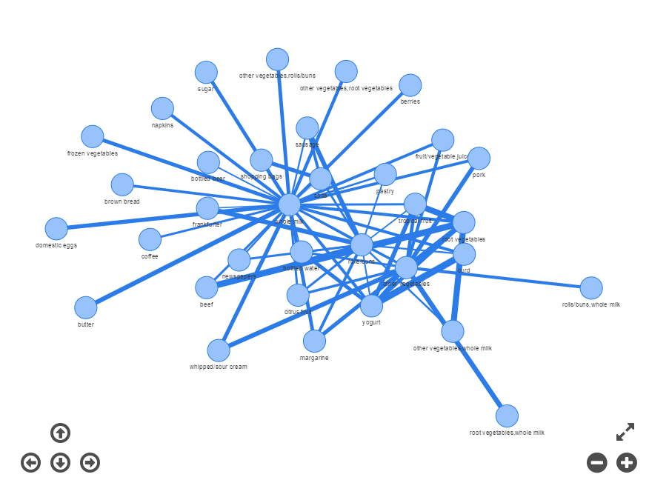
Network Analysis Chart

Slide 19
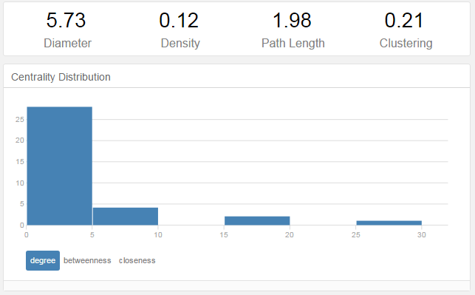
Network centrality measures

Slide 20
Pros and Cons of Alteryx Designer
Pros
Alteryx Designer can access and blend data from various sources and of different formats at the same time
Alteryx allows input and output of various data types (.csv, .tab, .shp, .png, .xlsx, .yxdb, etc.)
Simple drag-and-drop interface
60+ built-in tools for analysis of data

Slide 21
Pros and Cons (cont…)
Cons
As the operations on data increases, computational time also increases
Cannot generate sophisticated and wide range of charts like Tableau
Lack of better appearance

Slide 22
Lessons Learnt
To analyze the data by making use of various tools in Alteryx Designer
To generate Network chart and able to visualize how different nodes are connected each other
To choose dataset for network diagrams

Slide 23

Thank You

