Slide 1
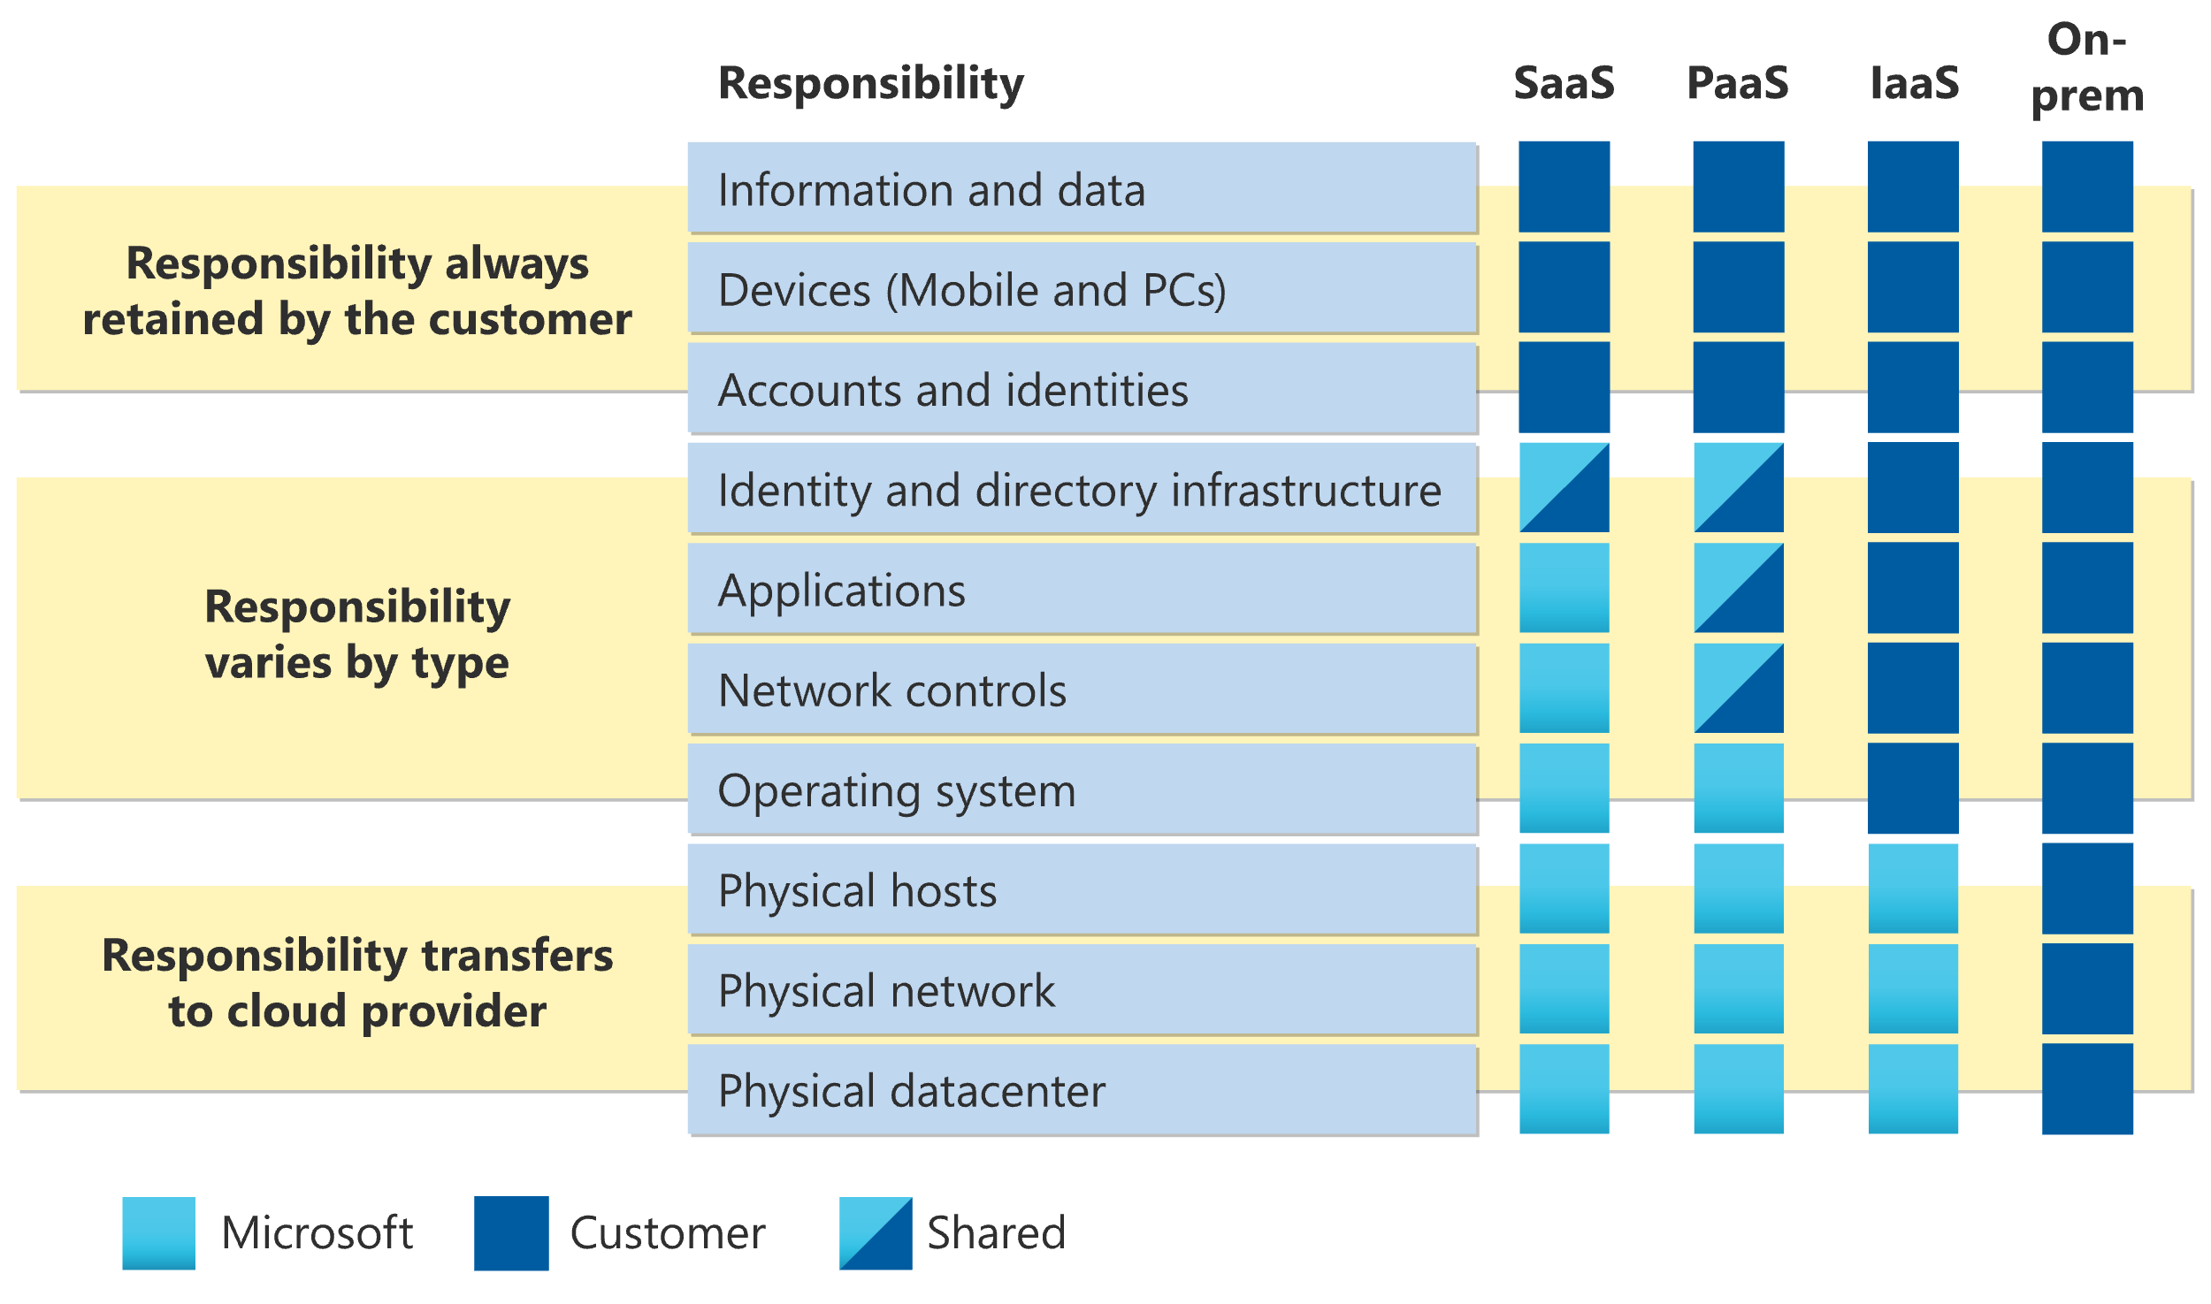

Slide 2
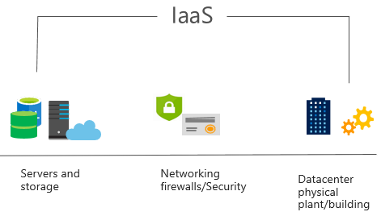
Infrastructure as a service (IaaS)
Build pay-as-you-go IT infrastructure by renting servers, virtual machines, storage, networks, and operating systems from a cloud provider.
Notes:
https://learn.microsoft.com/training/modules/describe-cloud-service-types/2-describe-infrastructure-service
For more information on IaaS, go to https://azure.microsoft.com/resources/cloud-computing-dictionary/what-is-iaas/
Most basic cloud computing services category.
Build pay-as-you-go IT infrastructure by renting servers, virtual machines, storage, networks, and operating systems from a cloud provider.
Instant computing infrastructure, provisioned and managed over the internet.

Slide 3
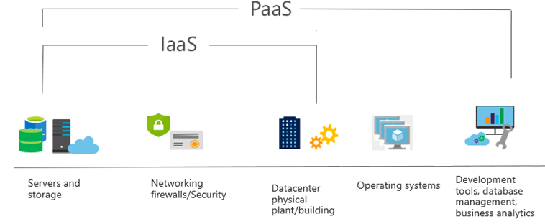
Platform as a service (PaaS)
Provides an environment for building, testing, and deploying software applications; without focusing on managing underlying infrastructure.
Notes:
https://learn.microsoft.com/training/modules/describe-cloud-service-types/3-describe-platform-service
For more information on PaaS, go to https://azure.microsoft.com/resources/cloud-computing-dictionary/what-is-paas/
Provides an environment for building, testing, and deploying software applications.
Helps create applications quickly, without focusing on managing underlying infrastructure.

Slide 4
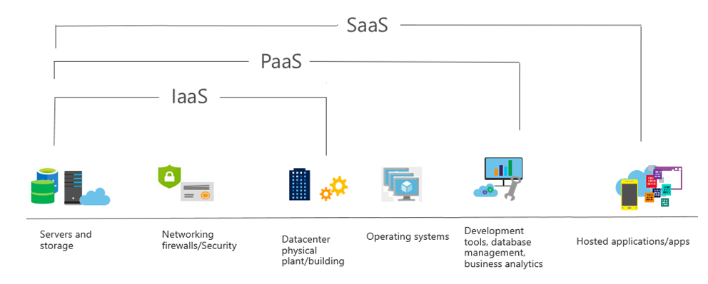
Software as a service (SaaS)
Users connect to and use cloud-based apps over the internet: for example, Microsoft Office 365, email, and calendars.
Notes:
https://learn.microsoft.com/training/modules/describe-cloud-service-types/4-describe-software-service
Common usage scenarios:
Examples of Microsoft SaaS services include Microsoft Office 365, Skype, and Microsoft Dynamics CRM Online.
For more information on SaaS, go to https://azure.microsoft.com/resources/cloud-computing-dictionary/what-is-saas/

Slide 5
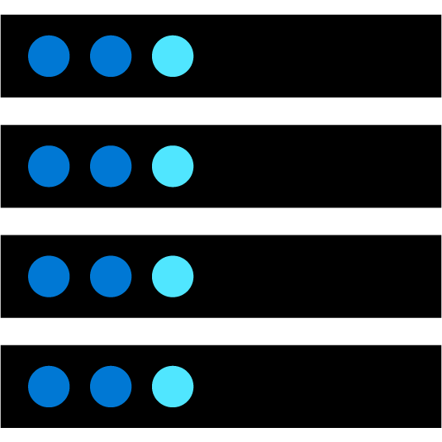


What is cloud computing?
Cloud computing is the delivery of computing services over the internet, enabling faster innovation, flexible resources, and economies of scale.
Compute
Networking
Storage
Notes:
https://learn.microsoft.com/training/modules/describe-cloud-compute/3-what-cloud-compute
Cloud computing is:
A model for enabling on-demand access to a shared pool of configurable computing resources―servers, network, storage, applications, and services.
Ubiquitous, convenient, on-demand network access.
Rapidly provisioned and released with minimal management effort or service provider interaction.
Definitions can be found at:
NIST definition - https://csrc.nist.gov/publications/detail/sp/800-145/final

Slide 6
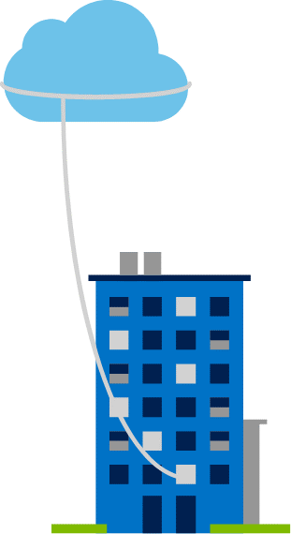
Private cloud
Organizations create a cloud environment in their datacenter.
Organizations are responsible for operating the services they provide.
Does not provide access to users outside of the organization.
Notes:
https://learn.microsoft.com/training/modules/describe-cloud-compute/5-define-cloud-models
Owned and operated by the organization that uses cloud resources.
Organizations create a cloud environment in their datacenter.
Self-service access to compute resources provided to users within the organization.
Organizations are responsible for operating the services they provide.

Slide 7
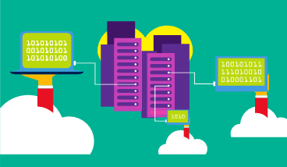
Public cloud
Owned by cloud services or hosting provider.
Provides resources and services to multiple organizations and users.
Accessed via secure network connection (typically over the internet).
Notes:
https://learn.microsoft.com/training/modules/describe-cloud-compute/5-define-cloud-models
What are public, private, and hybrid clouds? - https://azure.microsoft.com/resources/cloud-computing-dictionary/what-are-private-public-hybrid-clouds/

Slide 8
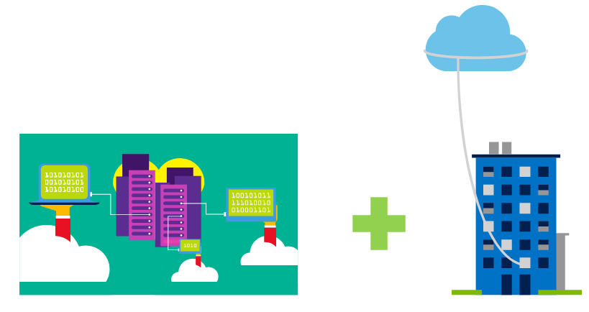
Hybrid cloud
Combines public and private clouds to allow applications to run in the most appropriate location.
Notes:
https://learn.microsoft.com/training/modules/describe-cloud-compute/5-define-cloud-models
Hybrid cloud models have the following characteristics:
Resource location. Specific resources are run or used in a public cloud―others are run or used in a private cloud.
Cost and efficiency. Hybrid cloud models allow an organization to leverage some of the benefits of cost, efficiency, and scale that are available with a public cloud model.
Control. Organizations retain management control in private clouds.
Skills. Technical skills are still required to maintain the private cloud and ensure both cloud models can operate together.

Slide 9
Cloud model comparison
Public cloud
Private cloud
Hybrid cloud
No capital expenditures to scale up.
Applications can be quickly provisioned and deprovisioned.
Organizations pay only for what they use.
Hardware must be purchased for start-up and maintenance.
Organizations have complete control over resources and security.
Organizations are responsible for hardware maintenance and updates.
Provides the most flexibility.
Organizations determine where to run their applications.
Organizations control security, compliance, or legal requirements.
Notes:
https://learn.microsoft.com/training/modules/describe-cloud-compute/5-define-cloud-models

Slide 10
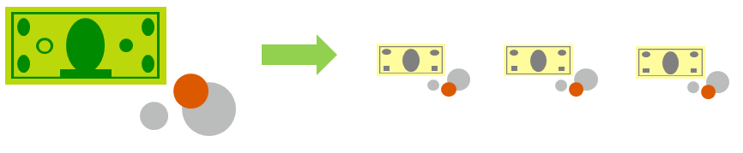
Compare CapEx vs. OpEx
Capital expenditure (CapEx)
Operational expenditure (OpEx)
The upfront spending of money on physical infrastructure.
Costs from CapEx have a value that reduces over time.
Spend on products and services as needed, pay-as-you-go.
Get billed immediately.
Notes:
https://learn.microsoft.com/training/modules/describe-cloud-compute/6-describe-consumption-based-model
Capital expenditure (CapEx)
Spend on physical infrastructure upfront.
Deduct the expense from your tax bill.
High upfront cost, but the value of your investment reduces over time.
Operational expenditure (OpEx)
Spend on services or products as needed.
Get billed immediately.
Deduct the expense from your tax bill in the same year.
No upfront cost, pay-as-you-use.

