Slide 1
A brief introduction to data analysis
DLM seminar,
WMG, University of Warwick
18/05/2018

Slide 2
What is data?
Data is any set of characters that has been gathered and translated for some purpose, usually analysis. It can be any character, including text and numbers, pictures, sound, or video. If data is not put into context, it doesn't do anything to a human or computer.
Forms of data –
Quantitative – Typically numbers, answers the questions such as - how many? When? How often? etc.
Qualitative – Such as colours, shapes, and textures of objects, etc. Does not involve measurements or numbers.
Data must be –
Reliable
Valid
Accessible

Slide 3
Data analytics vs Machine learning
Data analytics is the broader term:
Turn complex data into actionable information and obtain enhanced insight ^{[5,6]}
Data
Descriptive : What happened?
Diagnostics : Why did it happen?
Predictive : What will happen?
Prescriptive : What should be done?
Insights and decisions
Statistical and/or logical techniques are systematically applied to describe and illustrate, condense and recap, and evaluate data.

Slide 4
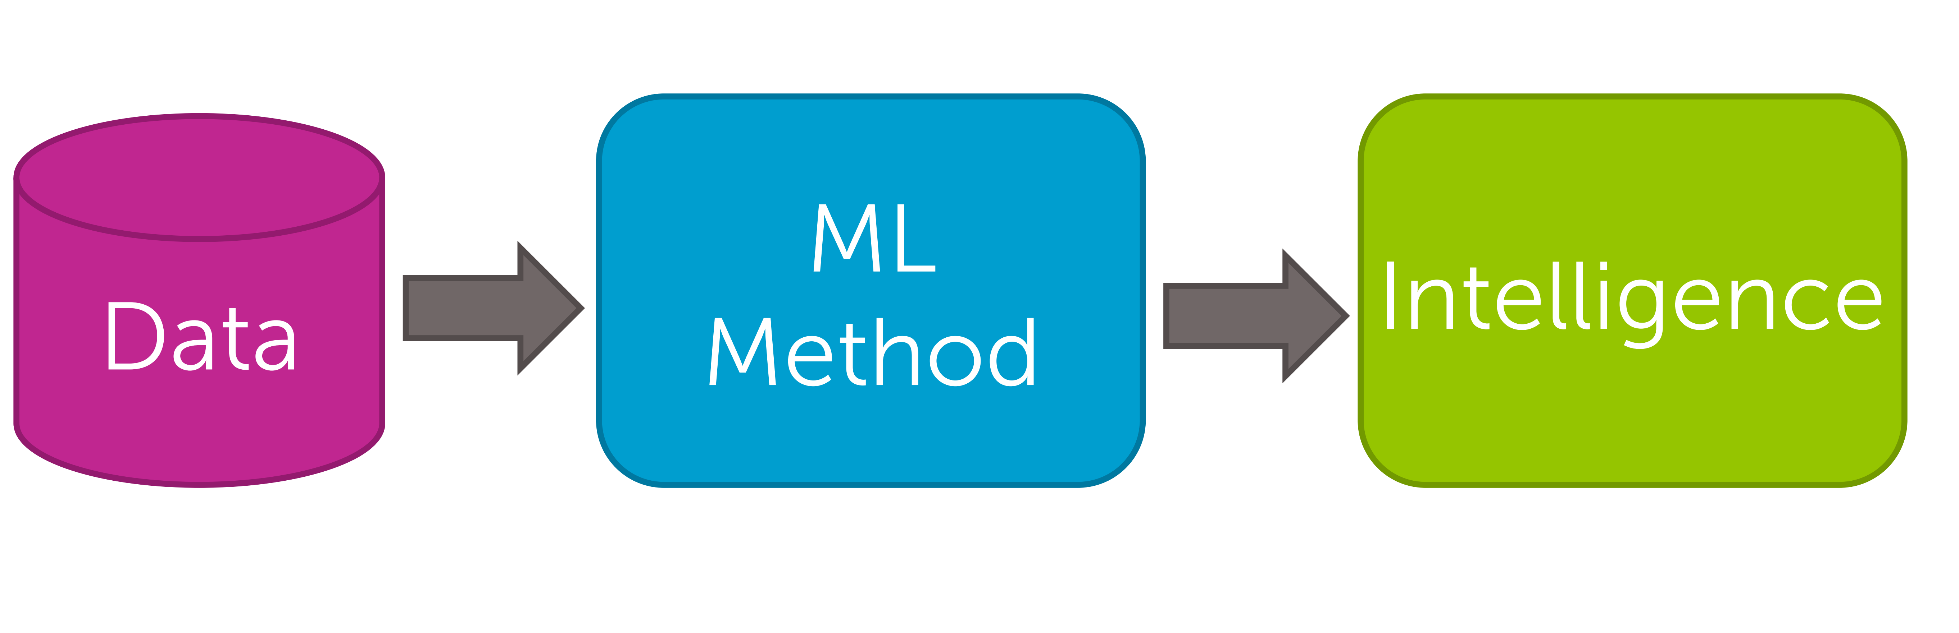
Machine learning
Arthur Samuel ^{[7]} described it as:
"the field of study that gives computers the ability to learn without being explicitly programmed." This is an older, informal definition.
Tom Mitchell ^{[8]}provides a more modern definition:
"A computer program is said to learn from experience E with respect to some class of tasks T and performance measure P, if its performance at tasks in T, as measured by P, improves with experience E.”
The machine learning pipeline ^{[3]}

Slide 5
Machine Learning - Broad categories
Supervised learning
In supervised learning, we are given a data set and already know what our correct output should look like, having the idea that there is a relationship between the input and the output.^{[9]}
Two main categories: Classification, Regression
Unsupervised learning
Unsupervised learning, on the other hand, allows us to approach problems with little or no idea what our results should look like. We can derive structure from data where we don't necessarily know the effect of the variables.^{[9]}
Examples: Density estimation, Clustering, Dimensionality reduction
Semi- supervised learning
Active learning
Reinforcement learning
Many more ….

Slide 6
Examples
Document retrieval
Decoding thoughts from brain scans
Product recommendation
Spam filtering
Speech recognition

Slide 7
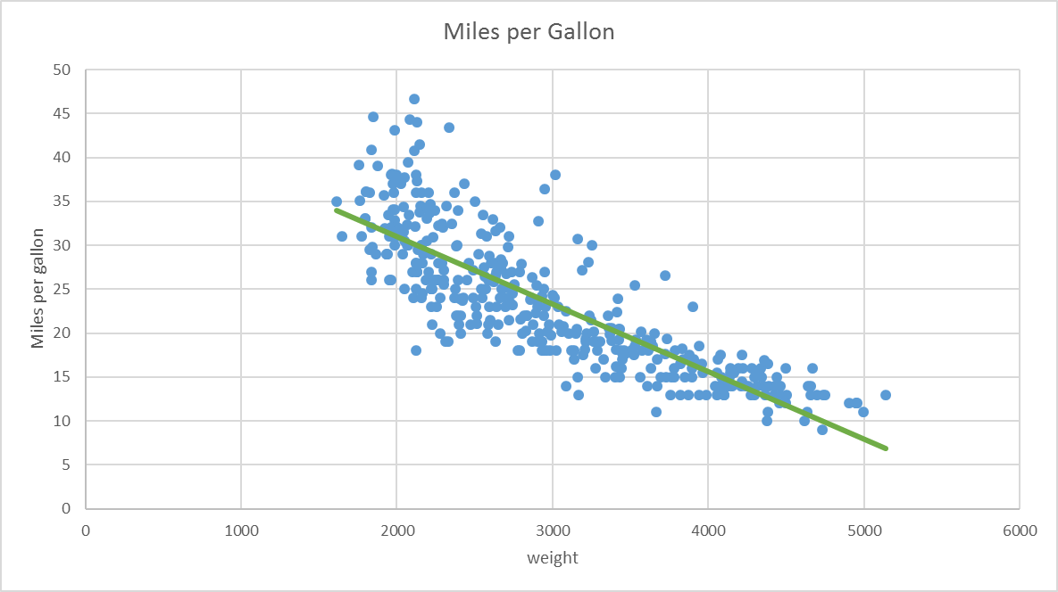
Regression
Minimizing the sum of squared errors
Maximum likelihood approach
Bayesian approach

Slide 8
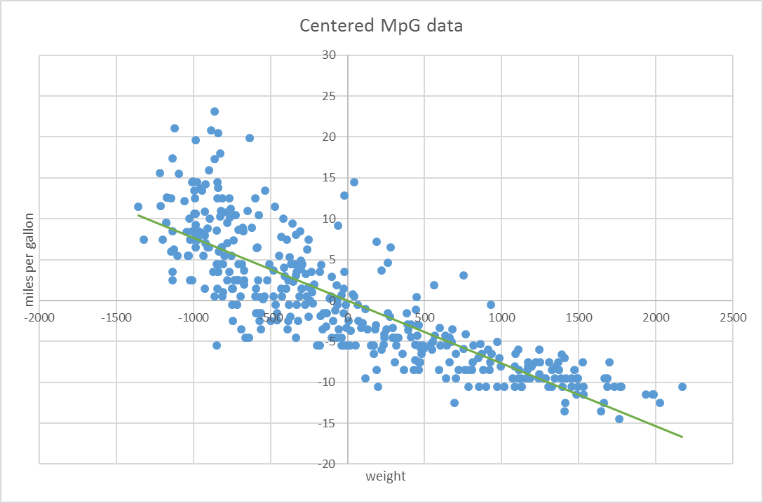
1 Parameter Linear Regression^{[2]}
The function f is a linear scaling of input x
If the data is centred the constant term w_{o} approaches zero
Excel file has the data

Slide 9
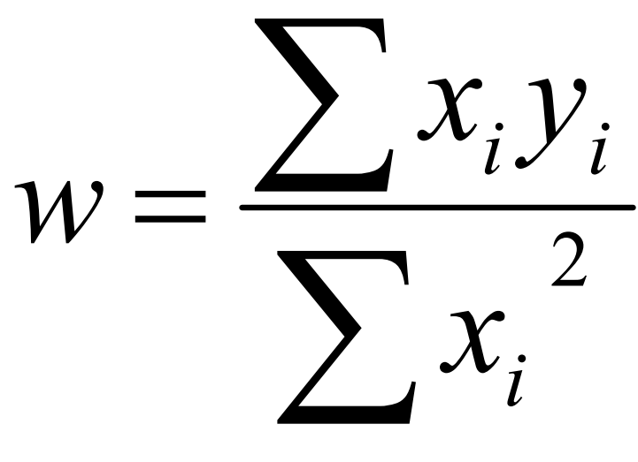
Minimizing the sum of squared errors
Matlab demo
Minimising SSE wrt. to w we get

Slide 10
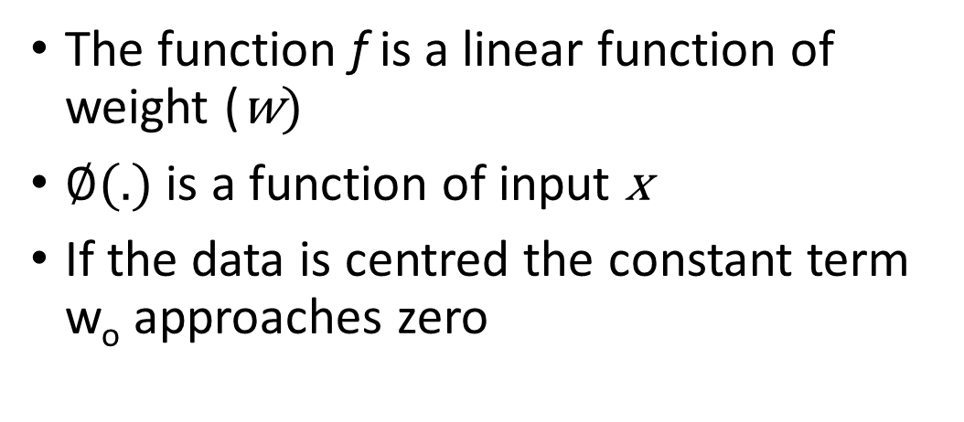
Polynomial regression
Matlab demo
The function f is a linear function of weight (w)
$∅$(.) is a function of input x
If the data is centred the constant term w_{o} approaches zero

Slide 11
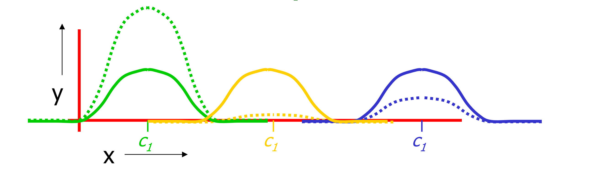
Radial Basis Function function regression
Matlab demo

Slide 12
Introduction to Bayes theorem

Slide 13
The equation^{[12]}
The prior distribution is the distribution of the parameter(s) before any data is observed, i.e. p ( θ)
The sampling distribution is the distribution of the observed data conditional on its parameters, i.e. p ( X ∣ θ ). This is also termed the likelihood, especially when viewed as a function of the parameter(s), sometimes written L ⁡ ( θ ∣ X ) = p ( X ∣ θ )
The marginal likelihood (sometimes also termed the evidence) is the distribution of the observed data marginalized over the parameter(s), i.e. p ( X ) = ∫ θ p ( X ∣ θ ) p ( θ ) d θ
The posterior distribution is the distribution of the parameter(s) after taking into account the observed data. This is determined by Bayes' rule, which forms the heart of Bayesian inference:

Slide 14
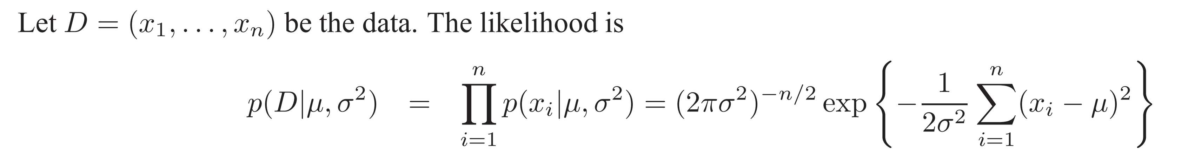
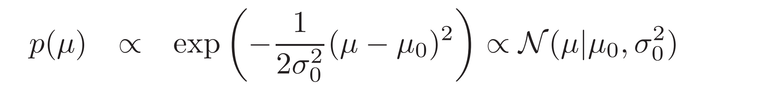
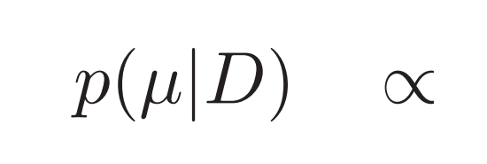
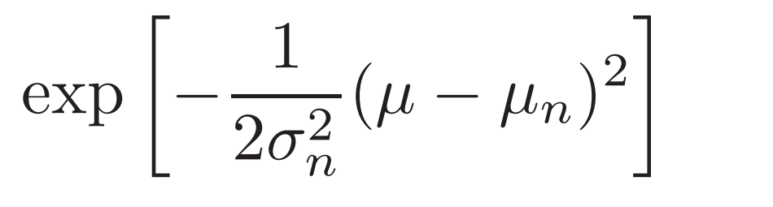
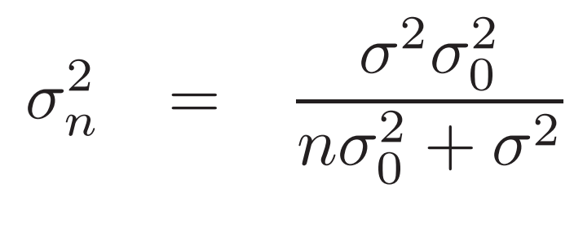
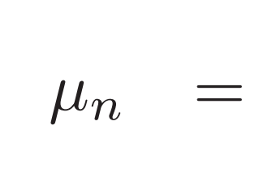
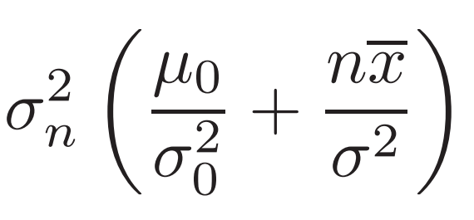
Finding the mean of an Gaussian distribution with known variance^{[10]}
Matlab demo
Prior:
Posterior:

Slide 15
Gaussian process regression

Slide 16
Bibliography and References
http://www.cs.cmu.edu/~aarti/Class/10701/lecs.html
https://www.autonlab.org/_media/tutorials/introreg05.pdf
https://www.coursera.org/learn/ml-foundations#%20
https://pn.is.tuebingen.mpg.de/person/phennig
MATLAB for Data Analytics, Presentation by, Emelie Andersson, Application Engineer
https://doi.org/10.1016/j.ijinfomgt.2014.10.007
10.1147/rd.33.0210
Michalski, Ryszard S., Jaime G. Carbonell, and Tom M. Mitchell, eds. Machine learning: An artificial intelligence approach. Springer Science & Business Media, 2013.
https://www.coursera.org/learn/machine-learning
Murphy, Kevin P. "Conjugate Bayesian analysis of the Gaussian distribution." def 1.2σ2 (2007): 16.
http://students.brown.edu/seeing-theory/index.html
https://en.wikipedia.org/wiki/Bayesian_inference

