Slide 1
HACK 303 – Team H2O

Slide 2
Technologies and tools
Vertex AI
Gemini-pro
Flask
Python 3.9+

Slide 3
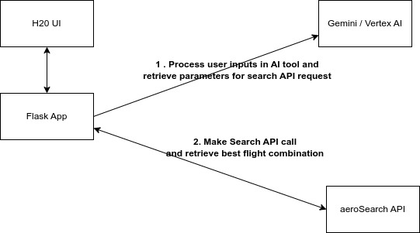
Architecture - design

Slide 4
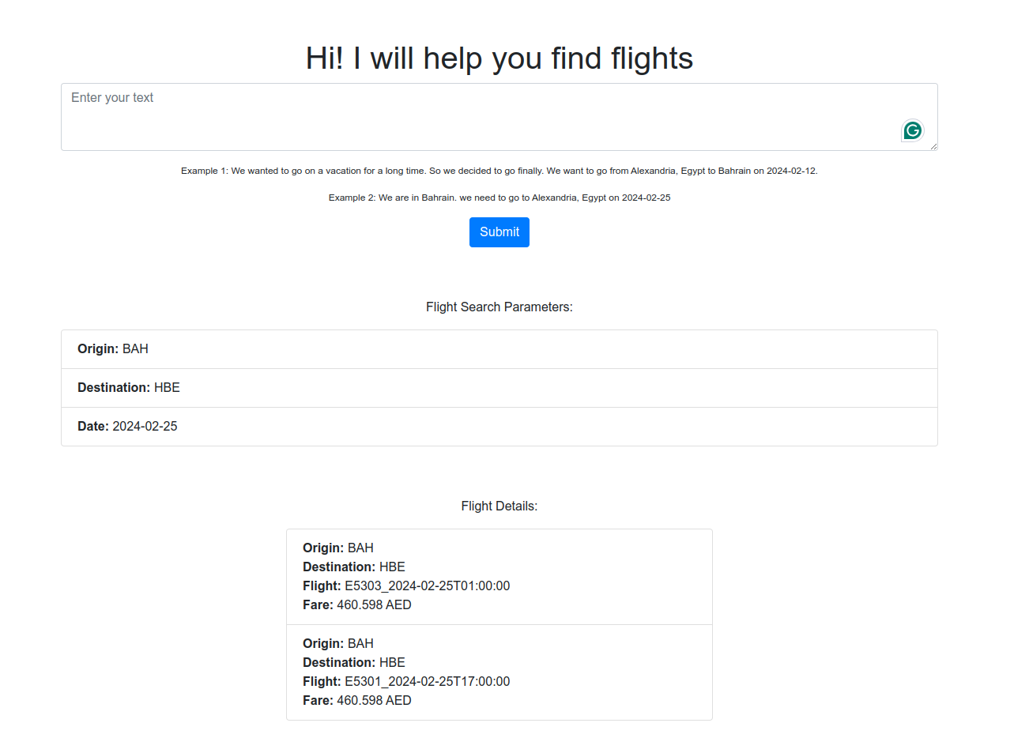
USER INTERFACE http://172.31.59.21:8080/

Slide 5
THANK YOU

