Slide 1
SeCURE DATA HIDING IN IMAGES USING STAGANOGRAPHY
CAPSTONE PROJECT
Presented By: Manoj
Student Name : Pagadala Manoj
College Name & Department : Kommuri Pratap Reddy Science and Technology & Computer Science And Engineering

Slide 2
OUTLINE
Problem Statement
Technology used
Wow factor
End users
Result
Conclusion
Git-hub Link
Future scope

Slide 3
Problem Statement
Securely embed and retrieve secret messages within an image.
Ensure confidential data transmission with encryption.
Prevent unauthorized access using a passcode.

Slide 4
Technology used
OpenCV (cv2) – Image processing.
NumPy – Numerical computations.
Python – Scripting and automation.

Slide 5
Wow factors
Hides messages without altering image quality.
Uses passcode-based encryption and decryption.
End marker ensures accurate retrieval.

Slide 6
End users
Secure communication seekers.
Cybersecurity professionals.
Digital watermarking applications.
Steganography enthusiasts.

Slide 7
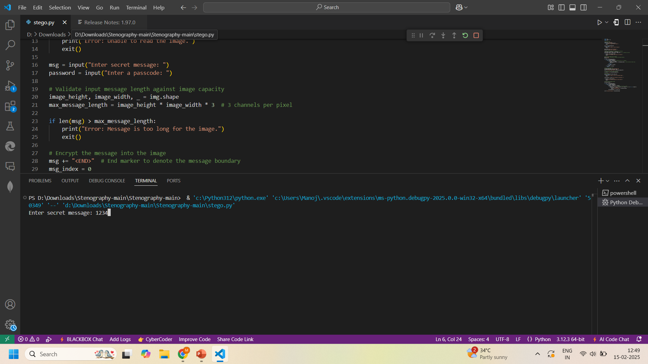


Results

Slide 8
Conclusion
This project successfully addresses the need for secure and confidential message transmission using image-based encryption.
The passcode-protected encryption ensures that unauthorized access is prevented.
It maintains image integrity while embedding and retrieving hidden messages efficiently.
This approach provides a practical and effective solution for cybersecurity, digital watermarking, and steganography applications.

Slide 9
GitHub Link
https://github.com/manojpagadala/Stegnography-ENC-DEC-project.git

Slide 10
Future scope(optional)
AI-driven encryption enhancements.
Support for multiple file formats.
Cloud-based encryption services.
User-friendly GUI for accessibility.

Slide 11
THANK YOU

