Slide 1
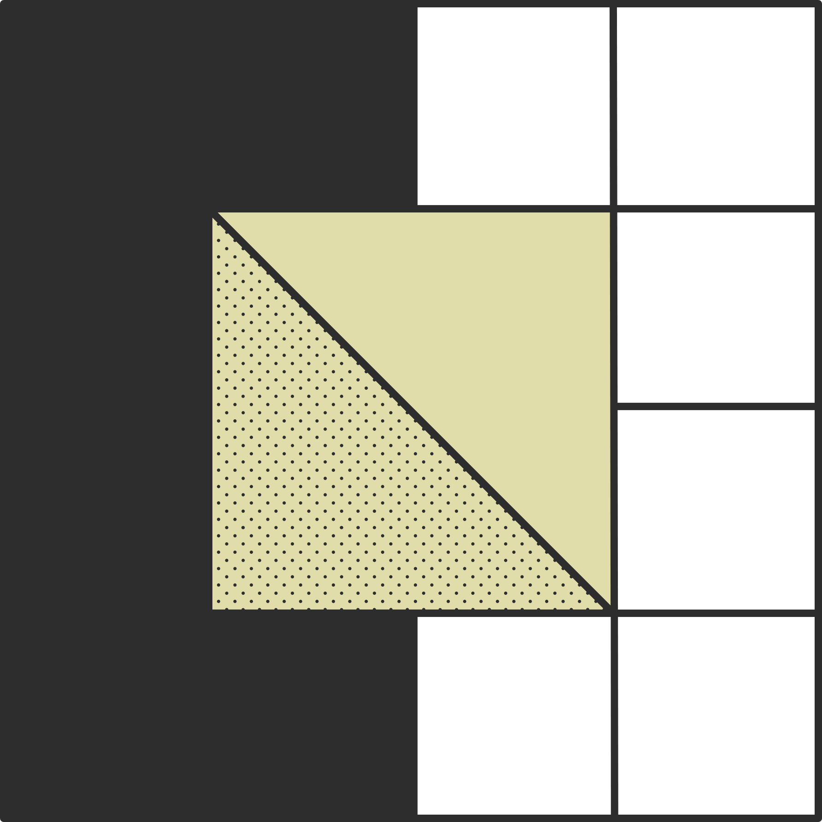

Computer Vision
Case Study
Manoj Parthiban - CB.EN.U4CCE20032

Slide 2
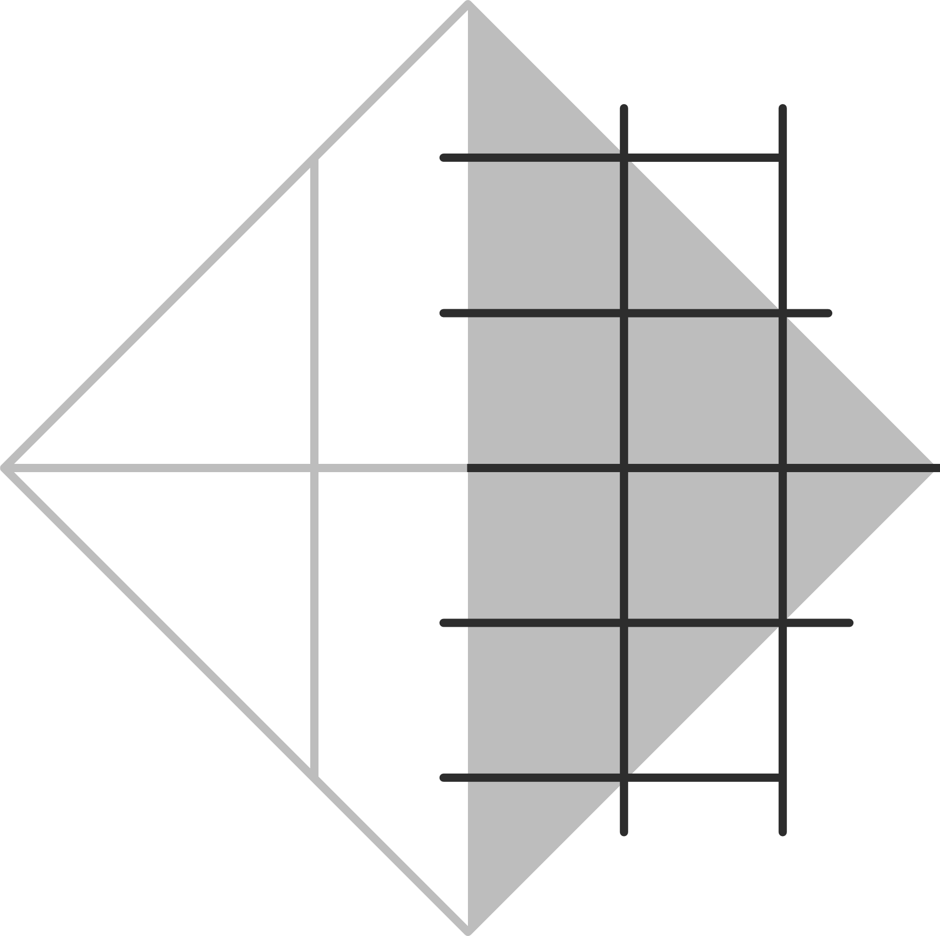

Road lane detection for autonomous vehicles
Objective: To Develop a robust road lane detection system for autonomous vehicles, utilizing computer vision techniques, to accurately identify and track lane boundaries in real-time, enhancing the vehicle's ability to navigate and maintain safe driving within designated lanes.
By leveraging computer vision, the system accurately identifies and tracks lane boundaries in real-time
2

Slide 3
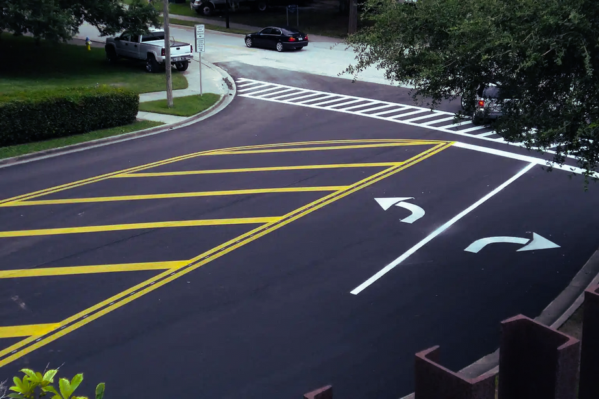
Why Lane detection?
Lane detection is a critical component of self-driving cars and autonomous vehicles. It is one of the most important research topics for driving scene understanding. Once lane positions are obtained, the vehicle will know where to go and avoid the risk of running into other lanes or getting off the road. This can prevent the driver/car system from drifting off the driving lane.

Slide 4


Pipeline
Apply Color Selection
Apply Canny edge detection.
Apply gray scaling to the images.
Apply Gaussian smoothing.
Perform Canny edge detection.
Determine the region of interest.
Apply Hough transform.
Average and extrapolating the lane lines.
Apply on video streams.
3

Slide 5

Brief steps involved in Road Lane Detection
Capturing and decoding video file
Grayscale conversion of image
Reduce Noise
Canny edge detector
Region of Interest
Hough line transform
Draw lines on the Image or Video
5

Slide 6
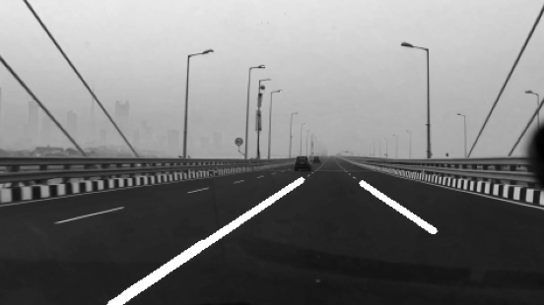
Grayscale conversion and Noise reduction
To retain the color information and segment the road from the lane boundaries using the color information this proved difficulties on edge detection and it will affect the processing time. In practice the road surface can be made up of many different colours due to shadows, different pavement style or age, which causes the color of the road surface and lane markings to change from one image region to another. Therefore, color image is converted into grayscale.
6

Slide 7
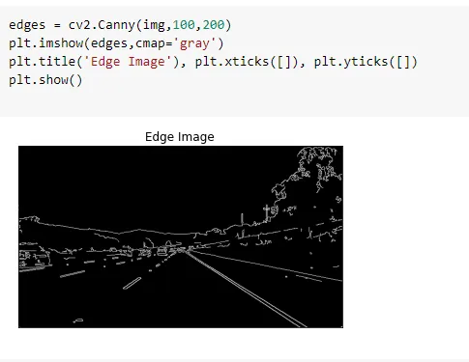
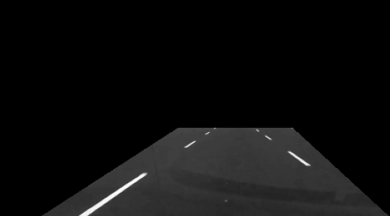
Canny Edge Detector
It computes gradient in all directions of our blurred image and traces the edges with large changes in intensity.
Canny Edge detector needs grey scale images, hence we need to convert our image into grey scale. We are collapsing 3 channels of pixel value (Red, Green, and Blue) into a single channel with a pixel value range of [0,255].
7

Slide 8
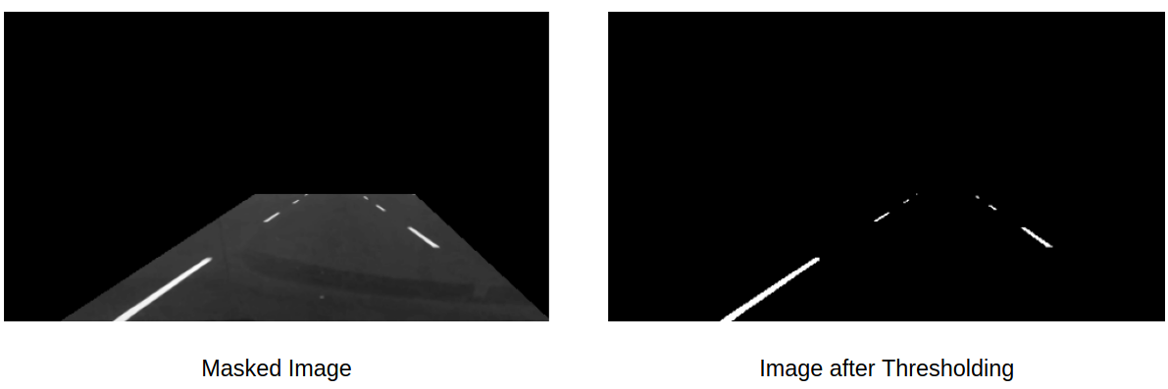
Region of Interest
In this method, the pixel values of a grayscale image are assigned one of the two values representing black and white colors based on a threshold value. So, if the value of a pixel is greater than a threshold value, it is assigned one value, else it is assigned the other value.
8

Slide 9
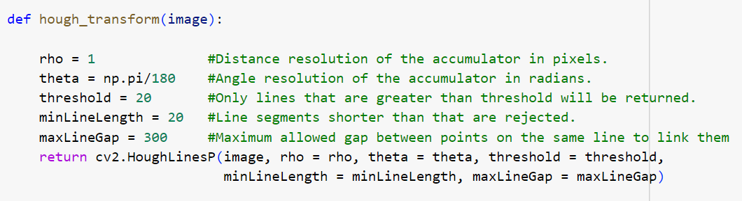
Hough Line Transformation
This one line of code is the heart of the whole algorithm. It is called Hough Transform, the part that turns those clusters of white pixels from our isolated region into actual lines.
Parameter 1: The isolated gradients
Parameter 2 and 3: Defining the bin size, 2 is the value for rho and np.pi/180 is the value for theta
Parameter 4: Minimum intersections needed per bin to be considered a line (in our case, its 100 intersections)
Parameter 5: Placeholder array
Parameter 6: Minimum Line length
Parameter 7: Maximum Line gap
9

Slide 10
Plotting Lines on Video Frames
After the coordinates are found using the Hough Transform, We plot them on the original image (frame) using four functions:
Average_Slope_Intercept: This function takes in the hough transform lines and calculate their slope and intercept. If the slope of a line is negative then it belongs to left lane else the line belongs to the right lane. Then we calculate the weighted average slope and intercept of left lane and right lanes.
Pixel_Points: By using slope, intercept and y-values of the line we find the x values for the line and returns the x and y coordinates of lanes as integers.
Lane_Lines: The function where Average_Slope_Intercept and Pixel Points are called and coordinates of right lane and left lane are calculated.
Draw_Lane_Lines: This function draws the left lane and right lane of the road on the input frame. Returns the output frame which is then stored in the variable “processed” in our driver function “process_video”.
10

Slide 11

Thank you

