Slide 1

Supply Chain Analysis
Name: S.Manoj Prabhakar
Course: CDA
Project-ID: CDACL-003-Supply Chain Analysis

Slide 2

Introduction
Supply chain management ensures smooth movement of goods from suppliers to customers.
Key Functions:
Procurement
Inventory management
Supplier coordination
Transportation & delivery
Quality control
Cost optimization
Why Analytics?
Businesses use data analytics to improve efficiency, reduce costs, and make better decisions.
Project Focus:
Power BI, SQL, Python for supply chain insights.

Slide 3

Problem Statement
Supply chain businesses generate large volumes of operational data related to products, suppliers, inventory, shipping, and quality.
Without proper analysis, businesses struggle to identify:
High-performing product categories
Supplier delays and inefficiencies
Rising shipping costs
Inventory shortages or excess stock
Quality issues and defect rates
Revenue growth opportunities
Proposed Solution
Developed an interactive Power BI dashboard to track KPIs, compare performance, and generate actionable insights.

Slide 4
Objective
This project aims to analyze supply chain data and develop an interactive Power BI dashboard for better business decisions.
Specific Objectives:
Analyze revenue and sales performance
Compare product categories
Evaluate supplier performance
Monitor inventory levels
Analyze shipping and logistics costs
Track quality and defect rates
Generate actionable insights

Slide 5

Dataset Description
The dataset includes supply chain information related to products, suppliers, inventory, shipping, and quality.
Main Columns:
Product Type
Price
Revenue
Products Sold
Supplier Name
Stock Levels
Shipping Cost
Lead Time
Defect Rate %

Slide 6
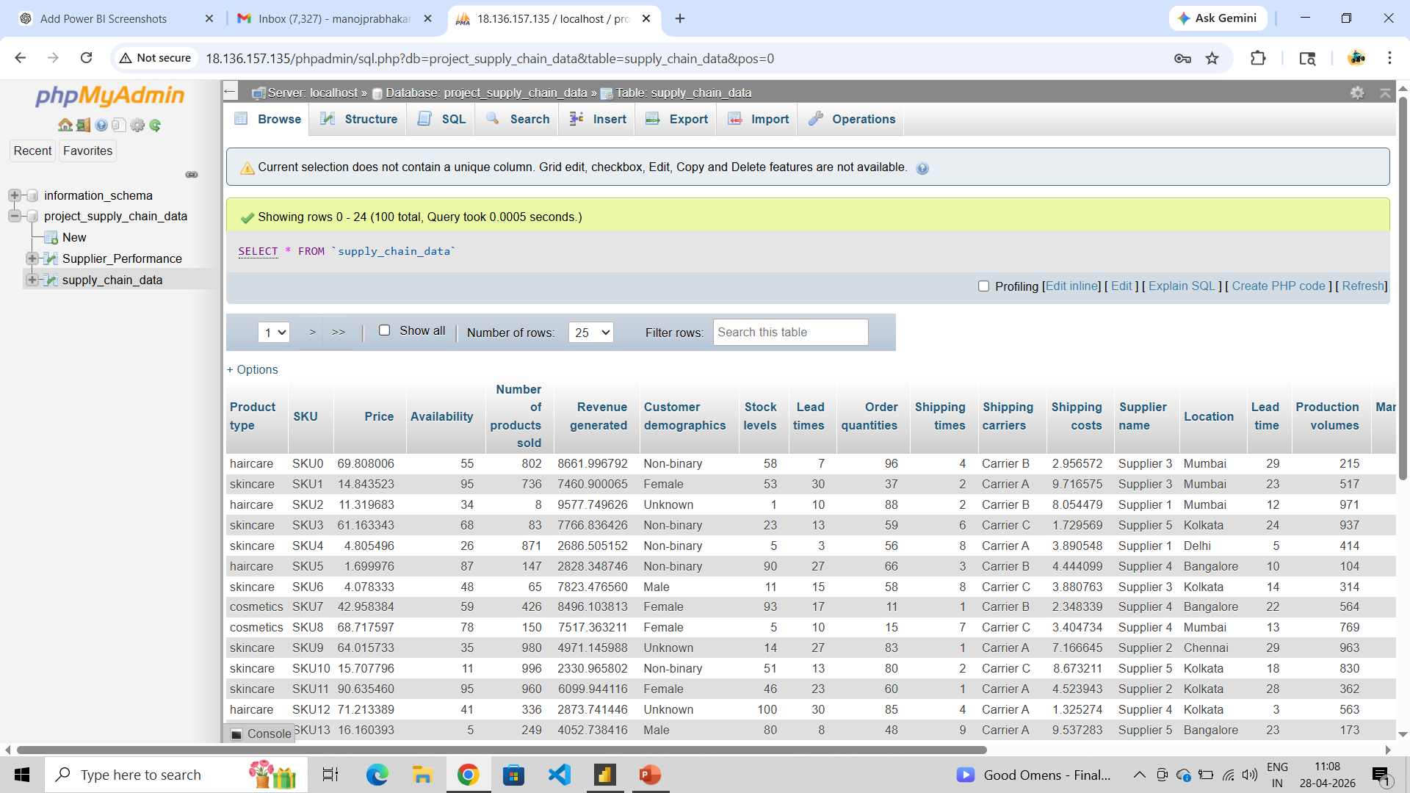
Database Connection & Data Extraction
Content:
SELECT * FROM supply_chain_data;
Connected to MySQL database successfully
Extracted supply chain records
Imported data into Power BI for visualization

Slide 7

Tools
This project was completed using multiple tools for data extraction, cleaning, analysis, and dashboard development.
Tools and technologies:
MySQL / phpMyAdmin – Database extraction
Python – Exploratory Data Analysis (EDA)
Matplotlib / Seaborn – Visualization during EDA
Power BI – Dashboard creation
DAX – KPI measures and calculations
Power Query – Data transformation in Power BI

Slide 8
🧹Data Preprocessing
Imported required Python libraries
Loaded CSV dataset using Pandas
Verified dataset shape and columns
Checked data structure
Prepared data for EDA

Slide 9
Diagnostic Report Summary
Dataset Health Check:
Total Records: 100
Total Columns: 24
Missing Values Found: 0
Duplicate Records Found: 0
Data types verified successfully
Outliers detected in Revenue and Shipping Cost columns
Data Cleaning Steps Performed:
Removed unnecessary spaces in text fields
Checked null values
Verified numeric columns
Standardized column names
Prepared clean dataset for analysis

Slide 10
Product Comparison Report
Product Type | Revenue | Units Sold | Stock Level | Shipping Cost | Defect Rate
Cosmetics | High | Medium | Good | Medium | Low
Skincare | Highest | Highest | Good | Medium | Medium
Haircare | Lowest | Low | Moderate | High | Medium
Key Insights:
Skincare achieved highest revenue and sales
Haircare requires improvement strategy

Slide 11
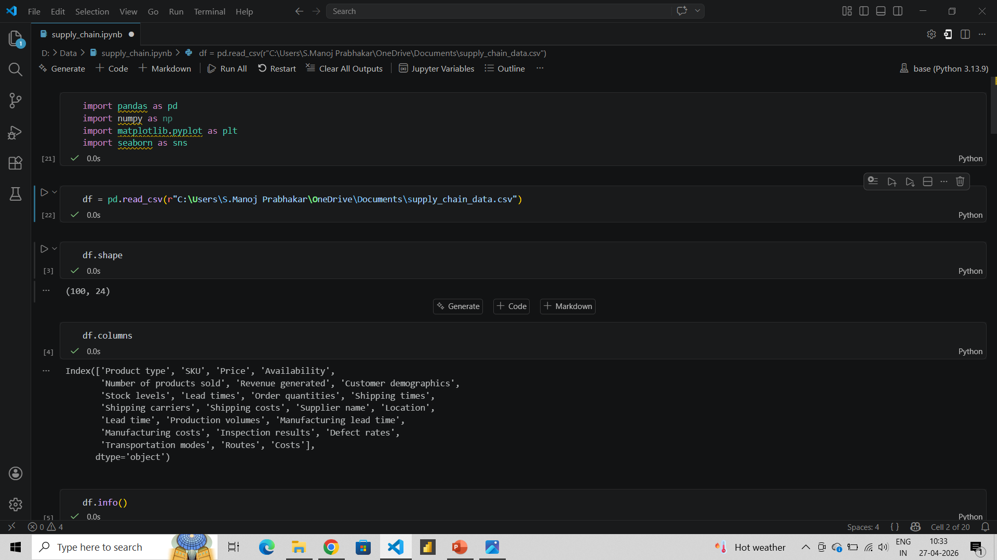
Python Implementation Output

Slide 12
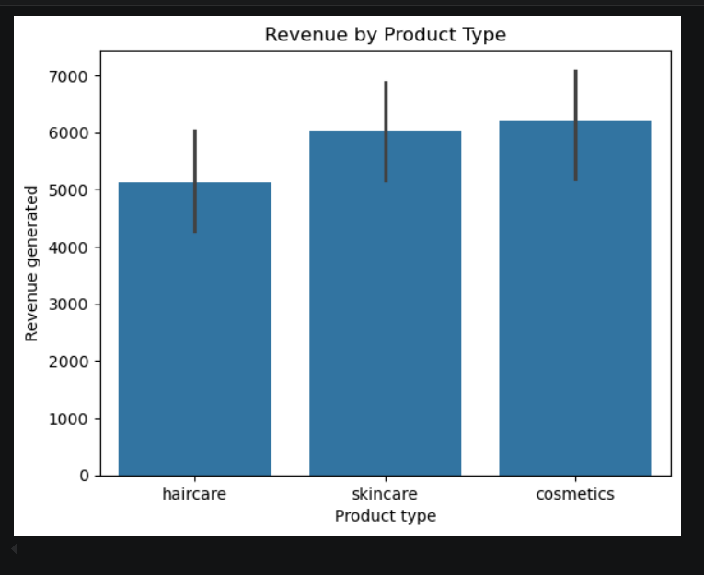
Revenue Analysis
Key Insights:
Cosmetics generated the highest average revenue.
Skincare performed second best.
Haircare generated the lowest revenue.
Product category analysis helps improve sales strategy.

Slide 13
Supplier Performance Analysis
⏱️ Lead Time
⚠️ Defect Rate
Supplier 3 fastest
Supplier 5 second best
Supplier 4 slowest
Supplier 1 lowest defects
Supplier 4 second best
Supplier 5 highest defects

Slide 14
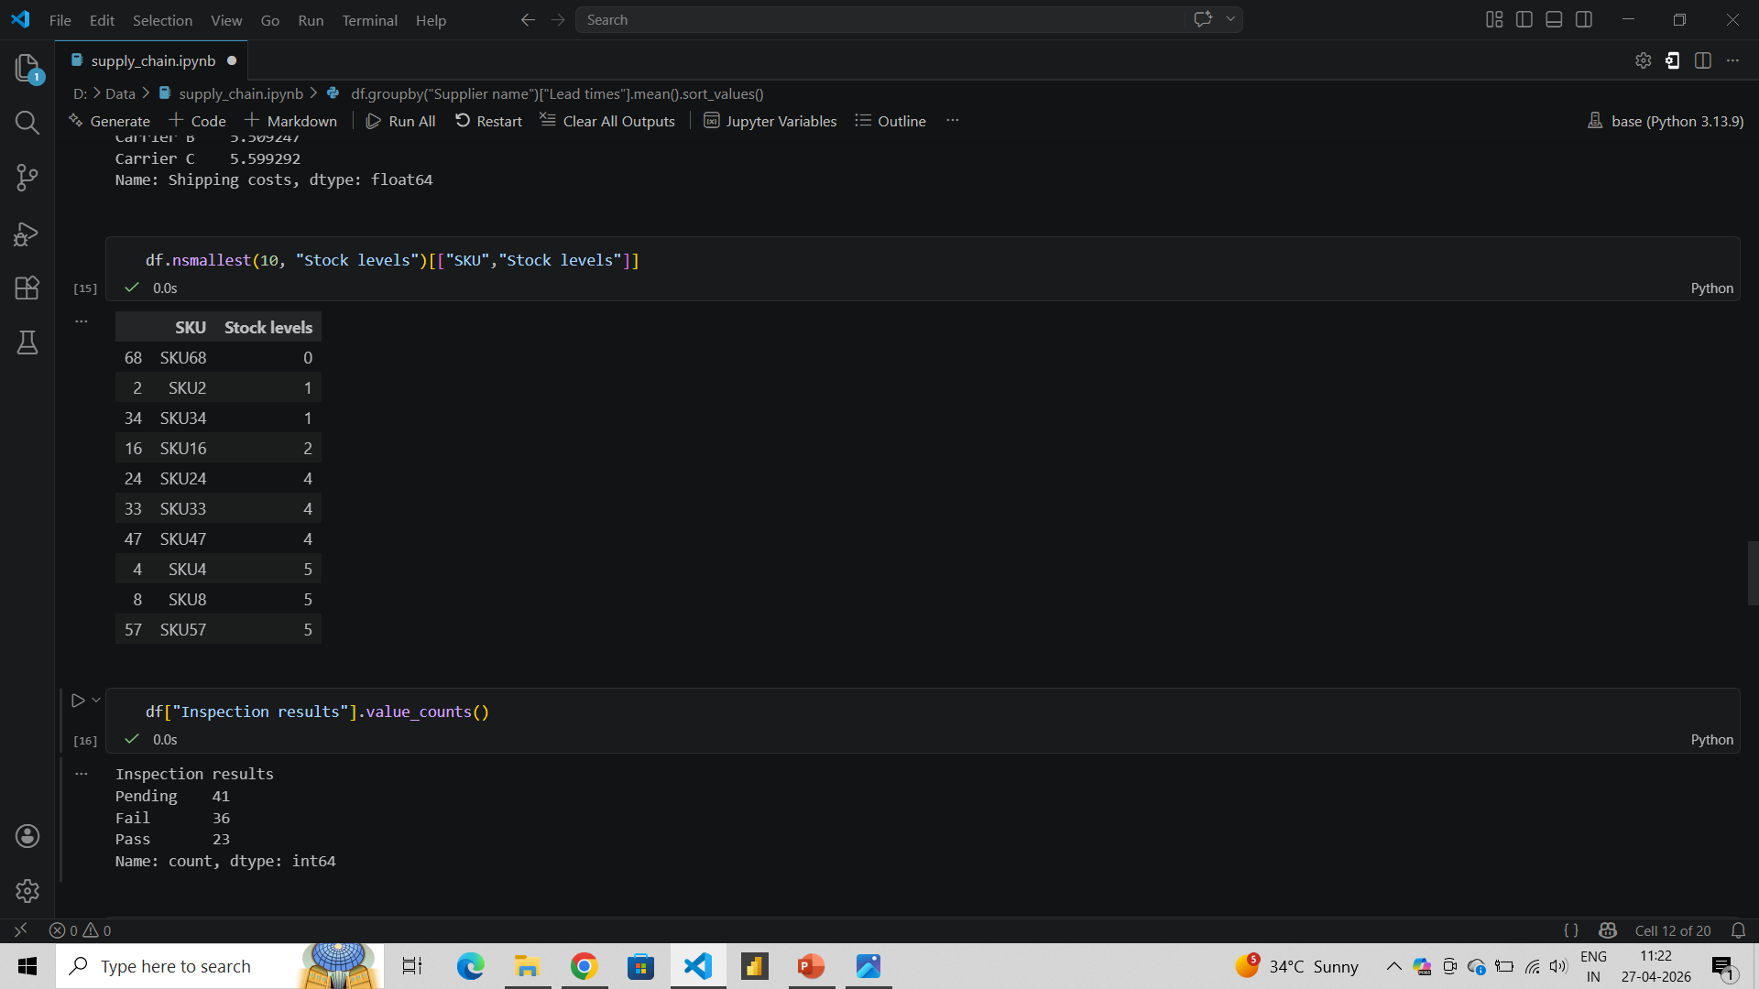
Stock Level Analysis
Key Insights:
SKU68 has zero stock
Multiple SKUs below safe level
Risk of product stockouts
Improve replenishment and inventory planning

Slide 15
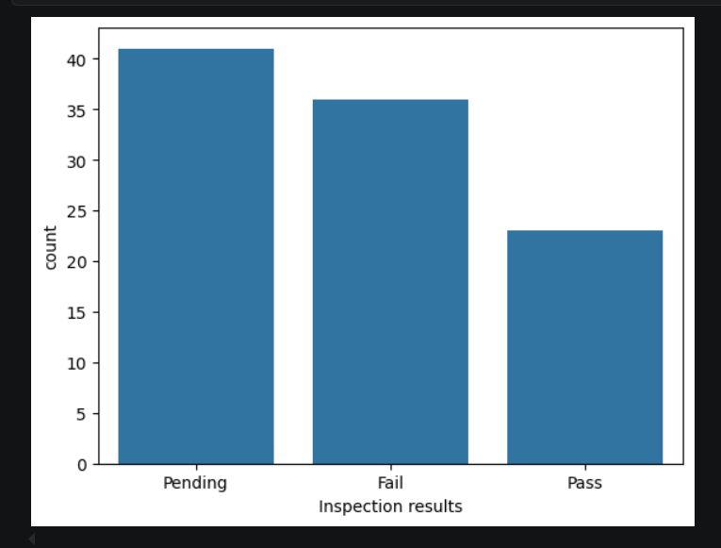
Inspection Results Analysis
Key Insights:
Pending inspections are highest
Fail rate needs attention
Pass count is lowest
Improve quality control process

Slide 16
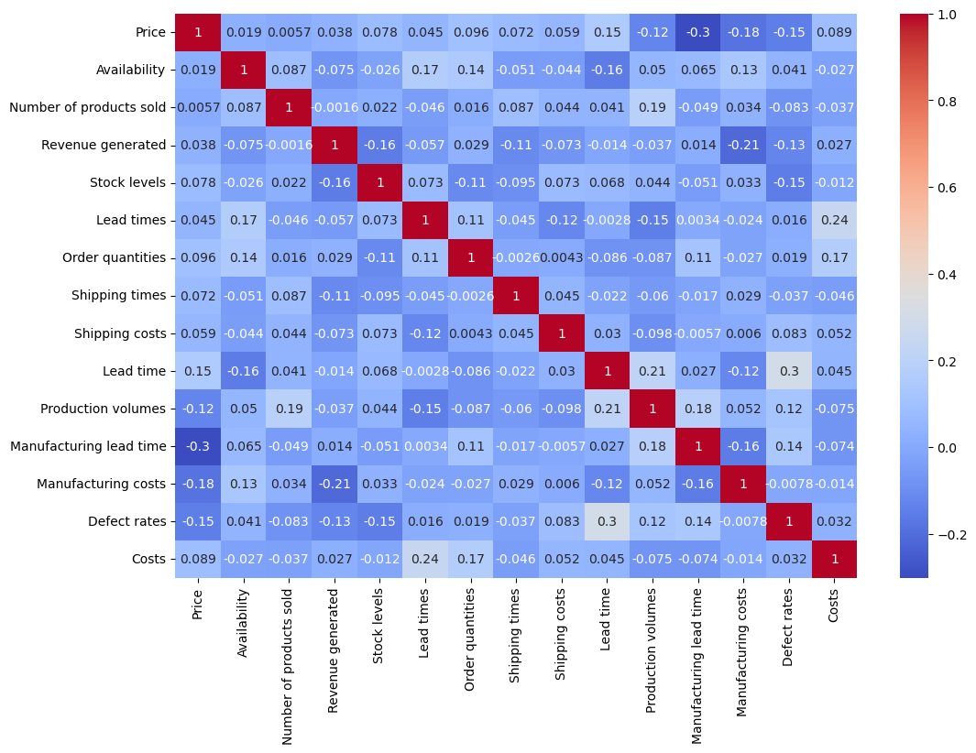
Correlation Analysis
Key Insights:
Most variables are weakly related
Price has low impact on revenue
Lead time slightly affects cost
No strong correlation detected

Slide 17
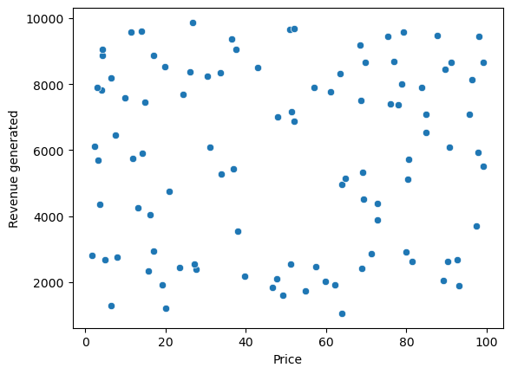
Price vs Revenue Analysis
Key Insights:
No clear linear trend
Revenue is spread across price ranges
High price ≠ high revenue
Multiple factors influence sales

Slide 18
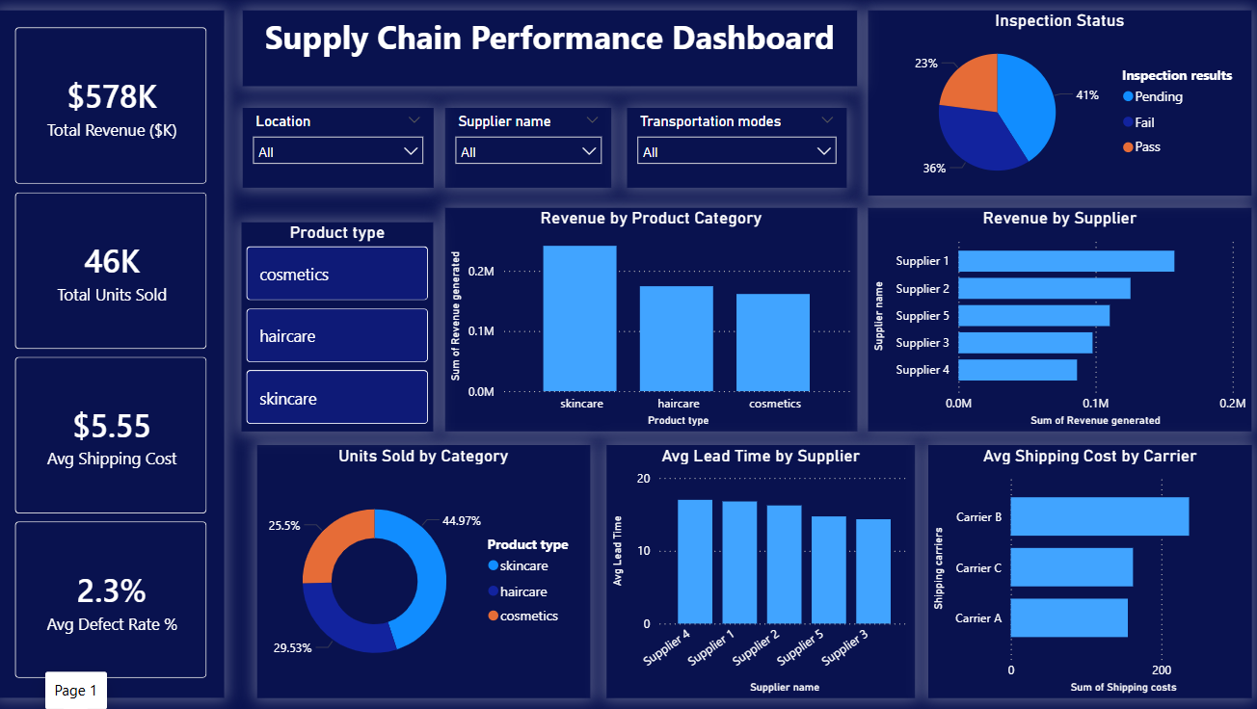
Interactive Dashboard Overview
Key Insights:
KPI cards for revenue & stock
Filters for supplier and product type
Trend charts for decisions
Real-time business insights

Slide 19
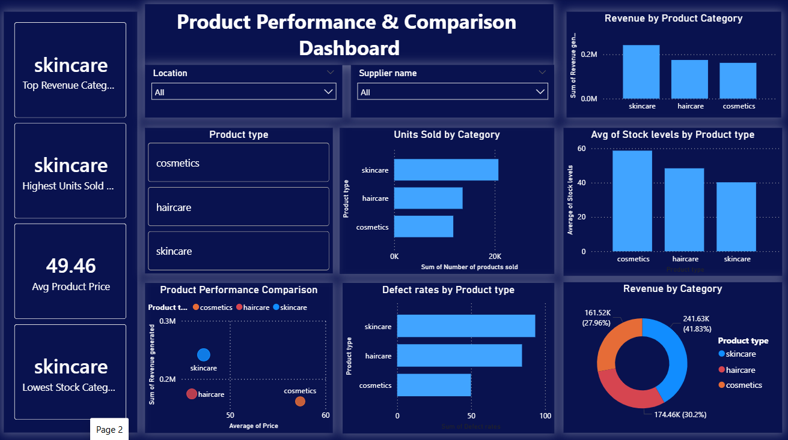
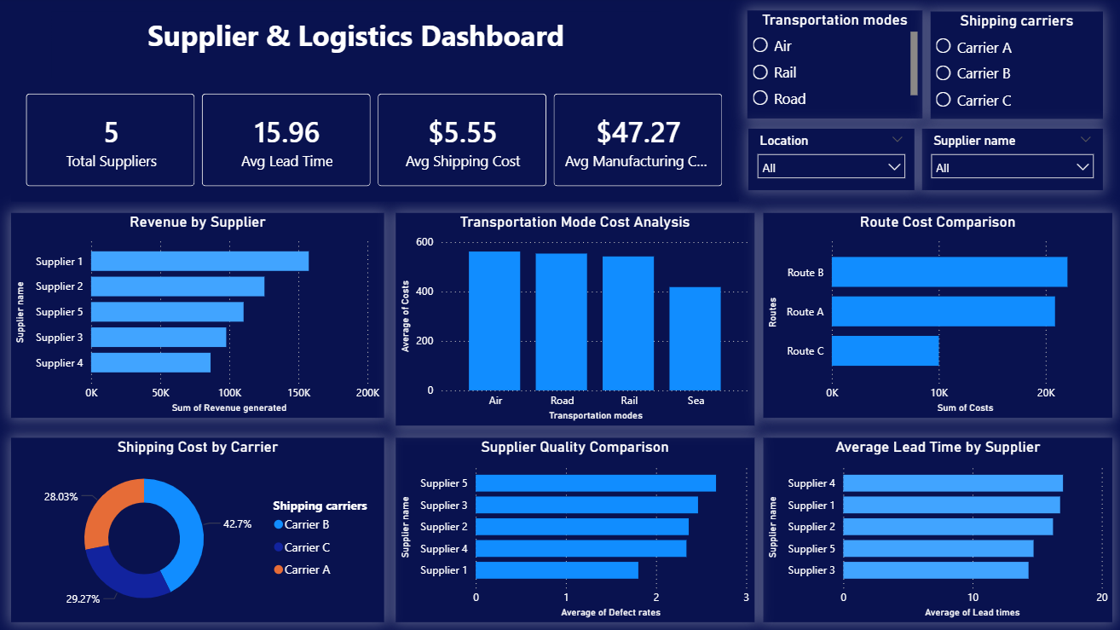
Advanced Dashboard Modules
• Product comparison dashboard for category insights • Supplier dashboard for logistics monitoring • Interactive slicers and KPIs included

Slide 20
Key Insights
Cosmetics category generated the highest revenue
Haircare showed the lowest sales performance
Supplier 3 had the fastest lead time
Supplier 1 had the lowest defect rate
Multiple SKUs were below safe stock levels
Pending inspections were highest
No strong correlation between price and revenue

Slide 21
Business Recommendations
Based on the analysis, the following recommendations are proposed:
Increase focus on high-performing product categories
Increase promotion for low-performing products
Reorder low-stock SKUs immediately
Increase collaboration with efficient suppliers
Reduce defect rate through stronger quality checks
Clear pending inspections quickly
Use dashboards for regular monitoring

Slide 22
Conclusion
This project successfully analyzed supply chain performance using Python and Power BI.
Key findings:
Revenue trends and product categories were identified
Supplier efficiency and defect rates were compared
Low stock products were detected
Inspection performance was analyzed
Dashboards improved business decision-making
Data-driven strategies can help improve supply chain efficiency and profitability.

Slide 23

Thank You

