Slide 1
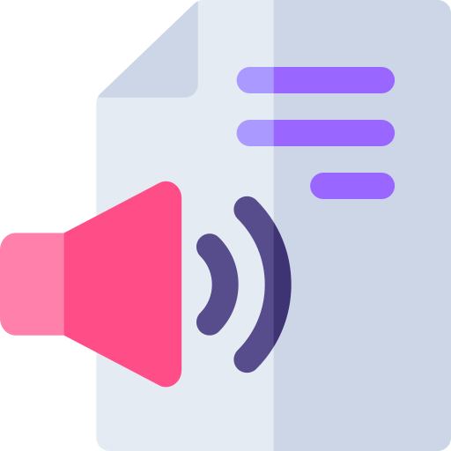
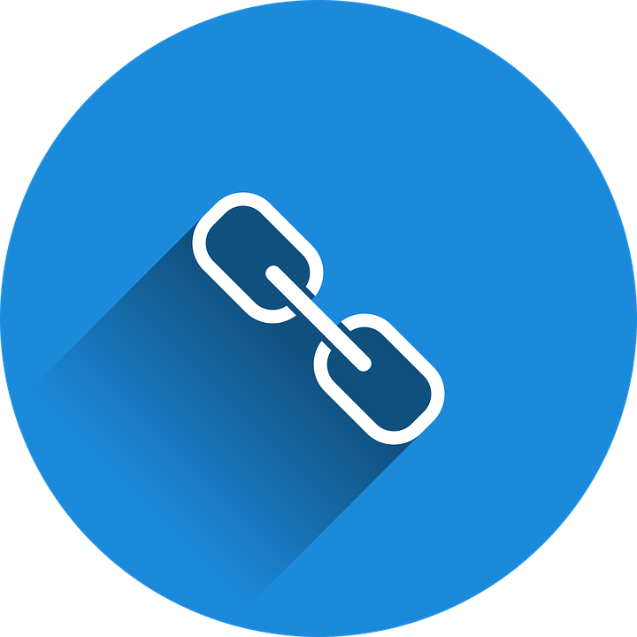
Aural
PDF to Audio
http://shorturl.at/jlvzS

Slide 2
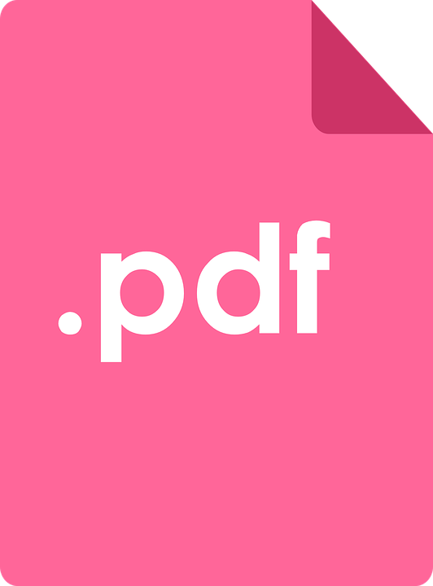
Description
Aural application aims at converting PDF file to Audio in a most simplest way, where in each and every user can easily listen to it anywhere anytime.
The purpose of this project is converting the PDF file to listenable voice.
It’s a major advantage is that it plays a very important role for visually impaired users who can simply just here to it.
Now , let’s explore more about Aural.

Slide 3

Sign-Up
Here one can Signup/Register for the Aural application , by providing his E-mail address and password.

Slide 4
Sign-In
If user has already Signed-Up / Registered for the application before, the he/she can directly Sign-In to the application by entering his E-mail address and password.

Slide 5
Home
Interface where user can click on “ Listen to PDF’s ” and user is redirected to PDF to audio conversion page / Converter page.

Slide 6
Converter
Select PDF File
Here user can select the PDF file which he/she wants to listen to the information inside of it.

Slide 7
Converter
Mention Page Number
Here user can specify the page number of the uploaded PDF file from which he/she wants to listen to the information.

Slide 8
Converter
Set Speech Rate
Here user can set the speed of the audio/voice at which he/she wants to listen to the converted information from PDF file.

Slide 9
Converter
Listen
Once the user selects the PDF file , mentioned the page number , and set the speech rate , he/she can click on “Listen” button to start listening to the audio.

Slide 10
Converter
Stop
Once the user start listening to the audio , and if he/she wants to stop listening to it at any moment of the time , can click on “Stop” button to stop listening to it.

Slide 11
Can be used by :
Students.
Visually impaired people.
Announcements.

Slide 12
Conclusion
We studied the efficient use of developing aural app an android application by making the great use of it,
We used these results to determine the usage of this application is very easy and everyone can make use of it by easy and feasible ways of conversion.
Main objective to develop the app was to provide conversion of PDF files to audio format.

Slide 13

Thanks!
Do you have any questions ?
mallikarjunrayar003@gmail.com
mallikarjunrayar.co.vu

