Slide 1
Double/Debiased Machine Learning for
Treatment and Structural Parameters
from Chernozhukov et al. (2018)
Seth Abramowitz and Mariano Sanchez Delgado | GSE 552 | June 2026
The Econometrics Journal, 21(1), C1–C68

Slide 2
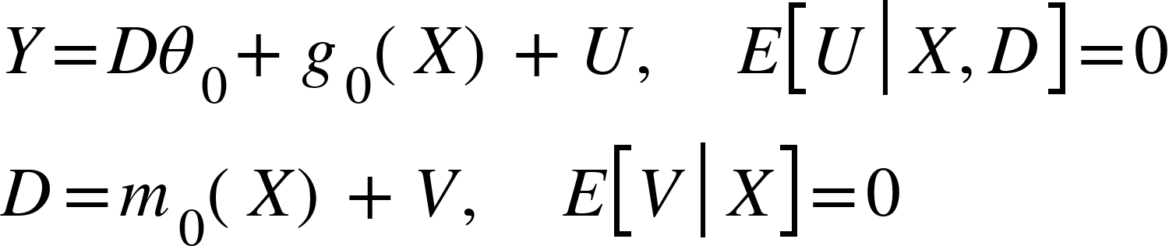
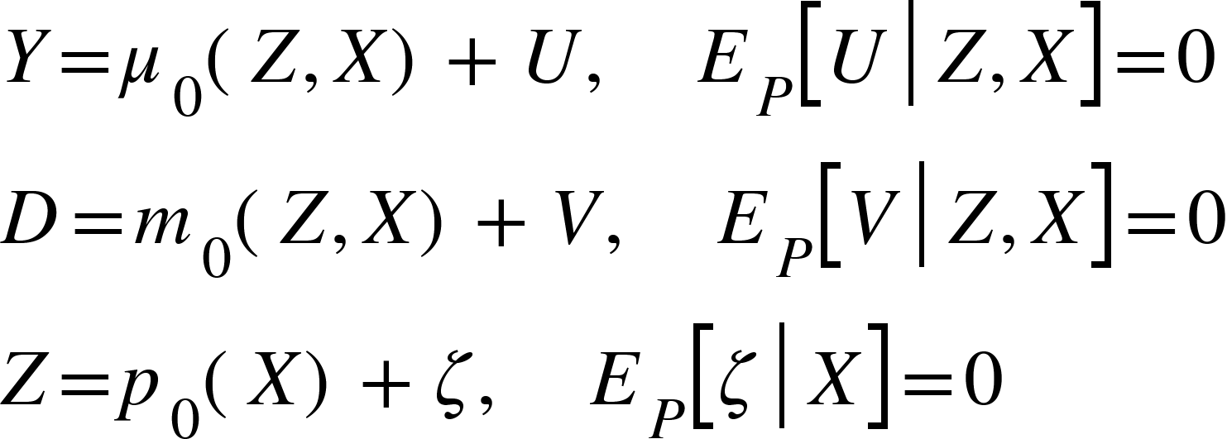
RESEARCH QUESTION
How Do We Estimate Causal Parameters When Controls Are High-Dimensional?
The Core Problem
The Partially Linear Model (PLR)
We want to estimate a low-dimensional causal parameter θ₀ (e.g., a treatment effect) in the presence of a high-dimensional nuisance parameter η₀ = (m₀, g₀). Standard ML methods reduce variance via regularization, but this regularization bias contaminates θ₀ when ML estimates are plugged in naively — the estimator fails to be √N-consistent.
Interactive Instrumental Variables Model (IIVM)
θ₀ is the low-dimensional parameter of interest — estimated after flexibly partialling out the high-dimensional X

Slide 3
METHOD
Double/Debiased Machine Learning — Why It’s Needed
✕
The Problem
Why This Applies Here
Standard ML methods are designed for prediction, not causal inference. Inserting ML predictions directly into a causal model introduces regularization bias and overfitting into the treatment-effect estimate.
9 correlated controls — assuming g₀(X) is linear is a strong and likely wrong restriction
401(k) eligibility is not randomly assigned — D correlates with X through employer and worker selection
Naive ML on the outcome equation introduces regularization bias directly into θ₀
DML allows flexible ML for g₀ and m₀ while still obtaining valid inference for θ₀
✓
The Fix: DML
Neyman-orthogonal moment conditions make θ₀ less sensitive to nuisance errors. Cross-fitting separates training data from estimation data, preventing overfitting from entering the final estimate.

Slide 4
Table 2 (Panel B) Replication

Slide 5
DATA
1991 Survey of Income and Program Participation (SIPP)
9,915
$18,052
9
40%
Observations
Mean net_tfa
Covariates
401(k) Eligible
Variable | Role | Description
net_tfa | Outcome (Y) | Household net total financial assets (USD)
e401 | Treatment (D) | = 1 if employer offers a 401(k) plan
age, inc, educ, fsize | Controls (X) | Continuous demographic and income variables
marr, twoearn, db, pira, hown | Controls (X) | Binary household characteristics

Slide 6
RESULTS
Replication Results — Table 2, Panel B (5-Fold)
 | Lasso | Reg. Tree | Forest | Boosting | Neural Net | Ensemble | Best
Paper ATE | 8187 | 8871 | 9247 | 9110 | 9038 | 9166 | 9215
Replication ATE | 9676 | 9026 | 9269 | 8983 | 9213 | 9338 | 9667
~$9,000 Effect
Economically Large
Robust Across Methods
Households eligible for a 401(k) hold roughly $9,000 more in net financial assets than comparable ineligible households. Given a sample mean of $18,052, this represents approximately a 50% increase in net wealth.
A $9,000 savings effect is substantial in policy terms. It suggests that access to tax-advantaged retirement accounts meaningfully shifts household wealth accumulation, not just portfolio reallocation.
The ATE ranges from $8,983 to $9,676 across 6 very different learners. This stability means the economic conclusion does not depend on which ML method is used to control for covariates.

Slide 7
WHAT I LEARNED
What I Learned
Easiest Part
Hardest Part
Broader Lesson
The final DML estimating equation. Once nuisance functions are estimated on separate folds, the residualized outcome and treatment combine mechanically in the PLR orthogonal score.
Matching the nuisance-function construction. Using only raw covariates for Lasso looks reasonable from the paper, but misses the richer polynomial and interaction feature matrix in the original code.
Small implementation choices — feature construction, sample splitting, random seeds, repeated cross-fitting — can matter for whether a table matches exactly. Reproducibility requires not just the data and the estimator, but a precise account of how every learner-specific input was built.

Slide 8
Table 3 Replication

Slide 9
DATA
Variable | Role | Description
net_tfa | Outcome (Y) | Household net total financial assets (USD)
p401 | Treatment (D) | = 1 if employer offers a 401(k) plan
e401 | Instrument (Z) | = 1 if the employer offers a 401(k) plan (eligibility)
age, inc, educ, fsize | Controls (X) | Continuous demographic and income variables
marr, twoearn, db, pira, hown | Controls (X) | Binary household characteristics

Slide 10
RESULTS
Replication Results — Table 3 (5-Fold)
 | Lasso | Reg. Tree | Forest | Boosting | Neural Net | Ensemble | Best
Paper LATE | 8944 | 11459 | 11764 | 11133 | 11186 | 11173 | 11113
Replication LATE | 11514 | 10862 | 11459 | 11523 | 9595 | 11386 | 11514
~$11,000 Effect
Economically Large
Robust Across Methods
401(k) participation increases net financial assets by about $11,000 for households whose participation is affected by eligibility.
The effect is large relative to average financial assets (~$18,000), implying a roughly 60% increase in household wealth for affected households.
All learners produce positive estimates between $9.6k and $11.5k, supporting the same conclusion. The economic outcome does not depend on which ML method is used to control for covariates.

Slide 11
WHAT I LEARNED
What I Learned
Easiest Part
Hardest Part
Broader Lesson
Interpreting results. Across all learners, the estimated effects remained positive and economically meaningful, making the paper's main conclusion easy to verify.
Matching the original machine learning specifications. The paper provides the overall methodology, but learner-specific tuning choices and feature construction are not always fully documented.
Machine learning alone does not solve causal inference problems. DML combines flexible prediction tools with econometric techniques such as orthogonalization and cross-fitting to obtain valid causal estimates.

Slide 12
Thank you!

