Slide 1
KisaanCenter: Addressing Real-World Market Challenges in India’s Agricultural Ecosystem
Innovative solutions for India's agricultural payment systems
Notes:
AI-generated content may be incorrect. --- This presentation explores how KisaanCenter tackles the complex challenges in India’s agricultural market payment systems. We'll examine traditional payment flows, key pain points, seasonal challenges, and the innovative solutions provided by KisaanCenter.

Slide 2

How KisaanCenter Works
Product Listings and Purchases
Products are listed for sale and buyers place orders, with every transaction carefully recorded for tracking and transparency.
Payment and Commission Process
Shops receive payments either instantly or after a delay, then commissions are calculated based on the transactions.
Farmer Payment Requests
Farmers request their payments, which are then processed by shops with every payment being properly logged.
Comprehensive Audit Logs
Every action and financial transaction is recorded in detailed audit logs, ensuring complete transparency throughout the process.
Notes:
Image source: Microsoft 365 content library Products are listed for sale, and buyers make purchases with every transaction recorded. Shops receive payment immediately or with delay, after which commissions are calculated. Farmers request their payments and shops pay them, ensuring all payments are logged. Comprehensive audit logs track every change, guaranteeing transparency throughout the process.

Slide 3

Why Choose KisaanCenter?
Efficient and Error-Free Operations
KisaanCenter streamlines business processes, saving time and reducing operational errors for shop owners in agricultural commerce.
Building Trust and Transparency
The platform facilitates transparent transactions, fostering trust among farmers, buyers, and shop owners for lasting business relationships.
Scalability and Compliance Support
KisaanCenter scales with market growth, supports dispute resolution, and ensures regulatory compliance, future-proofing your business.
Notes:
Image source: Microsoft 365 content library KisaanCenter saves time and reduces errors for shop owners, while building trust with farmers and buyers. The platform scales seamlessly with market growth, supports dispute resolution and regulatory compliance, and prepares your business for the future. It's the ideal solution for efficient, transparent agricultural commerce.

Slide 4

Empowering Farmers Digitally
Automated Digital Record-Keeping
Paper ledgers are replaced by digital dashboards, making farm transaction records easily accessible and much more organized.
Transparent Payments and Credits
Farmers can instantly view all transactions and outstanding credits, ensuring clarity and financial transparency in operations.
Simplified Dispute Resolution
Built-in audit logs help resolve disputes quickly and efficiently, improving trust between farmers and buyers.
Streamlined Stock and Credit Management
Automated reminders and visual workflows reduce defaults, ease stock recording, and track net quantities, boosting efficiency.
Notes:
Image source: Microsoft 365 content library KisaanCenter revolutionizes farm transactions with automated record-keeping, replacing paper ledgers with digital dashboards. It offers transparent payments, allowing instant access to transactions and outstanding credits. Built-in audit logs simplify dispute resolution, while credit management tools automate reminders and reduce defaults. KisaanCenter supports scalable operations and multi-shop oversight, enabling farmers to track all sales and payments. Visual workflows streamline stock recording and net quantity calculation.

Slide 5

Today's Discussion Points
Understanding the Traditional Market Payment System
Key Pain Points Faced by Market Participants
Challenges During Peak Seasons and Festivals
How KisaanCenter Provides Solutions
Notes:
--- Today, we will cover the traditional market payment system, the main challenges faced by market participants, issues during peak seasons and festivals, and how KisaanCenter offers effective solutions to improve the agricultural ecosystem. Image source: Microsoft 365 content library

Slide 6
Understanding the Traditional Market Payment System
Notes:
The traditional payment system in Indian agricultural markets is complex, involving multiple parties such as farmers, shop owners, and buyers, with commissions and payment delays impacting cash flow and relationships.

Slide 7
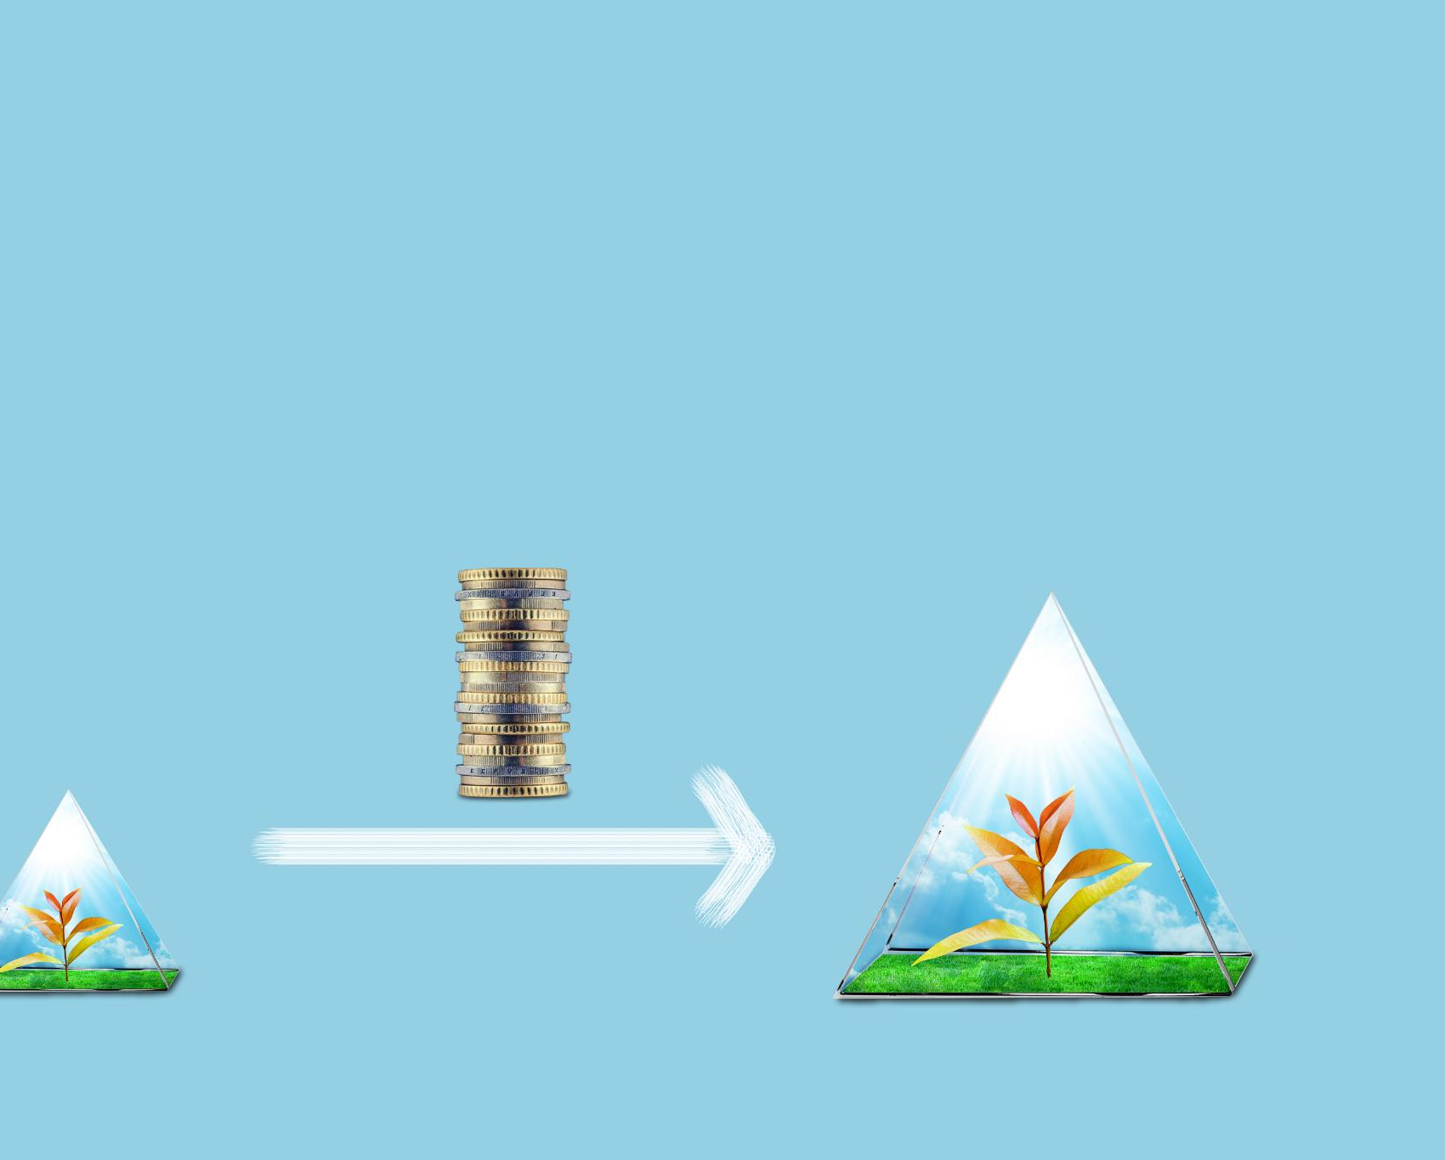
How Transactions Flow Between Farmers, Shop Owners, and Buyers
Multi-step Transaction Process
Farmers sell produce to shop owners, who then sell to buyers in a sequential transaction flow.
Payment Delays and Disputes
Lack of streamlined tracking can cause payment delays and disputes between parties in the transaction chain.
Notes:
--- Transactions typically involve farmers selling produce to shop owners, who then sell to buyers. This multi-step process can lead to payment delays and disputes due to the absence of streamlined tracking mechanisms. Image source: Microsoft 365 content library

Slide 8

Role of Commissions and Payment Delays
Informal Commission Negotiations
Commissions between parties are typically negotiated in informal settings without strict contracts.
Payment Delays Impact
Delays in payments reduce liquidity for farmers and shop owners, affecting their business operations.
Strained Business Relationships
Payment delays can strain relationships between business partners, risking operational stability.
Notes:
--- Commissions are often negotiated informally, and delays in payments are common. These delays affect liquidity for farmers and shop owners, sometimes straining their business relationships and operational stability. Image source: Microsoft 365 content library

Slide 9

Impact on Cash Flow and Business Relationships
Cash Flow Uncertainties
Delays in payments disrupt cash flow, causing financial instability for businesses and market participants.
Opaque Commission Structures
Lack of transparency in commissions breeds mistrust and complicates business relationships between participants.
Impact on Market Growth
Cash flow and trust issues hinder smooth operations, limiting growth opportunities in the market.
Notes:
--- Payment delays and opaque commission structures create cash flow uncertainties and mistrust among participants, which can hinder smooth market operations and growth opportunities. Image source: Microsoft 365 content library

Slide 10
Key Pain Points Faced by Market Participants
Notes:
Market participants face numerous challenges including manual record-keeping, delayed and fragmented payments, as well as disputes and credit risks that complicate daily business activities.

Slide 11

Manual Record-Keeping: Limitations and Risks
Manual Errors
Manual record-keeping often causes human errors that compromise data accuracy and reliability.
Data Loss Risks
Physical records are prone to damage or loss, risking critical information being permanently lost.
Tracking Difficulties
Manual systems make it difficult to track and reconcile transactions efficiently, leading to disputes.
Notes:
--- Most records are maintained manually, leading to errors, loss of data, and difficulties in tracking transactions accurately, which increases the risk of disputes and financial losses. Image source: Microsoft 365 content library

Slide 12

Delayed and Fragmented Payments: Effects on Farmers and Shop Owners
Cash Flow Disruption
Delayed payments cause significant cash flow challenges for farmers and shop owners, hindering their financial stability.
Credit Dependency
Farmers and shop owners often resort to credit to manage delayed income, increasing their financial burden.
Market Trust Impact
Payment delays undermine trust and sustainability within the market ecosystem, affecting long-term relationships.
Notes:
--- Fragmented and postponed payments disrupt cash flow, forcing farmers and shop owners to seek credit or delay their own payments, impacting sustainability and trust within the market ecosystem. Image source: Microsoft 365 content library

Slide 13

Disputes, Errors, and Credit Risks in Daily Operations
Errors Leading to Disputes
Record-keeping mistakes and payment delays commonly cause operational disputes between parties.
Credit Risks from Unregulated Extensions
Unregulated credit given by shop owners to farmers increases financial uncertainty and risk for both sides.
Notes:
--- Errors in records and delayed payments often lead to disputes. Credit risks arise when shop owners extend unregulated credit to farmers, exposing both parties to financial uncertainties. Image source: Microsoft 365 content library

Slide 14
Challenges During Peak Seasons and Festivals
Notes:
Peak seasons and festivals intensify transaction volumes and complexities, overwhelming manual systems and escalating error rates and payment challenges.

Slide 15
Increase in Transaction Volume and Complexity
Surge in Transaction Volume
Peak periods cause a sharp rise in transaction numbers, increasing processing demands significantly.
Complex Payment Tracking
Increased transaction complexity complicates tracking and record management during busy periods.
Operational Bottlenecks
High volume and complexity often lead to bottlenecks and inefficiencies in transaction processing.
Notes:
--- During peak times, the number of transactions rises sharply, complicating payment tracking and record management, which often leads to bottlenecks and inefficiencies. Image source: Microsoft 365 content library

Slide 16

Strain on Manual Processes and Error Rates
Inadequate Manual Processes
Manual handling struggles under high transaction volumes, reducing operational efficiency significantly.
Increased Error Frequency
Higher transaction loads lead to more frequent errors and mistakes in records and operations.
Lost Records and Confusion
Lost data and disorganized records cause confusion among market participants, disrupting workflows.
Notes:
--- Manual processes become inadequate under high transaction loads, resulting in more frequent errors, lost records, and confusion among market participants. Image source: Microsoft 365 content library

Slide 17

Specific Examples of Seasonal Payment and Record-Keeping Issues
Delayed Payments During Harvest
Harvest festivals often cause delayed payments, disrupting farmers' cash flow and shop owners' business operations.
Inaccurate Record-Keeping
Errors in keeping financial records during peak seasons increase disputes and complicate settlements.
Increased Credit Risks
Payment delays and record inaccuracies raise credit risks, negatively affecting trust and operations.
Notes:
--- For instance, during harvest festivals, delayed payments and inaccurate records commonly lead to disputes, delayed settlements, and increased credit risks, hurting farmers' income and shop owners’ operations. Image source: Microsoft 365 content library

Slide 18
How KisaanCenter Provides Solutions
Notes:
KisaanCenter offers a digital platform designed to address payment and record-keeping challenges with transparency, accuracy, and efficiency tailored for India’s agricultural markets.

Slide 19

Digital Record-Keeping for Accuracy and Transparency
Accurate Real-Time Data
Digital record-keeping provides accurate and up-to-date information on transactions, improving decision-making.
Error Reduction
Digitizing records minimizes human errors, ensuring reliable and consistent data management.
Fostering Trust
Transparent digital records build trust among farmers, shop owners, and buyers through reliable transaction histories.
Notes:
--- By digitizing records, KisaanCenter ensures accurate, real-time data on transactions, reducing errors and fostering trust among farmers, shop owners, and buyers. Image source: Microsoft 365 content library

Slide 20
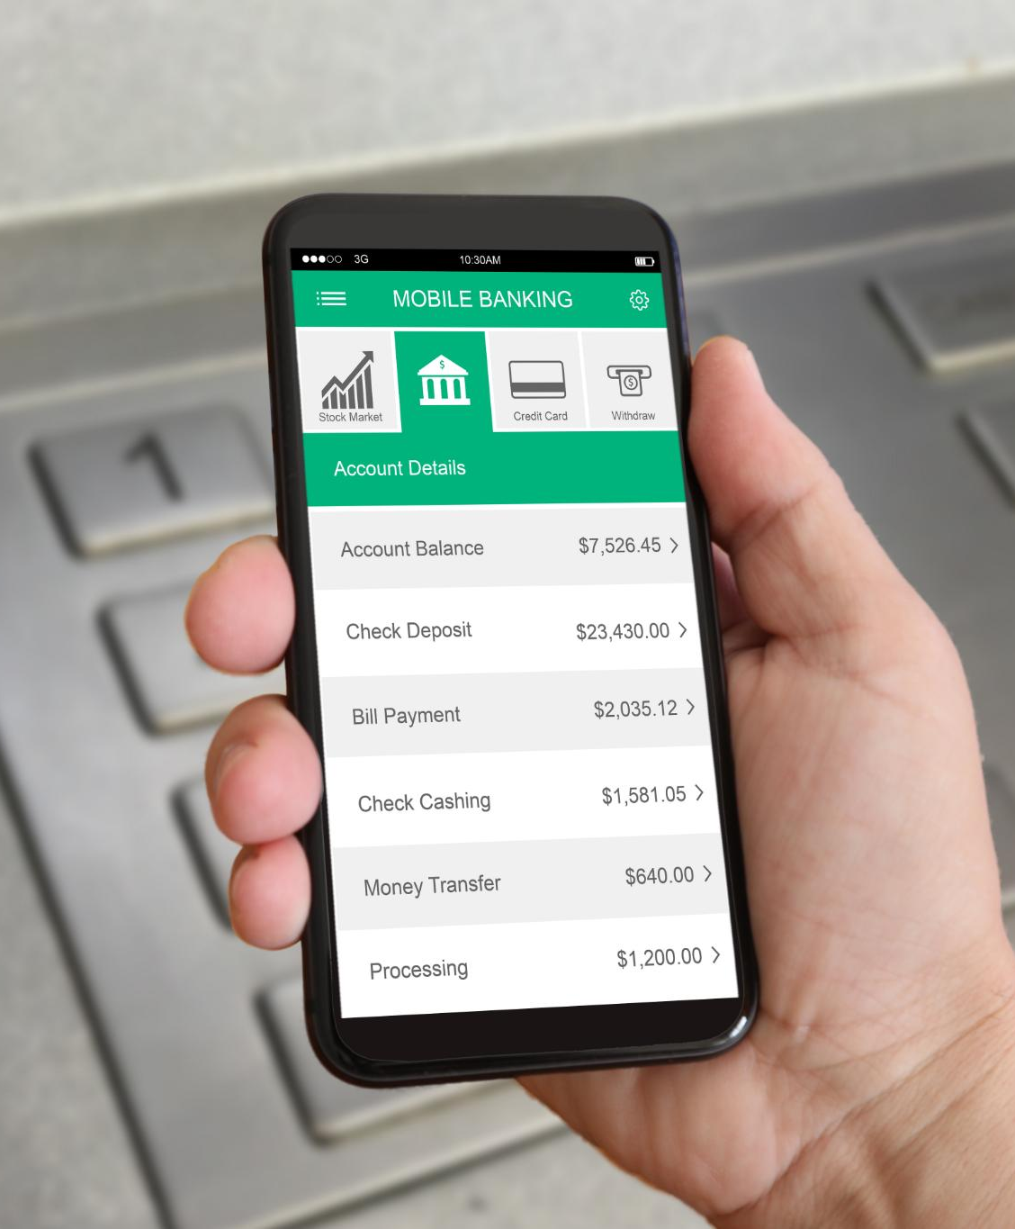
Streamlined Payment Management and Tracking
Timely Payment Facilitation
The platform ensures payments are made on time, reducing financial delays and improving cash flow.
Clear Payment Tracking
Users can easily track payment statuses, enhancing transparency and accountability in transactions.
Strengthening Business Relationships
Reliable payment management fosters trust and strengthens partnerships between businesses.
Notes:
--- The platform facilitates timely payments with clear tracking, minimizing delays and fragmentation, thus improving cash flow and strengthening business relationships. Image source: Microsoft 365 content library

Slide 21

Tools for Managing Commissions, Credits, and Disputes
Commission Calculation Tools
KisaanCenter automates commission calculations to ensure accurate and timely payments, reducing manual errors.
Credit Limit Management
Tools to monitor and control credit limits help reduce financial risks and improve credit oversight.
Dispute Resolution System
Systematic dispute resolution tools streamline handling conflicts, accelerating problem-solving and operational flow.
Notes:
--- KisaanCenter provides specialized tools to manage commission calculations, credit limits, and dispute resolution systematically, reducing risks and enhancing operational efficiency. Image source: Microsoft 365 content library

Slide 22
Conclusion
Addressing Agricultural Challenges
KisaanCenter tackles key challenges in India’s agricultural payment ecosystem using innovative digital solutions.
Enhancing Transparency and Accuracy
Digital innovation by KisaanCenter increases transparency and accuracy in transactions for all stakeholders.
Building Trust Among Participants
KisaanCenter fosters trust between farmers, traders, and markets through reliable digital payment methods.
Notes:
KisaanCenter effectively addresses the real-world challenges in India’s agricultural market payment ecosystem through digital innovation, improving transparency, accuracy, and trust to benefit all participants.

